Slide 1
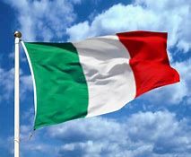
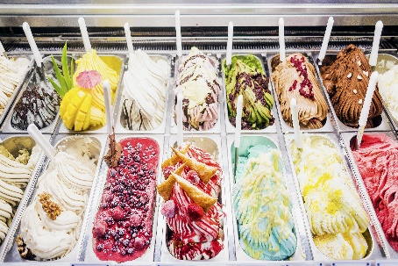
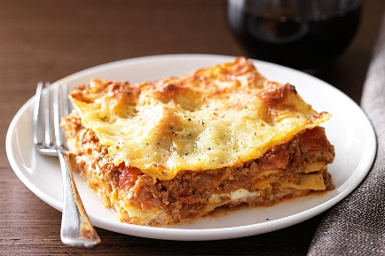
Italian Food

Slide 2
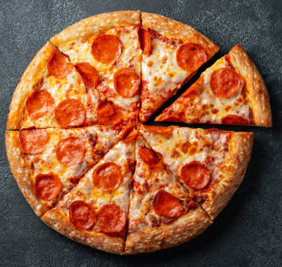
Pizza
Pizza was invented in Naples and has become popular in many countries.
Pizza dough is made from flour, yeast, salt, water and olive oil.
Pizza is made from a round dough base topped with tomatoes, cheese and various other toppings. It is baked at a high temperature in a wood-fired oven.

Slide 3
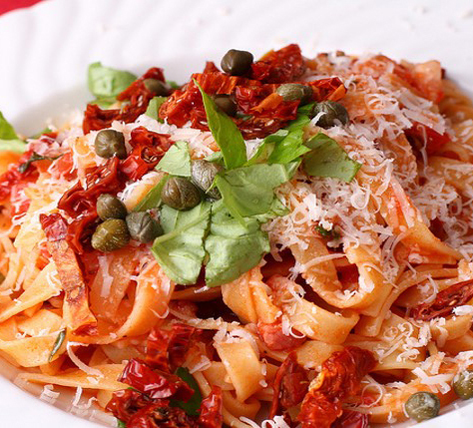
Pasta
Pasta is made from a dough consisting of ground durum wheat and water or eggs. The dough is shaped into sheets, ribbons or shapes. It can then be left to dry. Pasta is cooked in boiling water or baked in the oven. Pasta sauces vary and can be made from tomatoes, cream or herbs. Meat and fish are often added to the sauce.

Slide 4
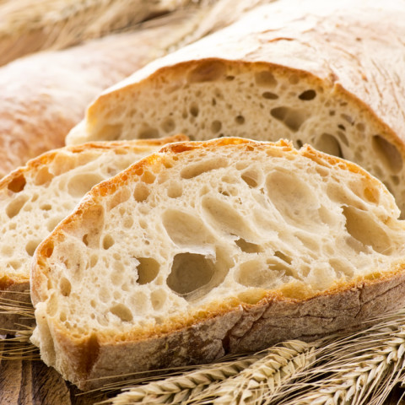
Italian bread – Ciabatta
Ciabatta is an Italian white bread made from wheat flour, water, olive oil, salt and yeast. It was first made in a bakery in Verona.

Slide 5
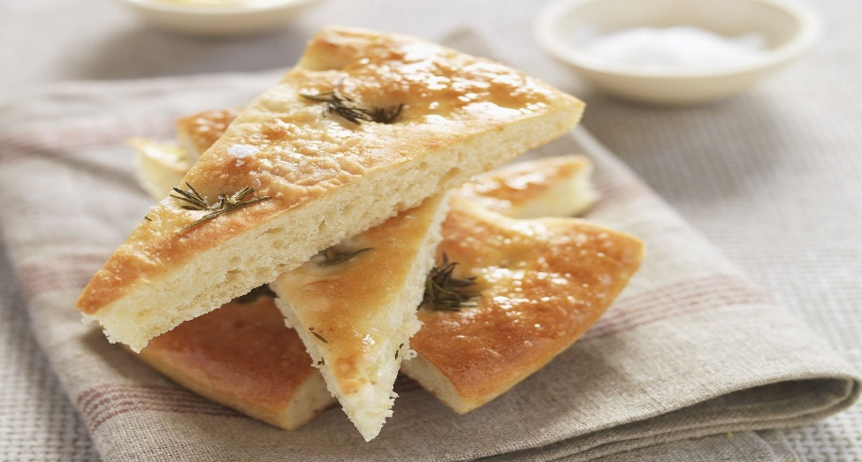
Italian bread – Focaccia
Focaccia is an Italian flat bread similar in style and texture to pizza dough. It is often made with olive oil and rosemary and salt.

Slide 6
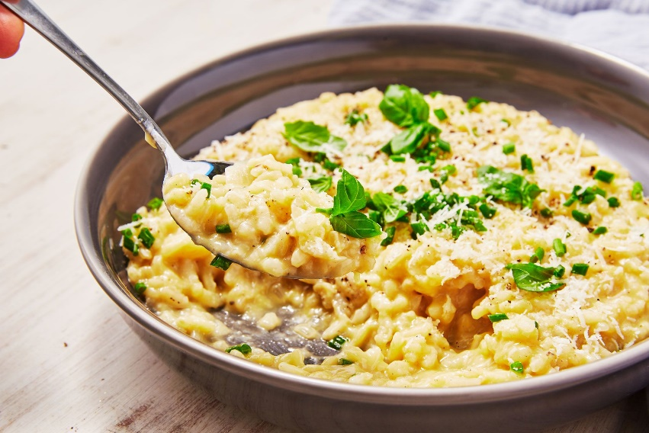
Risotto
Risotto is an Italian rice dish from the North of Italy.

Slide 7
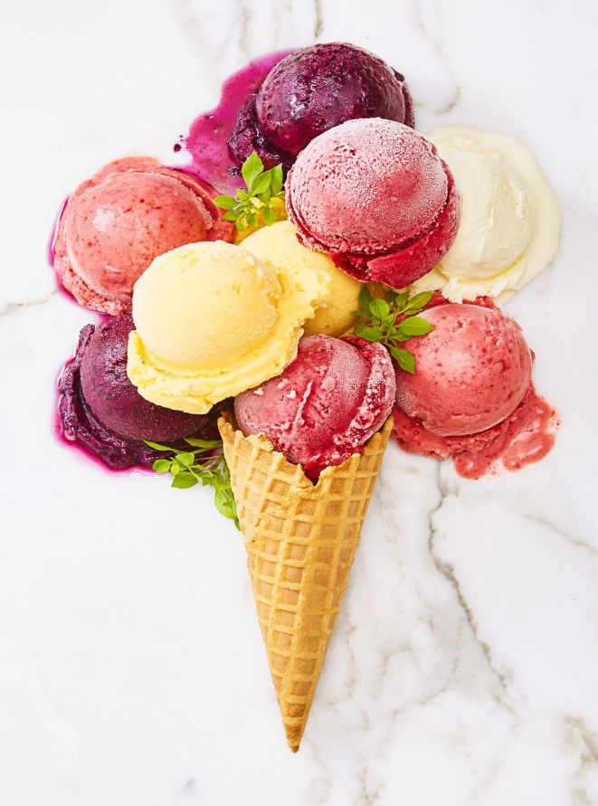
Ice cream
The Italian word for ice-cream is gelato.

