Slide 1

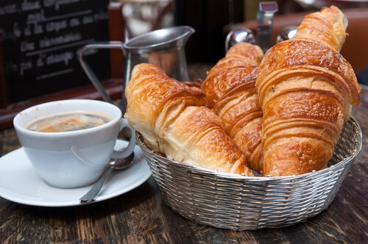
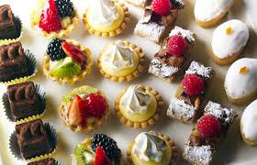
French Food

Slide 2
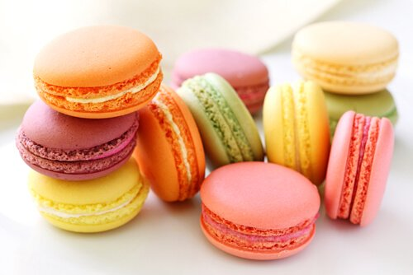
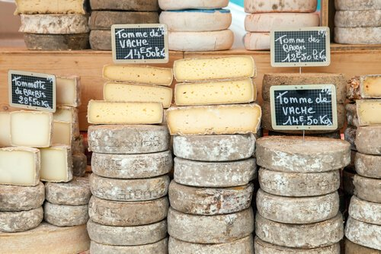
France is famous for food including bread, cheese and cakes.
French people love to eat in restaurants and cafes.

Slide 3
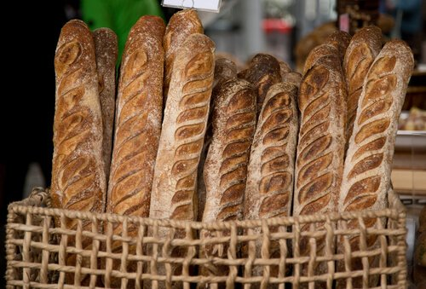
Baguettes
A baguette is a long, thin loaf of French bread.

Slide 4
Croissants
A croissant is made from flaky, buttery pastry. Croissants are crescent shaped and often eaten for breakfast.

Slide 5
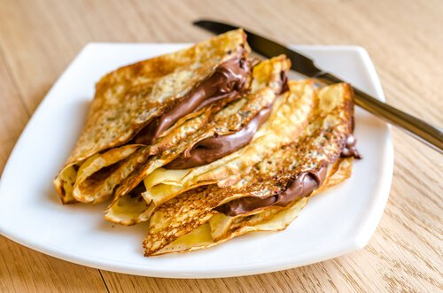
Crepes
Crepes are very thin pancakes that can be eaten with a sweet or savoury filling.

Slide 6
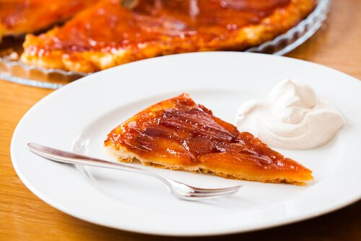
Tarte Tartin
A delicious upside down apple pie ! This is made by caramelizing the apples in butter and sugar before baking.

Slide 7
Macarons
Macarons are a meringue like biscuit made from almonds and filled with cream. They are made in many different flavours including strawberry, chocolate and pistachio.
Miss McWilliams loves macarons !!

Slide 8
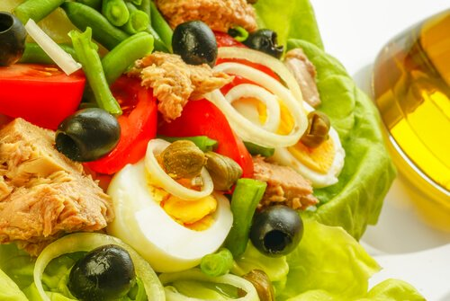
Salad Nicoise
This salad is named after the French city Nice where it was first made. It is made from lettuce, tuna, black olives, eggs and olive oil.

Slide 9
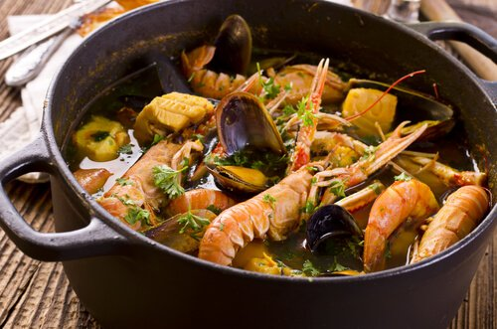
Bouillabaisse
Bouillabaisse is a seafood stew. It is made from various types of fish and shellfish. Vegetables such as leeks and potatoes are often added along with olive oil and garlic. It was first made by Marseille fishermen who couldn’t sell bony fish at the market.

Slide 10
French cheese
French people love to eat cheese at the end of a meal. There are many different types including Brie and Camembert. Some French cheeses taste and smell
very strong !
Mrs Connery loves French cheese !!

Slide 11
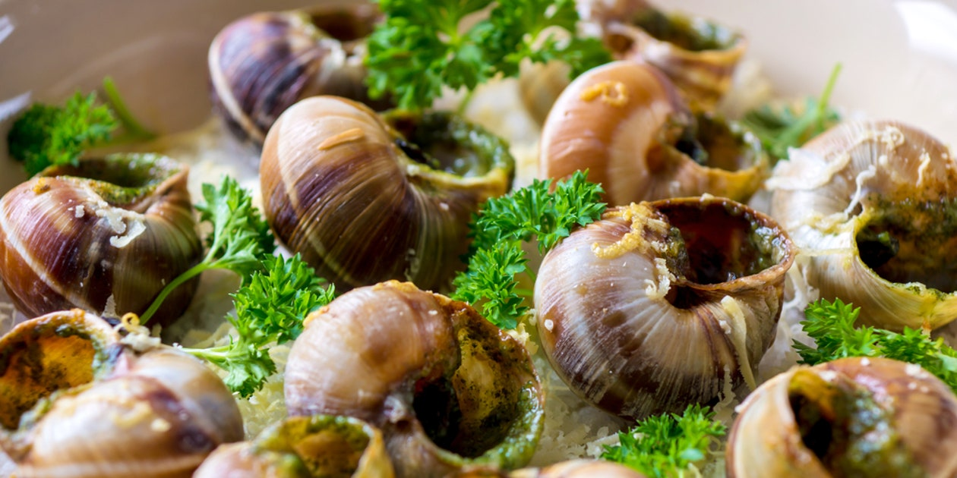
Escargot (snails!)
An unusual dish of edible land snails cooked with butter, garlic and parsley.

