Slide 1

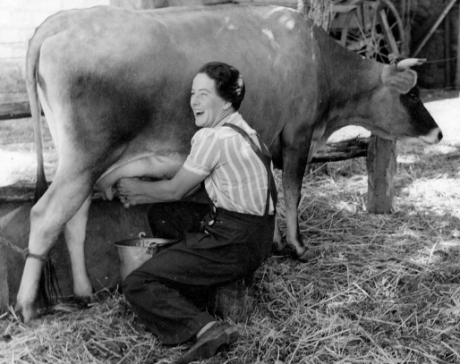
Farming Then and Now

Slide 2
Farming Then and Now

Slide 3
We are learning how farming has changed through time.

Slide 4
Look at the photos of farming today and farming in the past. Discuss the differences in the photos.

Slide 5
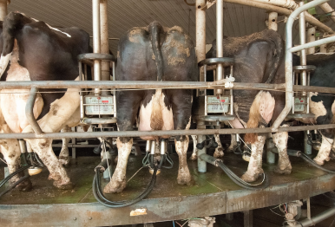
Milking the cows.

Slide 6
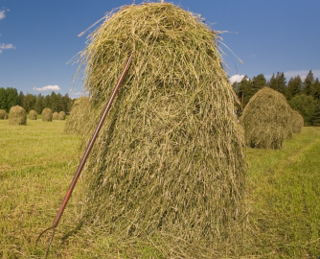
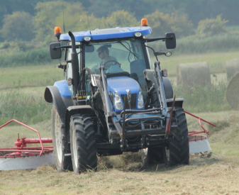
Harvest

Slide 7
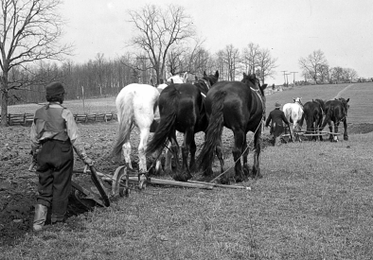
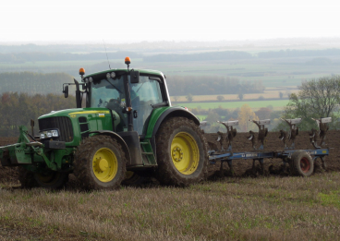
Ploughing the fields.

Slide 8
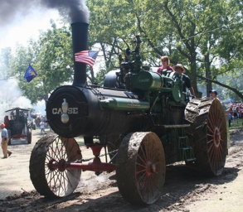
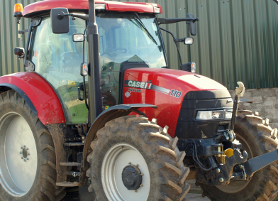
Tractors

