Slide 1
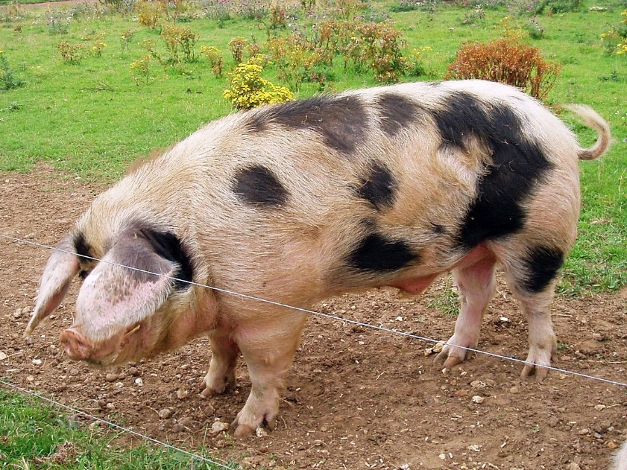
Rare Breed
Pigs

Slide 2
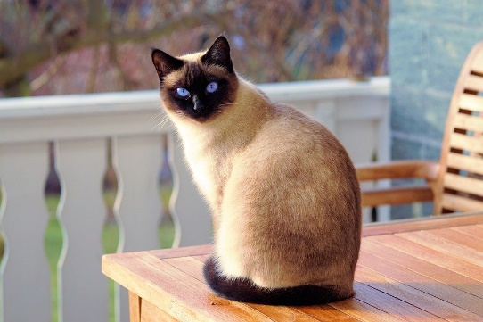
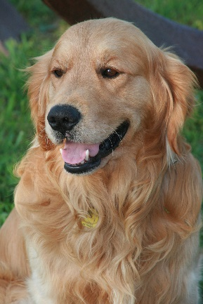
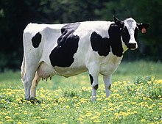
A breed is a group of animals that look the same and have the same characteristics eg Golden Retriever dogs, Siamese cats or Friesian cows

Slide 3

What is a rare breed farm animal?
A rare breed farm animal is a breed in danger of becoming extinct.

Slide 4
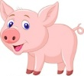
Some farmers keep rare breeds on their farms to help protect those animals from becoming extinct.
Today we are going to be learning about rare breed pigs.

Slide 5

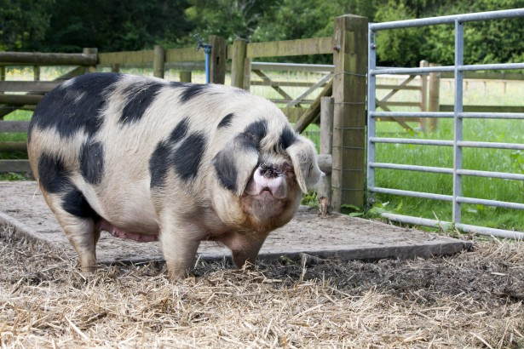
Gloucestershire Old Spot
A gentle breed of pig that is white in colour with distinctive black spots. They have large, lop ears.
As the breed has often been kept in orchards, it has earned the nickname of The Orchard Pig.
Legend says that the black spots are bruises from falling apples!

Slide 6
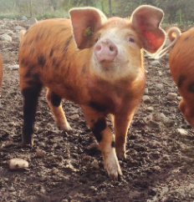
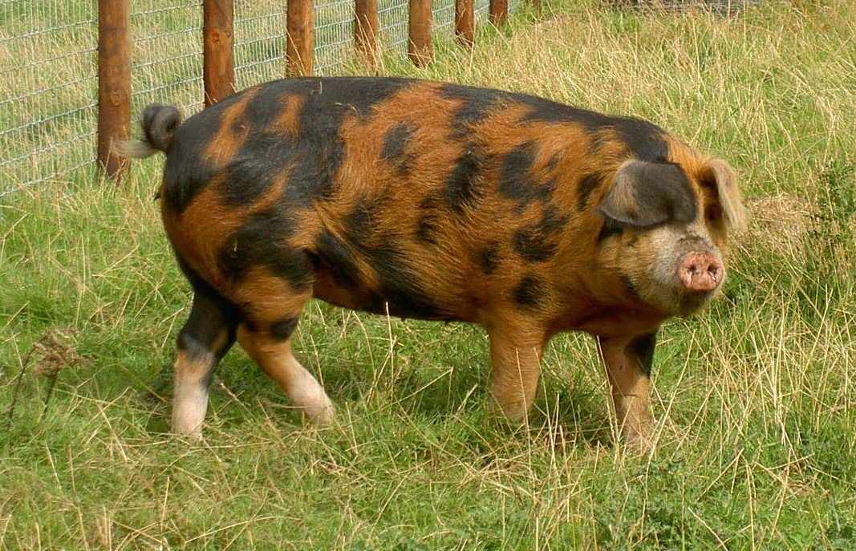
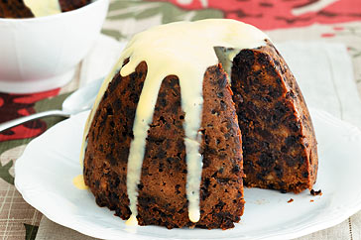
Oxford Sandy and Black
The Oxford Sandy and Black is a pale sandy to rust coloured pig, with black patches. It has pale feet, a long snout and lop ears.
Due to their appearance they are often
called the Plum Pudding Pig.

Slide 7
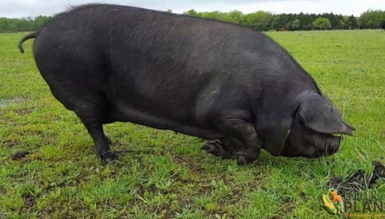
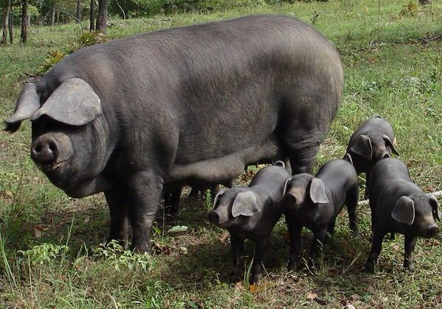
Large Black
The Large Black is completely black in colour with lop ears. They are
very gentle animals. The Mummy pigs are very good at looking after their piglets.
Their black skin makes them very good at coping with sunburn.

Slide 8
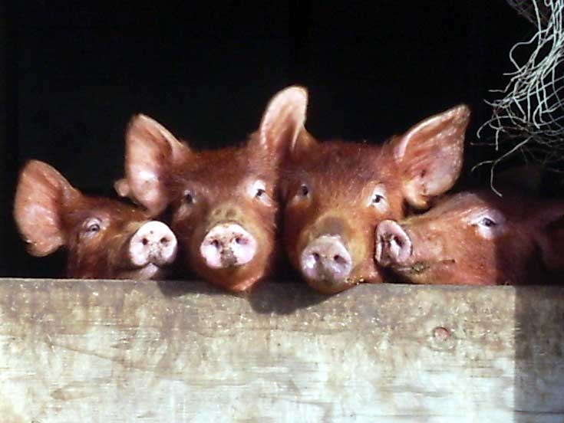
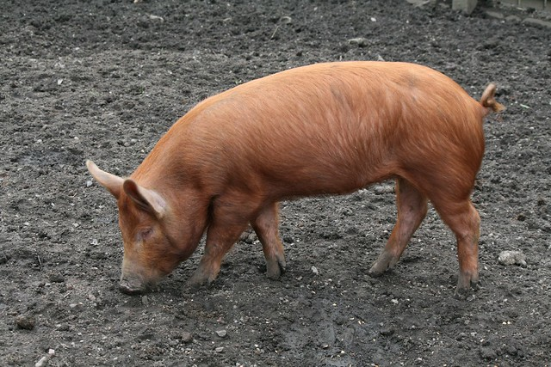
Tamworth
Tamworth pigs are long legged and lean. Their coat is a distinctive ginger colour. Their ears sit up and they have a long snout.

Slide 9

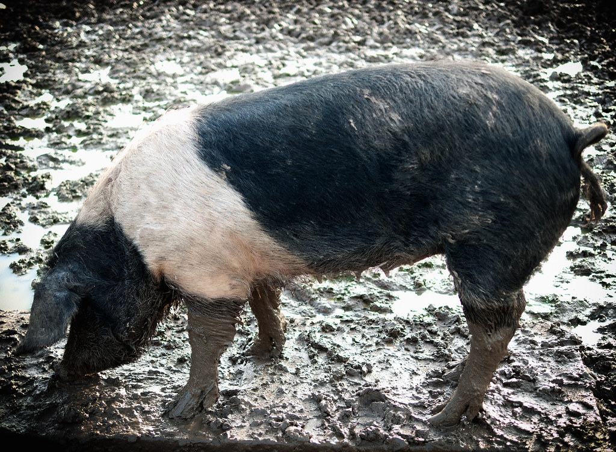
British Saddleback
The British Saddleback are large, lop eared pigs.
They have a black body with a white band around the saddle and the front legs.
The hind feet, nose and tail can also be white.

Slide 10

Information adapted from the RBST website.

