Slide 1

Similes

Slide 2
We are learning to use a simile.

Slide 3
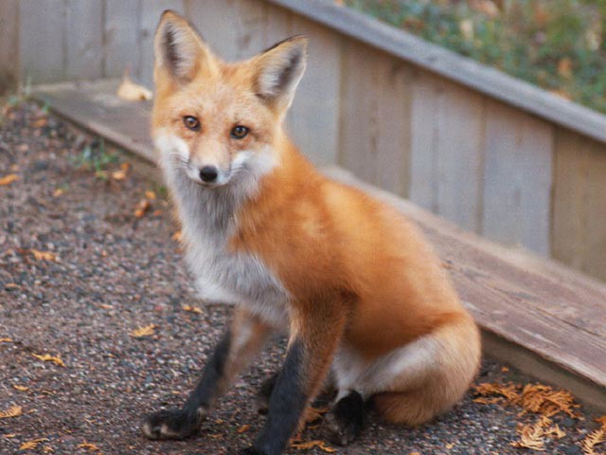
A simile is a comparison between two things using ‘as’ or ‘like’ e.g. as sly as a fox.

Slide 4
Similes are most often used in stories and poems.

Slide 5
Similes try to create a
picture in the reader’s mind.

Slide 6
Similes are used to make a story or a poem more interesting.

Slide 7
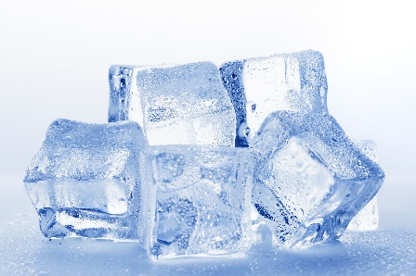
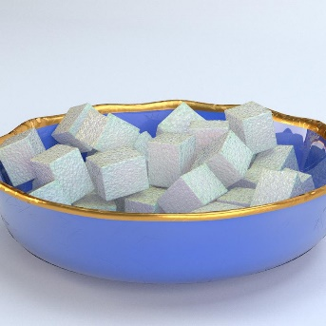
Examples of similes –
as cold as ice
as sweet as sugar

Slide 8
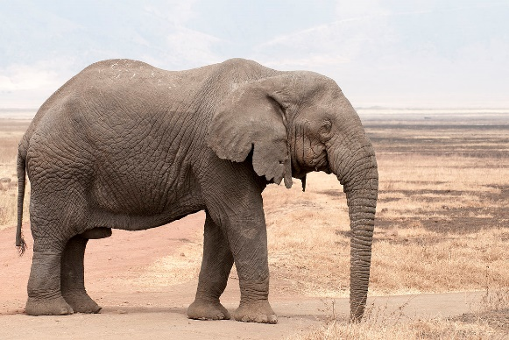
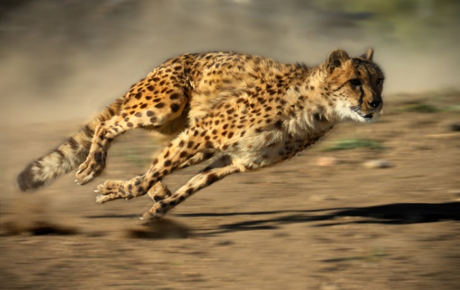
as big as an elephant
as fast as a cheetah

Slide 9
Now can you think of any similes of your own ?

Slide 10
Challenge
You will need the resource Similes Activity page.
Can you complete the
similes ?

Slide 11
END

