Slide 1
Wheat
Farm machinery used to grow and harvest wheat

Slide 2
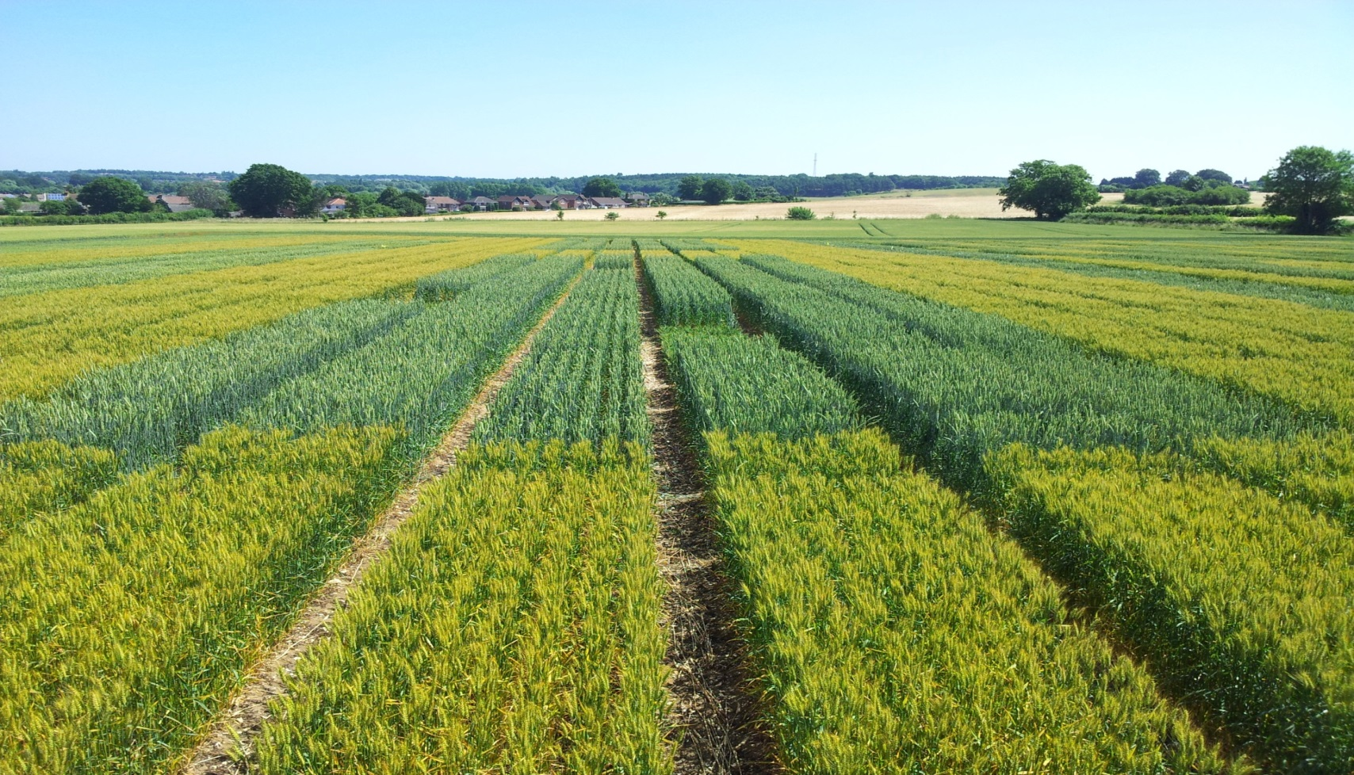
Wheat field

Slide 3
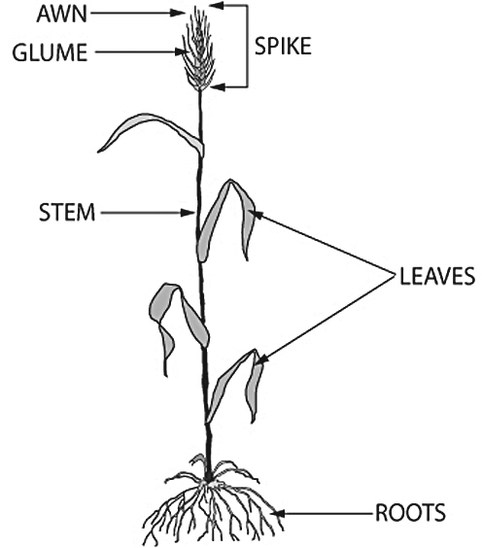
Wheat
Parts of a wheat plant
1 seed
Tillers
Several stems
Can grow 500 seeds from one seed

Slide 4
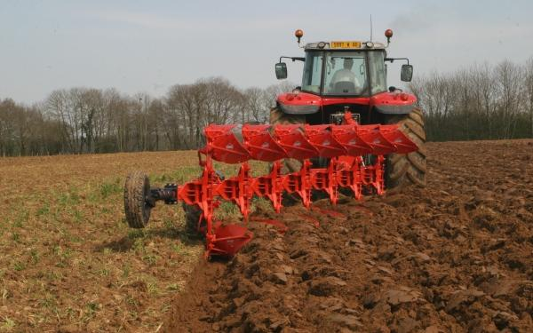
A plough is pulled by a tractor – it turns the soil over.

Slide 5
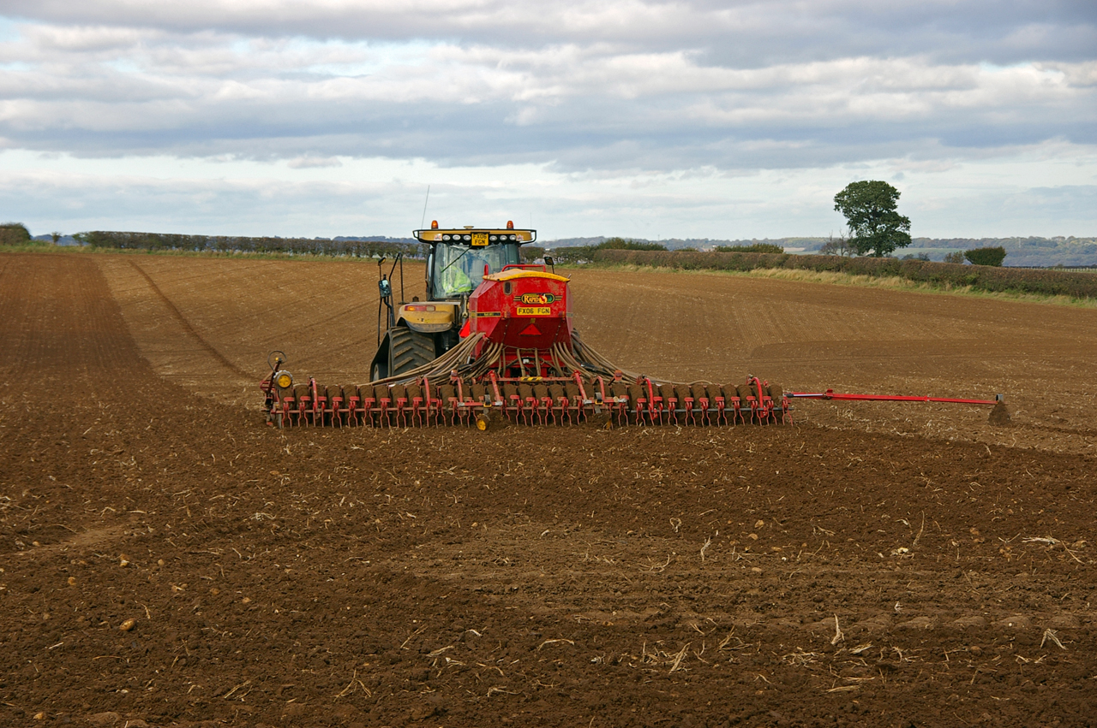
The seed drill drops the seeds in exactly the right place.

Slide 6
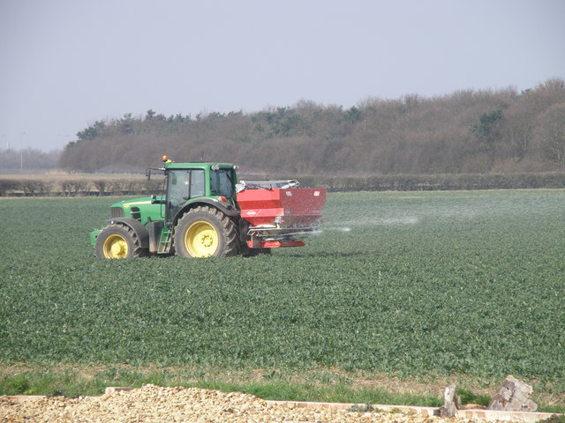
Adding fertilizer to the growing crop.

Slide 7
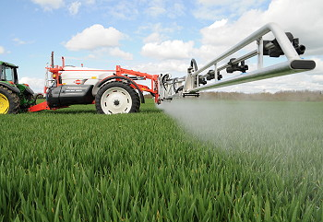
Spraying the wheat to stop diseases or other things which will damage the plants.

Slide 8
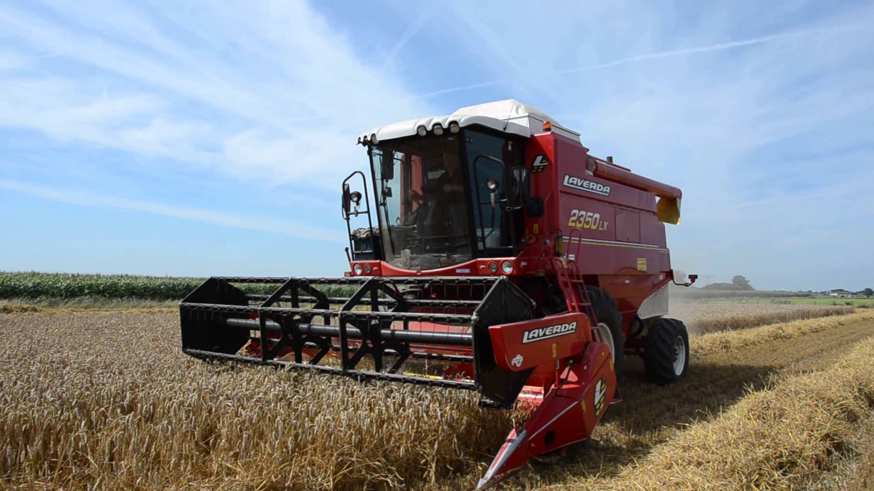
Combine harvester cutting and threshing the wheat.

Slide 9
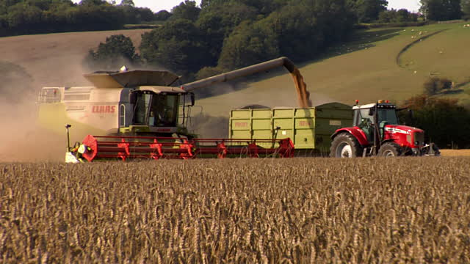
The wheat grains go into a trailer to be carried to the store.

Slide 10
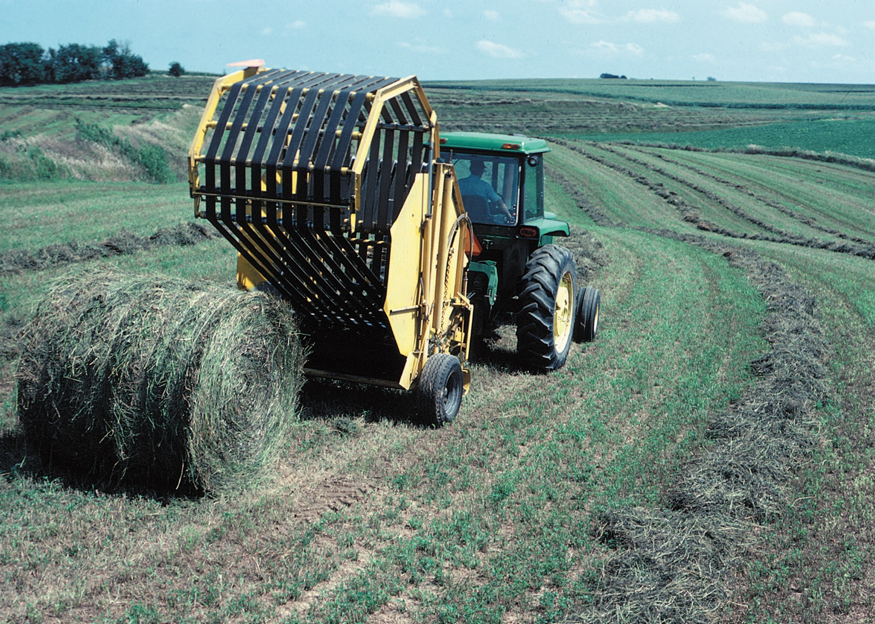
A baler packs the straw into a bale (this baler is collecting hay which is dried grass).

