Slide 1


Guided Reading
The Little Red Hen
Year One
Guided Reading | Year 1 | The Little Red Hen

Slide 3
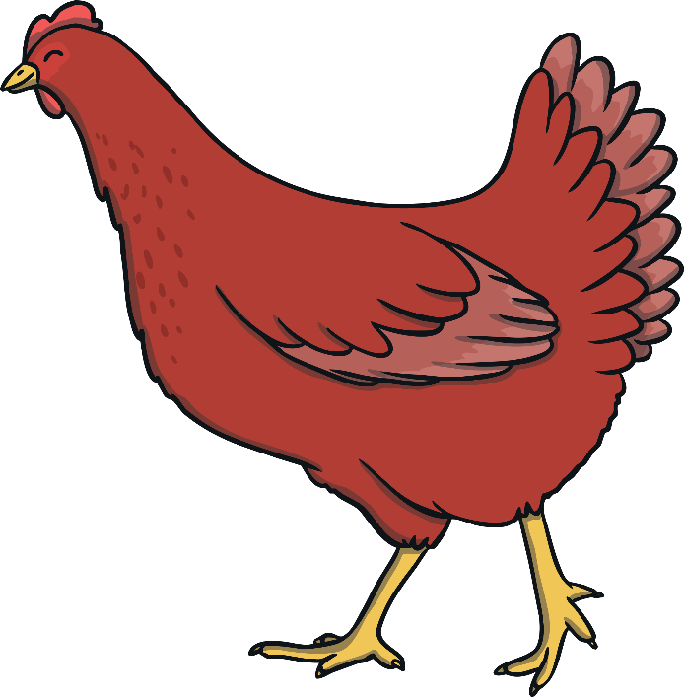


Missing Words
Choose the right word to complete the sentence.
Try again!
?
The Little Red planted the grains of wheat in the soil.
grow
hen
cut
flour

Slide 4

Missing Words
Choose the right word to complete the sentence.
Try again!
?
She waited for the wheat to
grow
hen
cut
flour

Slide 5
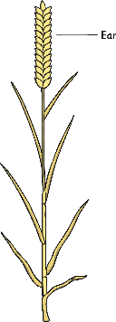
Missing Words
Choose the right word to complete the sentence.
Try again!
?
She down the wheat.
grow
hen
cut
flour

Slide 6
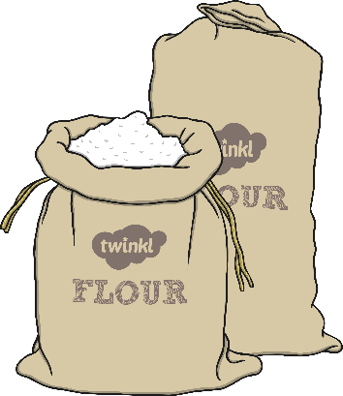
Missing Words
Choose the right word to complete the sentence.
Try again!
?
The Little Red Hen ground the wheat into
grow
hen
cut
flour

Slide 7
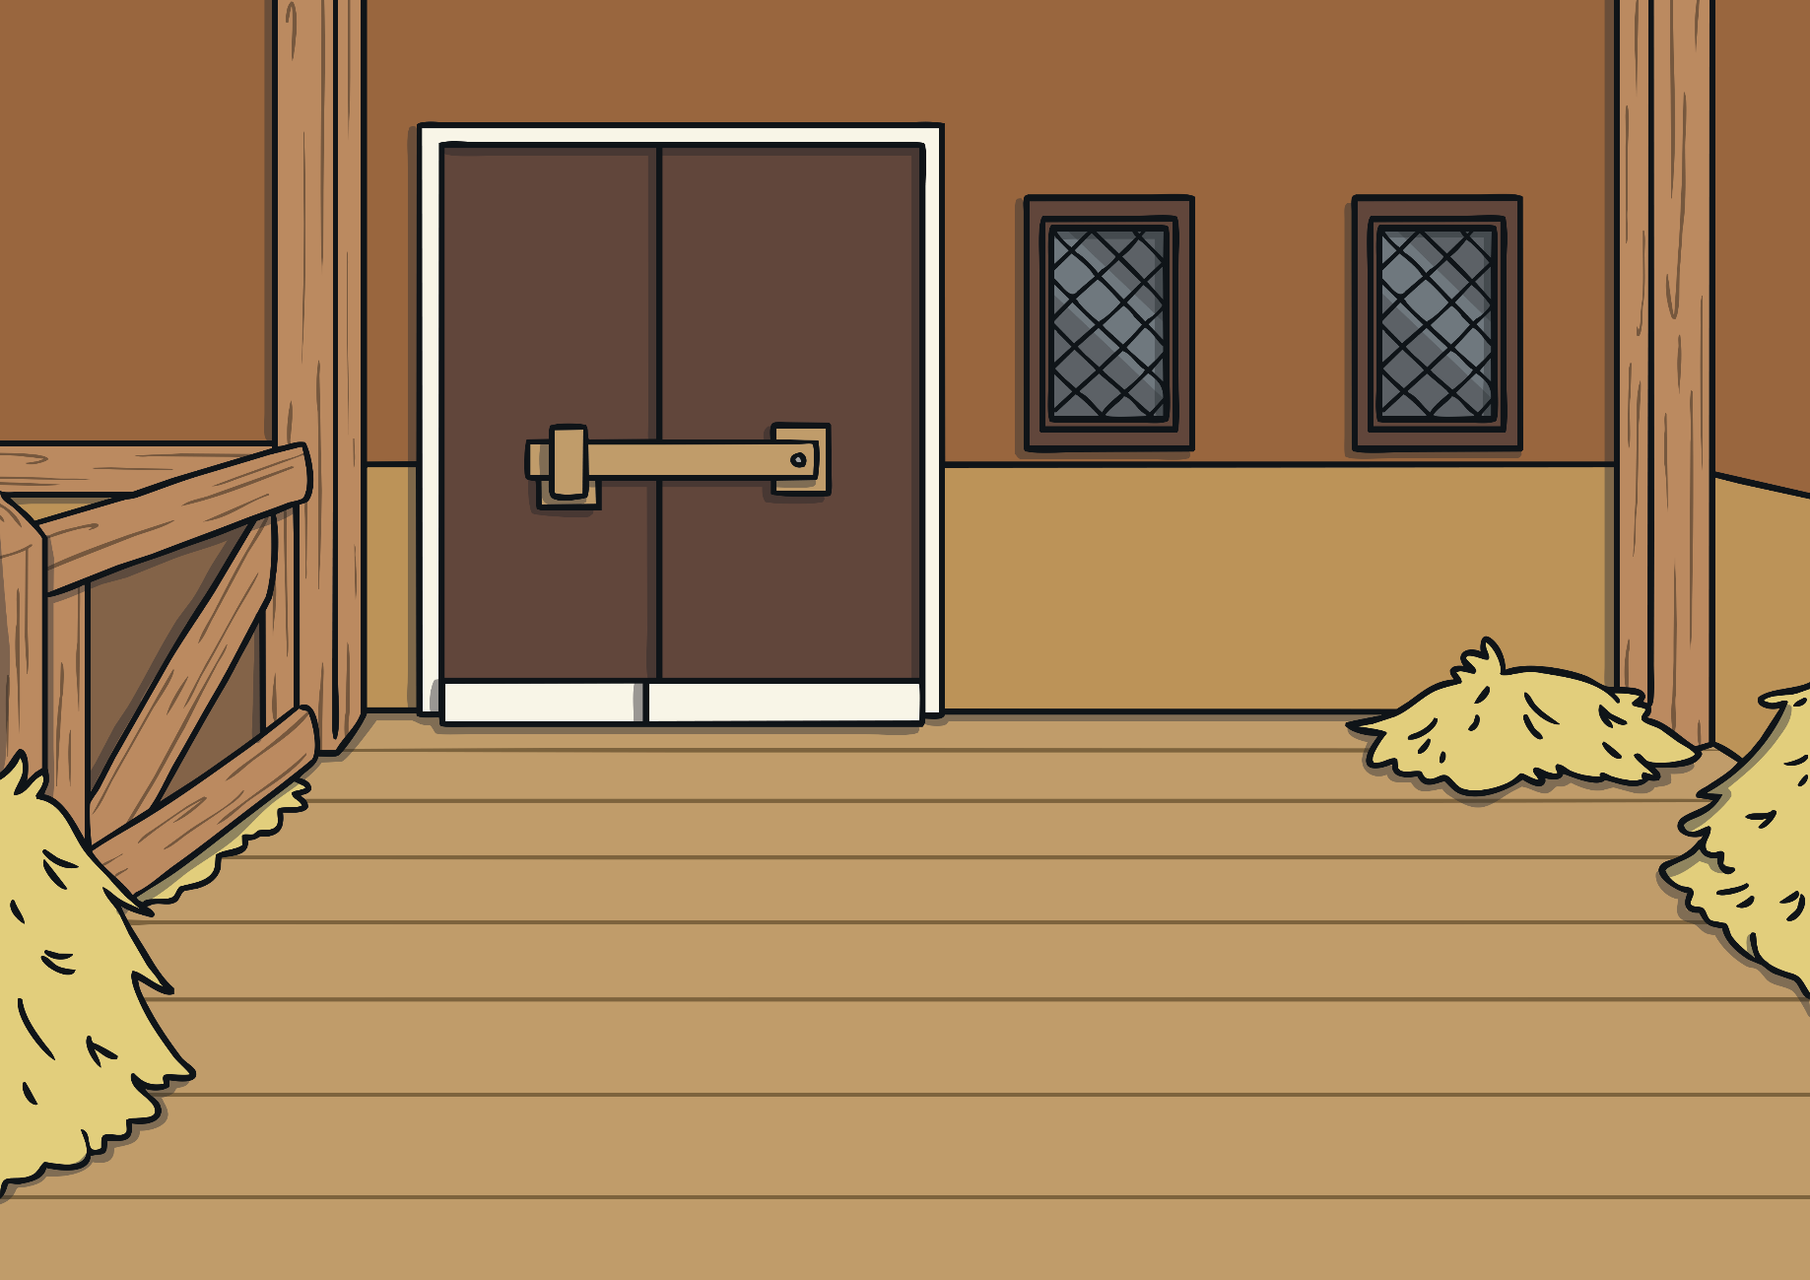


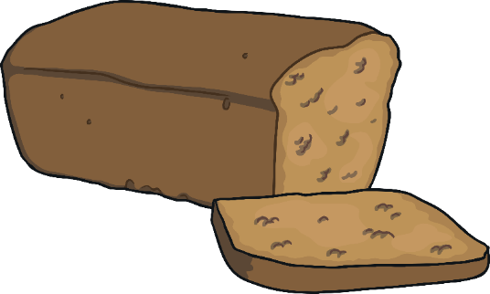
Missing Words
Type your own sentence to match the picture.

Slide 8
Missing Words
Click on the words in the right order to make a sentence.
She
baked
the
bread
in
the
oven.
oven.
bread
the
She
baked
in
oven.
bread
the
She
baked
in
oven.
oven.
bread
bread
the
the
She
She
baked
baked
in
oven.
in
oven.
oven.
bread
bread
bread
the
the
the
She
She
She
baked
baked
baked
in
in
in
Well done!

