Slide 1
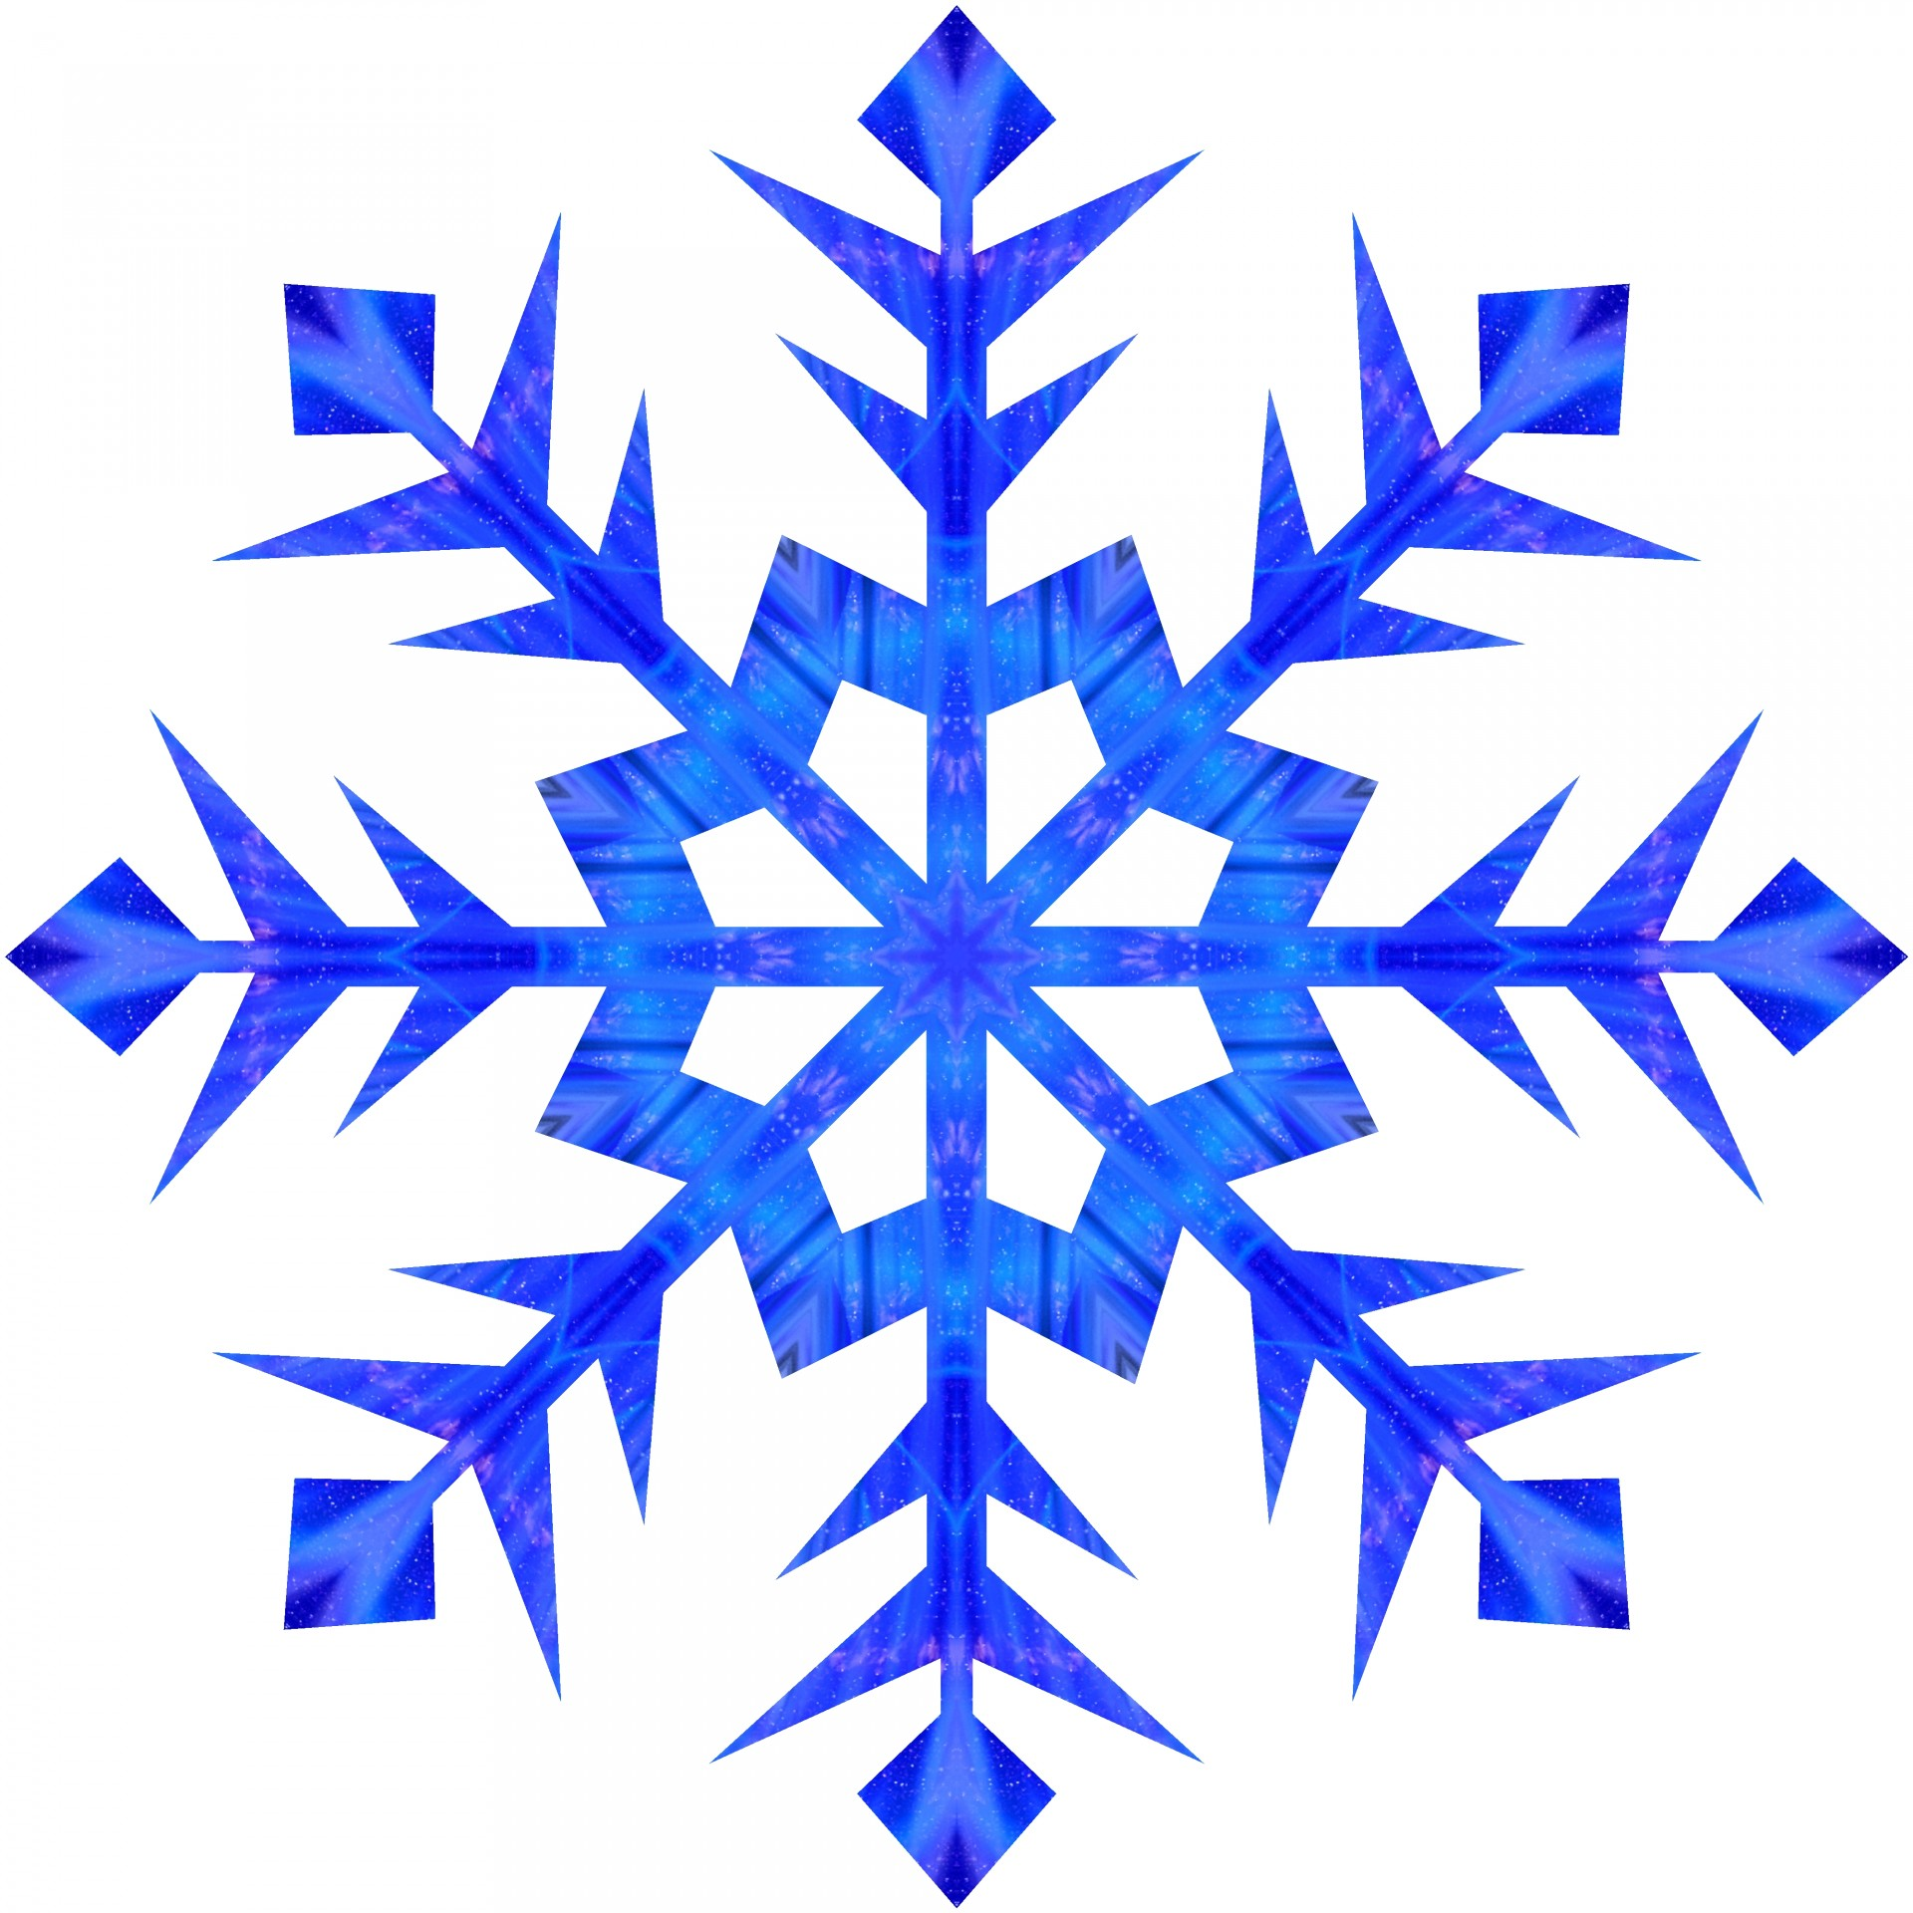

Animals of the Antarctic

Slide 2
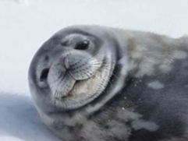
Weddell Seal
Weddell seals spend most of their day swimming under the ice looking for food. This also helps them to hide from any hungry Orcas !

Slide 3
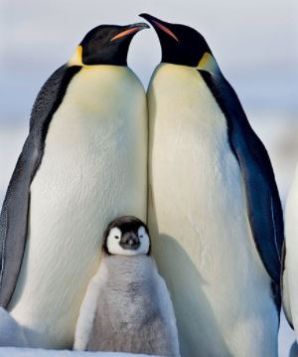
Emperor Penguins
Emperor penguins are the largest and heaviest of all penguins. They are birds but they can’t fly. They are excellent swimmers.

Slide 4
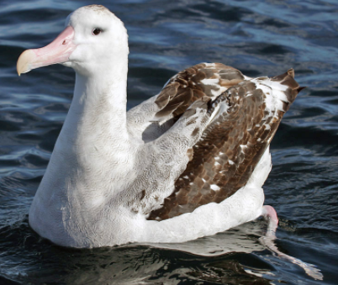
Wandering Albatross
The Wandering Albatross spends most of the day flying. Sometimes they eat so much they have to rest in the water !

Slide 5
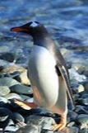
Gentoo Penguin
Gentoo penguins are easily recognised by the wide, white stripe on their heads.

Slide 6
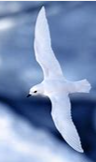
Snow Petrel
Snow Petrel are snowy white birds. They can fly at speeds up to 40km per hour !

Slide 7
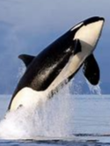
Orca Whales
Orcas are sometimes called killer whales. They hunt everything including fish, seals, squid, penguins and even other whales !

Slide 8
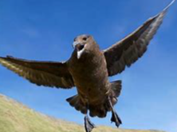
Skua
The Skua is a bird. They are fierce hunters who will try to eat penguin eggs and chicks.

Slide 9
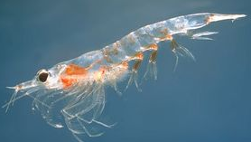
Krill
Krill are small, shrimp like sea animals. They are eaten by penguins, seals, whales and birds.

Slide 10
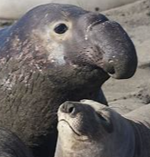
Elephant Seal
The Southern Elephant Seal is the largest of all seals. The male seal has a trunk like nose which is how the species get their name.

Slide 11
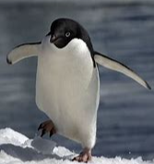
Adelie Penguins
Adelie penguins can dive 175m deep to hunt for food. They like to eat krill and squid.

