Slide 1
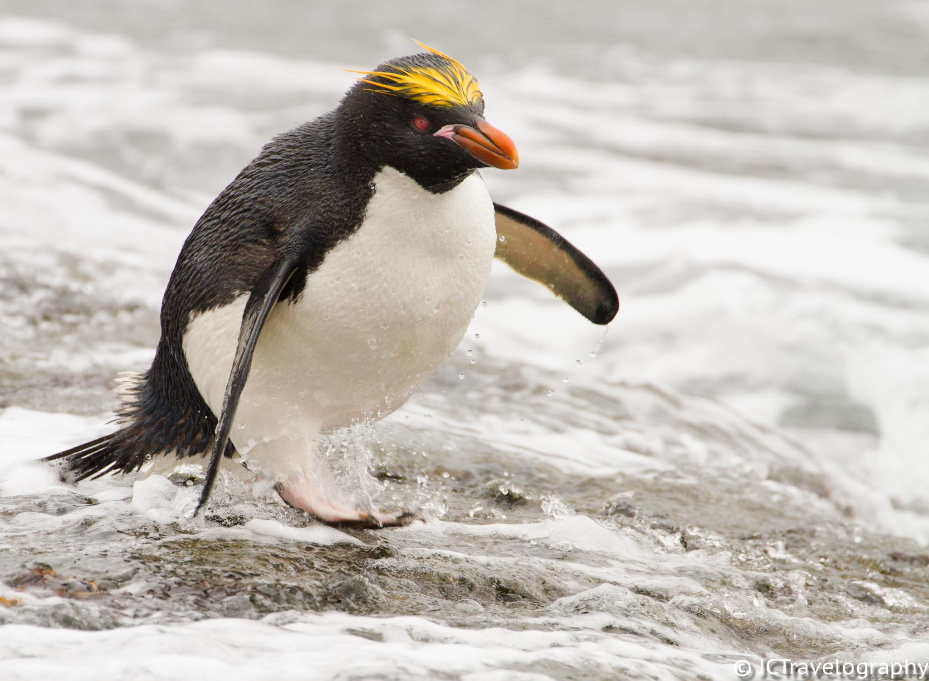

Macaroni Penguins

Slide 2
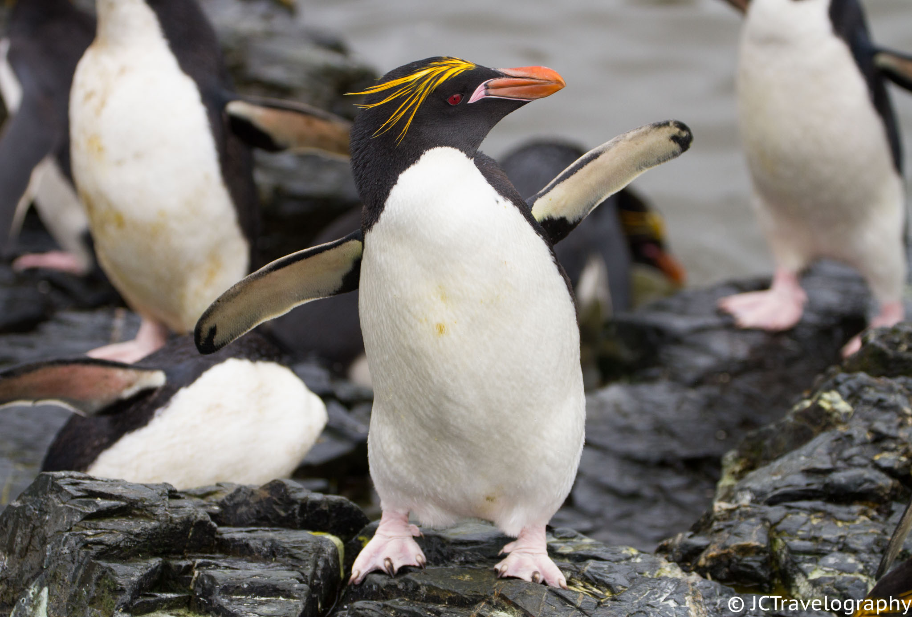
Macaroni penguins live in the continent of Antarctica.

Slide 3
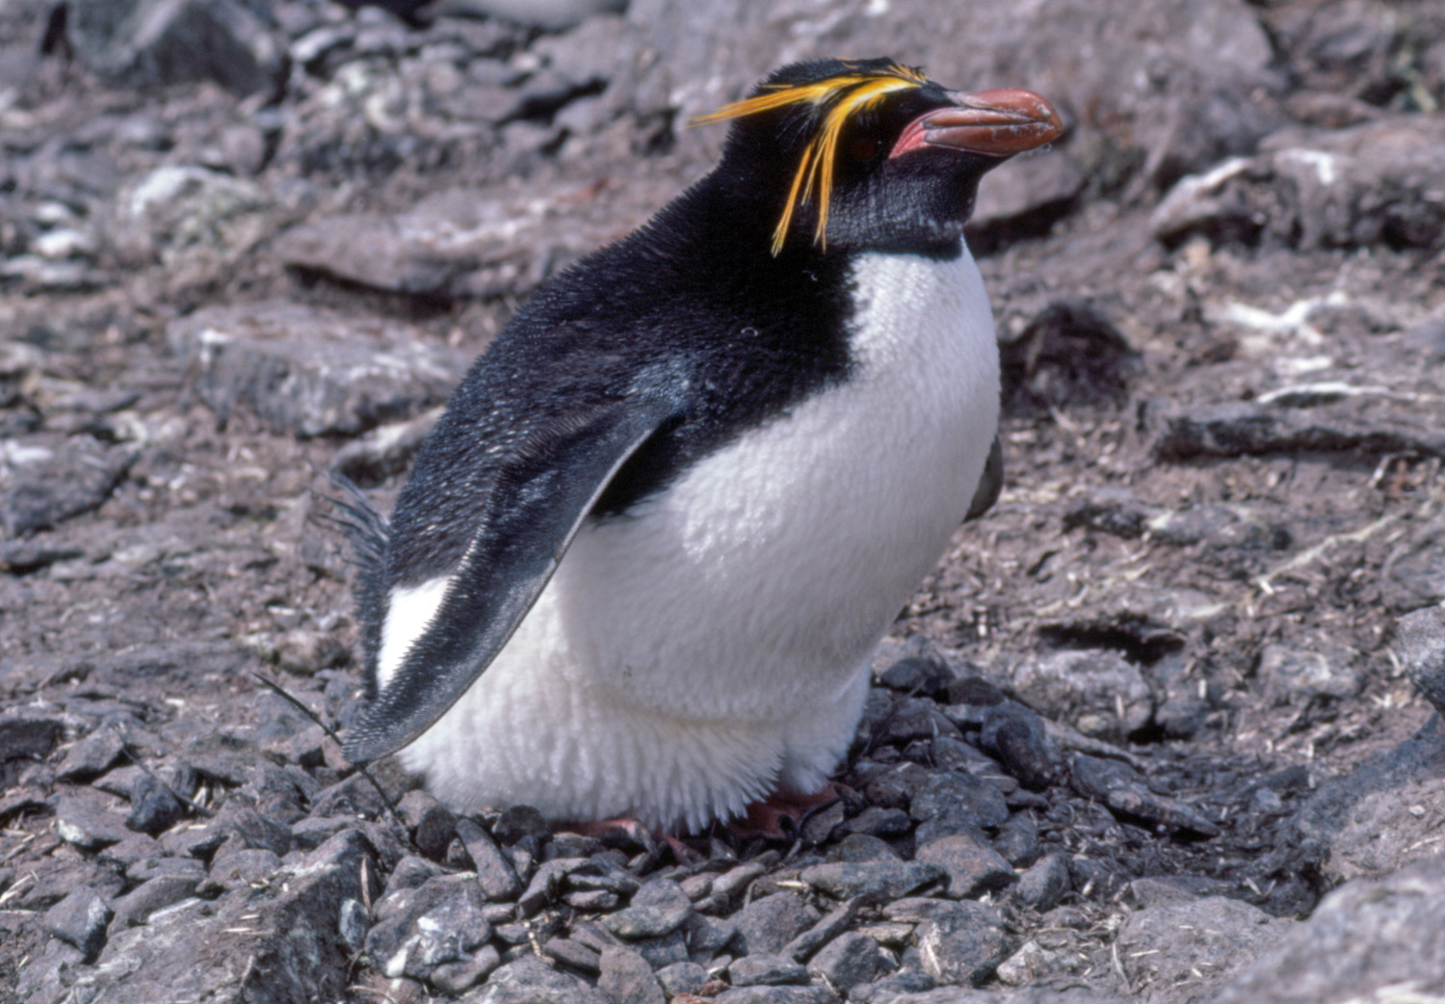
They like to live in rocky areas.

Slide 4
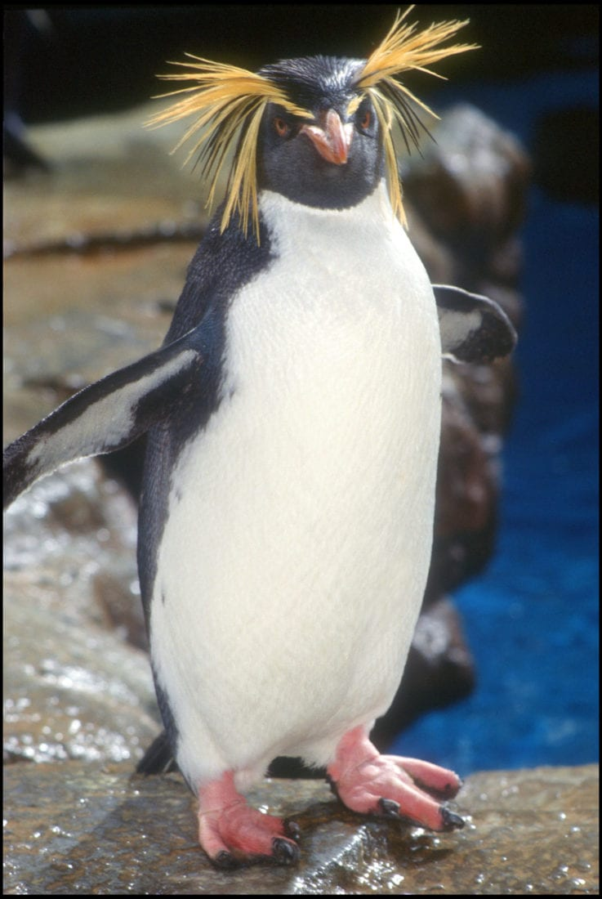
They have black backs, black wings, white fronts and red eyes. They have yellow feathers on the side of their head and a reddish-brown beak.

Slide 5
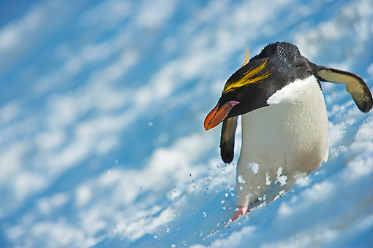
In the winter they spend most of their time in the water. In the summer they come to the land to lay eggs and look after their chicks.

Slide 6
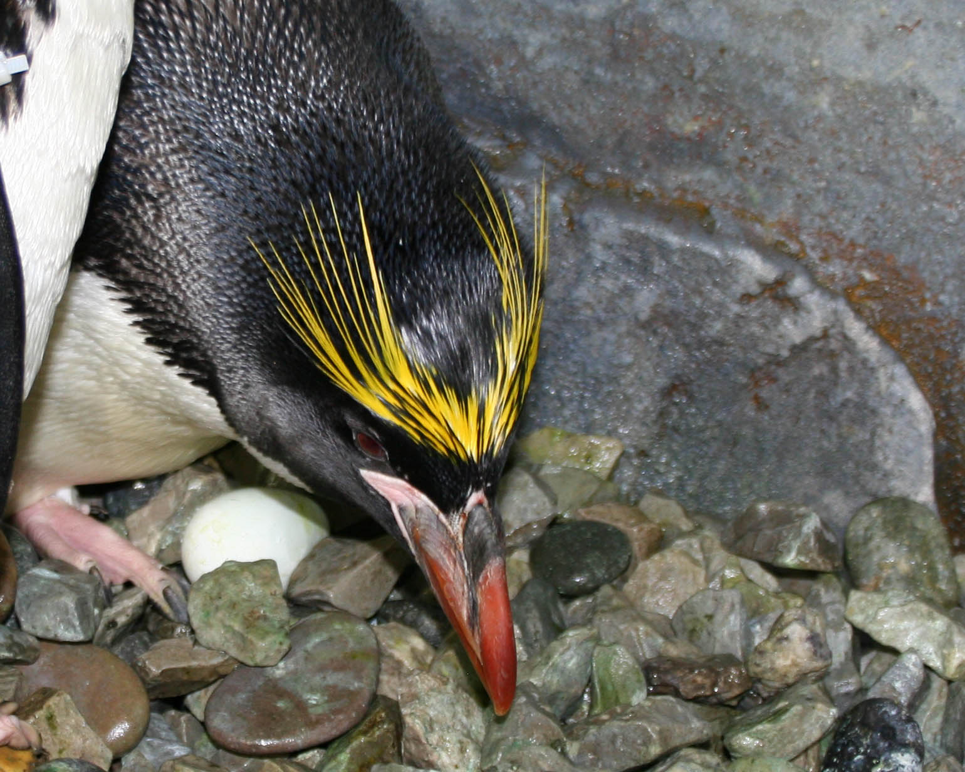
Some Macaroni penguins build nests using pebbles, mud and sand, but others lay their eggs on the rocks.

Slide 7
They hunt in the ocean for food and like to eat krill, squid
and fish.

