Slide 1
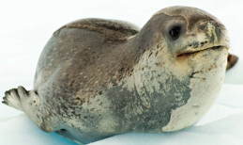

Leopard Seals

Slide 2

We are learning facts about Leopard Seals.

Slide 3
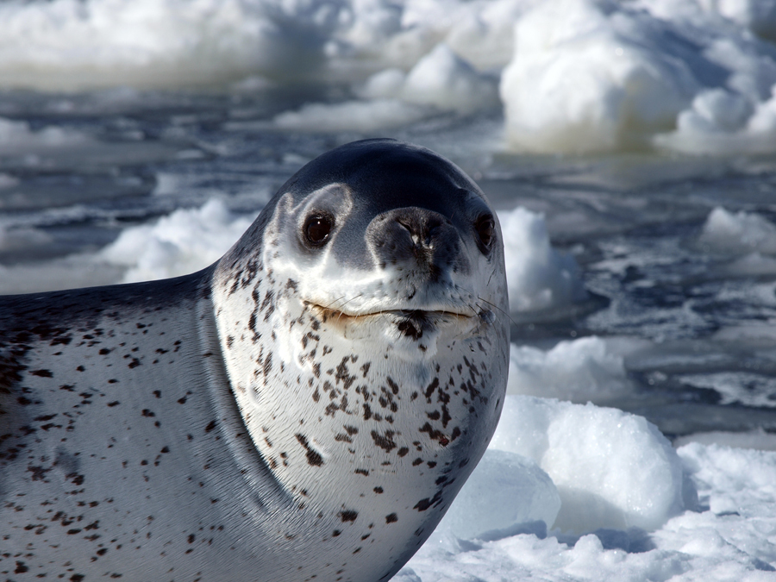
Leopard seals are large, grey mammals with black spots. This pattern gives them their name.
They are the second largest species of seal in the Antarctic.

Slide 4
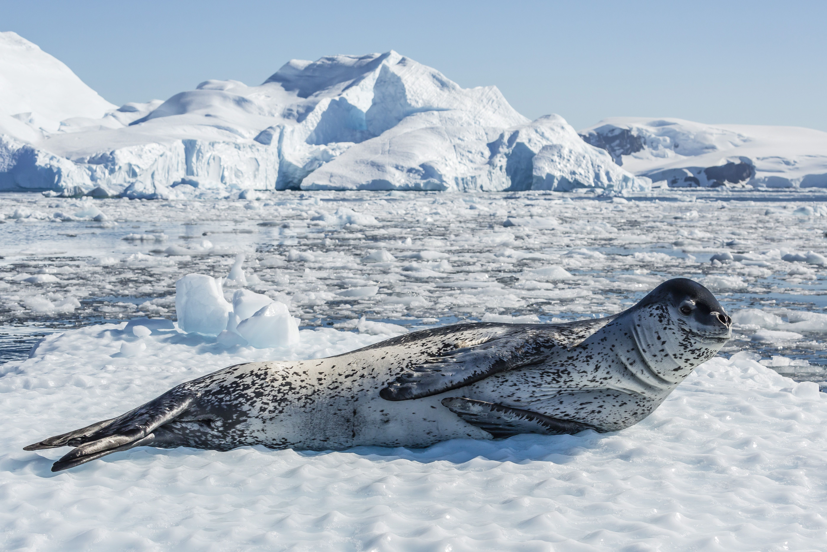
Leopard seals are 2 to 3 meters long and can weigh up to 600 kilograms.

Slide 5
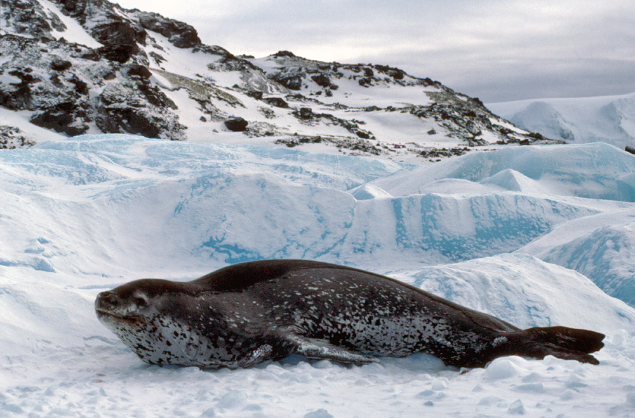
Female leopard seals are larger than the males.

Slide 6
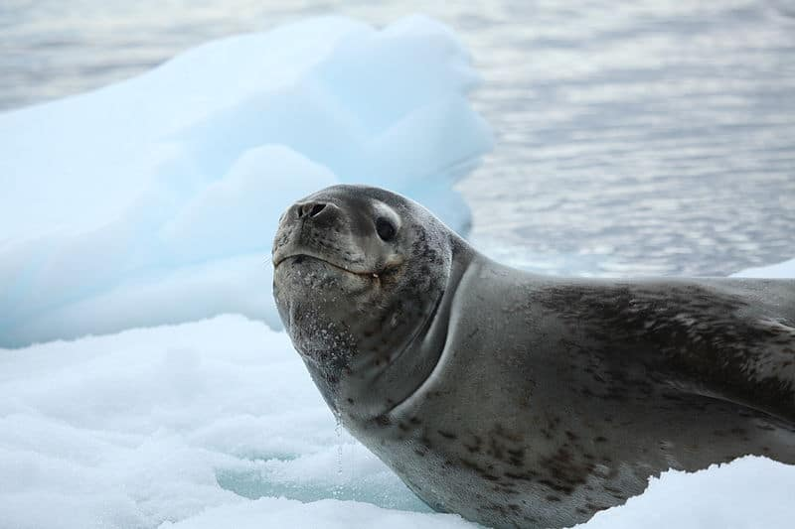
They have large flippers and large heads, with short whiskers.

Slide 7
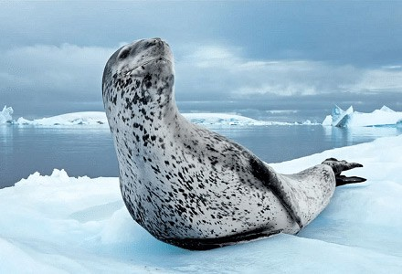
Leopard seals are carnivores, this means they eat meat. They eat penguins, seals, fish, birds and krill.

Slide 8
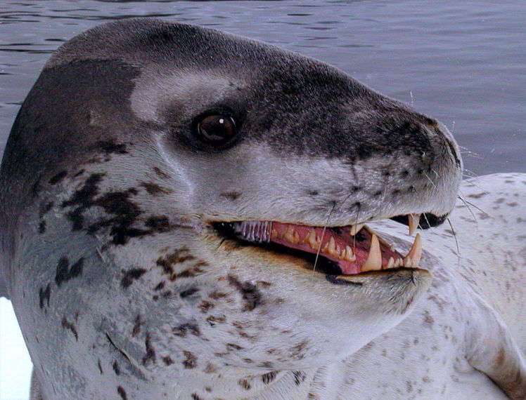
They have sharp front teeth to help them eat their food. These teeth also lock together to help them sieve krill from the water.

Slide 9
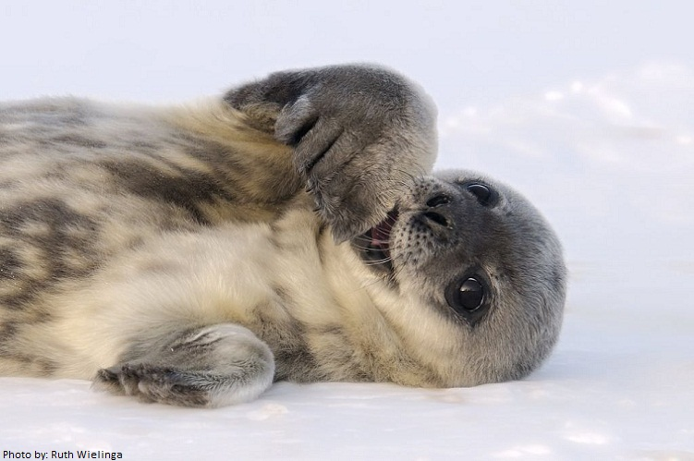
A baby Leopard seal is called a pup.
They become adults between the ages of 4-5.
They can live for up to 26 years.

Slide 10
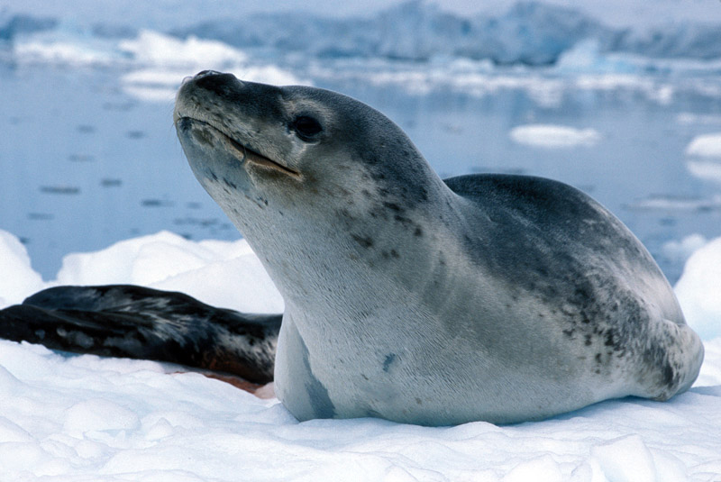
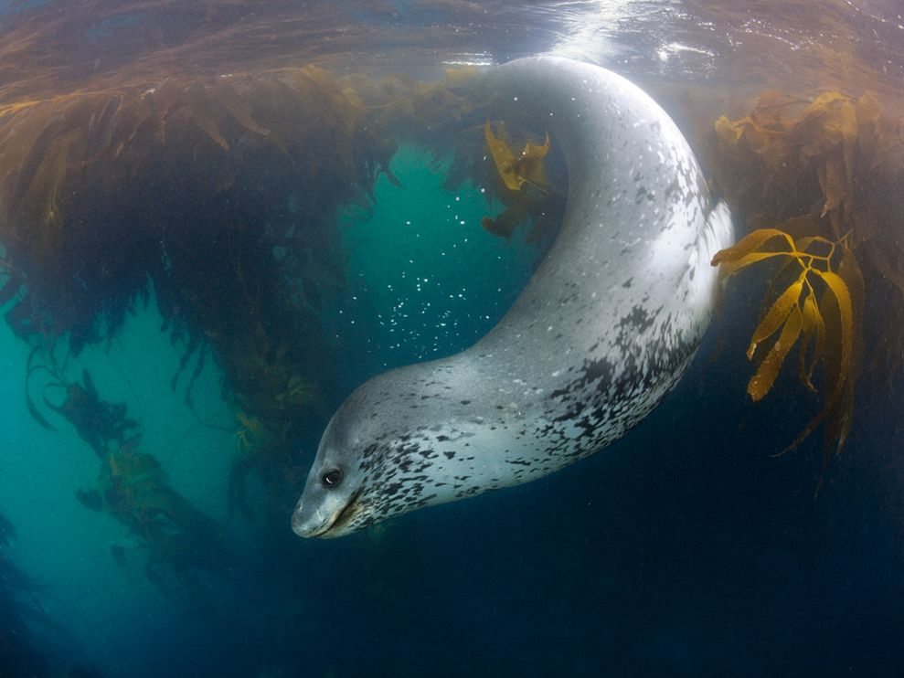
Leopard seals spend most of their time sitting on the ice or swimming in the water.

