Slide 1
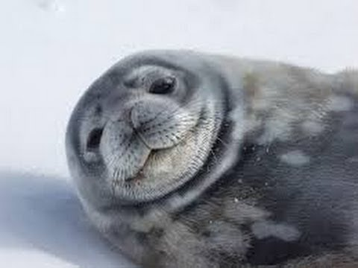

Weddell Seals

Slide 2
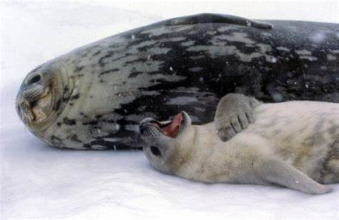
Weddell Seals
Weddell seals are mammals.
They were named after James Weddell the British Antarctic Explorer.
A male seal is called a bull.
A female seal is called a cow.
A baby seal is called a pup.

Slide 3
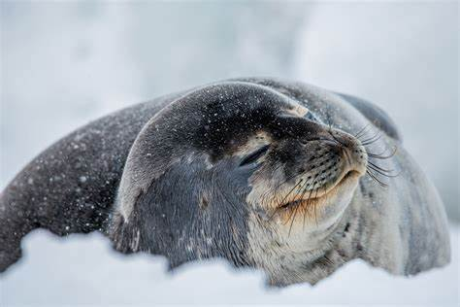
What they look like
Weddell seals are large animals.
They can grow to about 3m long and weigh about 500kg.
They are a silver grey colour and they have short dense fur that protects them from the cold. They have a grey black pattern on their backs.
They have a small head and flippers.
They have a short muzzle and a few short whiskers.
Weddell seals often look like they are smiling !

Slide 4
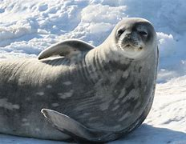
Dinner time !
Weddell seals like to eat fish, squid and other sea creatures.

Slide 5
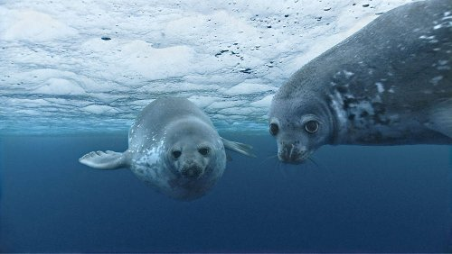
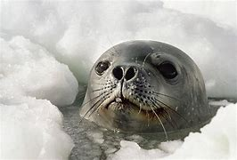
Underwater Life
Weddell seals spend most of their time in the water under the ice. This helps to protect them from predators such as Orcas and Leopard Seals, as well as letting them hunt for food.
They breathe through ice holes. They use their sharp teeth to make these ice holes and to crack them back open if they freeze over.

Slide 6
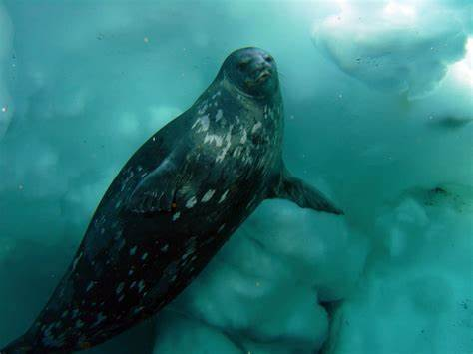
Champion Divers
They are excellent divers and can hold their breath underwater for over an hour.
They can dive down as far as 600m and swim for 5km without needing to take a breath!

Slide 7
Keeping clean and tidy!
Weddell seals can groom themselves to keep clean by using the nails on their front flippers.
If they can’t reach a part of their body they will rub and roll on the ice until they are clean.

Slide 8
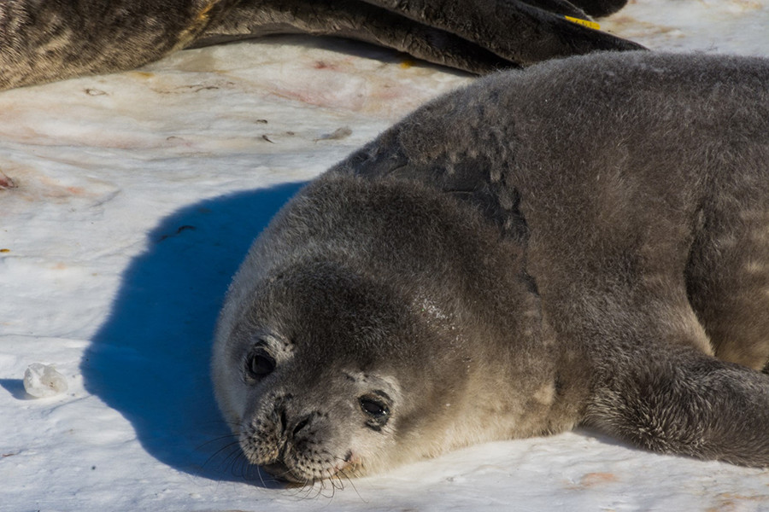
Resting
When they have a rest or sleep they stay in the same place for a long time. This causes the ice under them to melt from the heat of their bodies.

Slide 9
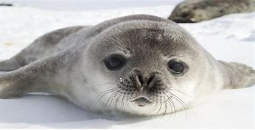
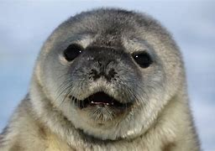
Pups
A pup is usually born from September to October and will have light grey fur.
Pups will be born with a full set of teeth.
A pup will drink mum’s milk and stay with her until it is six weeks old.
Pups are fully grown at three years old.

Slide 10
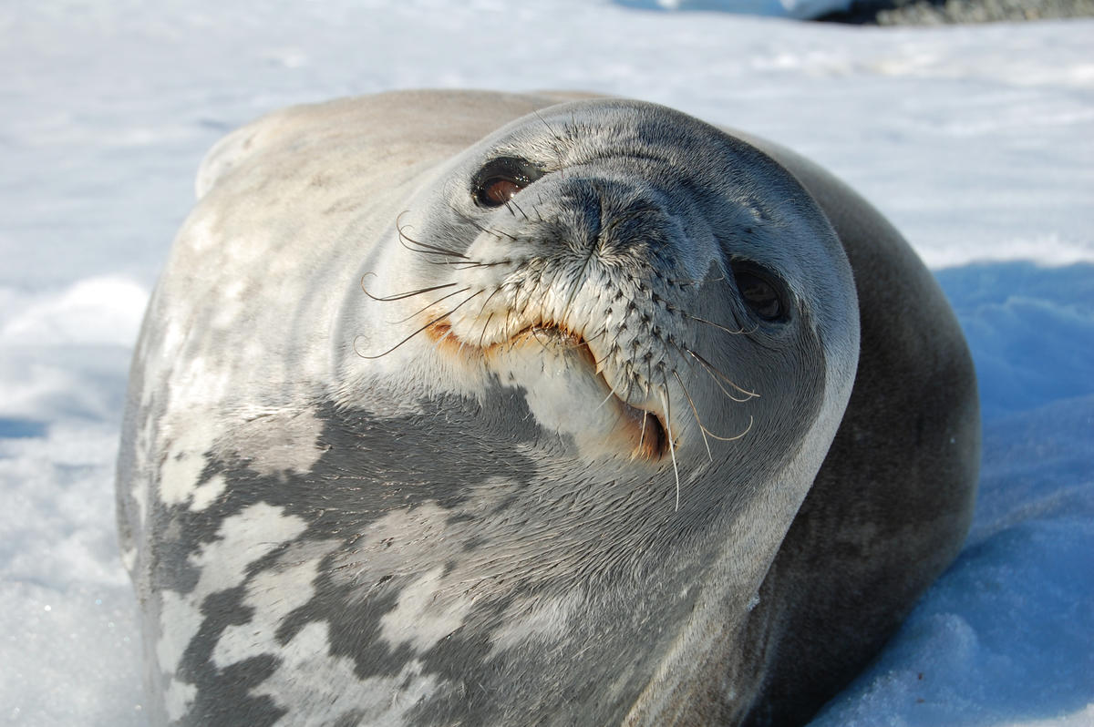
Communication
They are very noisy animals especially under the water.
A female can be heard from 20 miles away !

