Slide 1

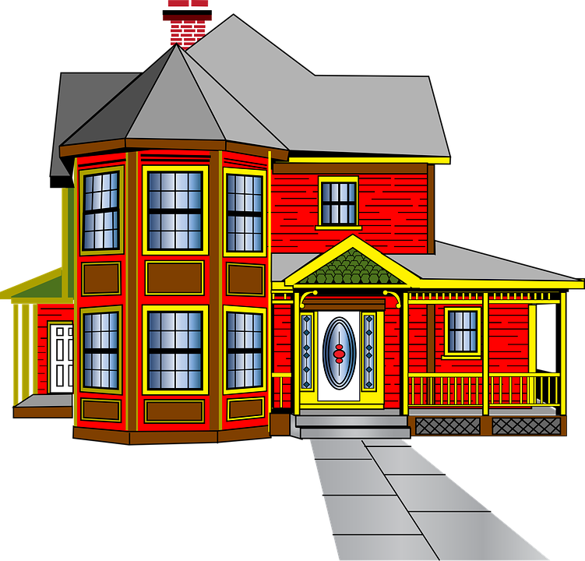
Houses in the past

Slide 2
We are learning how houses have changed through history.

Slide 3
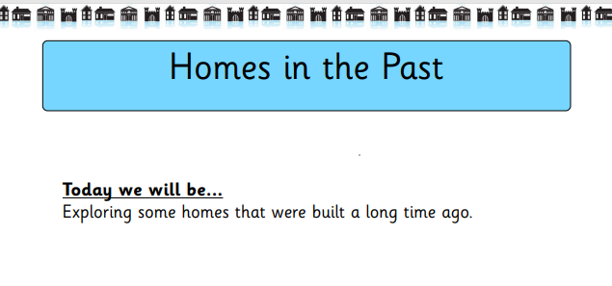

Slide 4
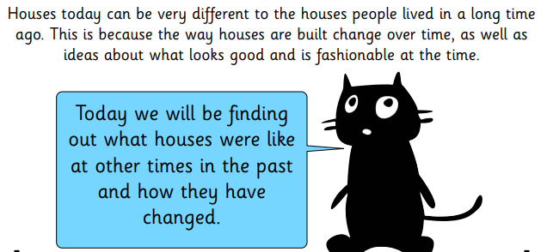

Slide 5
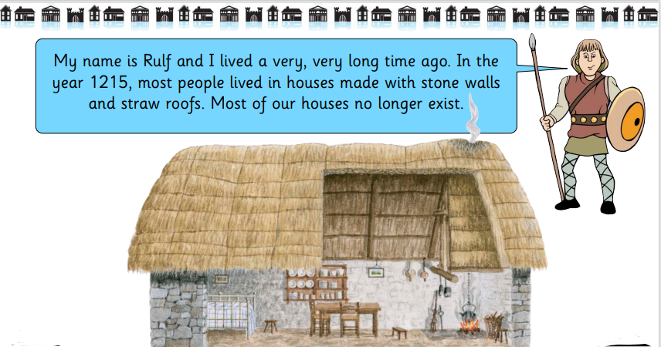
Medieval Houses

Slide 6
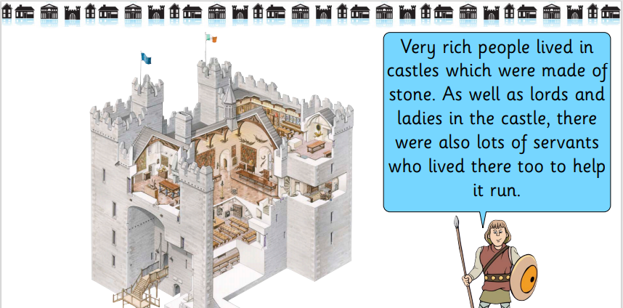
Medieval Houses

Slide 7
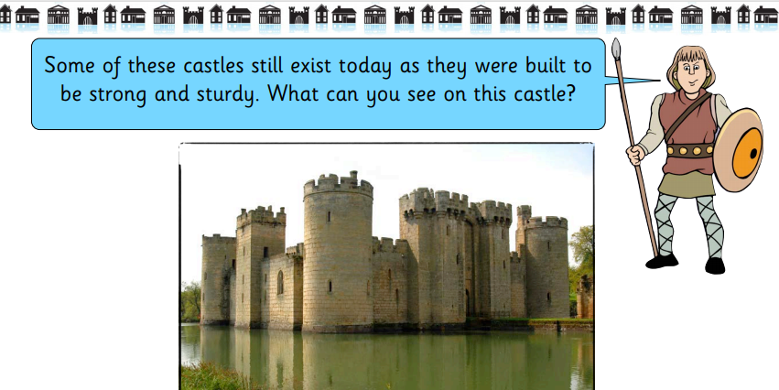
Medieval Houses

Slide 8
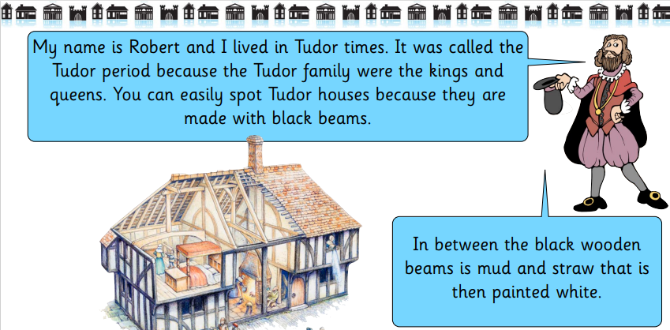
Tudor Houses

Slide 9
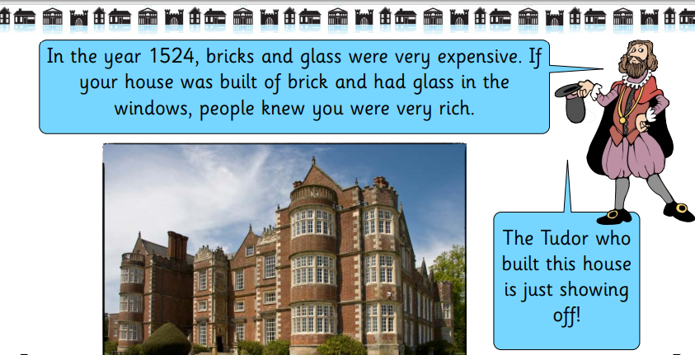
Tudor Houses

Slide 10
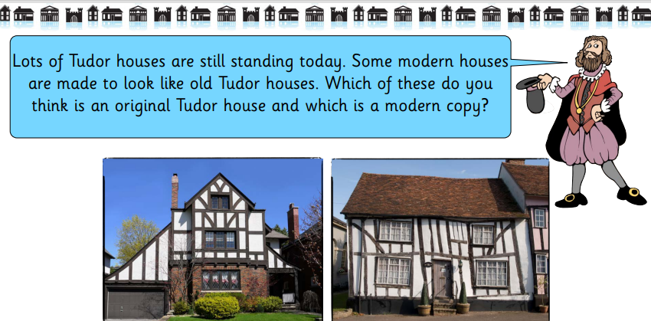
Tudor Houses

Slide 11
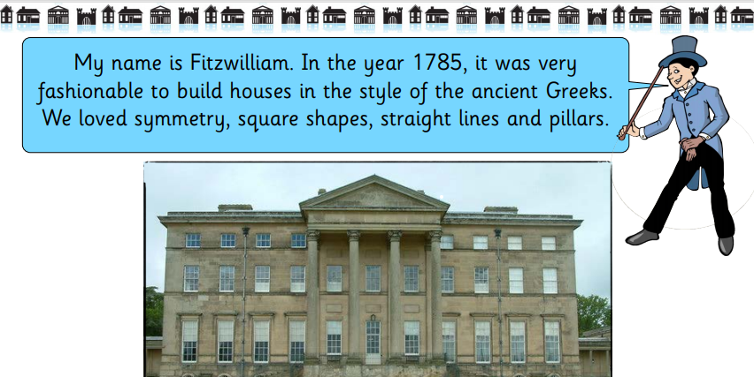
Georgian Houses

Slide 12
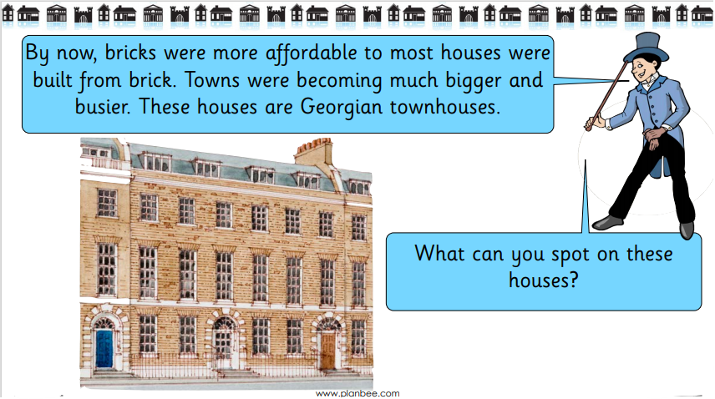
Georgian Houses

Slide 13
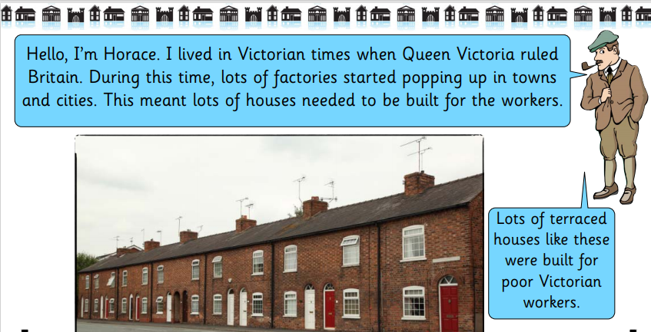
Victorian Houses

Slide 14
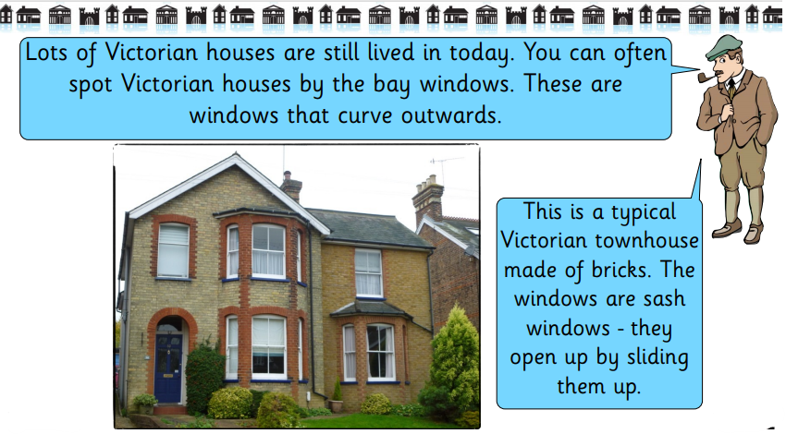
Victorian Houses

Slide 15
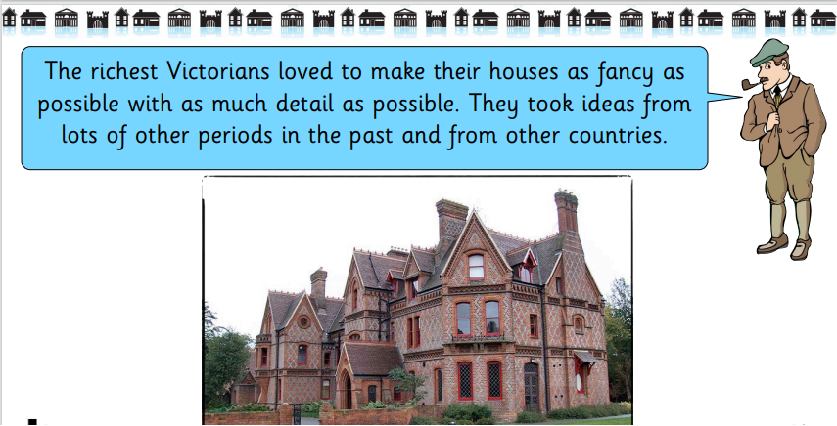
Victorian Houses

Slide 16


