Slide 1
Plurals adding es
WALT: Adding es to make words plural.

Slide 2
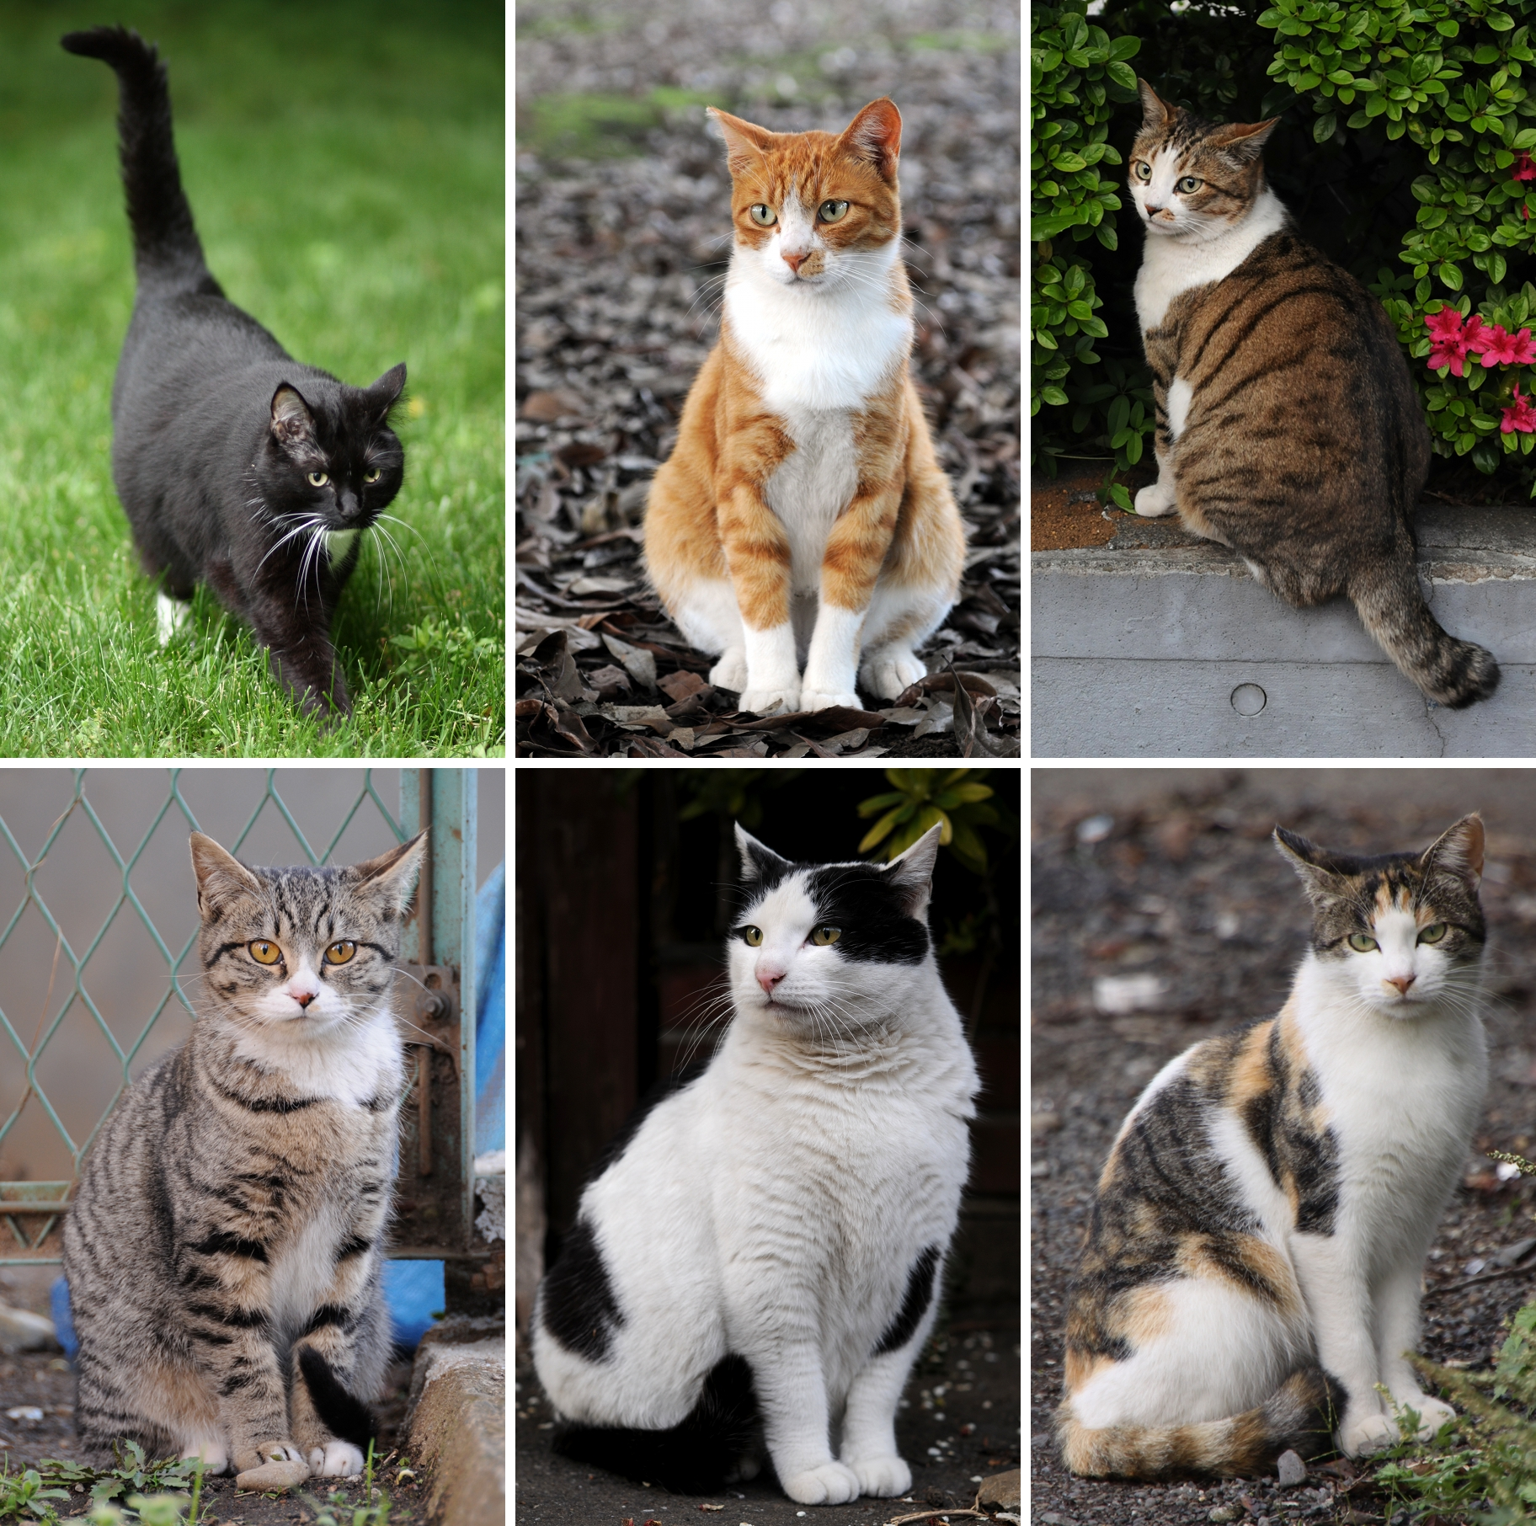

P3 we already know that some words are made plural by adding s. For example;
One cat
Lots of cats

Slide 3
But P3, some words are made plural by adding es.
A word that ends with
sh, ch, ss, s, x, o, and z
is made plural by adding es.
Let’s take a closer look ☺

Slide 4
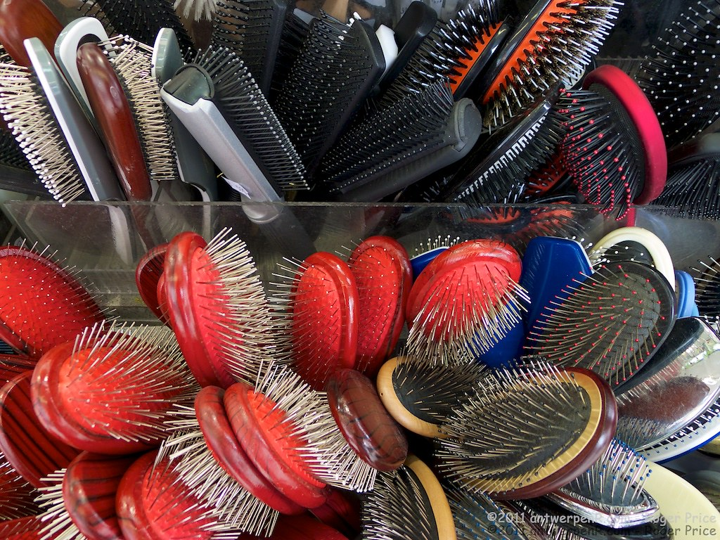

A word ending with sh
brush
brushes

Slide 5



A word ending in ch
church
churches

Slide 6


A word ending in ss
boss
bosses

Slide 7

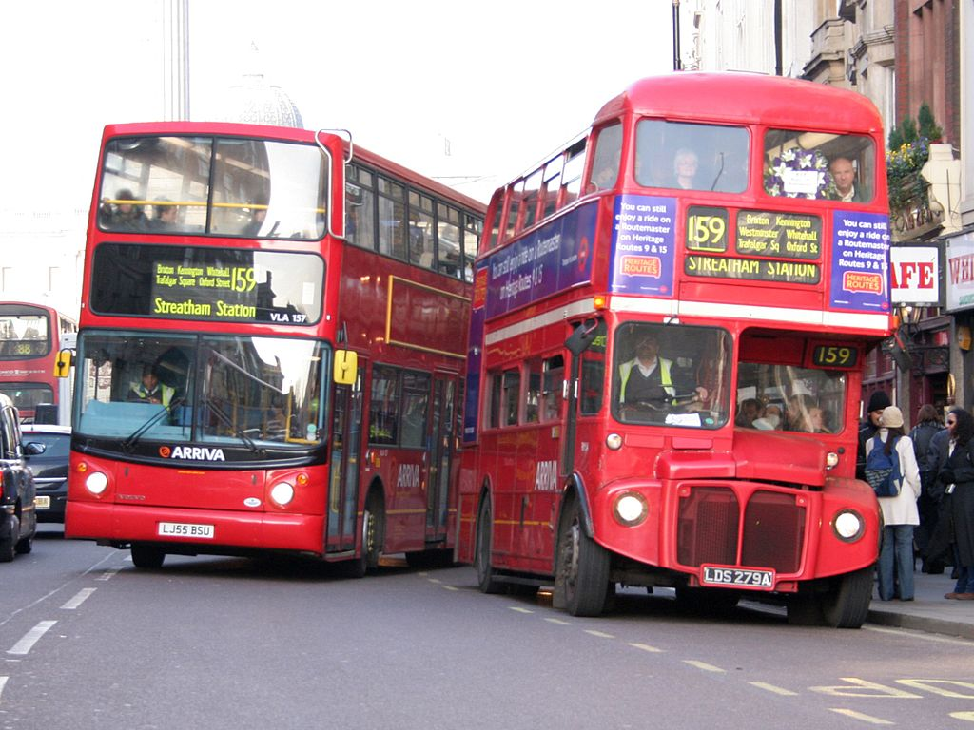
A word ending in s
bus
buses

Slide 8


A word ending in x
box
boxes

Slide 9
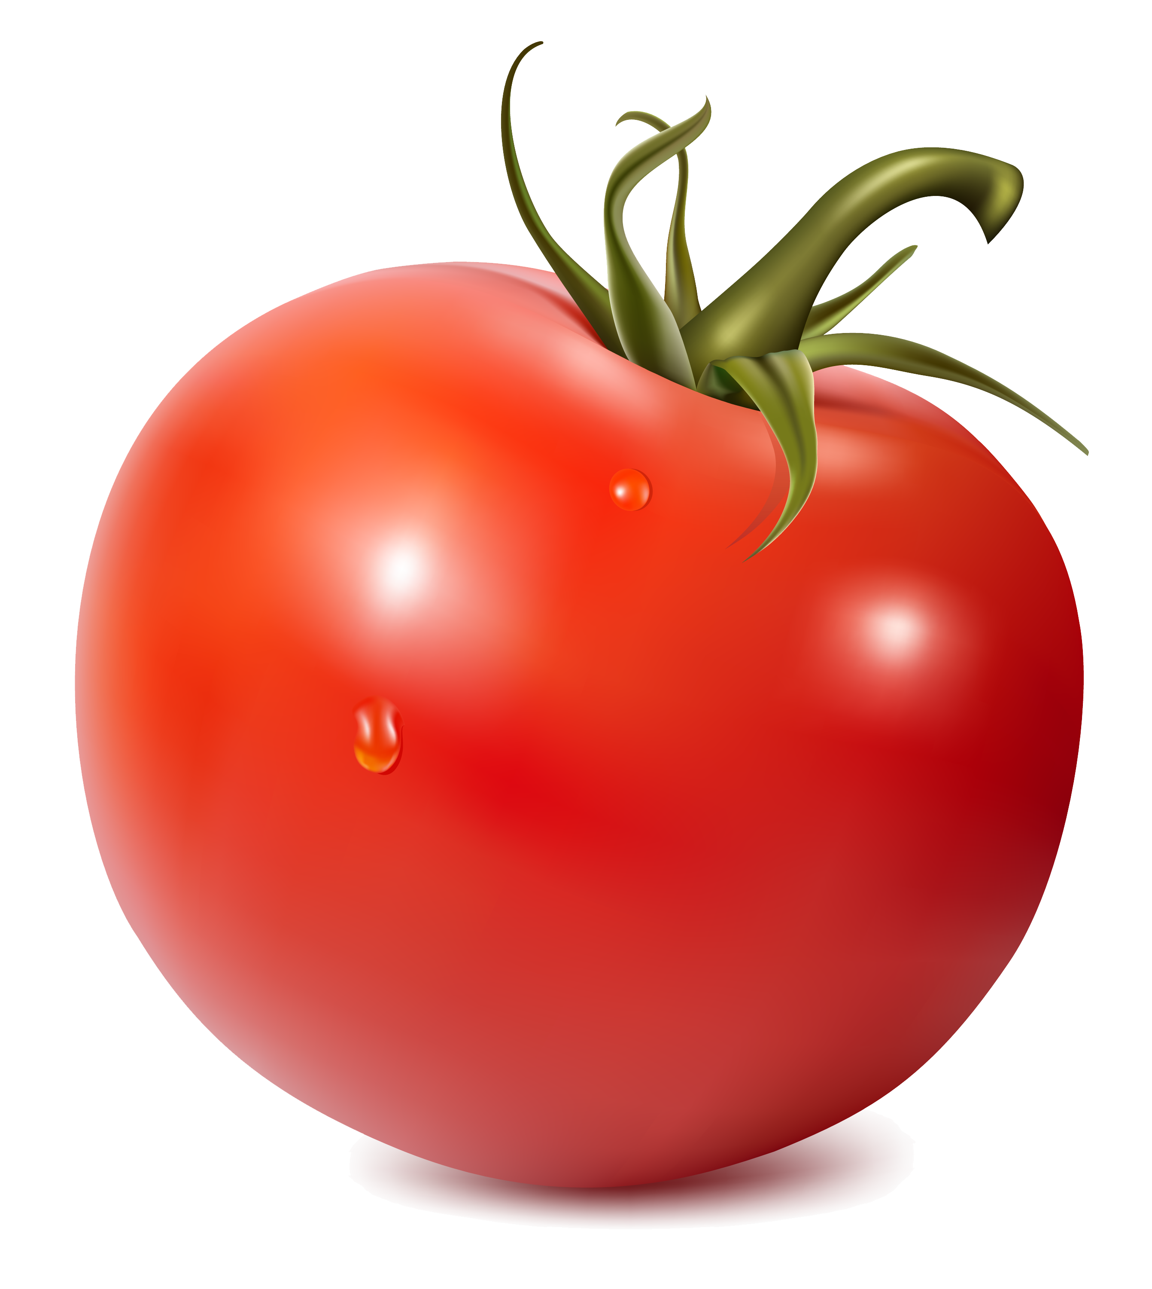
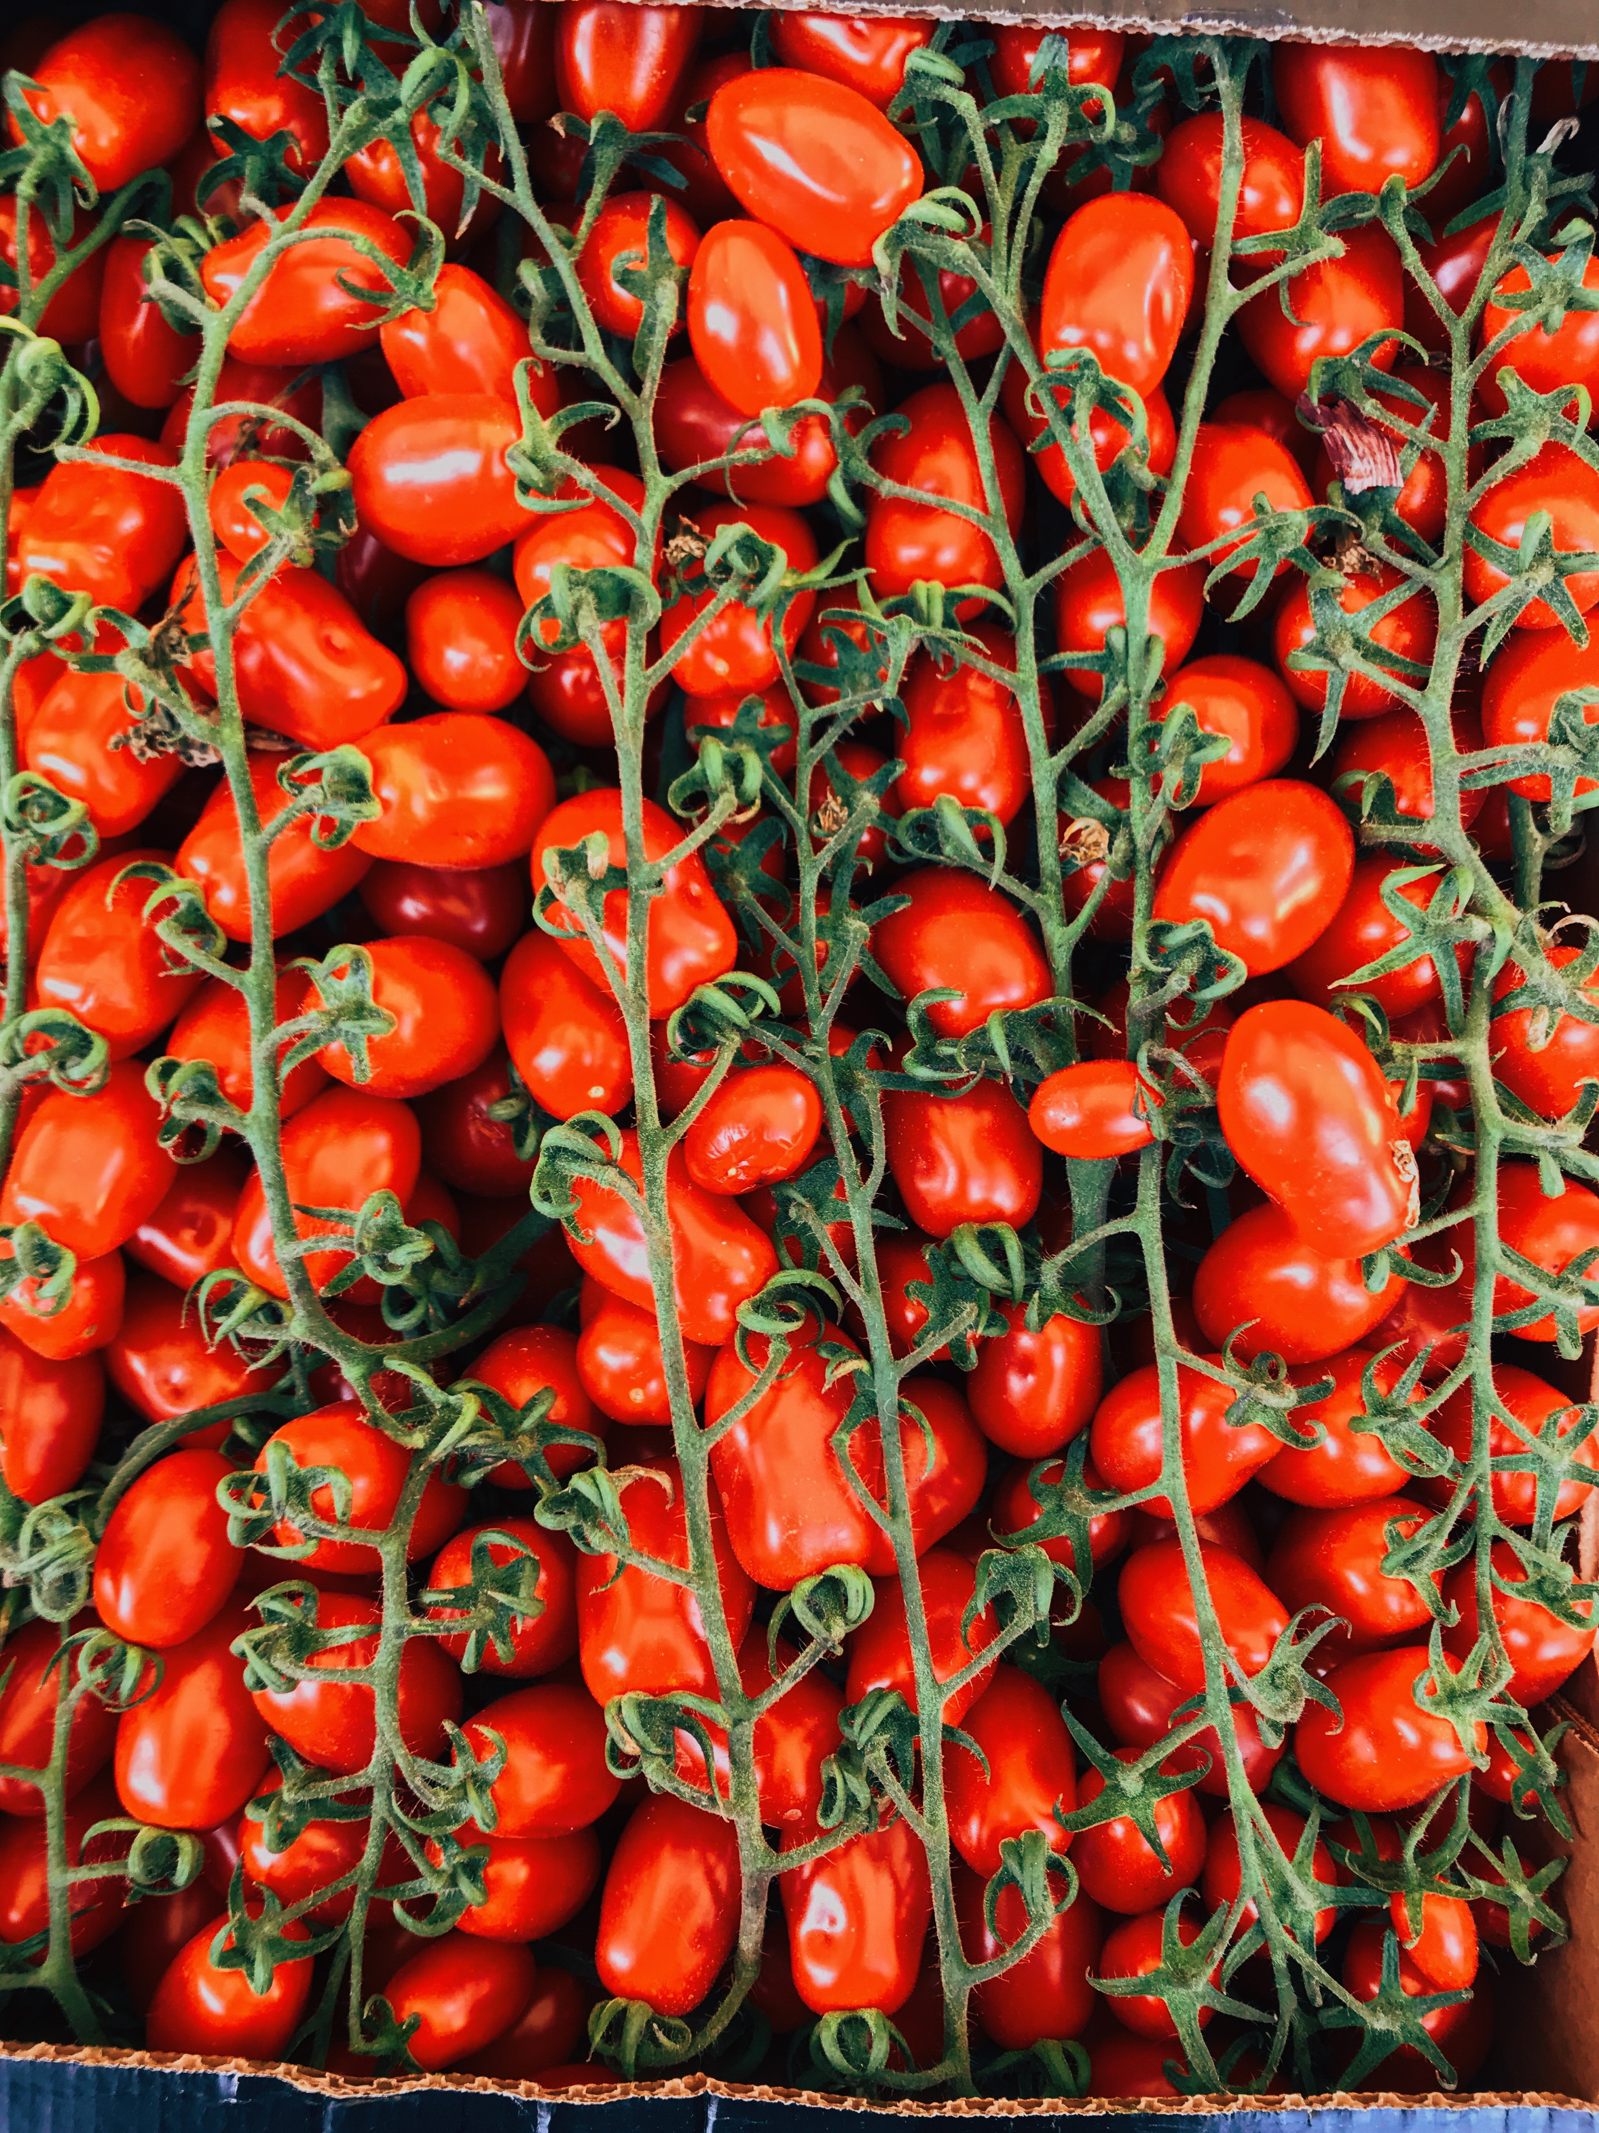
A word ending in o
tomato
tomatoes

Slide 10

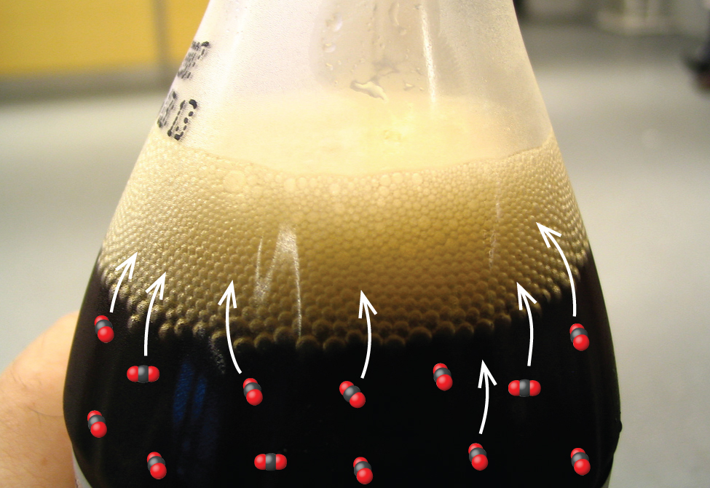
A word ending in z
fizz
fizzes

Slide 11
So P3 superstars, what do we know now?
Words ending with sh, ch, ss, s, x, o and z are made plural by…………. adding es.
push pushes
lunch lunches
toss tosses
bus buses
fox foxes
potato potatoes
buzz buzzes

Slide 12
Good luck with your literacy today P3!
Do your best ☺
Just remember words ending with sh, ch, ss, s, x, o and z are made plural by adding es!

