Slide 1
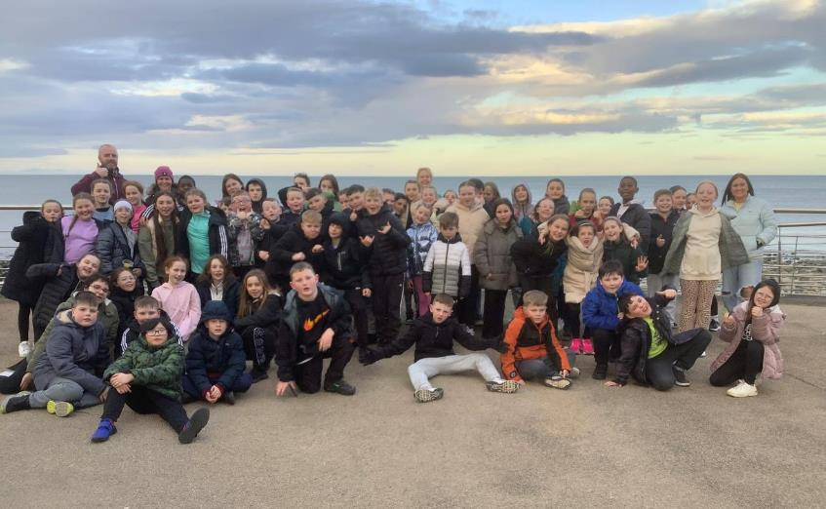
P6 visit to Greenhill YMCA
16th – 19th April 2024

Slide 2
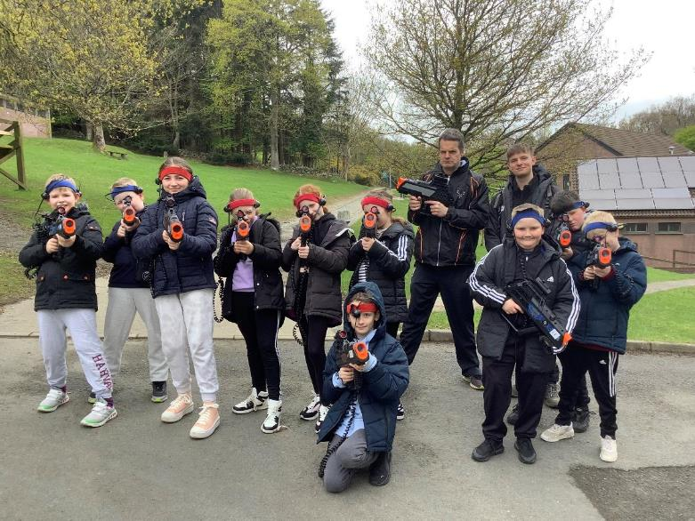
Laser tag!

Slide 3
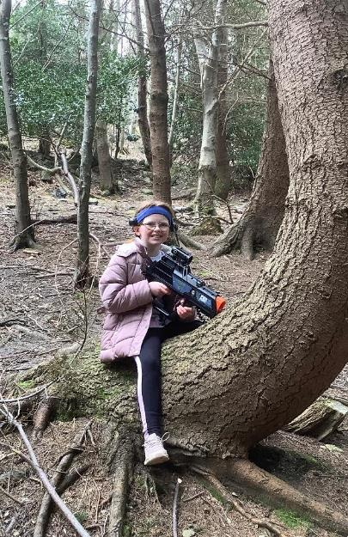
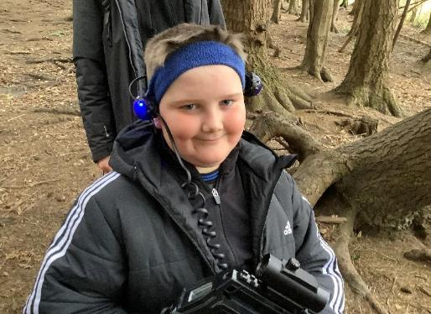

Slide 4
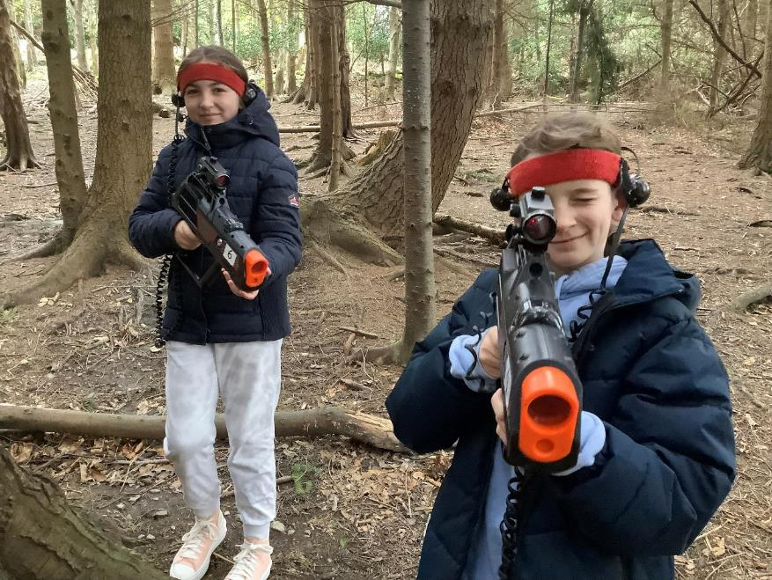

Slide 5
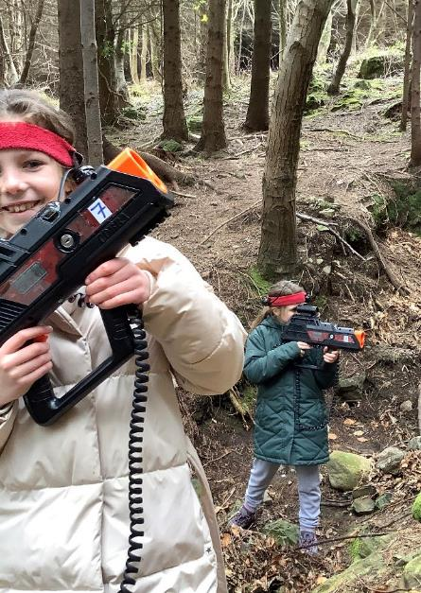
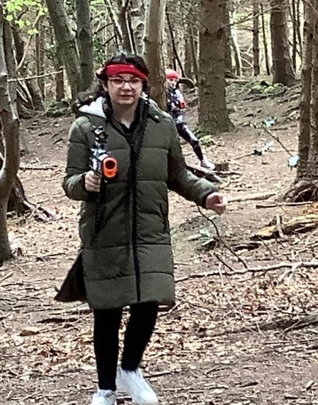

Slide 6
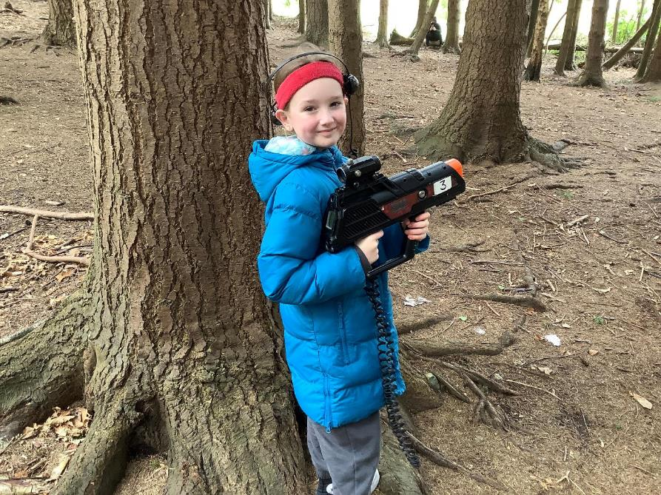

Slide 7
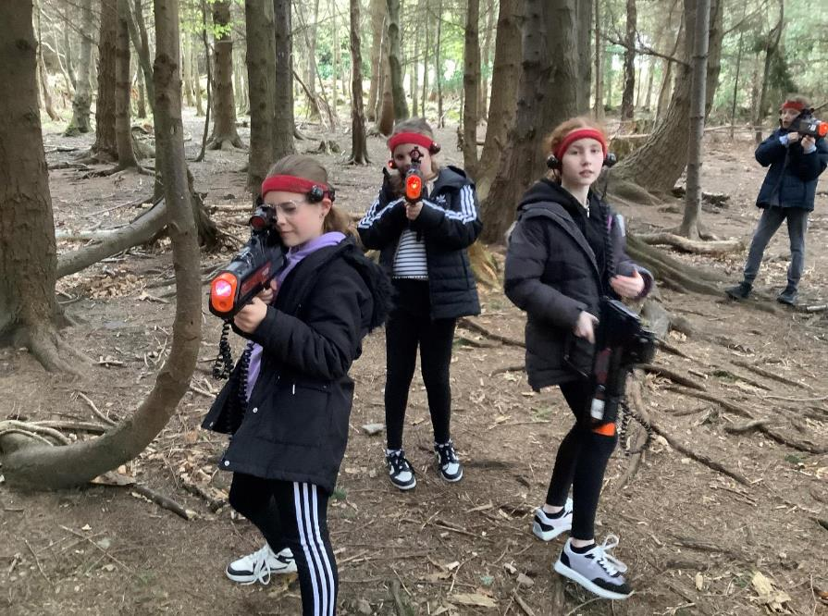

Slide 8
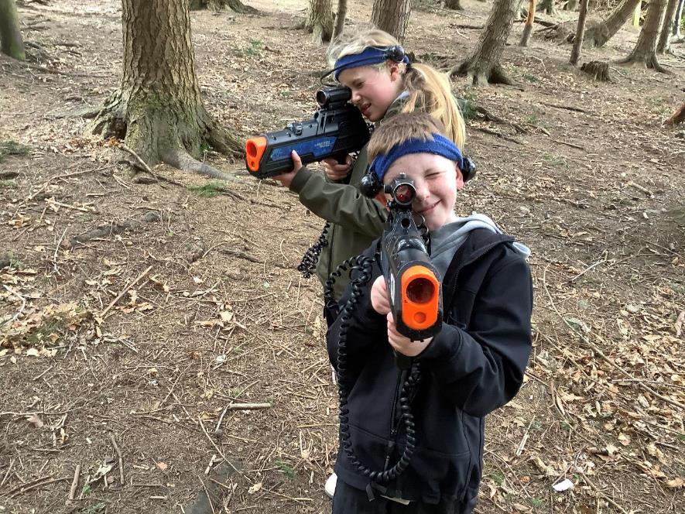

Slide 9
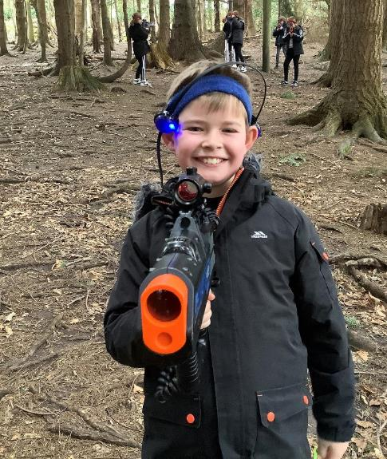
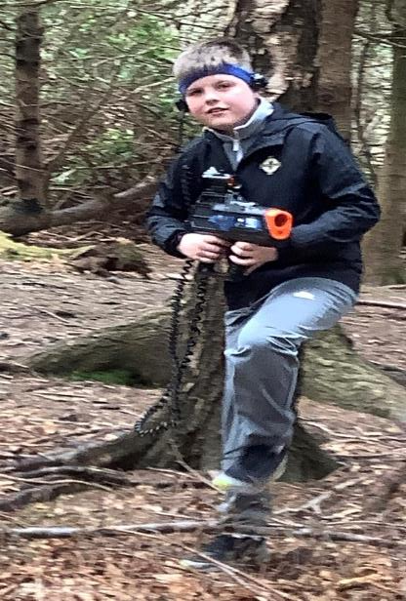

Slide 10
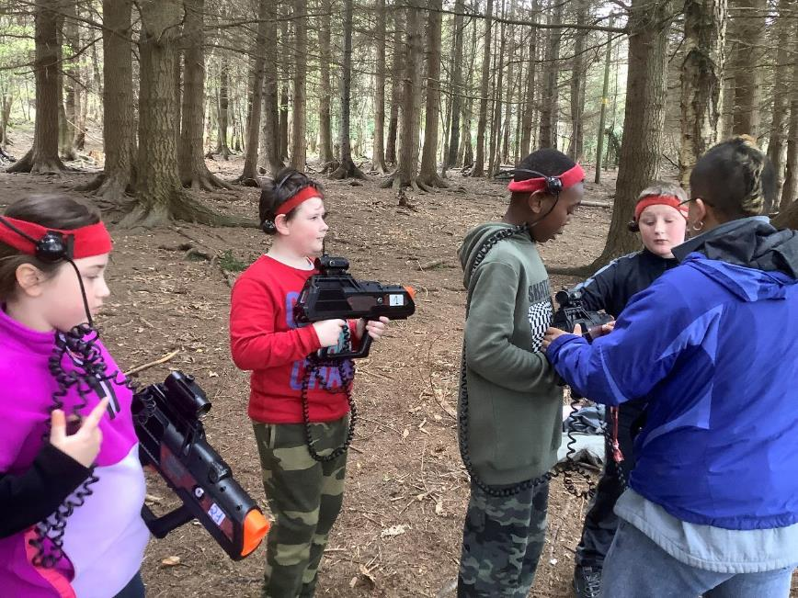

Slide 11
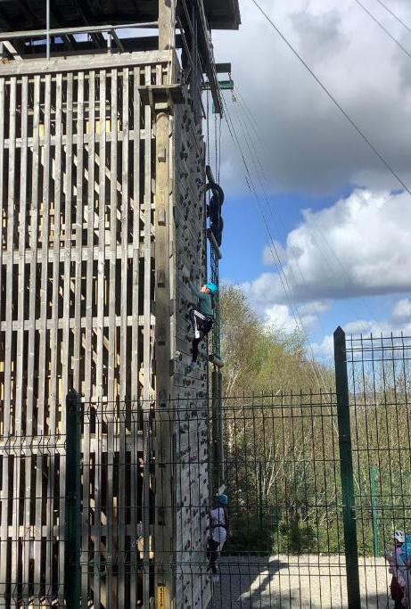
Climbing wall!

Slide 12
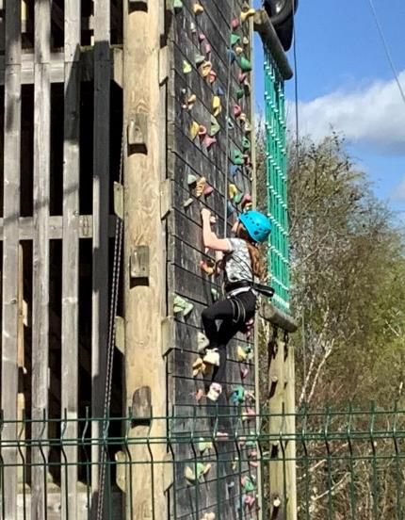
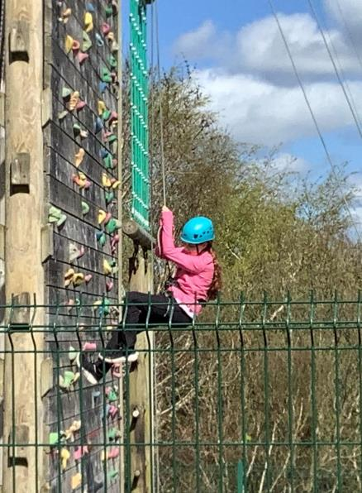

Slide 13
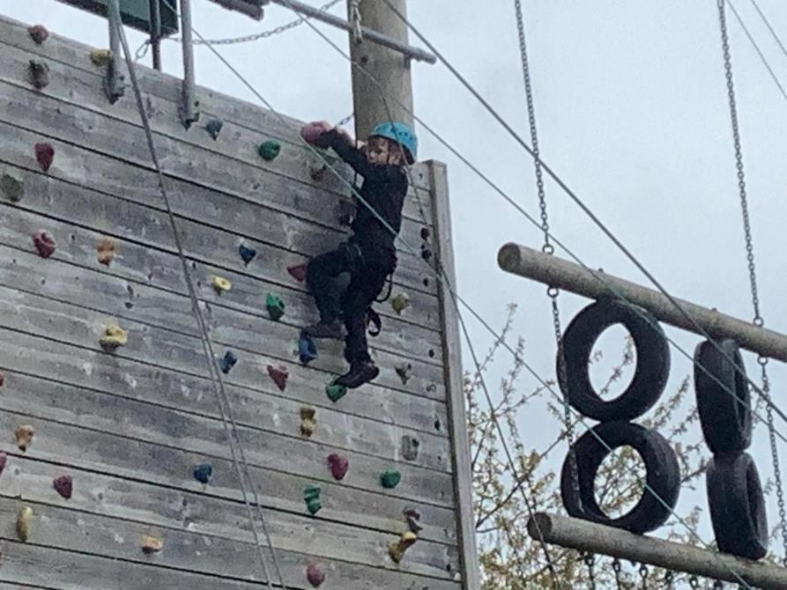

Slide 14
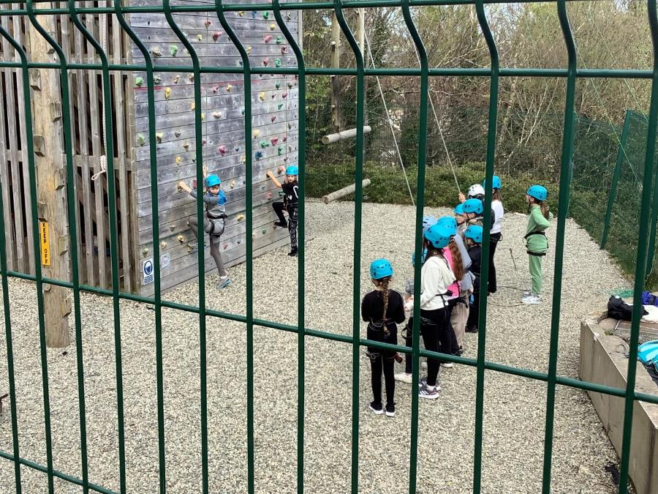

Slide 15
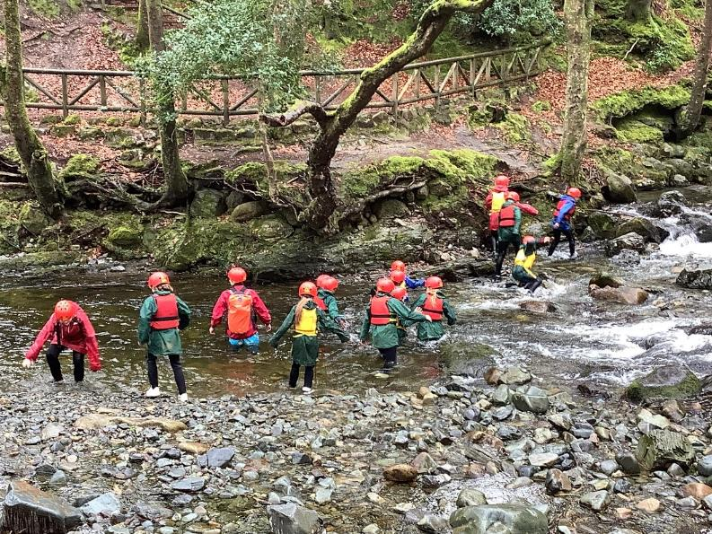
Bouldering!

Slide 16
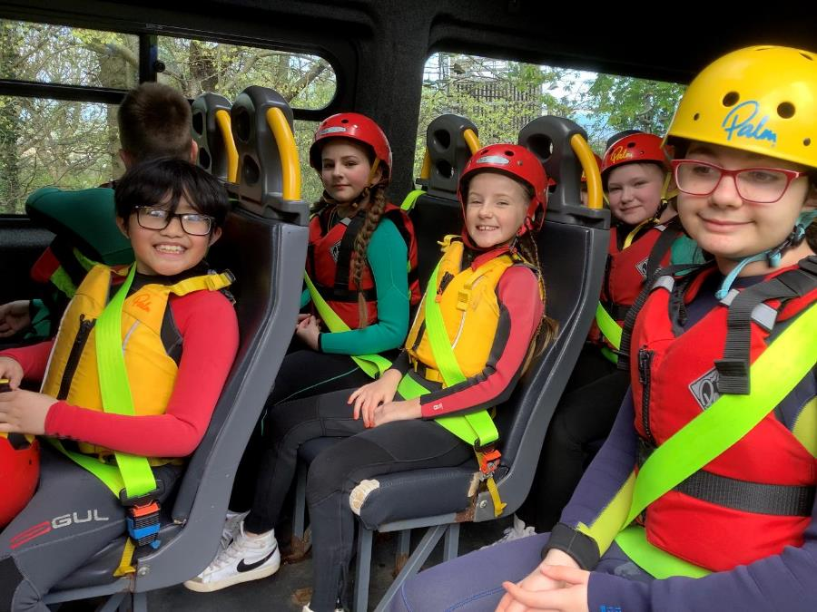

Slide 17
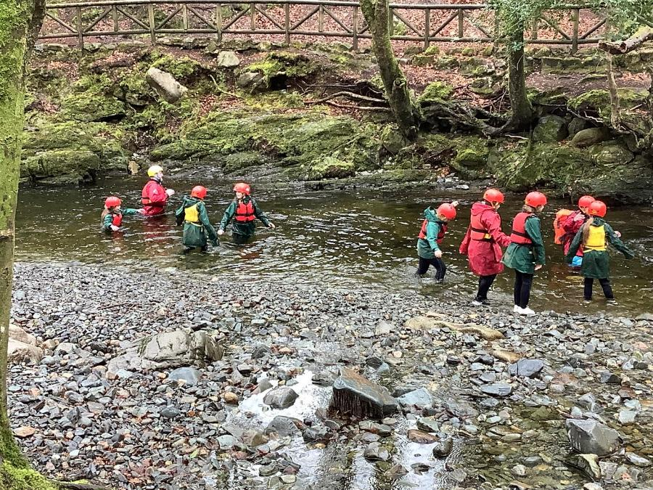

Slide 18
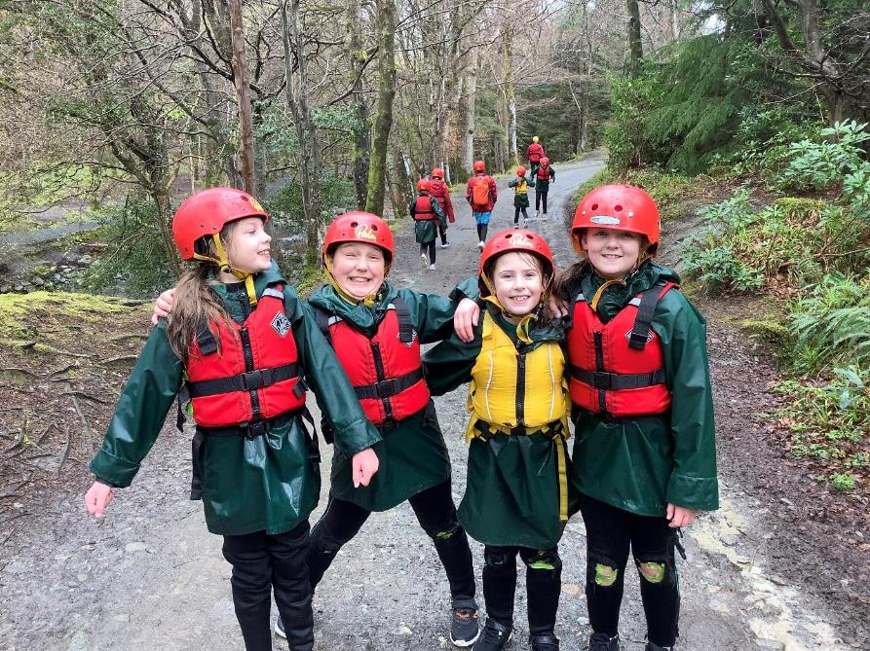

Slide 19
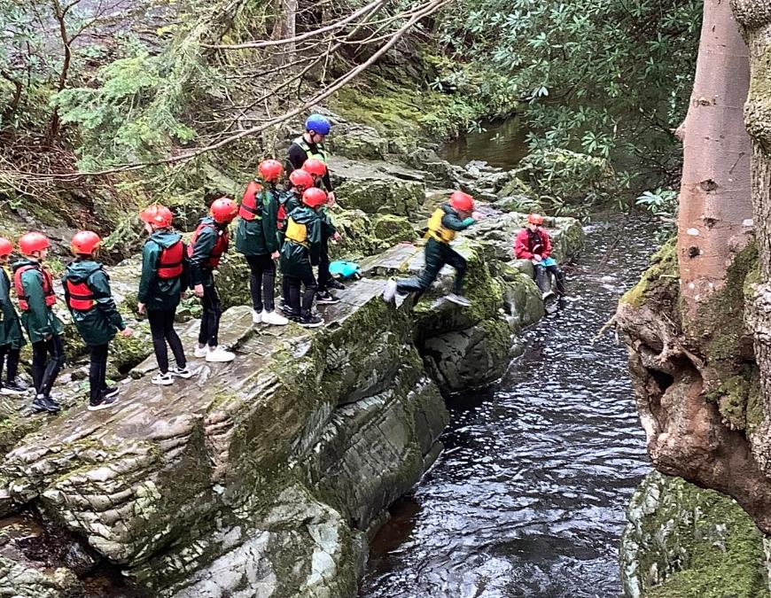

Slide 20
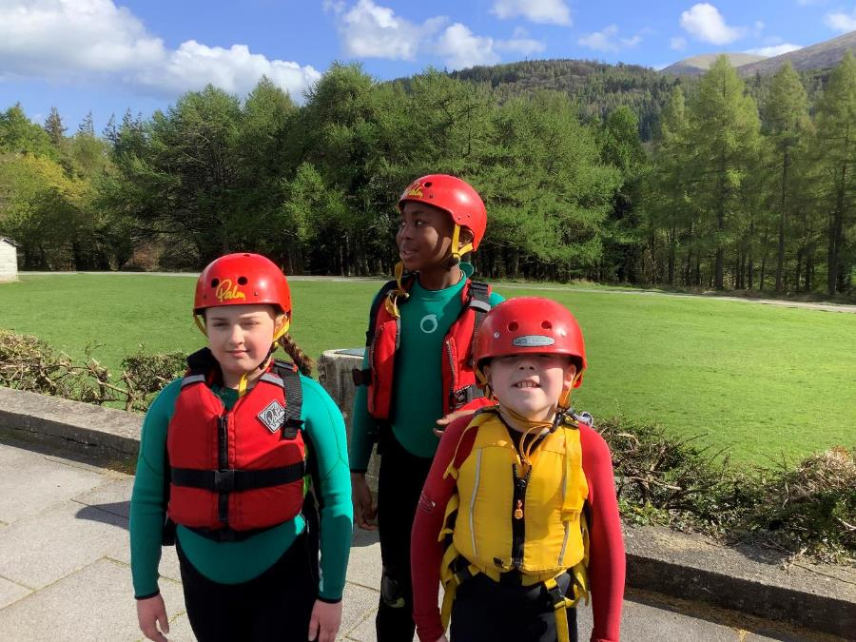

Slide 21
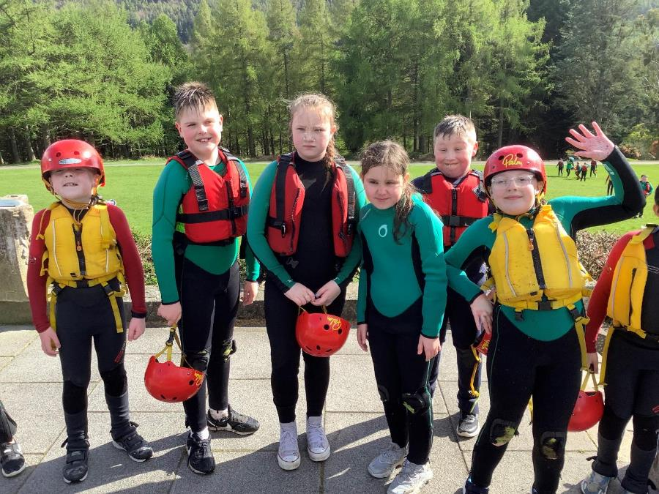

Slide 22
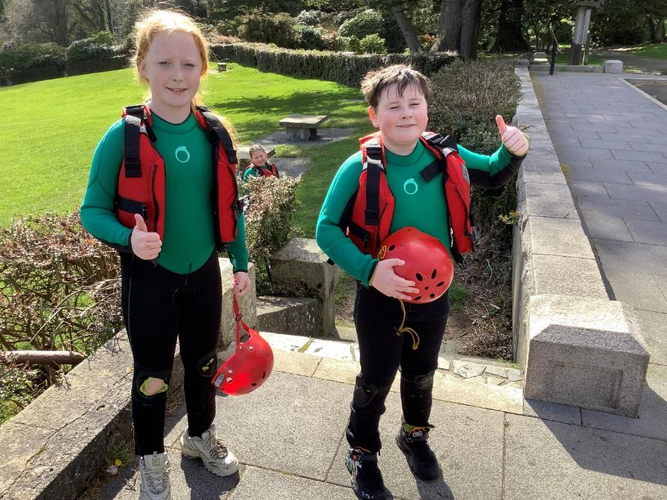

Slide 23
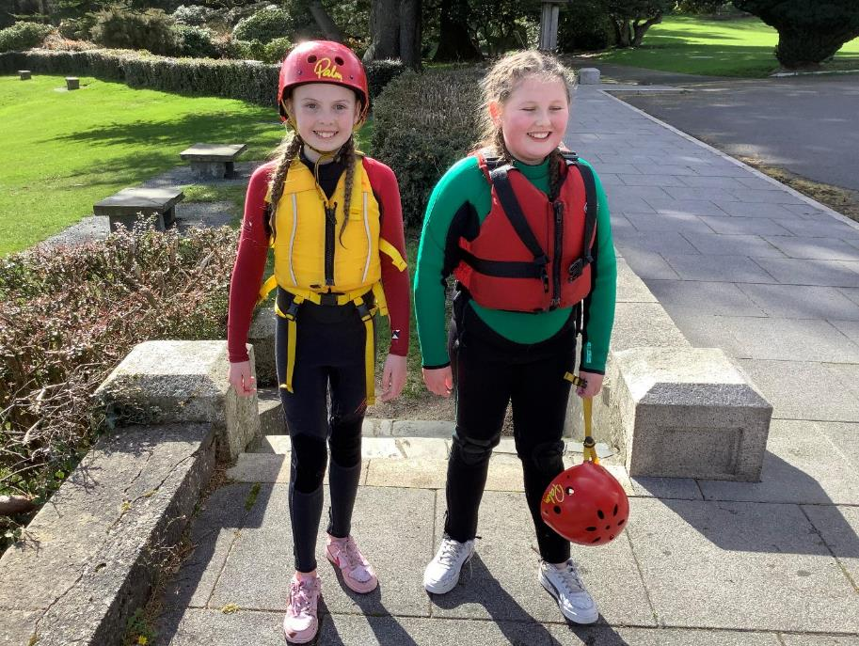

Slide 24
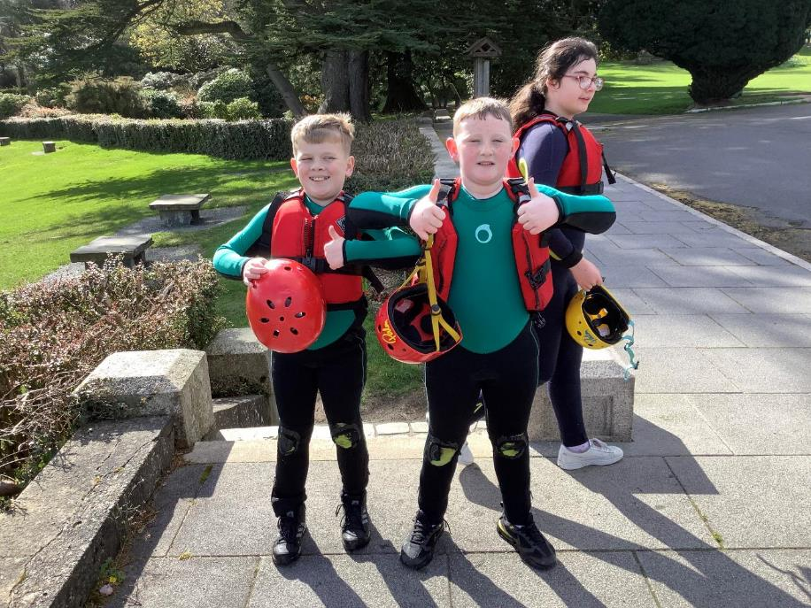

Slide 25
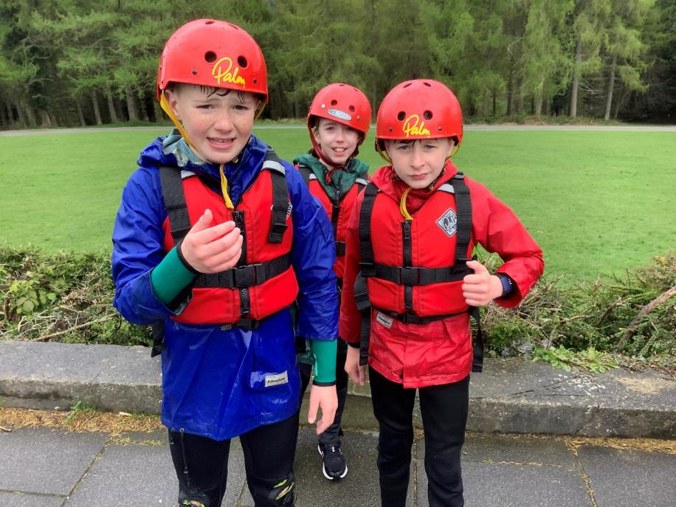

Slide 26
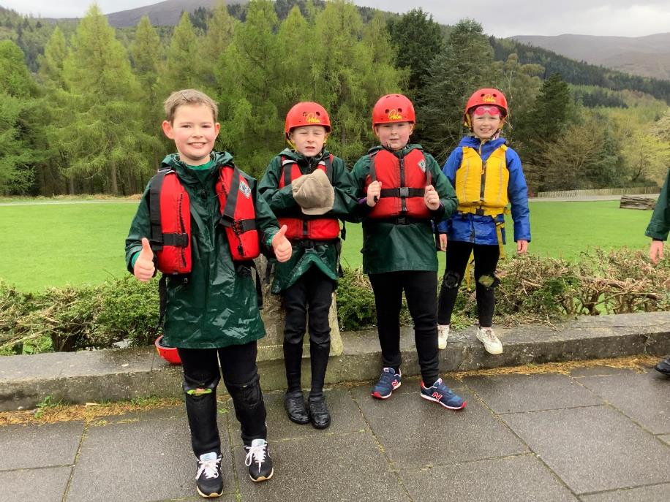

Slide 27
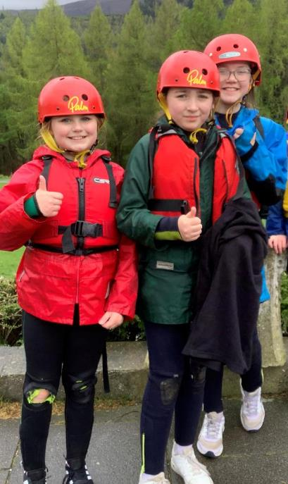
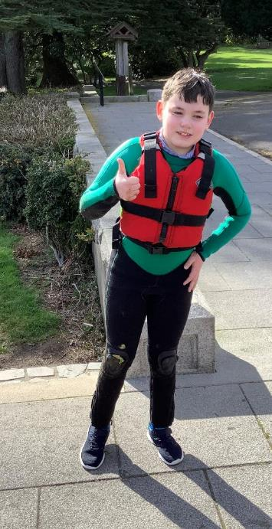

Slide 28
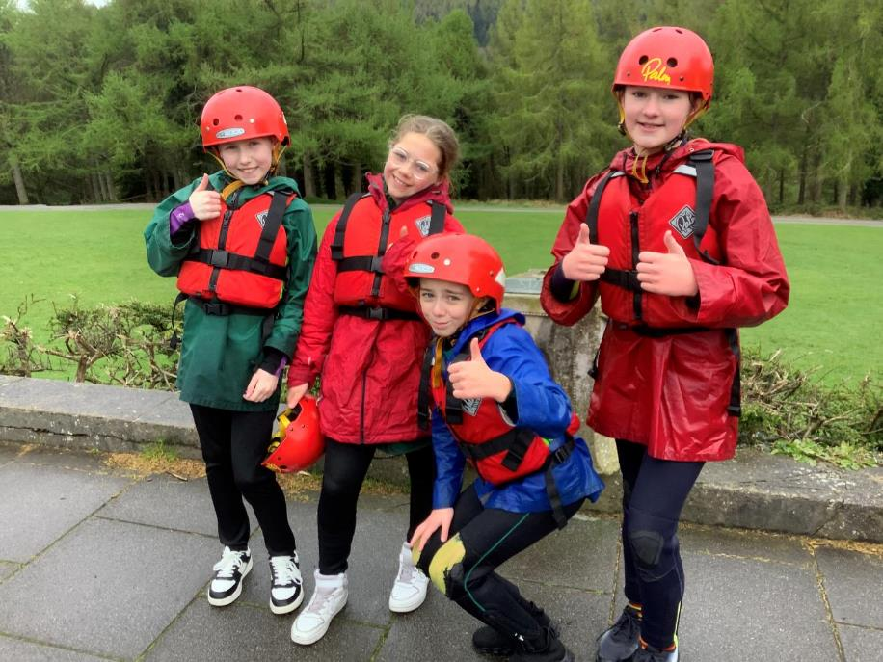

Slide 29
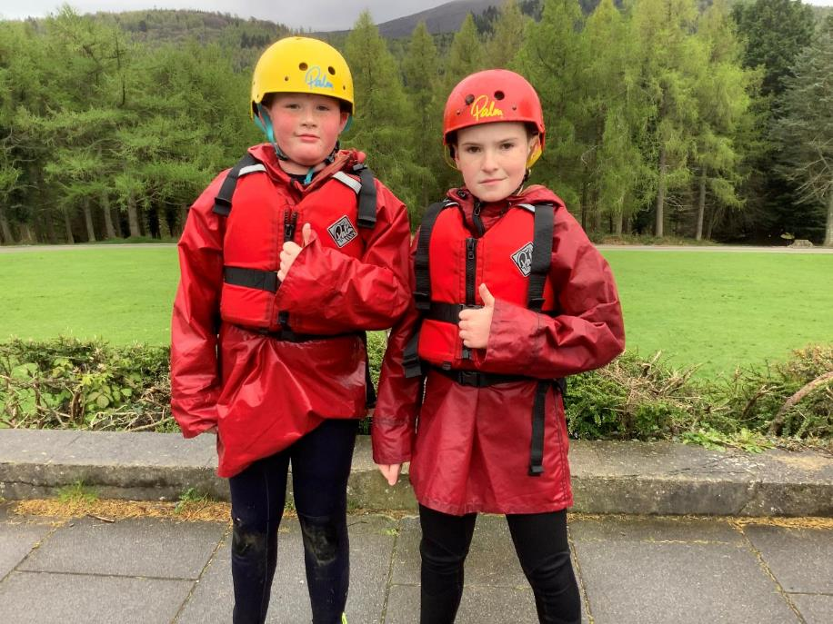

Slide 30
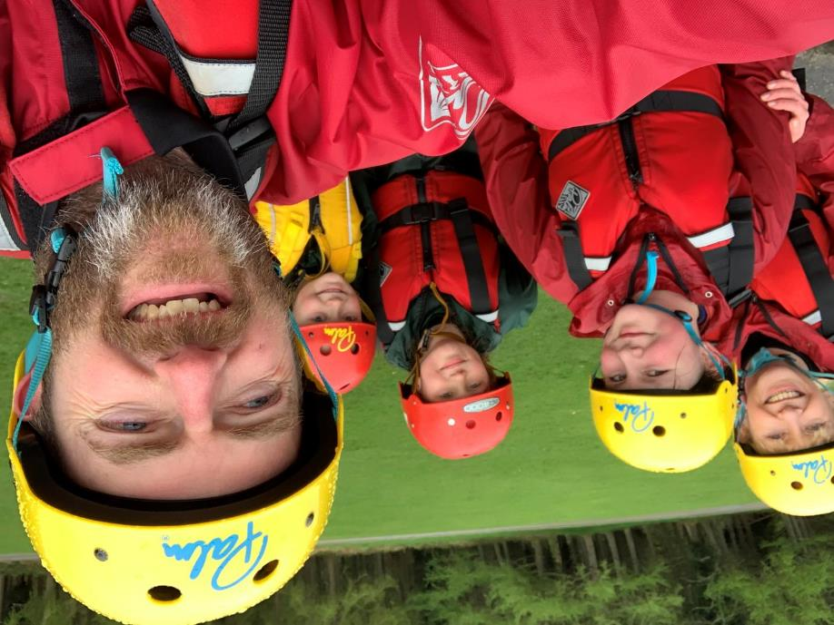

Slide 31
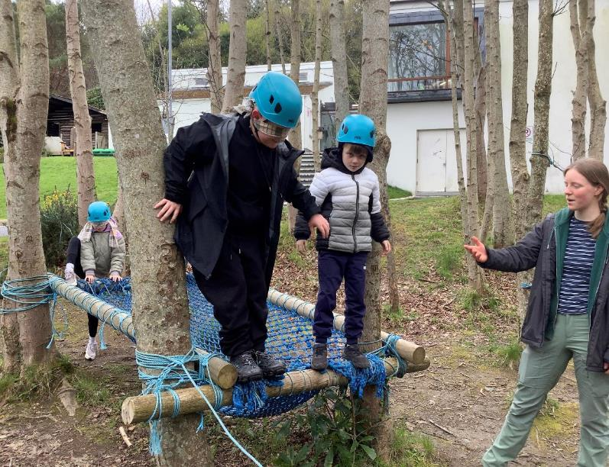
Blind trail!

Slide 32
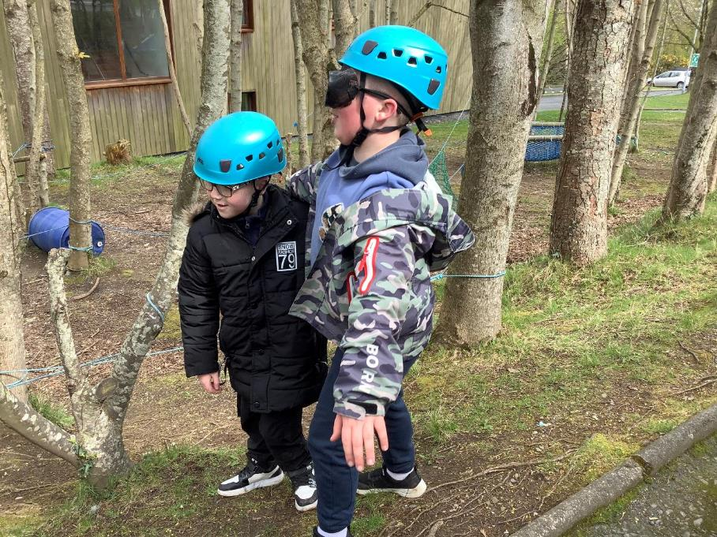

Slide 33
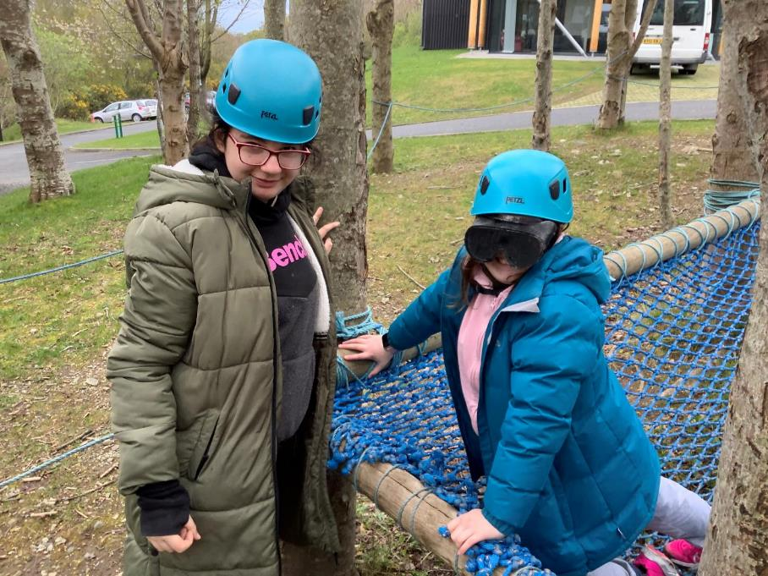

Slide 34
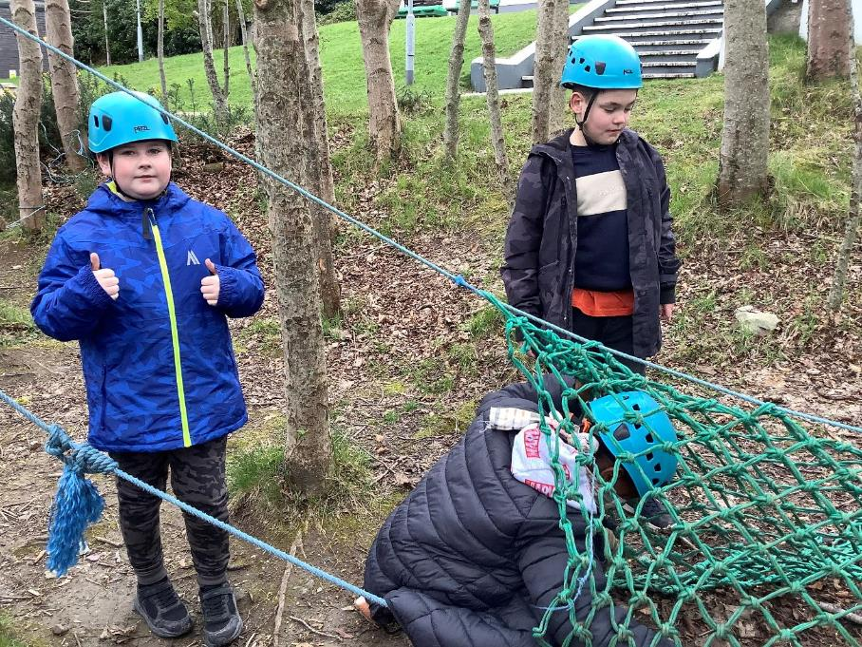

Slide 35
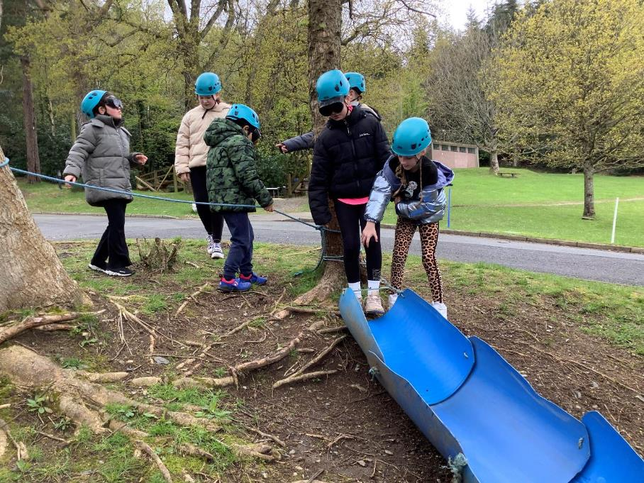

Slide 36
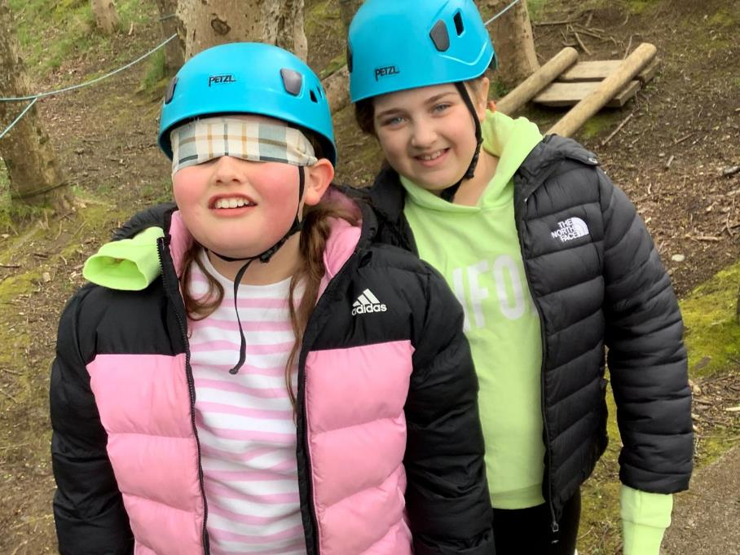

Slide 37
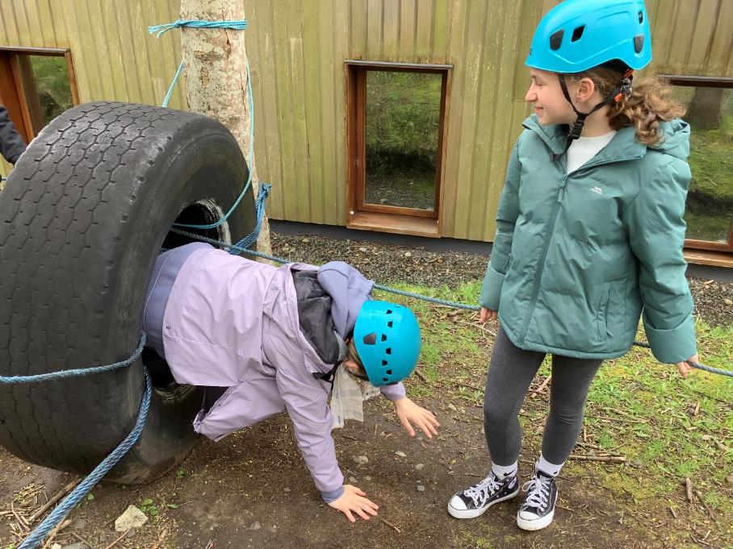

Slide 38
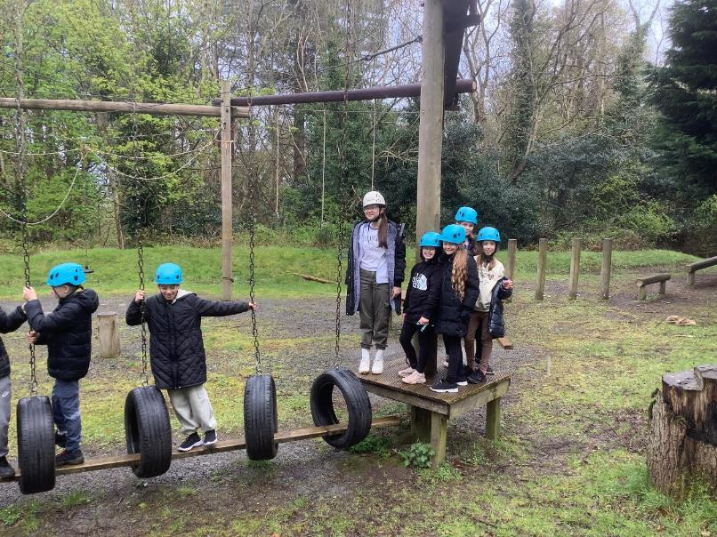
Team Ropes Challenge!

Slide 39
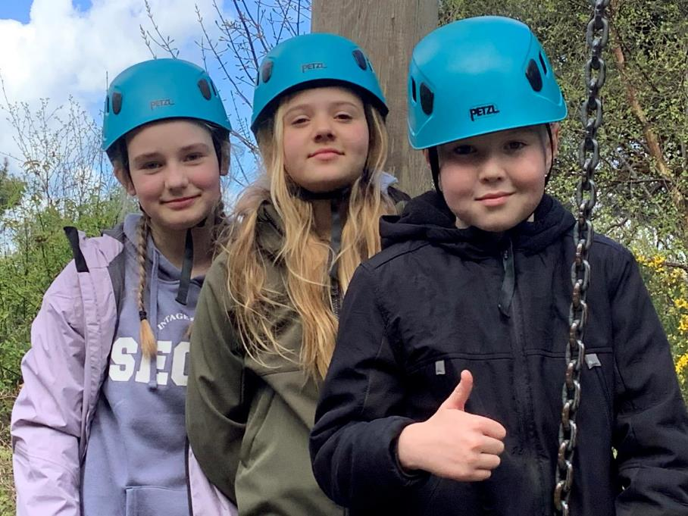

Slide 40
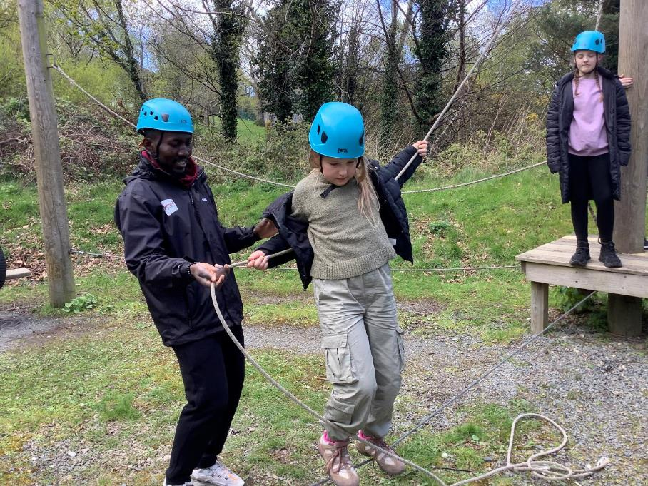

Slide 41
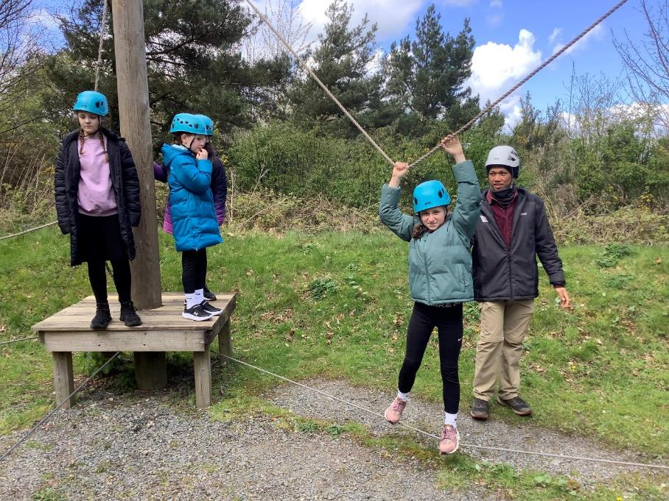

Slide 42
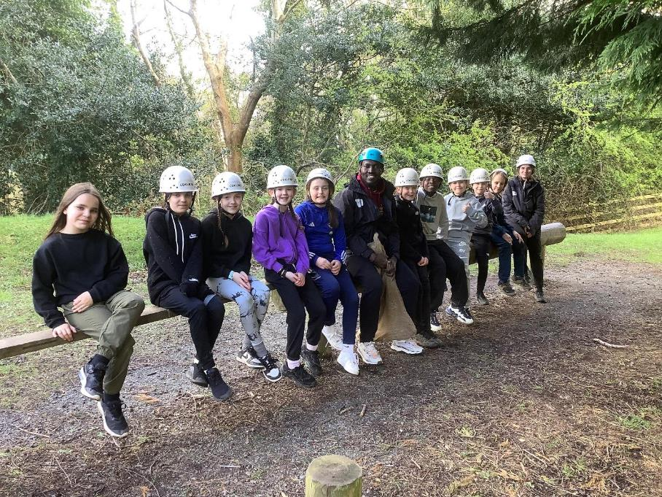

Slide 43
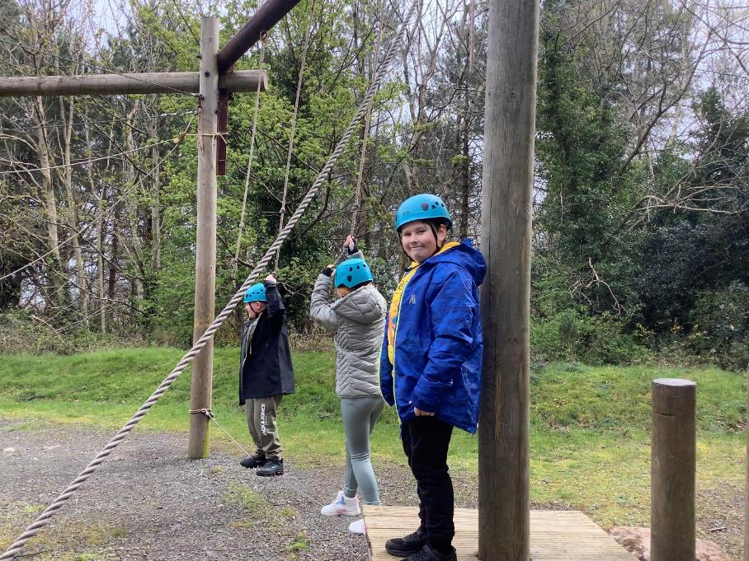

Slide 44
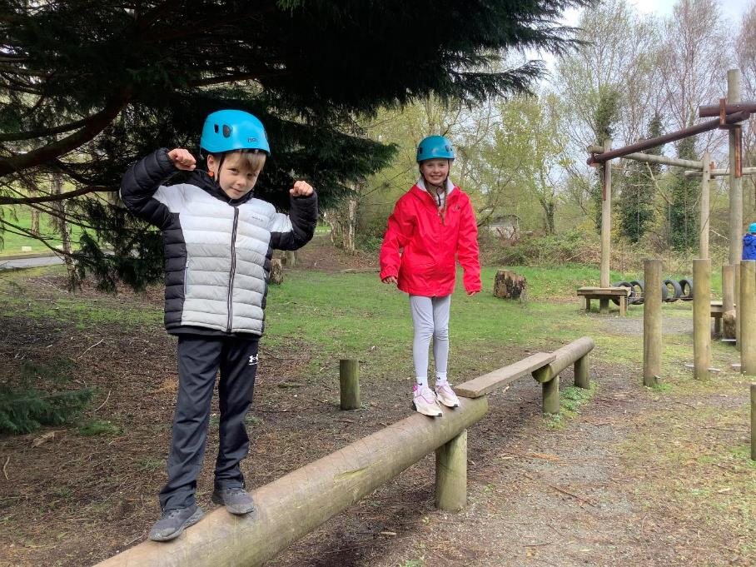

Slide 45
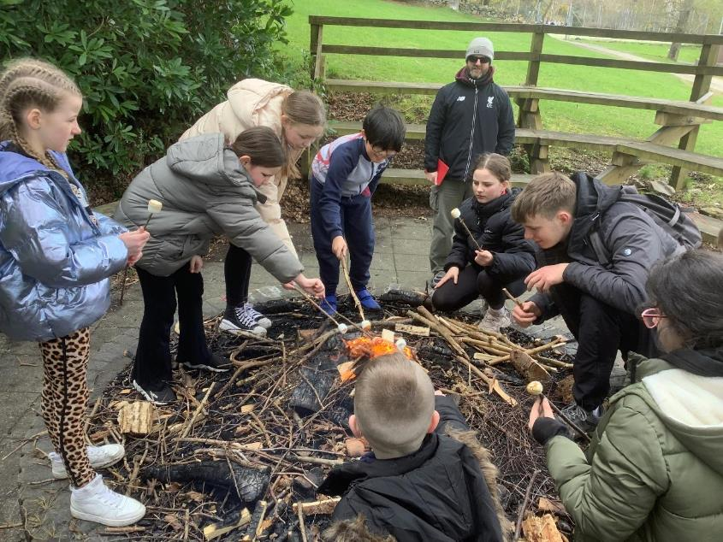
Campfire cooking!

Slide 46


Slide 47


Slide 48


Slide 49


Slide 50


Slide 51


Slide 52

Archery!

Slide 53


Slide 54


Slide 55


Slide 56


Slide 57


Slide 58


Slide 59


Slide 60


Slide 61

Zipline!

Slide 62


Slide 63


Slide 64


Slide 65

Time to eat!

Slide 66


Slide 67


Slide 68


Slide 69


Slide 70


Slide 71

Free time and evening walks!

Slide 72


Slide 73


Slide 74


Slide 75


Slide 76


Slide 77


Slide 78


Slide 79

Talent show contestants!

Slide 80



Slide 81


Slide 82



Slide 83


Slide 84


Slide 85



Slide 86


Slide 87


Slide 88



Slide 89


Slide 90


Slide 91


Slide 92

The frog thing! Design

Slide 93


Slide 94


Slide 95


Slide 96


Slide 97


Slide 98

The frog thing!
Heats back at school

Slide 99


Slide 100


Slide 101


Slide 102


Slide 103


Slide 104


Slide 105


Slide 106


Slide 107


Slide 108


Slide 109

The frog thing! Finalists!

Slide 110


Slide 111


Slide 112

The frog thing! Podium!

Slide 113

The frog thing! Champion 2024!

Slide 114

Dessert!

Slide 115



Slide 116



Slide 117



Slide 118


Slide 119

Greenhill challenges!

Slide 120


Slide 121


Slide 122



Slide 123


Slide 124


Slide 125

Time to go home!

Slide 126

Our Greenhill superstars 2024!

