Slide 1


Slide 2
Imagine the night sky being filled with different coloured lights, like a dancing rainbow.
These natural light shows are auroras. They are spectacular to view from the ground and even in space.
They fascinate people and the scientists who study energy and particles from the sun.
Let’s find out more.

Slide 3
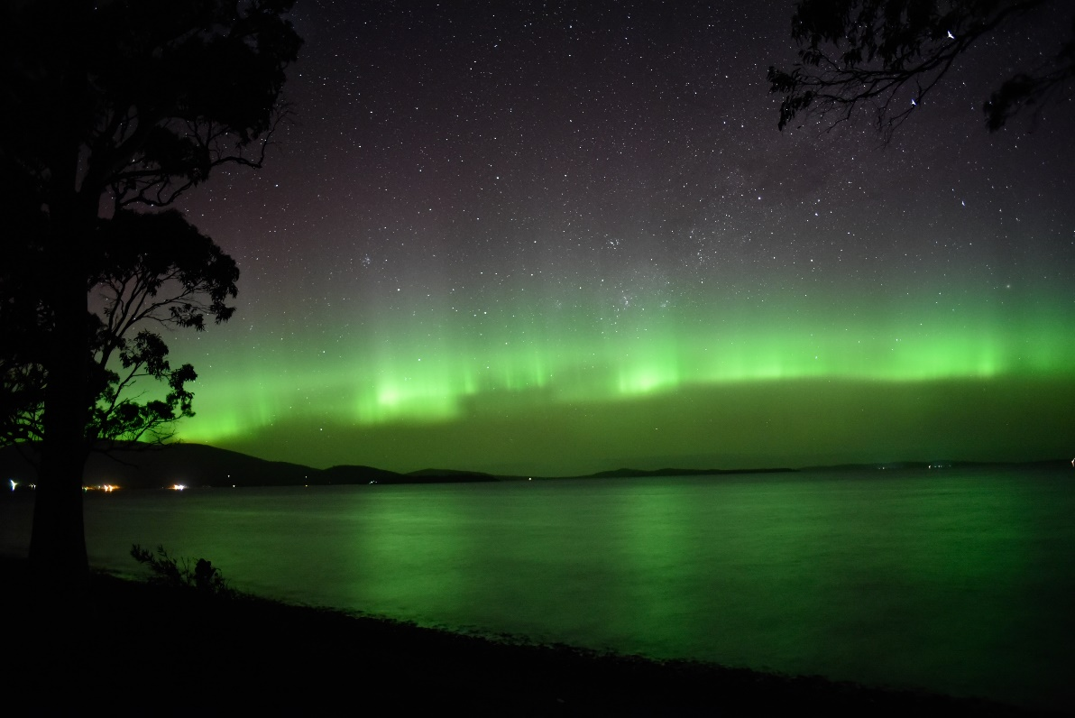
What are they?
Otherwise known as the Aurora Australis, the Southern Lights are bright, dancing streams of purple, green, red and yellow in the night sky. The Southern Lights can be seen in Antarctica.
“Ninepin Aurora Curtains.jpg” by [will standring] is licensed under CC BY 2.0

Slide 4
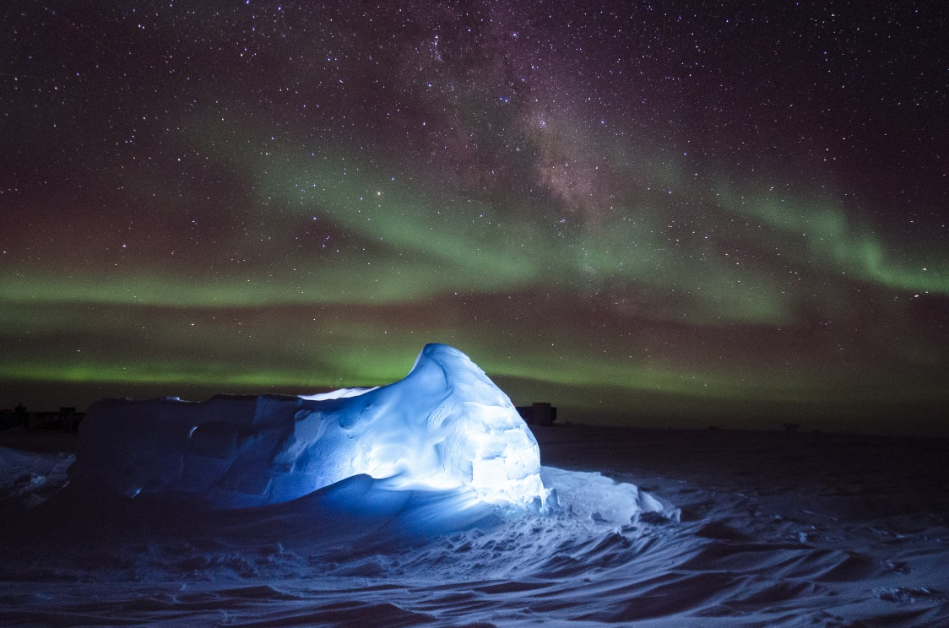
When can they be seen ?
The Southern Lights are best seen between autumn and winter.
“Space” by [IIP Photo Archive] is licensed under CC BY 2.0

Slide 5
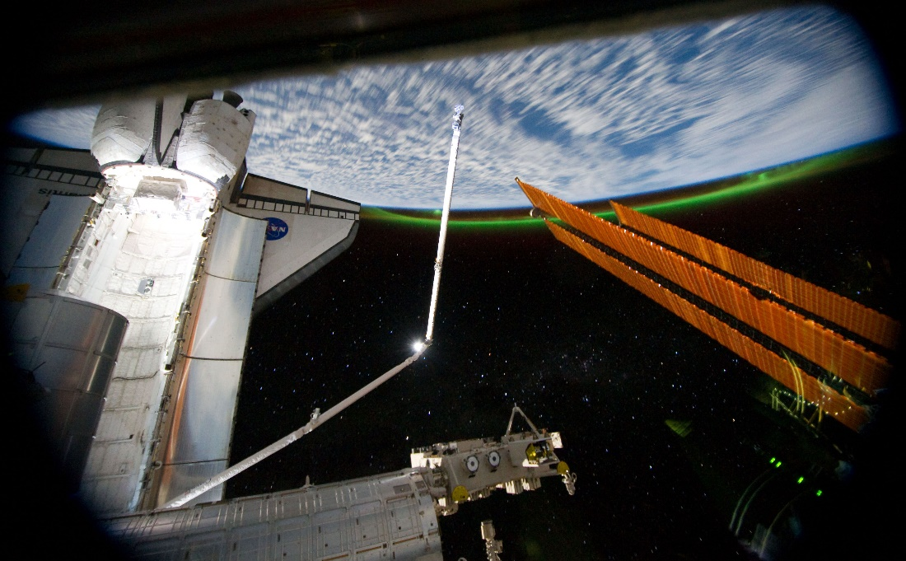
Why?
The Southern Lights are caused by particles from the sun, called solar flares or solar wind. They collide with the gas atoms in the Earth’s atmosphere. This causes the gases to form coloured light.
“Southern Lights Captured from Space” by [NASA Goddard Space Flight Center] is licensed under CC BY 2.0

