Slide 1
plurals
WALT: adding s to make singular words plural.

Slide 2
Singular - MEANS one
One bun

Slide 3
Plural – MEANS more than one
Two buns
We add s to the word bun because there is more than one.

Slide 4

Adding s to make a word plural
One apple
Two apples

Slide 5

Adding s to make a word plural
One pencil
Seven pencils

Slide 6
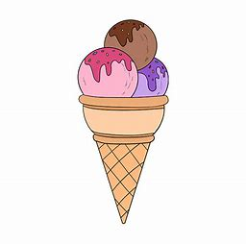
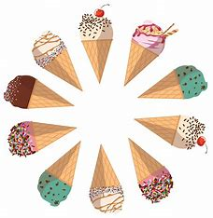
Adding s to make a word plural
One ice-cream
Ten ice-creams

Slide 7
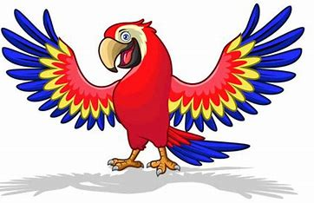
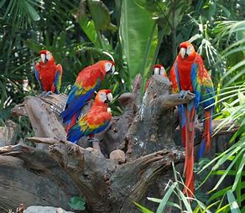
Adding s to make a word plural
One parrot
Five parrots

Slide 8
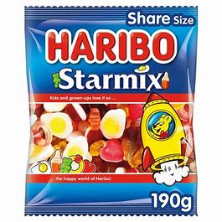
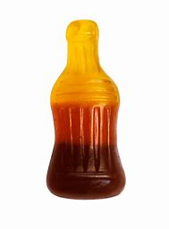
Adding s to make a word plural
One sweet
A bag of sweets

Slide 9
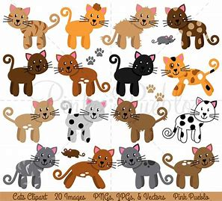
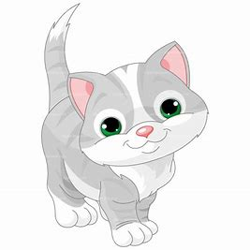
Adding s to make a word plural
A cat
Lots of cats

Slide 10
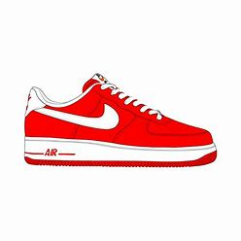
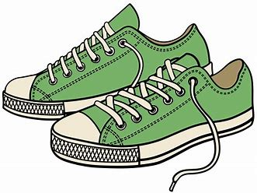
What do we know now P3?
When we are talking about one person, place or thing we are referring to the singular. For example,
One shoe
When we are talking about more than one, we add s to make the word plural.
A pair of shoes

Slide 11
Can you make these words plural P3?
One girl five ________
One dog nine ________
One hat three _______
A coin many ________
A car Lots of ______
A lion Pride of _____

Slide 12
Good luck with your task ☺

