Slide 1
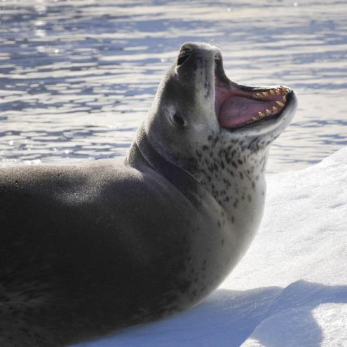
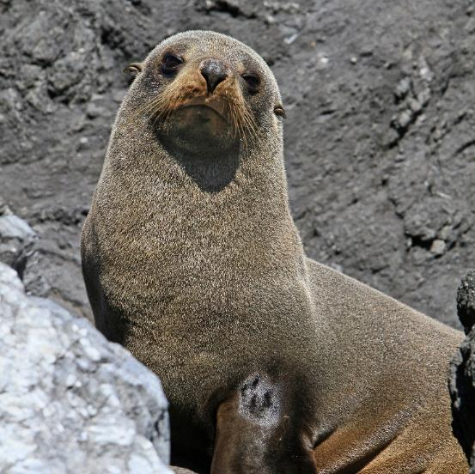

Antarctic
Seals

Slide 2
Antarctic Seals
There are six species of seal in the Antarctic.
Weddell Seal
Leopard Seal
Elephant Seal
Fur Seal
Ross Seal
Crabeater Seal

Slide 3
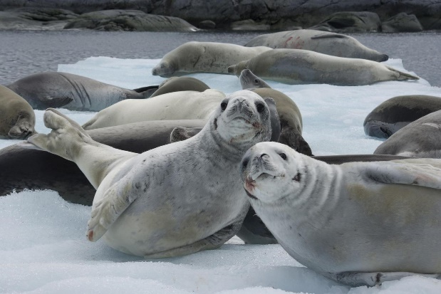
Seals
Seals are mammals. Most seals have a thick layer of blubber to help keep them warm.

Slide 4
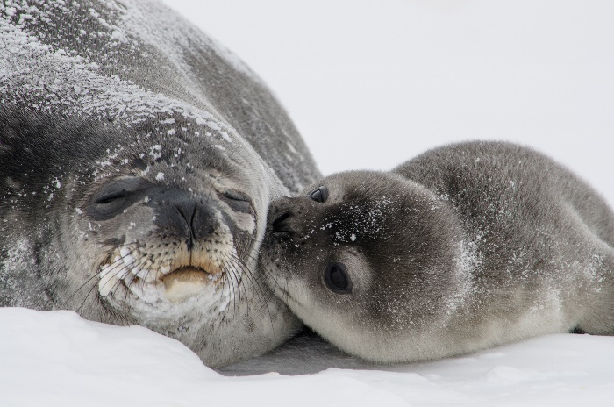
Weddell Seal
Weddell seals use their sharp front teeth to chew and scrape breathing holes in the ice.
They spend a lot of time living beneath the ice where they feed on fish.

Slide 5
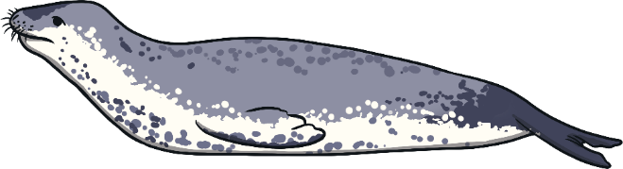
Leopard Seal
Leopard seals are named after their spotted coats which make them look a little like a leopard!
Leopard seals are fierce predators. This means they survive by eating other animals.
Leopard seals eat krill, squid, fish, birds, other seals and penguins.
Did you know? Leopard seals can dive underwater for up to 15 minutes!

Slide 6
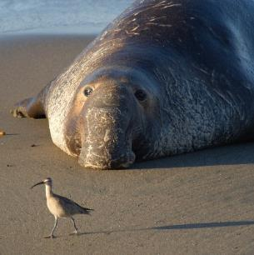
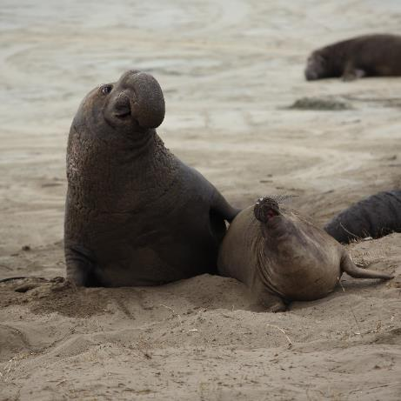
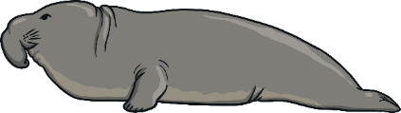
Elephant Seal
Male elephant seals are bigger than females and have a large trunk-like nose, which is where they get their name.
There are two types of elephant seals: the northern and the southern. The southern elephant seal is the type found in Antarctica.
Southern elephant seals are the largest of all the seals.
They can dive over 4900 metres and can stay underwater for more than two hours.
Did you know? Male elephant seals can weigh as much as 4000 kilograms. That’s twice as heavy as a car!

Slide 7
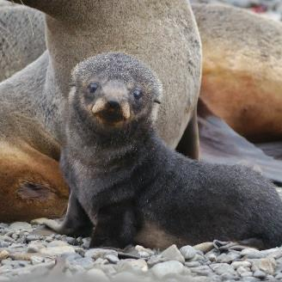
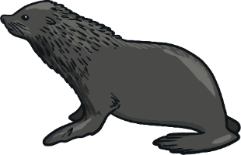
Fur Seal
Fur seals have excellent hearing and sight. They can also turn their back flippers forwards, meaning they can walk (in a clumsy way) on land.
They have thick fur and a thicker layer of blubber (fat) under their skin. This helps to keep them warm in Antarctic temperatures.
Mother fur seals can recognise their babies by the unique noise they make. They can even recognise this call after four years apart!
Did you know? Male fur seals are five times bigger than females!
“Baby Fur Seal” by [Rob Oo] is licensed under CC BY 2.0

Slide 8
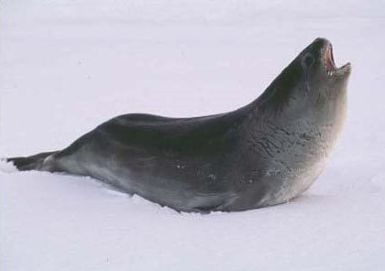
Ross Seal
Ross seals like to be left alone. They are solitary creatures who live in very dense icy areas which are hard to reach.
They have very large eyes which scientists think helps them search for their prey.

Slide 9
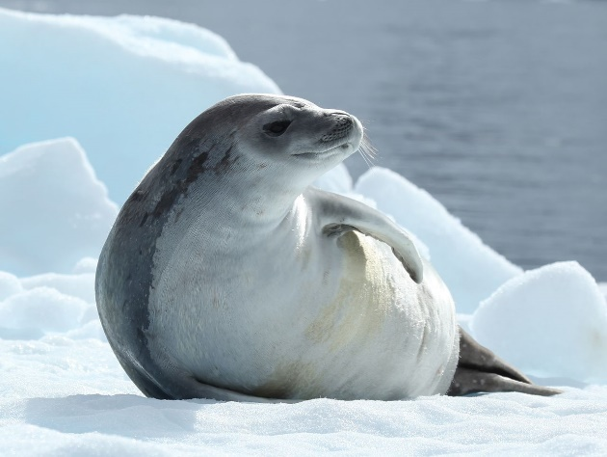
Crabeater Seal
Crabeater seals don’t actually eat crabs! They have special teeth which act like a sieve and this helps them to catch krill.

