Slide 1
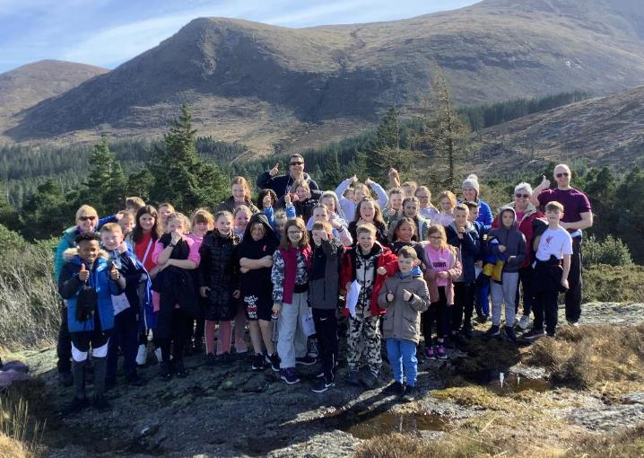
P6 visit to Greenhill YMCA
27th – 30th March 2023

Slide 2
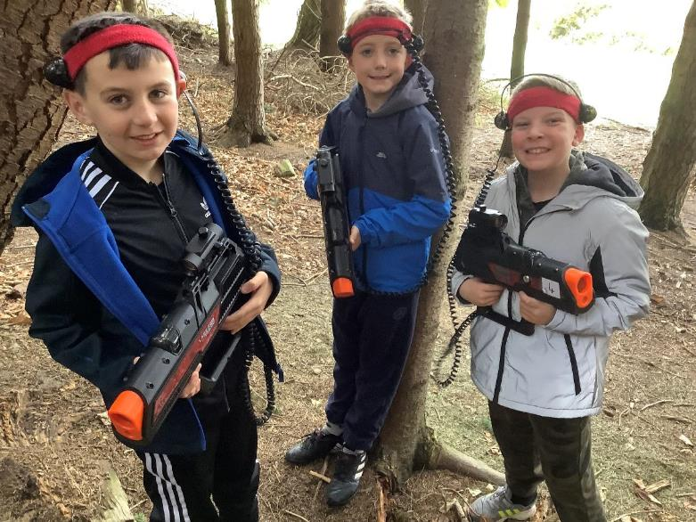
Laser tag!

Slide 3
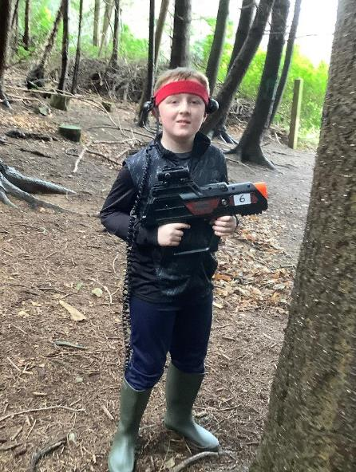
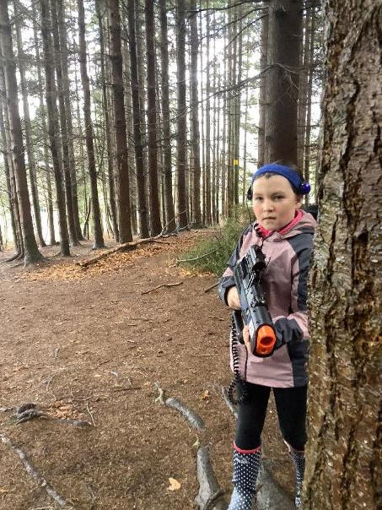

Slide 4
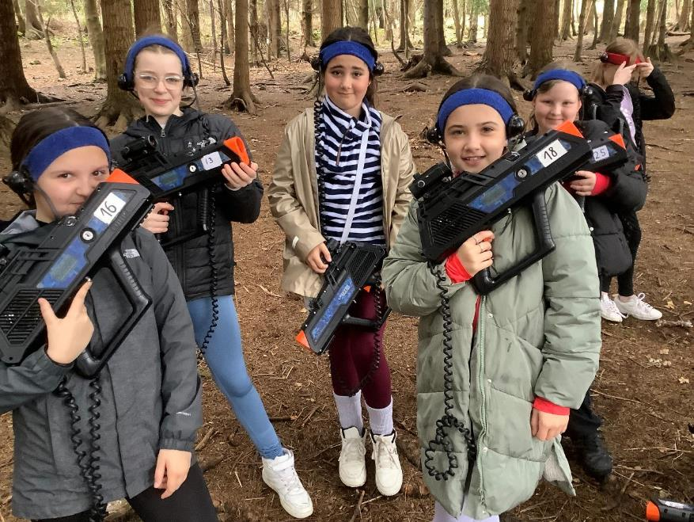

Slide 5
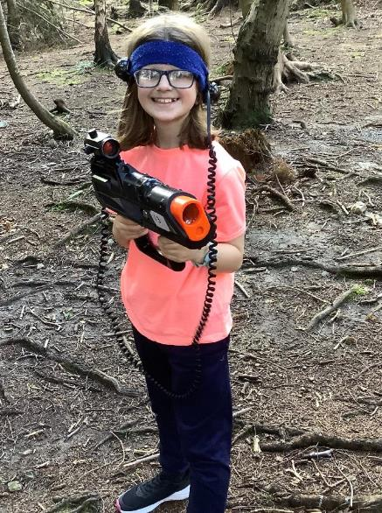
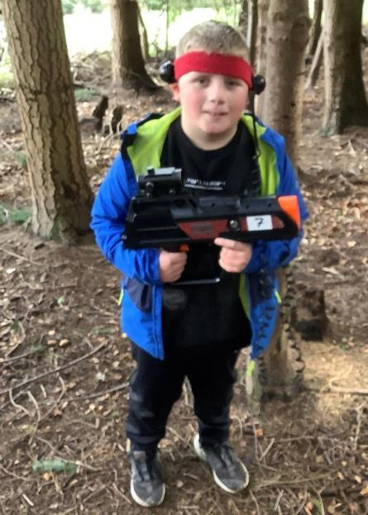

Slide 6
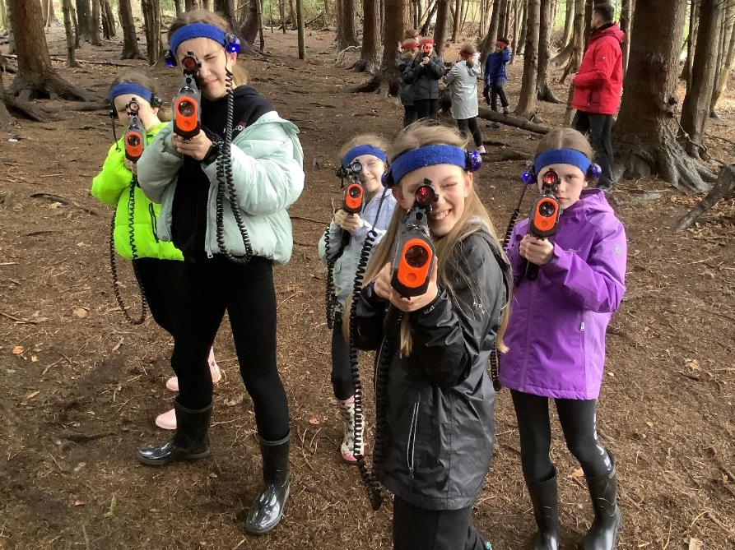

Slide 7
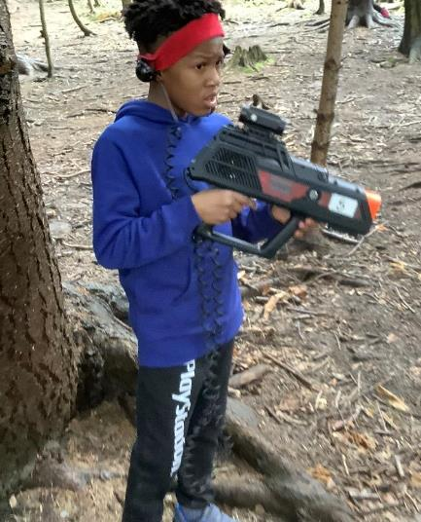
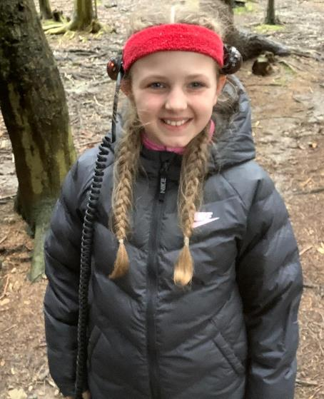

Slide 8
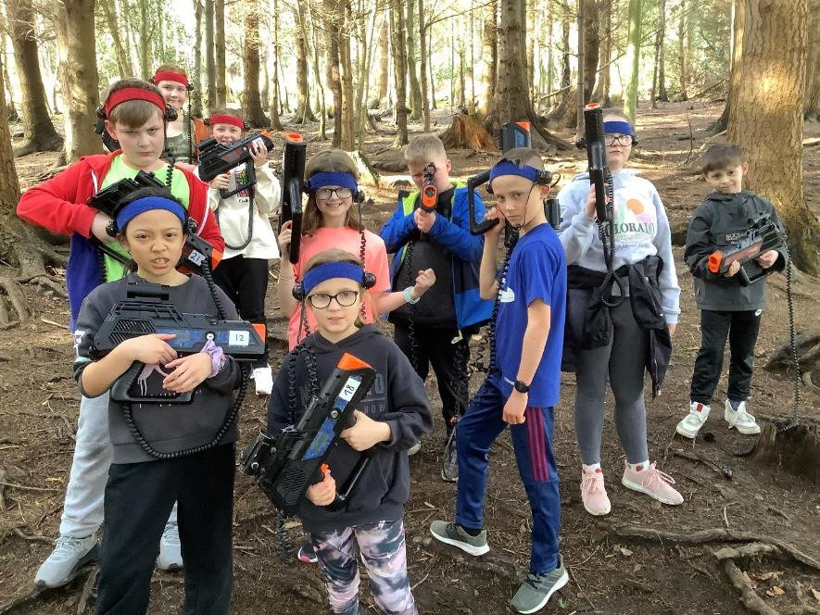

Slide 9
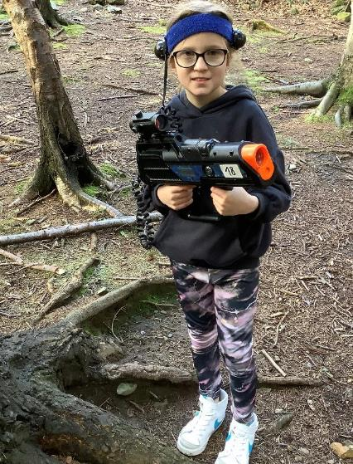
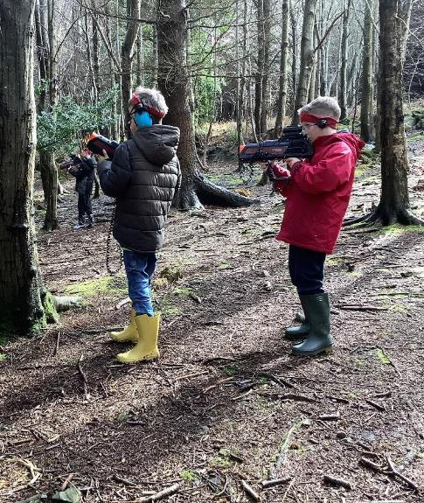

Slide 10
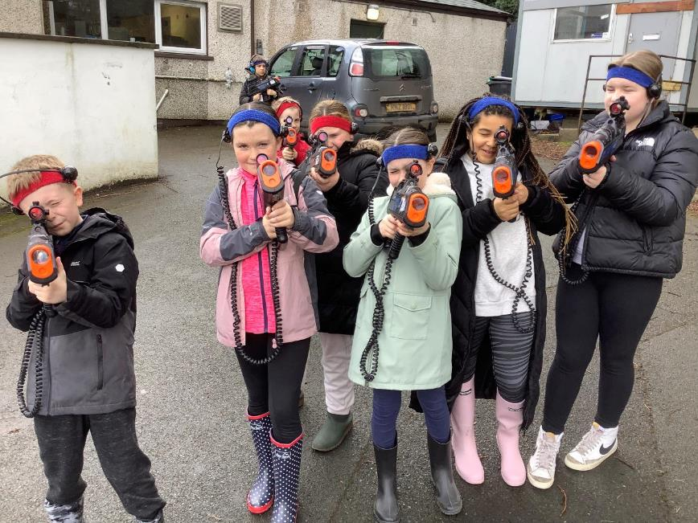

Slide 11
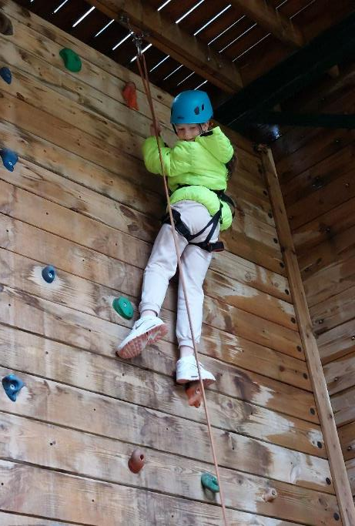
Climbing wall!

Slide 12
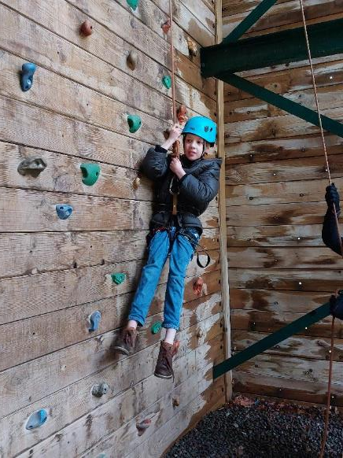
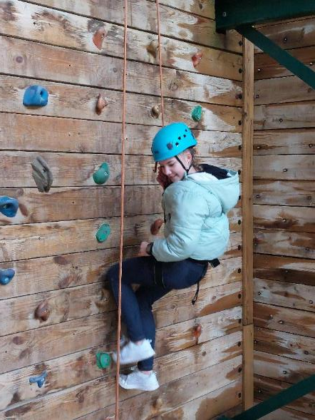

Slide 13
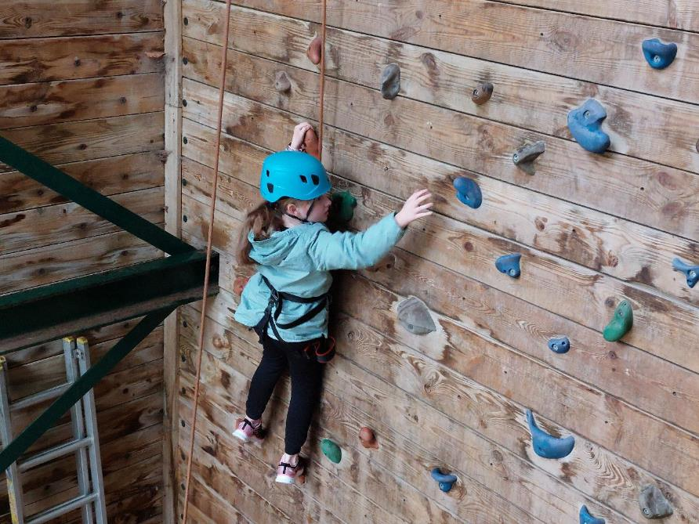

Slide 14
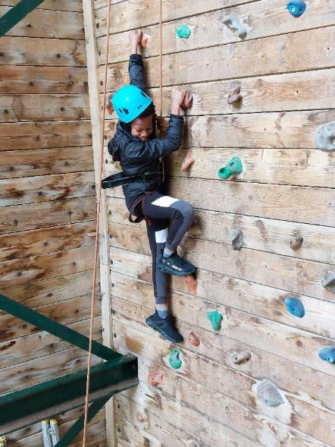
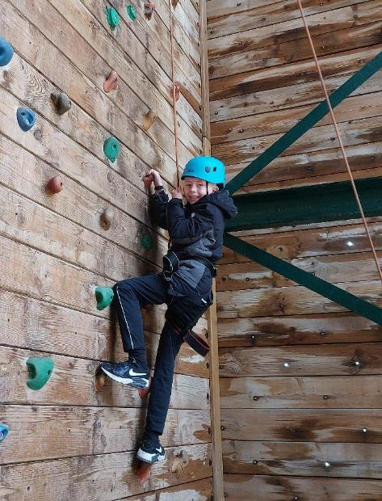

Slide 15
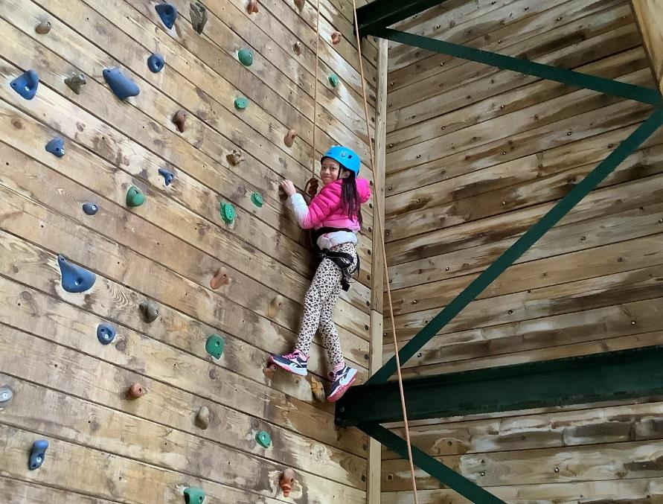

Slide 16
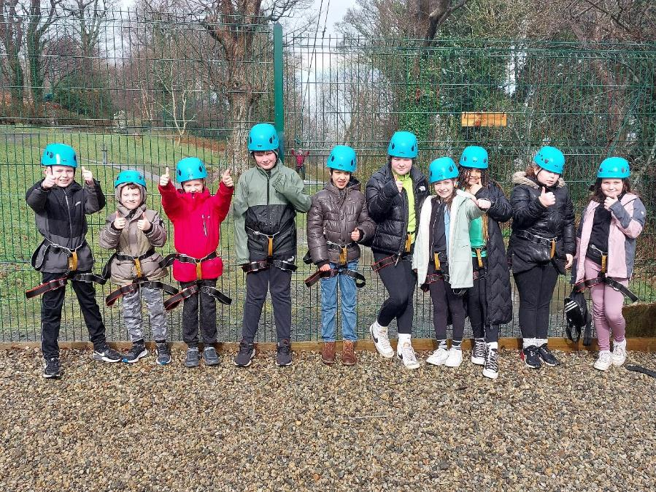

Slide 17
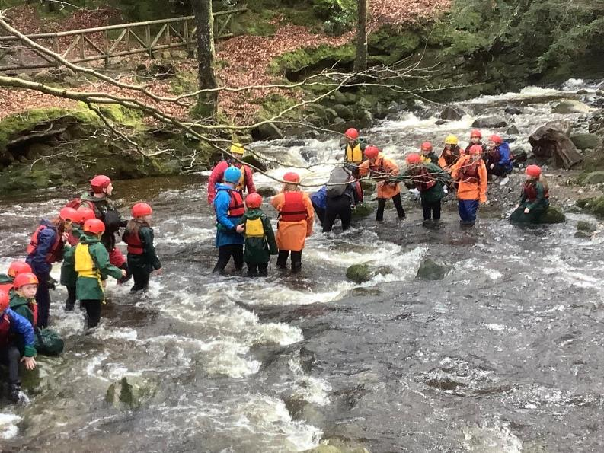
Bouldering!

Slide 18
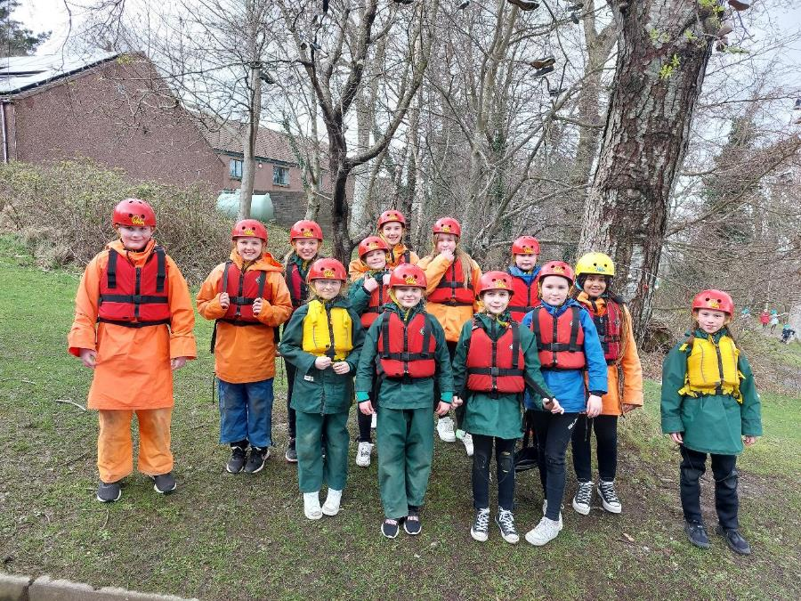

Slide 19
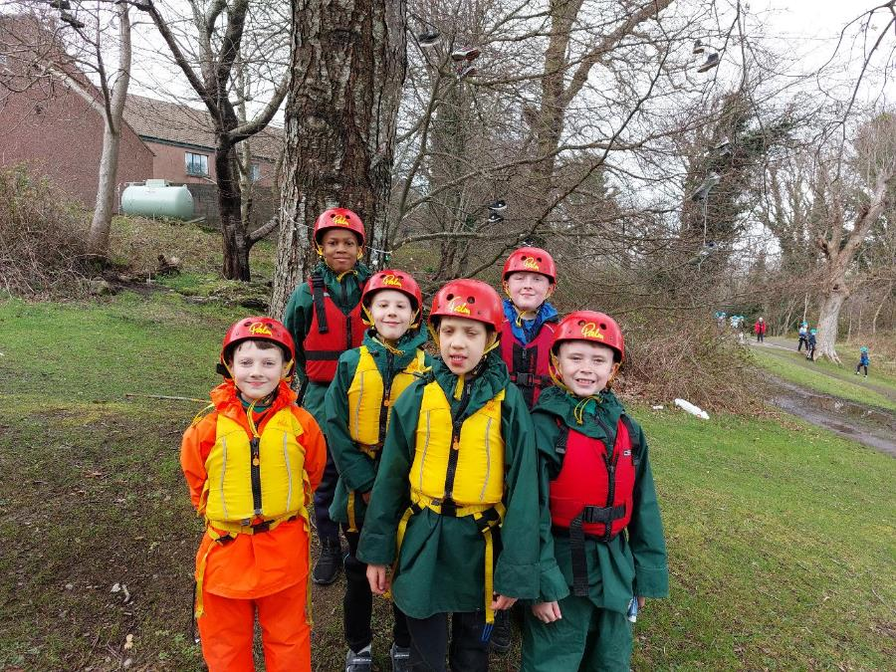

Slide 20
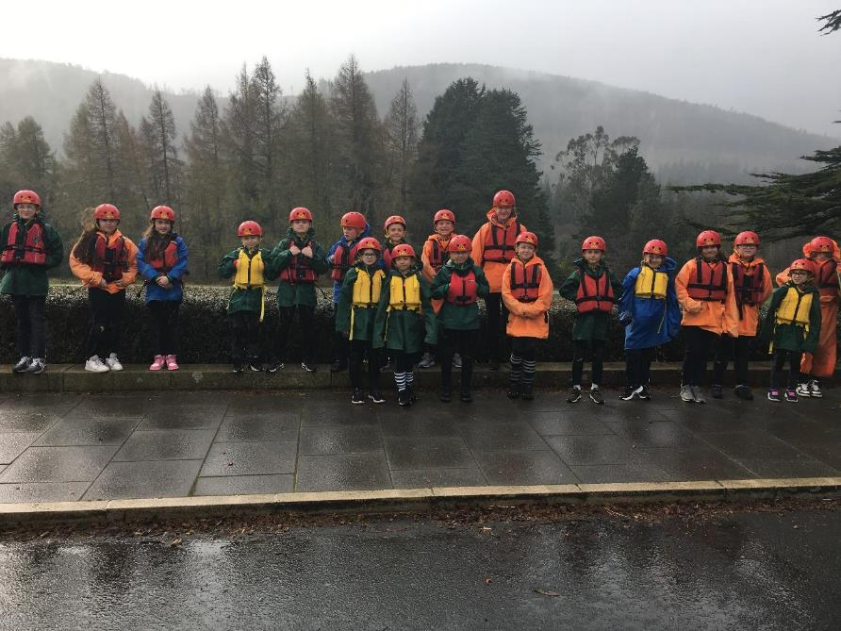

Slide 21
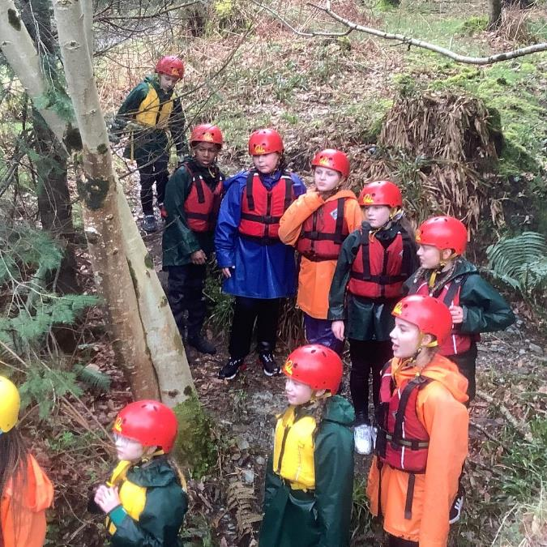

Slide 22
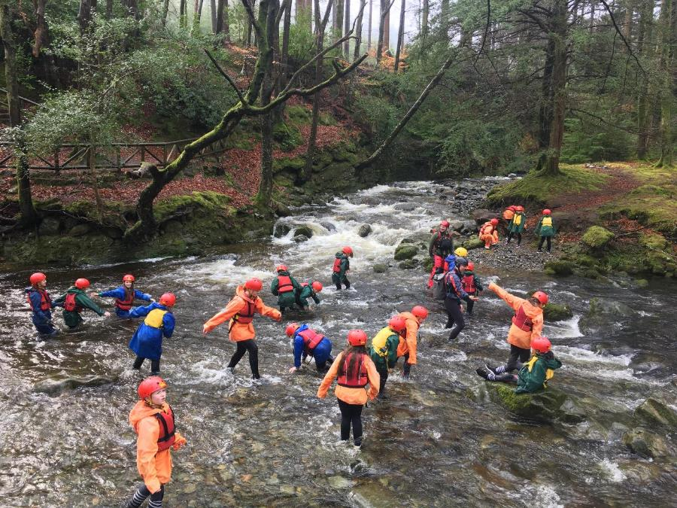

Slide 23
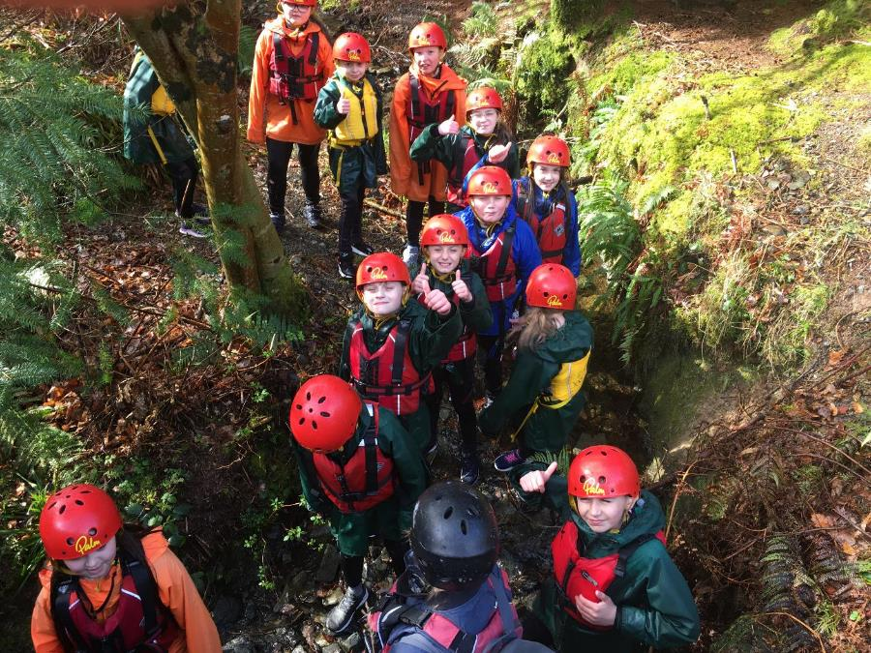

Slide 24
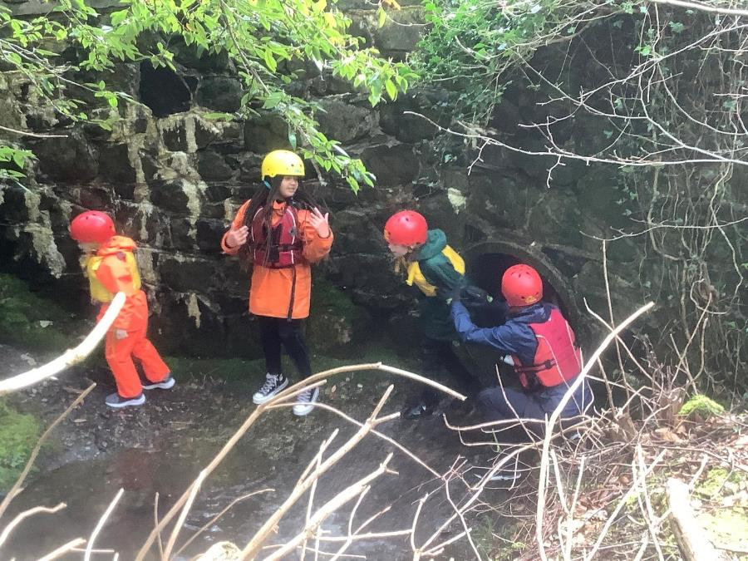

Slide 25
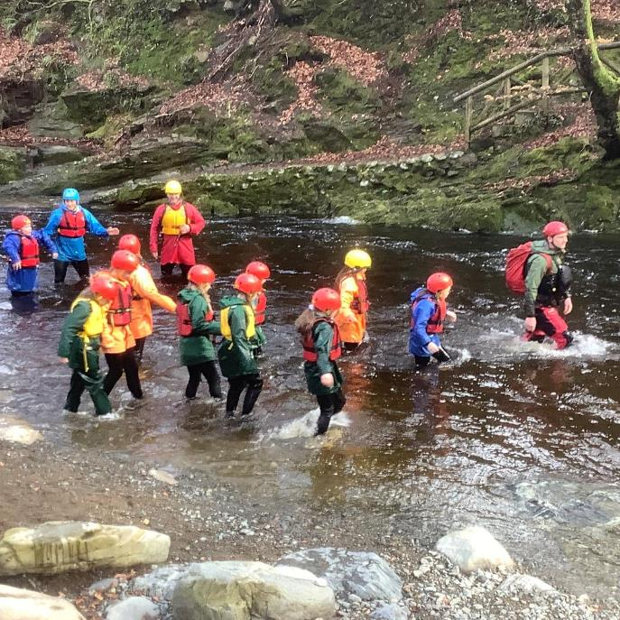

Slide 26
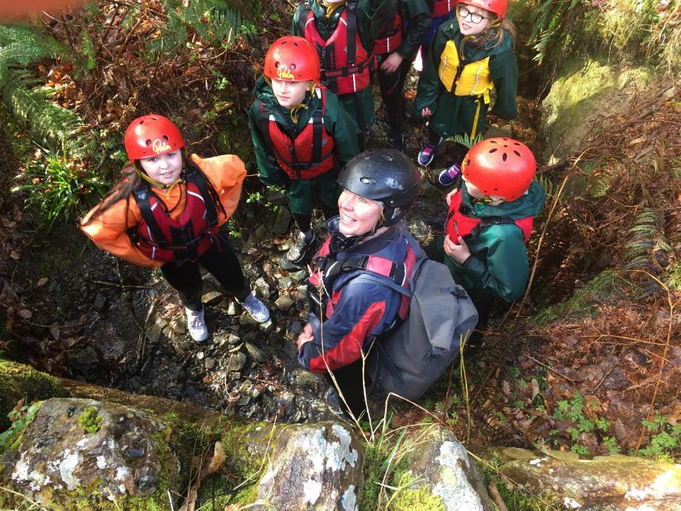

Slide 27
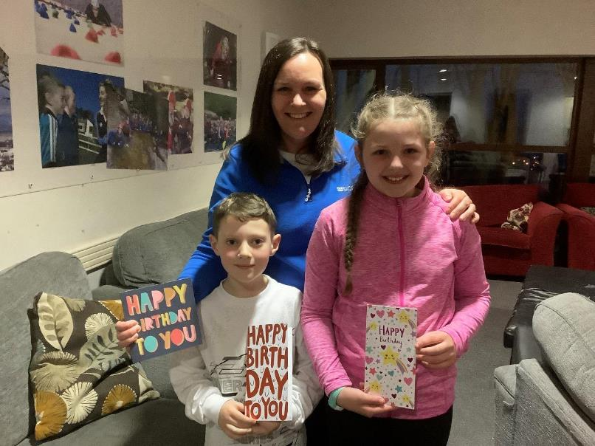
Birthday celebrations!

Slide 28
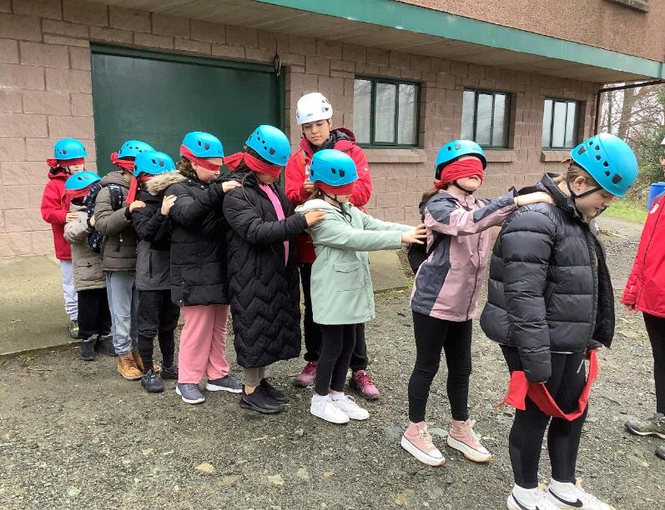
Blind trail!

Slide 29
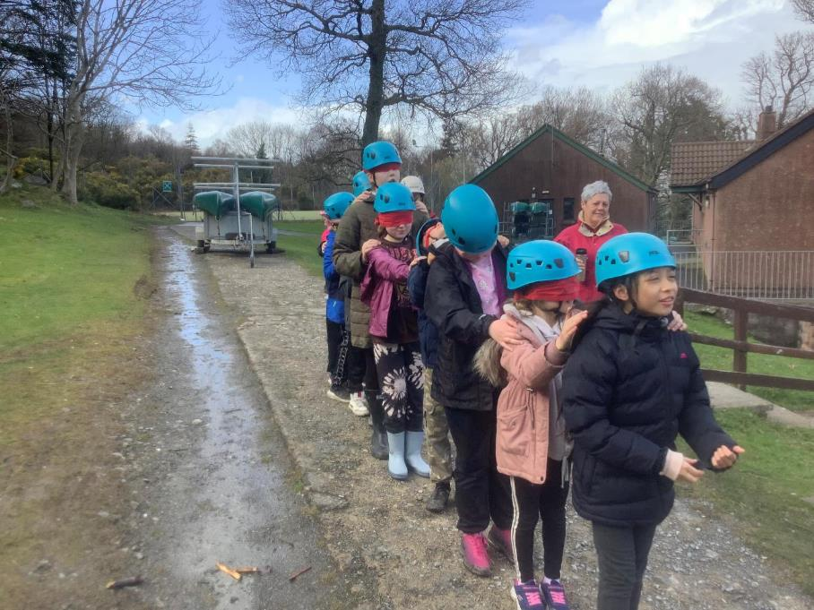

Slide 30
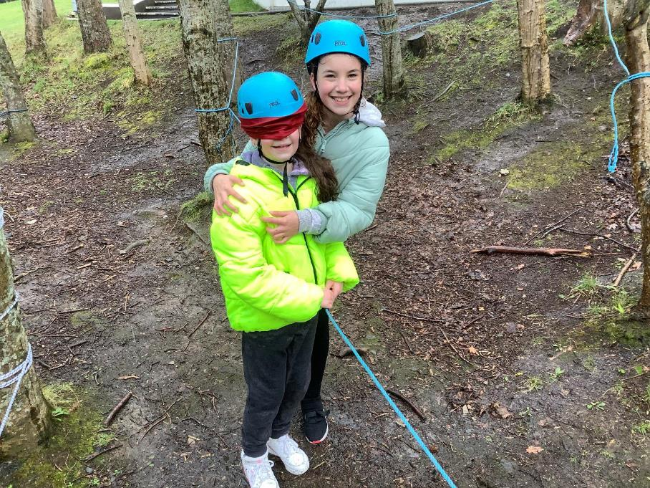

Slide 31
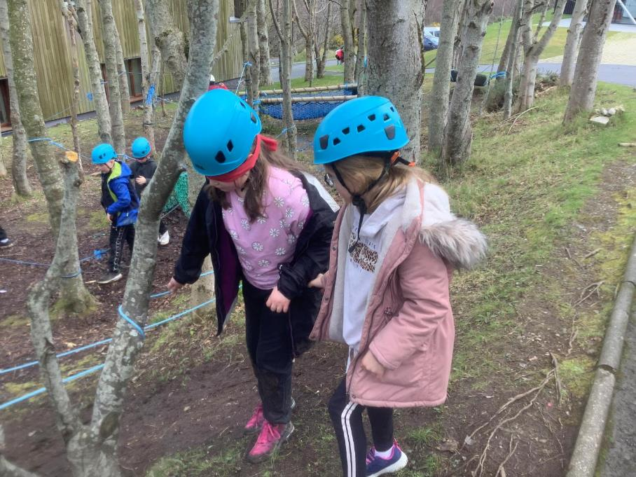

Slide 32
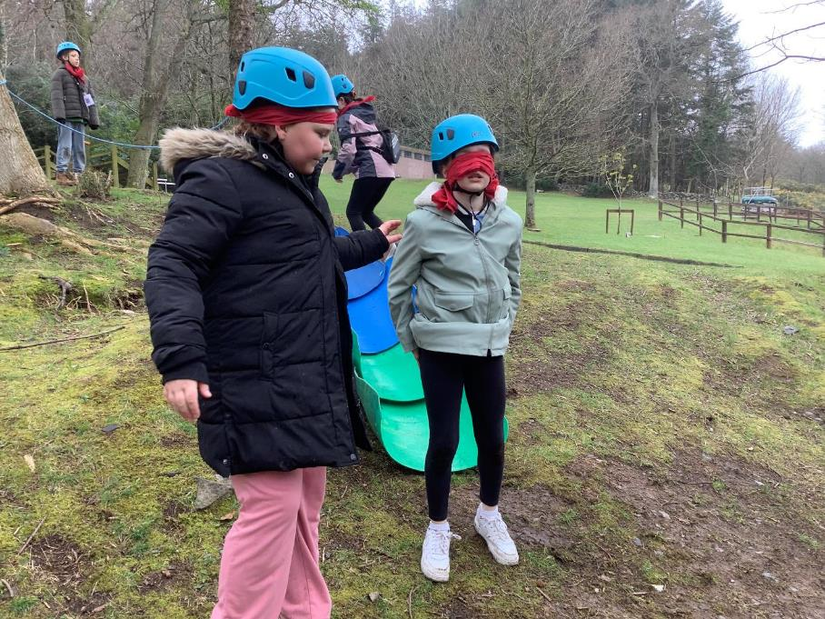

Slide 33
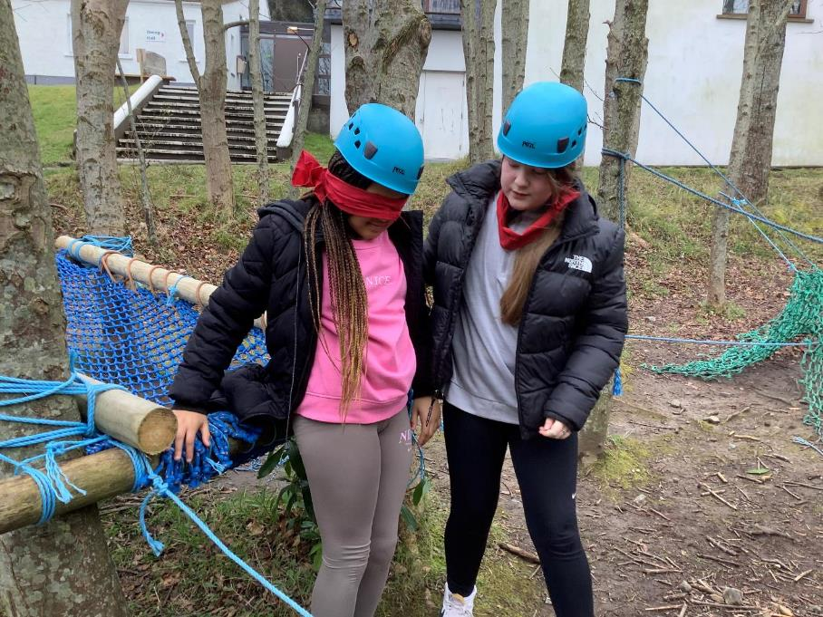

Slide 34
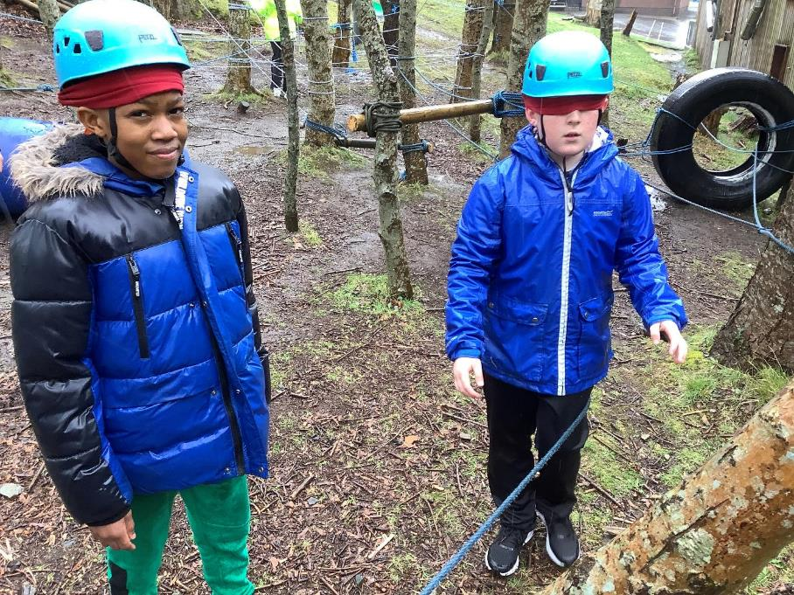

Slide 35
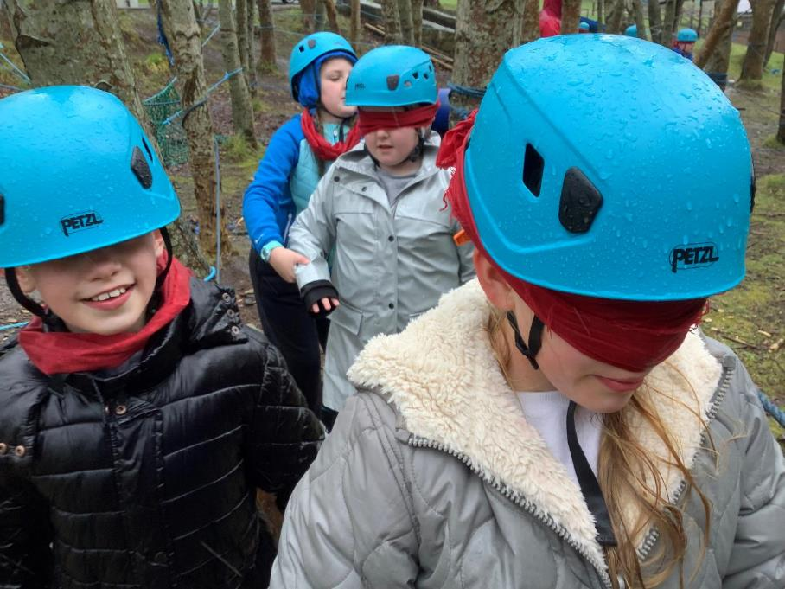

Slide 36
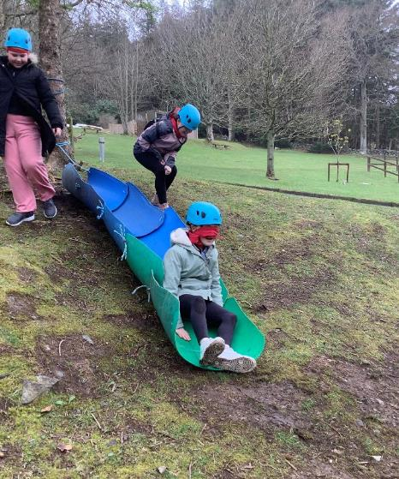
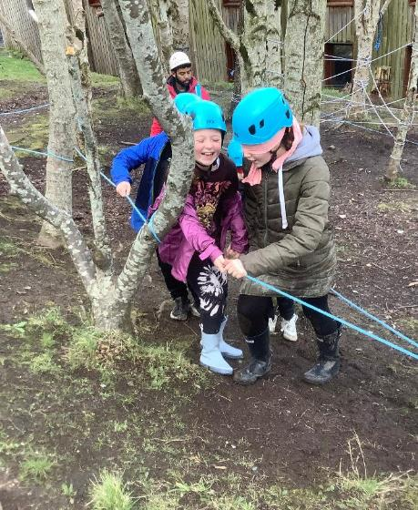

Slide 37
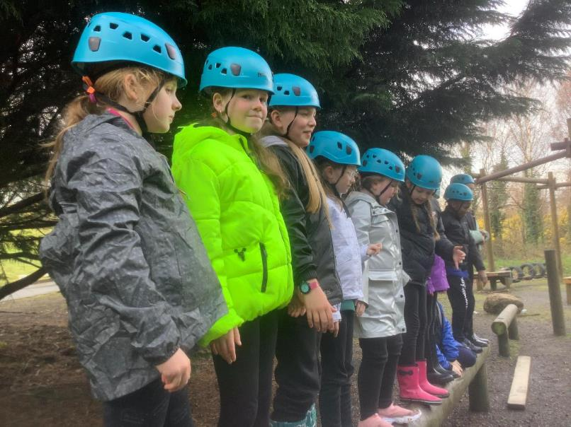
Team Ropes Challenge!

Slide 38
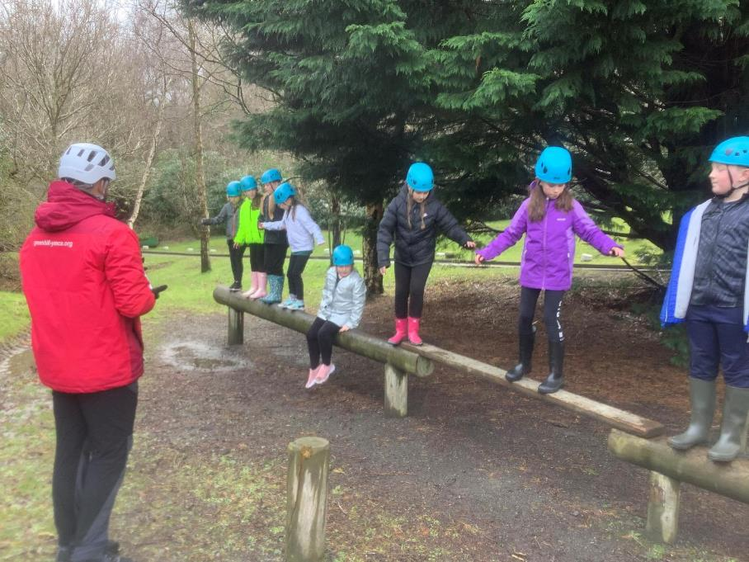

Slide 39
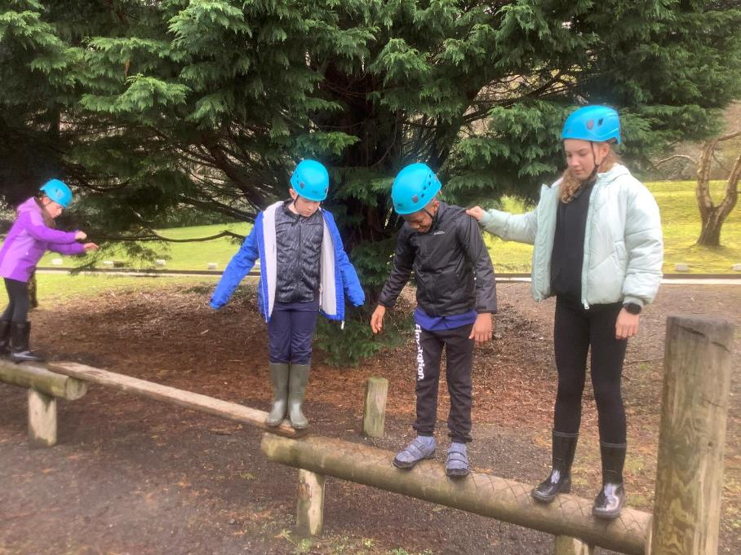

Slide 40
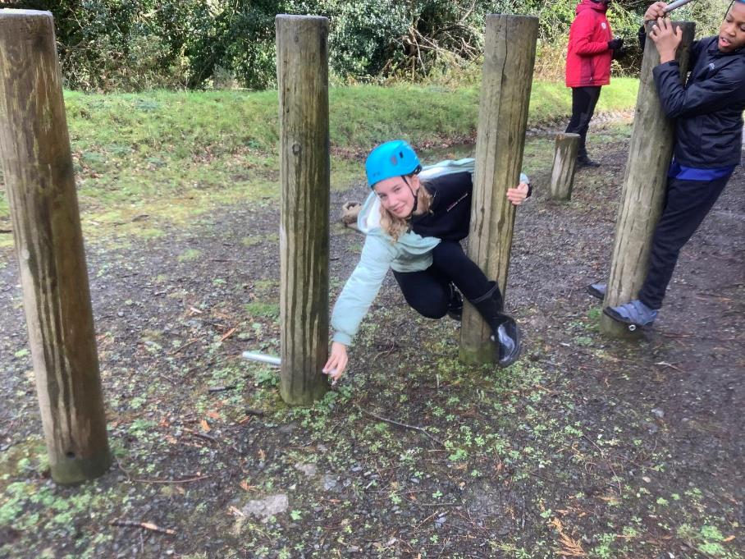

Slide 41
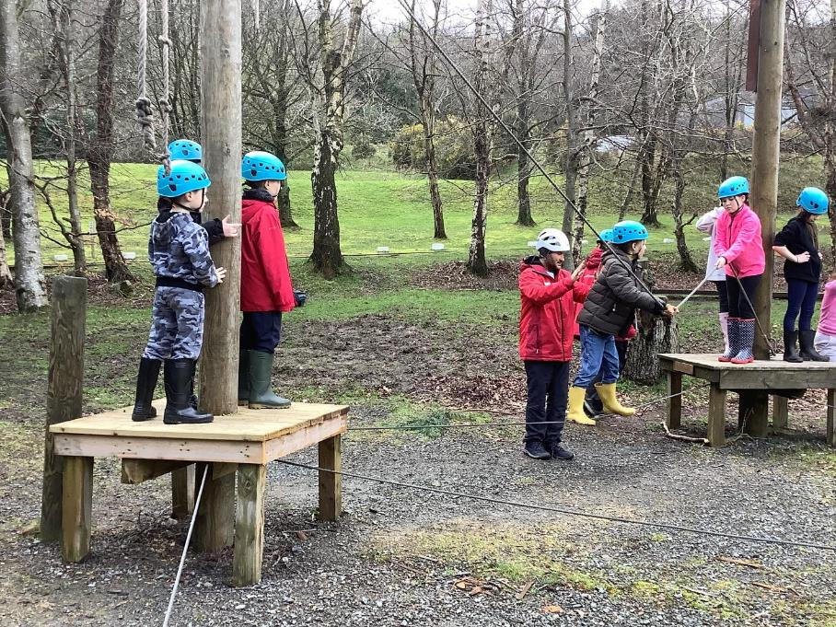

Slide 42
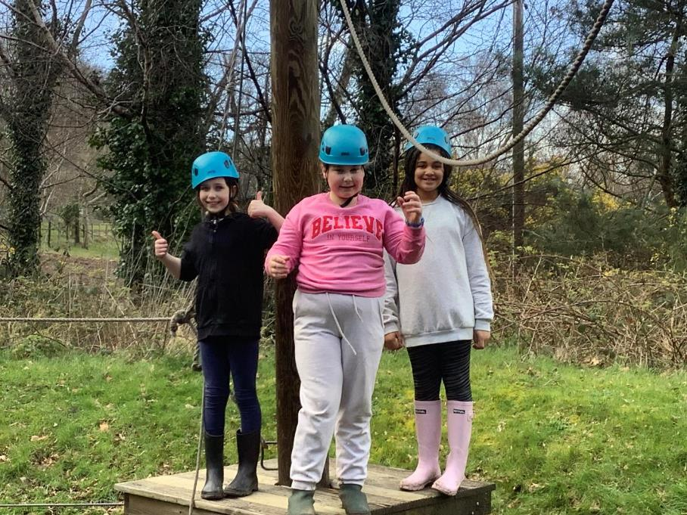

Slide 43
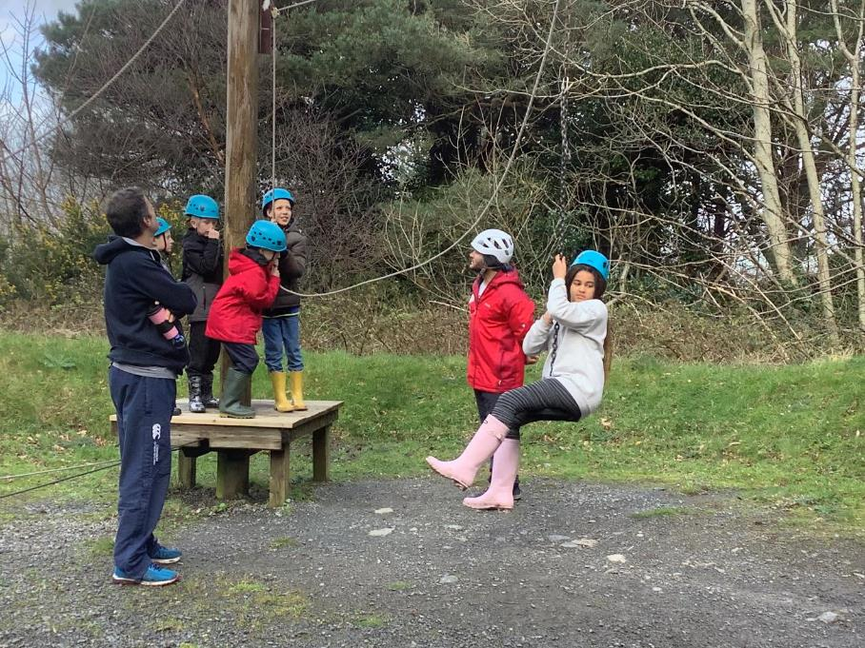

Slide 44


Slide 45

Mountain walk!

Slide 46


Slide 47


Slide 48


Slide 49


Slide 50


Slide 51


Slide 52


Slide 53


Slide 54


Slide 55


Slide 56


Slide 57


Slide 58


Slide 59


Slide 60


Slide 61


Slide 62


Slide 63


Slide 64


Slide 65


Slide 66

Archery!

Slide 67


Slide 68


Slide 69


Slide 70


Slide 71


Slide 72


Slide 73


Slide 74


Slide 75


Slide 76


Slide 77

Zipline!

Slide 78


Slide 79


Slide 80



Slide 81


Slide 82



Slide 83


Slide 84


Slide 85


Slide 86

Time to eat!

Slide 87


Slide 88


Slide 89


Slide 90


Slide 91

Free time and evening walks!

Slide 92


Slide 93


Slide 94


Slide 95


Slide 96


Slide 97


Slide 98


Slide 99


Slide 100


Slide 101


Slide 102


Slide 103


Slide 104


Slide 105


Slide 106


Slide 107


Slide 108


Slide 109


Slide 110

Talent show contestants!

Slide 111



Slide 112


Slide 113



Slide 114


Slide 115

The frog thing! Design

Slide 116


Slide 117


Slide 118


Slide 119

The frog thing! Heats

Slide 120


Slide 121


Slide 122


Slide 123


Slide 124


Slide 125


Slide 126


Slide 127


Slide 128


Slide 129


Slide 130


Slide 131


Slide 132


Slide 133


Slide 134

The frog thing! Finalists!

Slide 135


Slide 136


Slide 137

The frog thing! Podium!

Slide 138

The frog thing! Champion 2023!

Slide 139

Our last day!

Slide 140


Slide 141


Slide 142


Slide 143


Slide 144

Greenhill challenges!

Slide 145


Slide 146


Slide 147



Slide 148


Slide 149


Slide 150


Slide 151


Slide 152


Slide 153


