Slide 1



Life cycle of a penguin

Slide 2
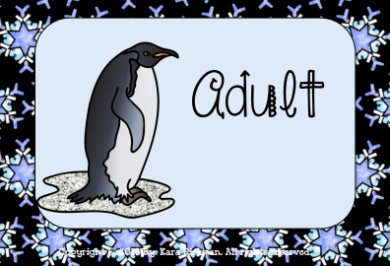
Adult
The female penguin lays an egg.

Slide 3
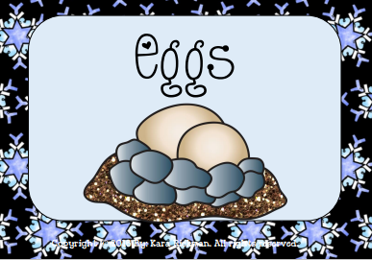
Egg
The female penguin carefully moves the egg to the father’s feet.

Slide 4

Incubation
The male penguin keeps the egg warm under his feet.

Slide 5
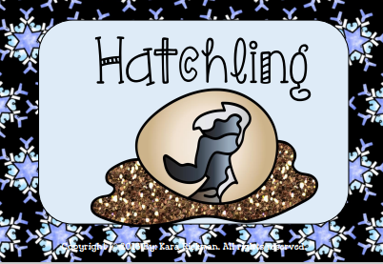
Hatchling
The egg hatches, the male penguin keeps it safe.

Slide 6
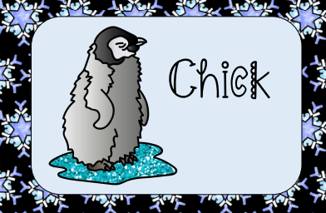
Chick
The chick keeps warm on the male penguin’s feet. When the chick grows up and gets waterproof feathers it can go to sea.

Slide 7
The life cycle of a penguin.

