Slide 2
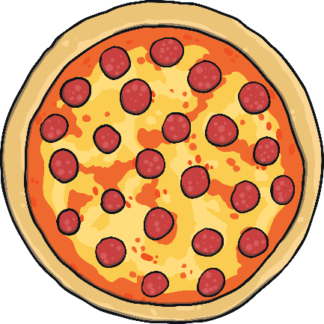
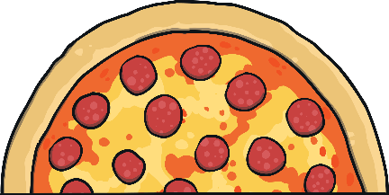
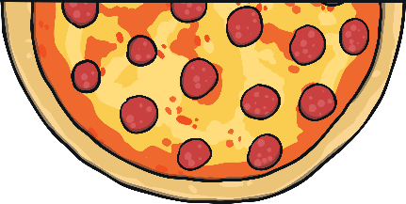
What Is a Half?
This is the whole pizza.
The pizza has been cut into two halves.
Each piece is the same size.
This is one half of the pizza.

Slide 3
What Is a Quarter?
This is two halves of a pizza.
The two halves have been cut in half. The pizza
has been cut into four quarters.
Each piece is the same size.
A quarter is one of four equal parts.
This is one quarter of the pizza.

Slide 4

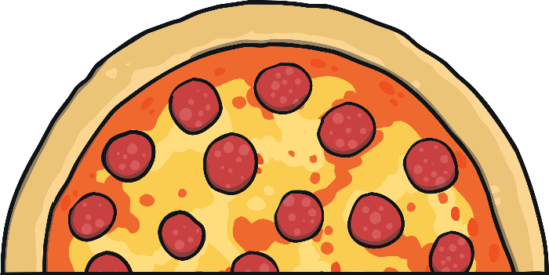
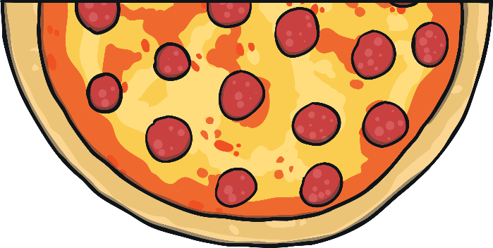
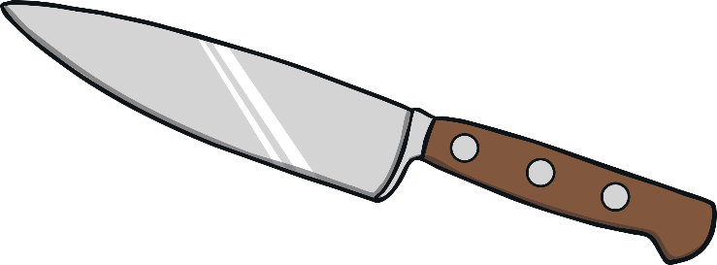
Making A Quarter
Can you click on the knife again to cut the two halves into
four quarters?
This is a whole pizza.
Can you click on the knife to cut it into two halves?
You have made two halves. Each piece is a half.
You have made four quarters. Each piece is a quarter.

Slide 5

Finding a Quarter
A quarter of this cake is missing. Can you find the quarter?
The four quarters make a whole.

Slide 6
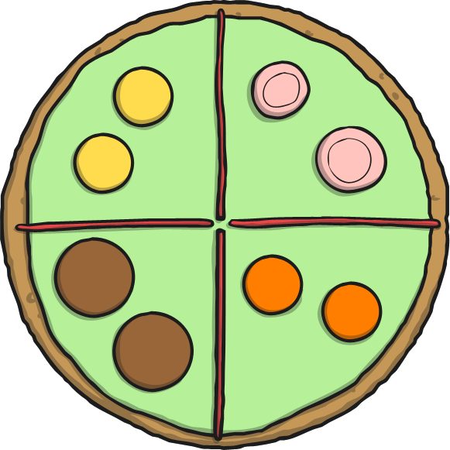
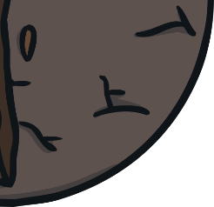
Finding a Quarter
A quarter of this biscuit is missing. Can you find the quarter?
Each quarter is the same size.

Slide 7
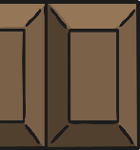
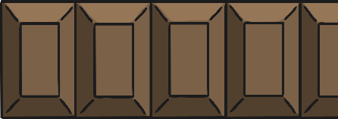
Finding a Quarter
A quarter of this chocolate is missing. Can you find the quarter?
The four quarters of the chocolate are equal.

Slide 8


Finding a Quarter
A quarter of this pizza is missing. Can you find the quarter?
How many people can share the pizza when it is in quarters?

Slide 9
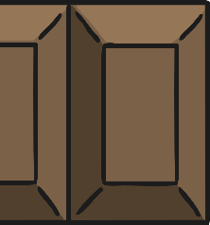
Finding a Quarter
A quarter of this pie is missing. Can you find the quarter?
Together, this makes the whole pie.

