Slide 1
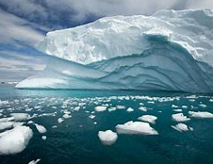
Antarctica

Slide 2
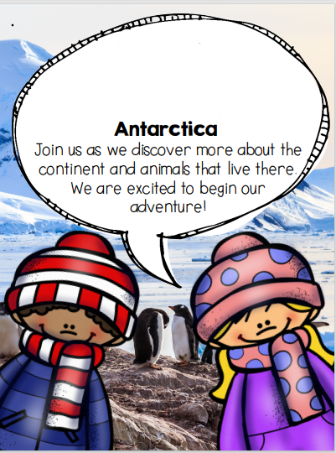
Antarctica
Antarctica means ‘opposite to the North’.
Most of Antarctica is covered in ice.

Slide 3
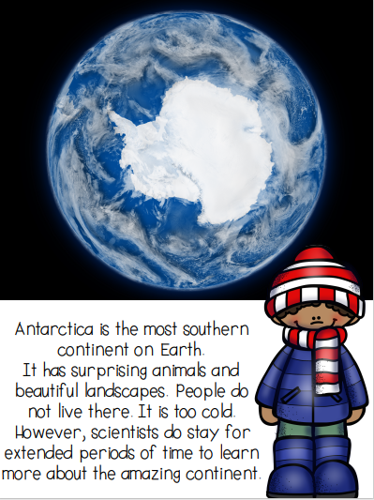
Antarctica
The South Pole is found in Antarctica.
Antarctica is surrounded by the Southern Ocean, also known as the Antarctic Ocean.

Slide 4
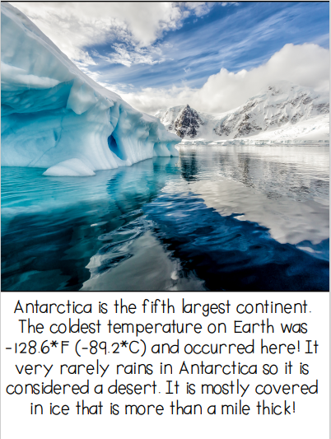
Antarctica
Around 90% of the Earth’s ice is found in Antarctica.

Slide 5
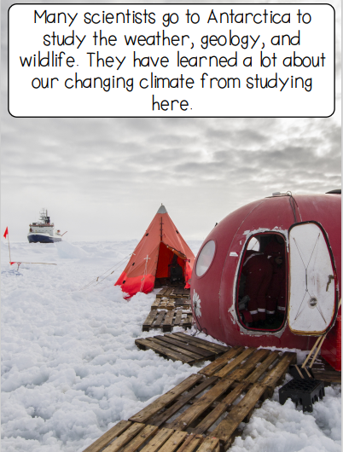
Antarctica
Antarctica is the windiest place on Earth.

Slide 6
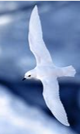
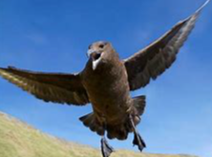
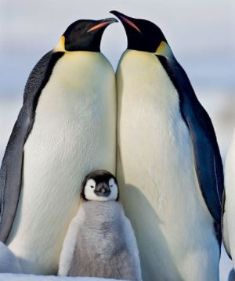
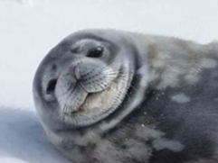
Antarctica
Many animals and plants have adapted to survive and live in this icy climate.

