Slide 1
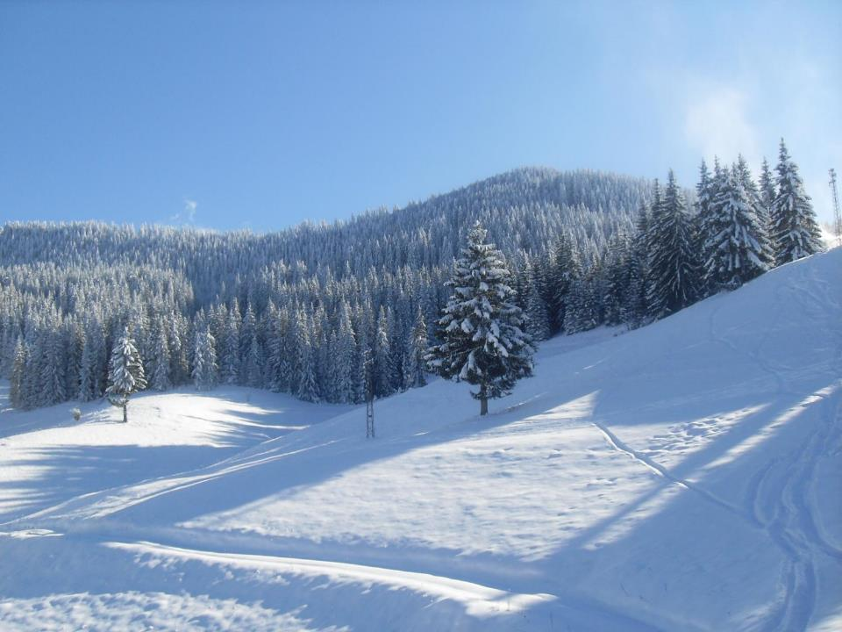
Brooklands Ski trip
Pamporovo 2023

Slide 2
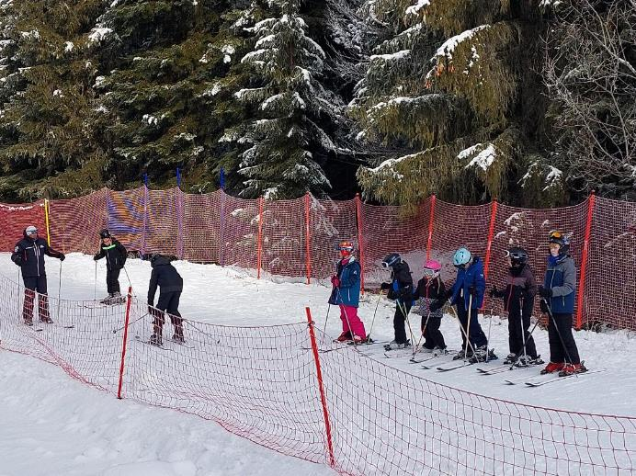
Off to
the
nursery
slopes!

Slide 3
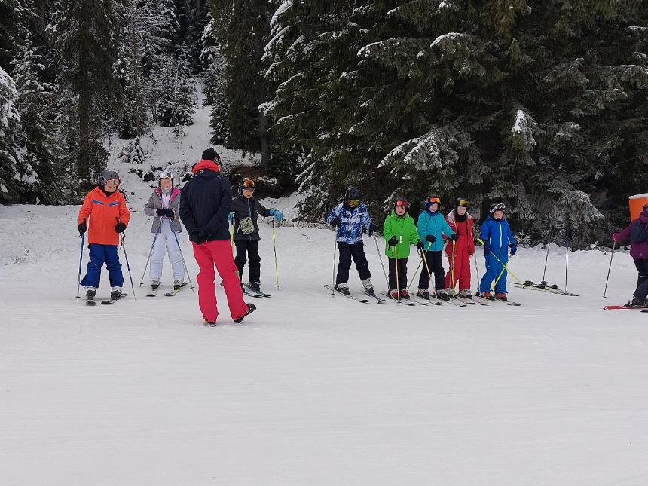

Slide 4
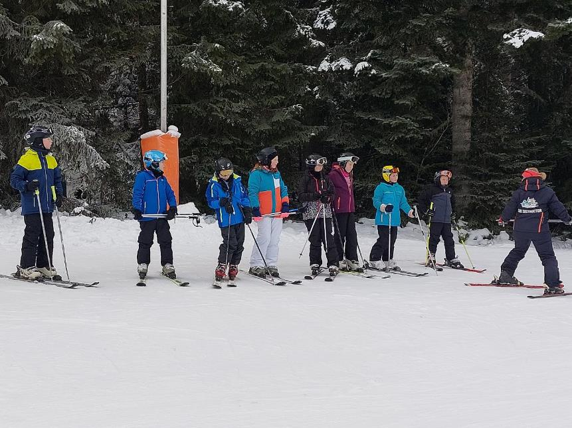

Slide 5
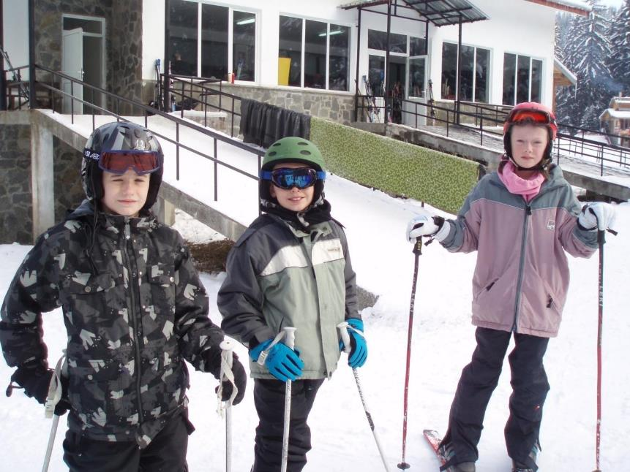
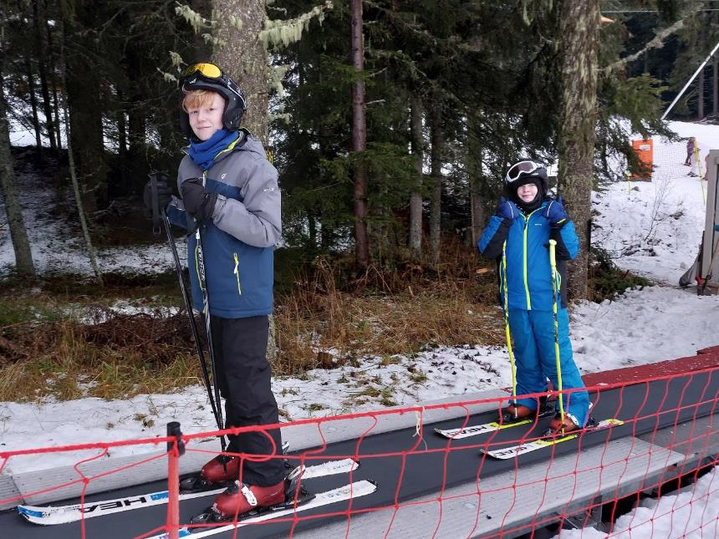

Slide 6
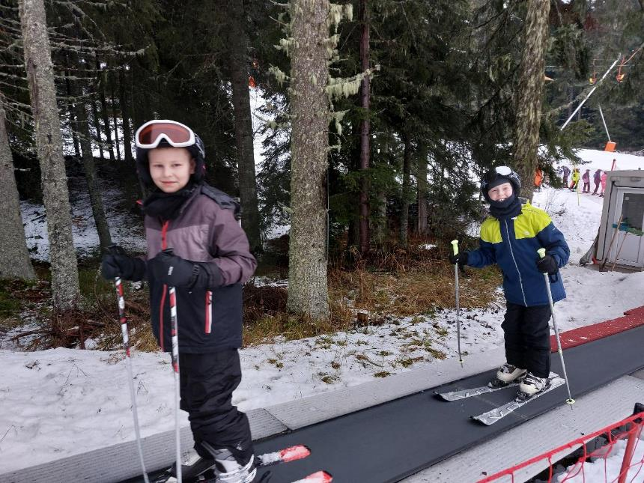

Slide 7
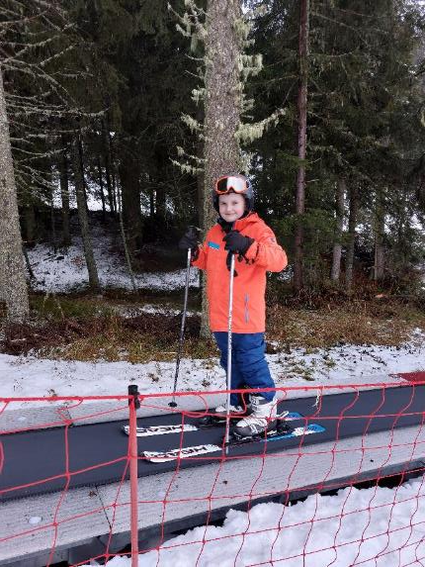
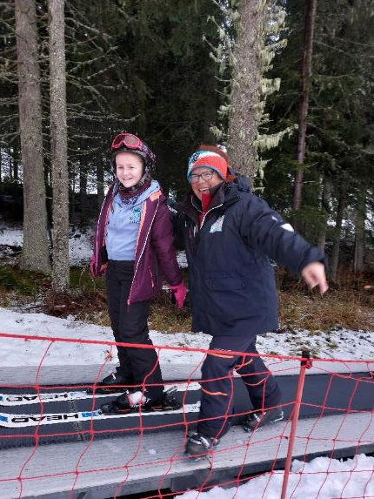

Slide 8
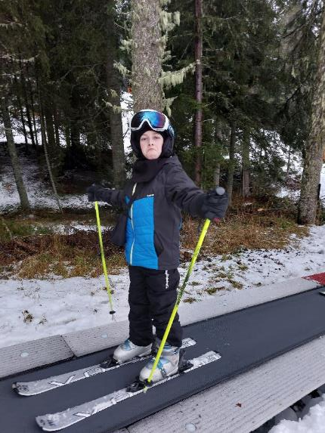
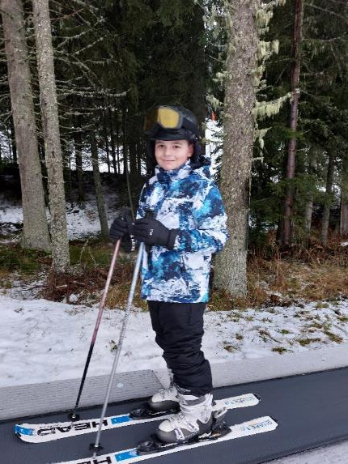

Slide 9
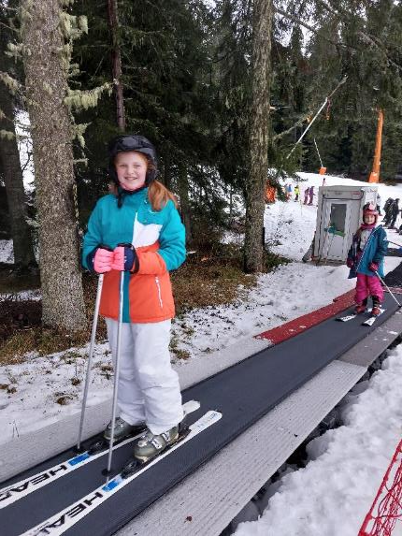
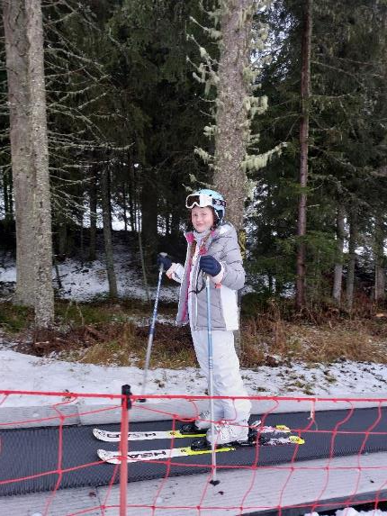

Slide 10
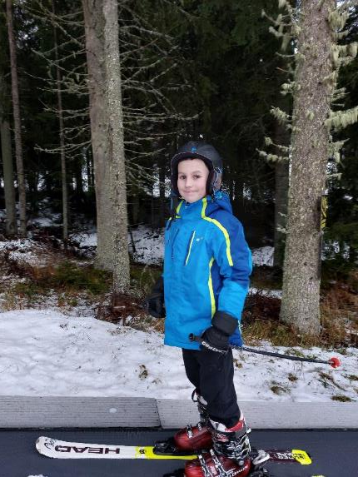
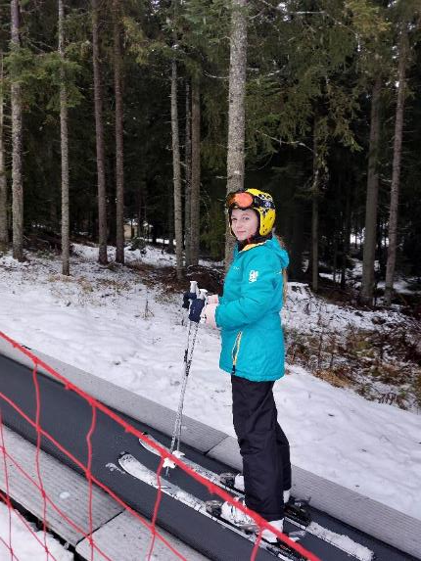

Slide 11
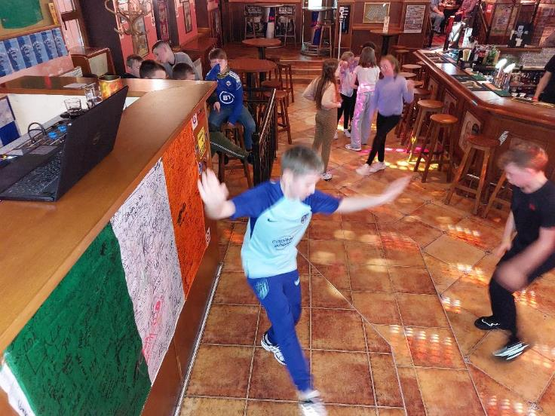
Disco
Night!

Slide 12
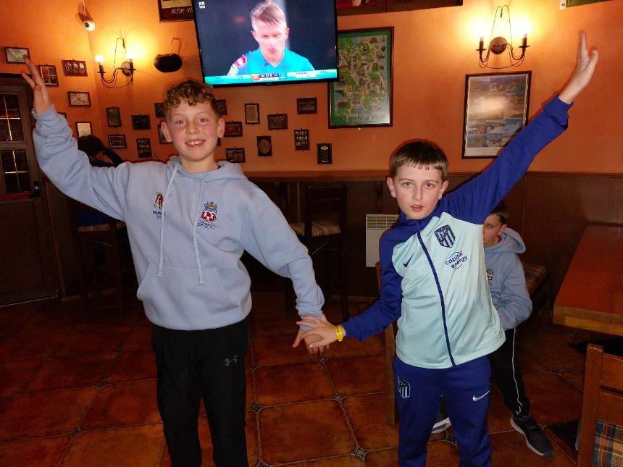

Slide 13
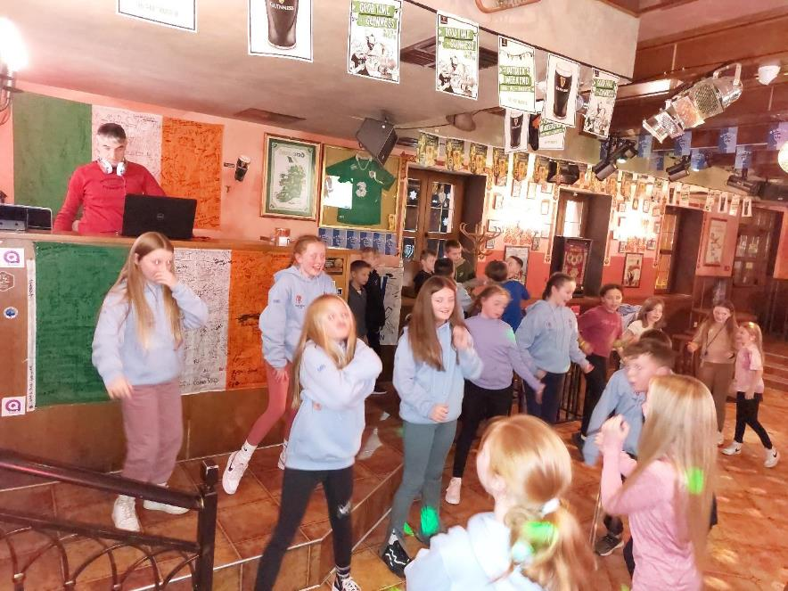

Slide 14
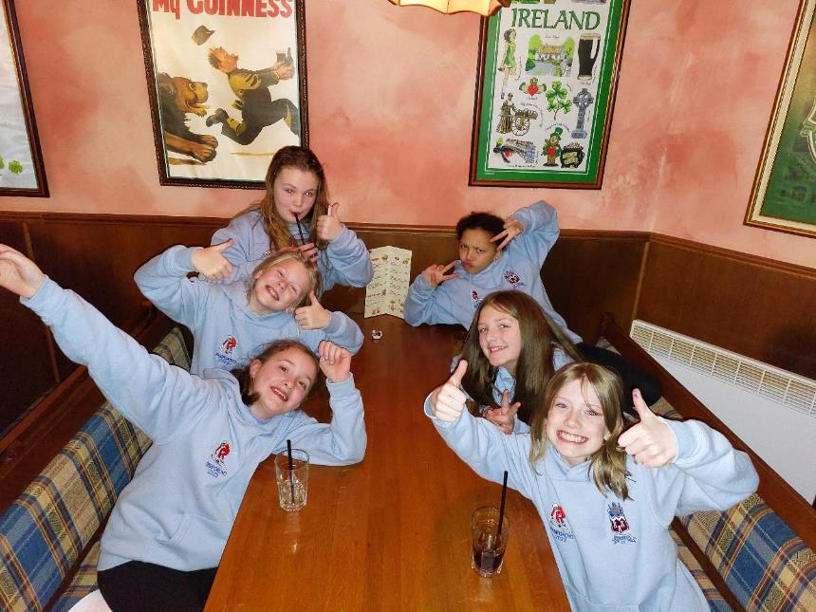

Slide 15
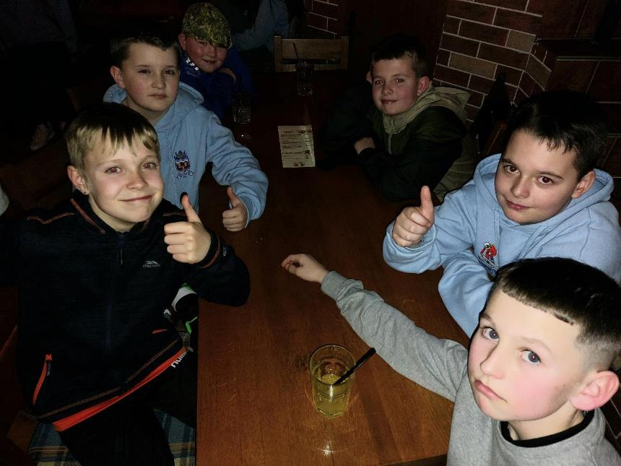

Slide 16
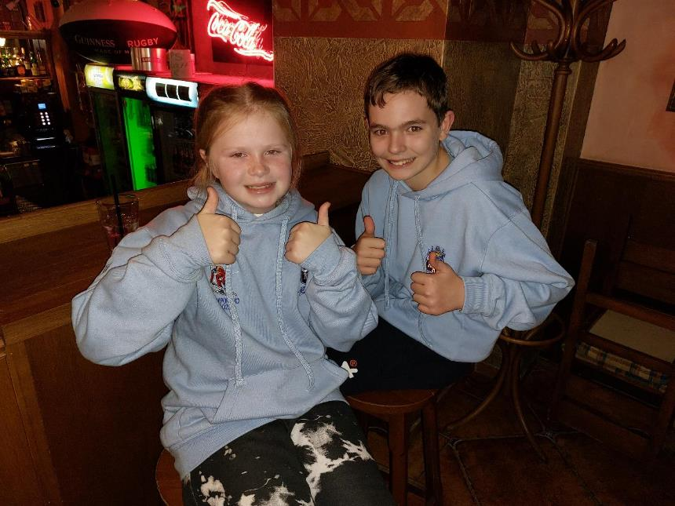

Slide 17
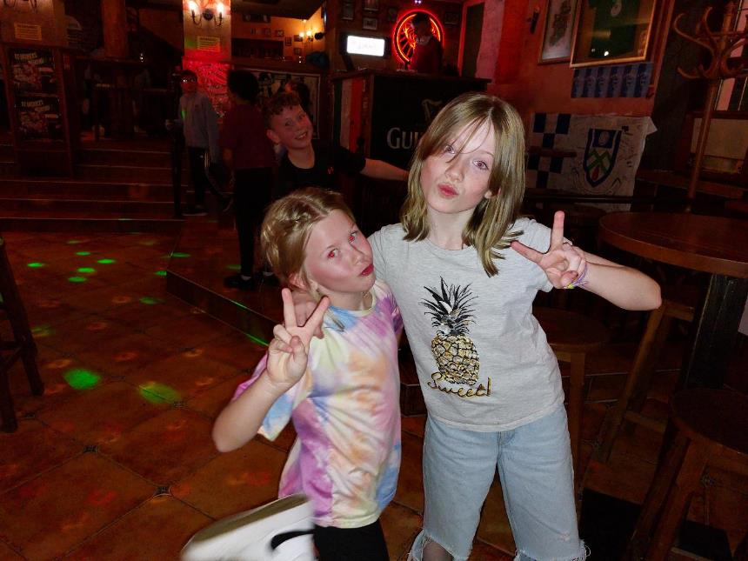

Slide 18
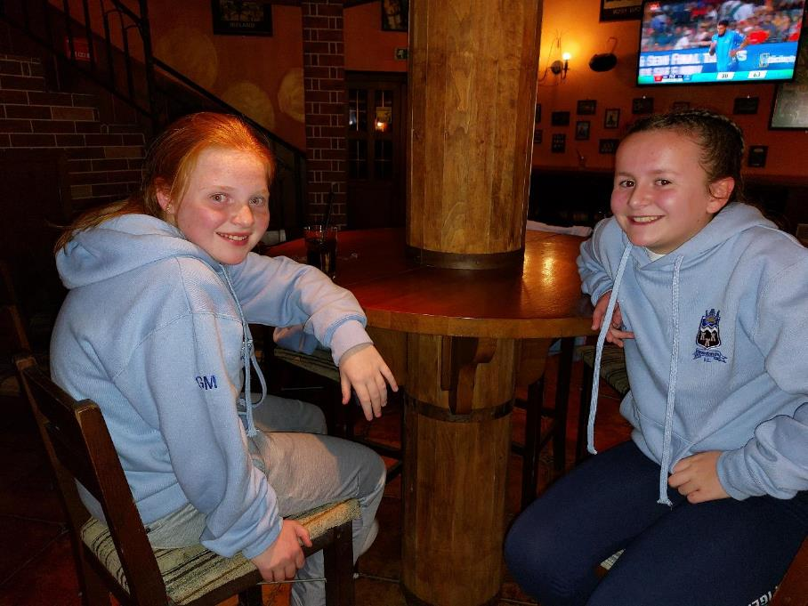

Slide 19
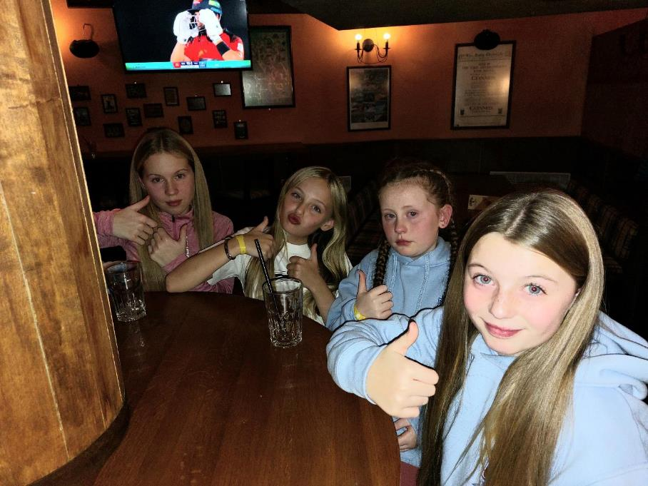

Slide 20
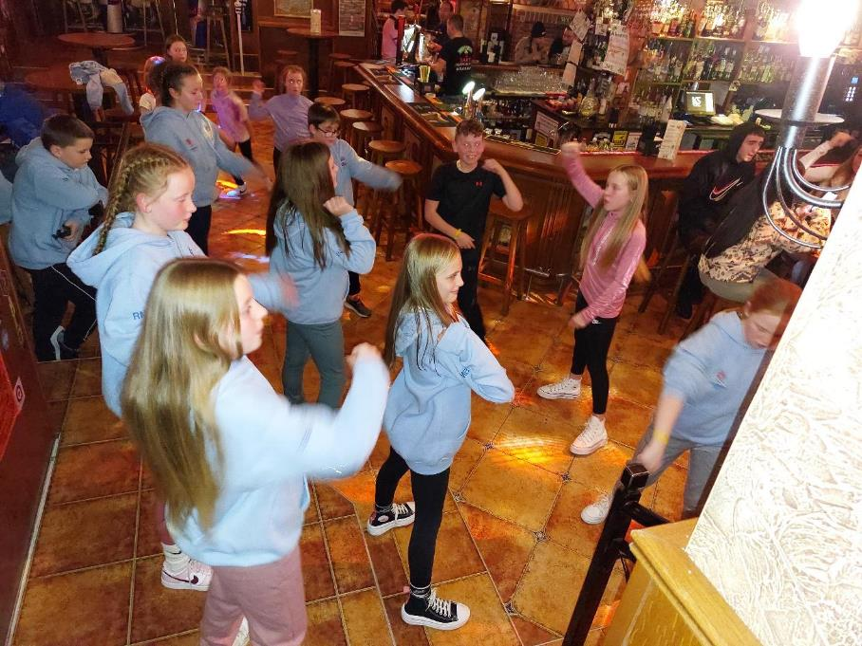

Slide 21
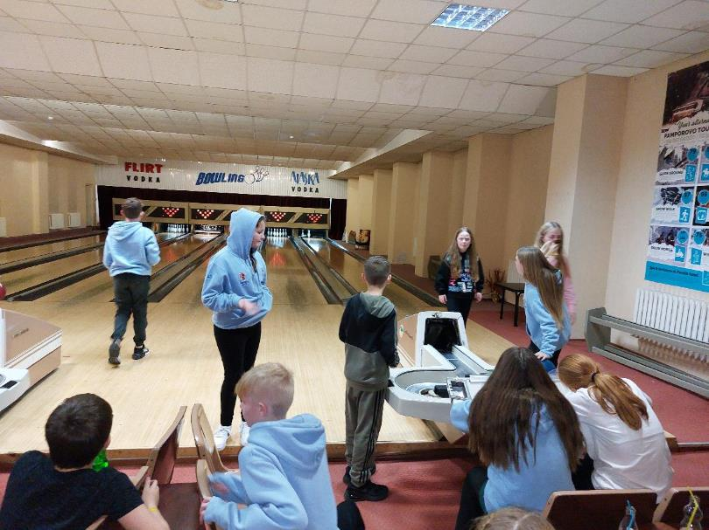
Ten-pin bowling

Slide 22
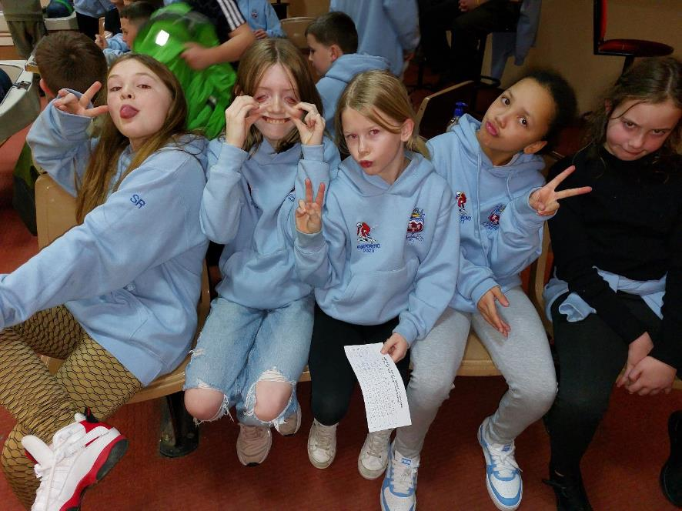

Slide 23
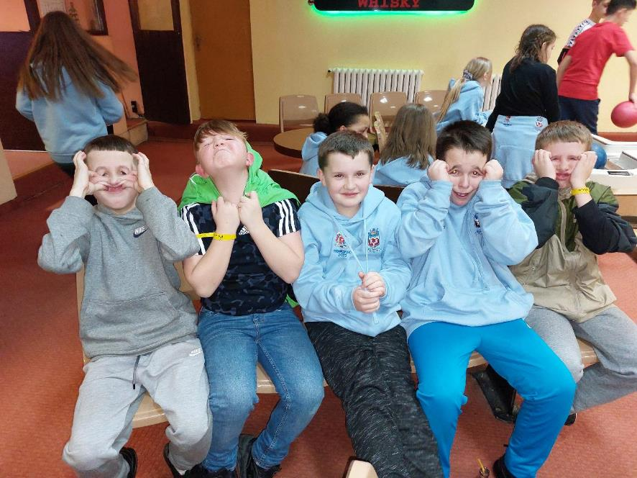

Slide 24
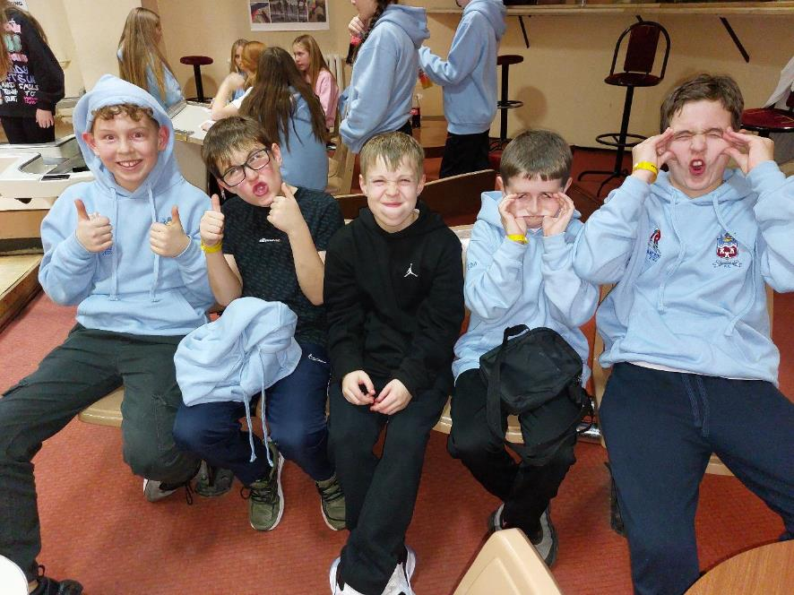

Slide 25
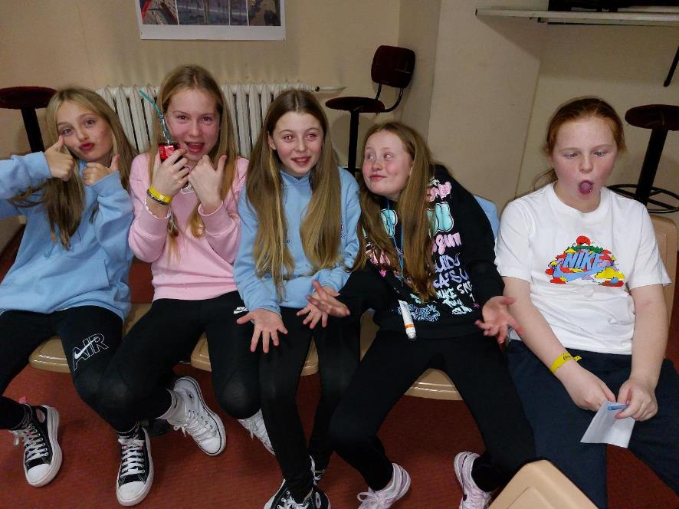

Slide 26
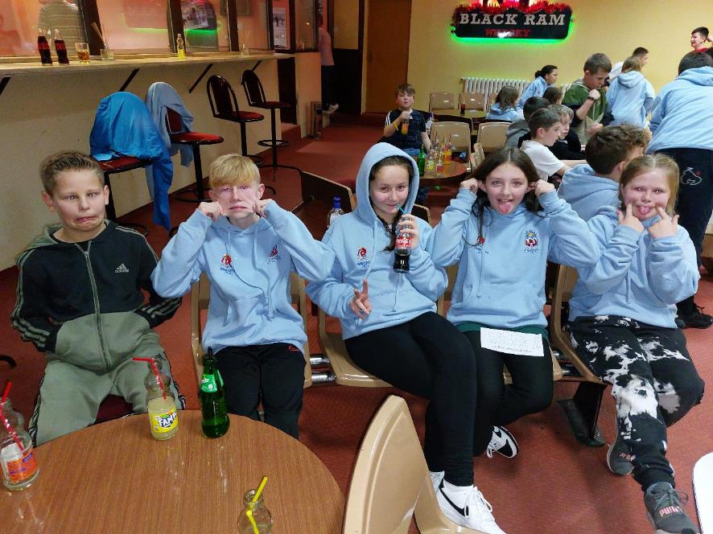

Slide 27
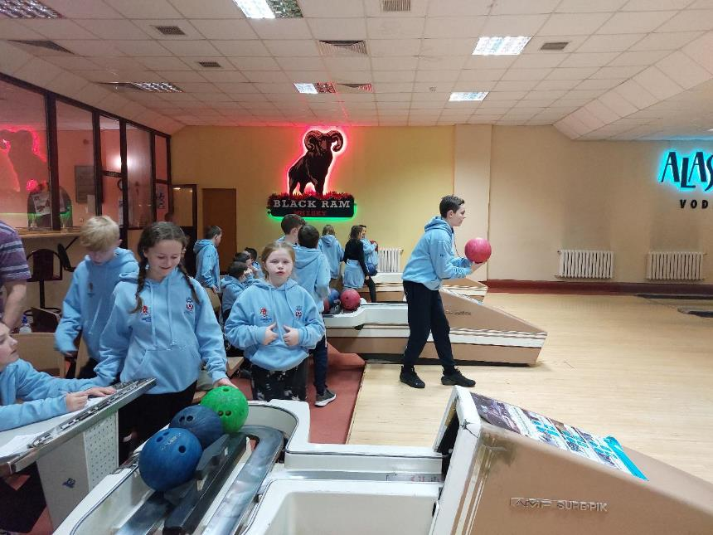

Slide 28
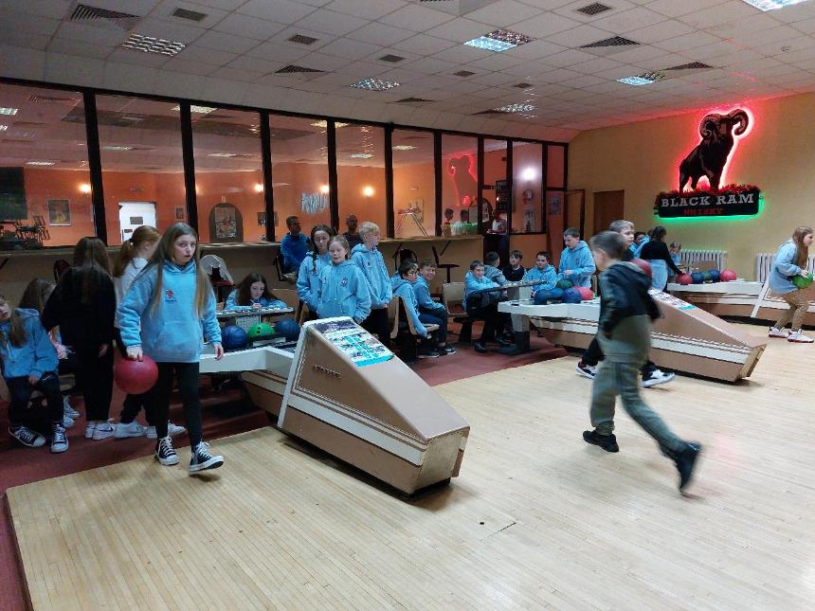

Slide 29
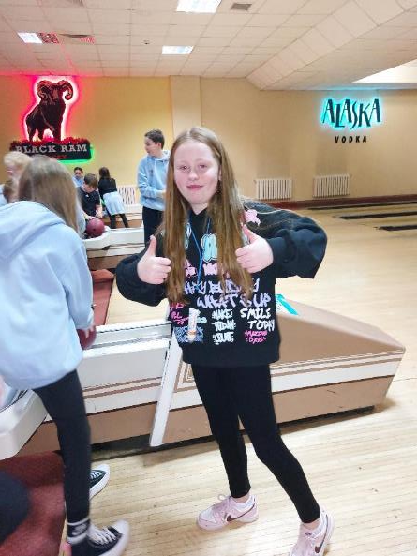
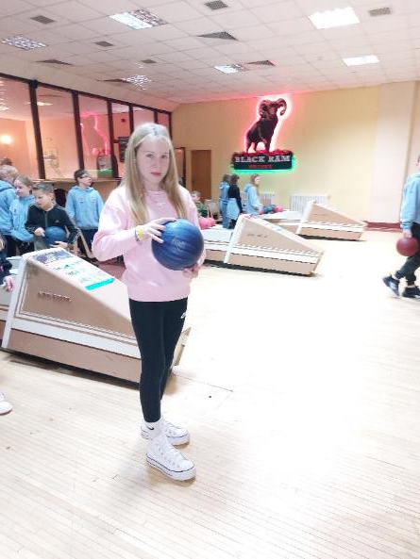

Slide 30
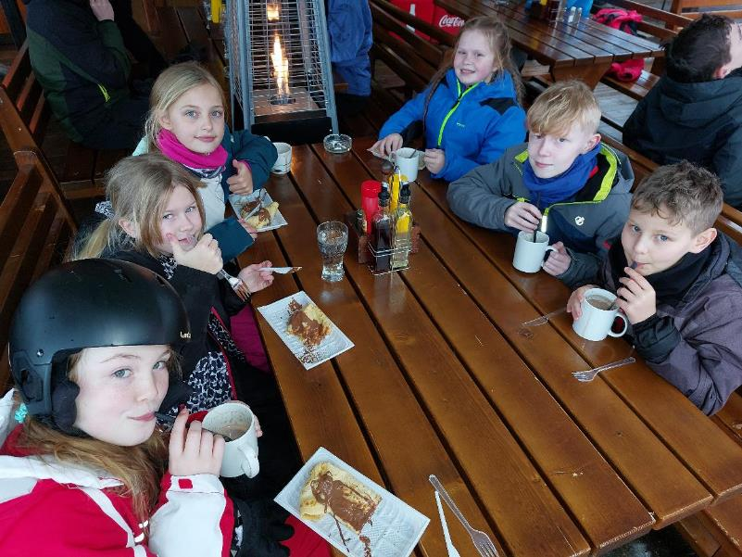
Time for a break!

Slide 31
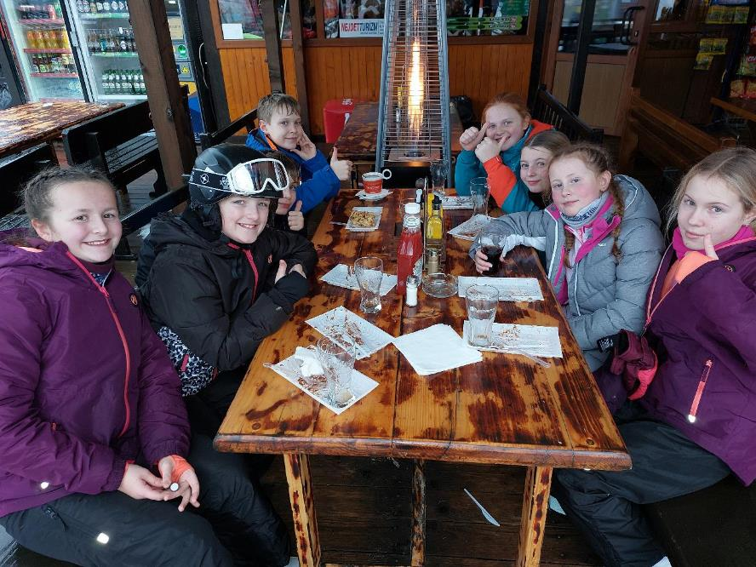

Slide 32
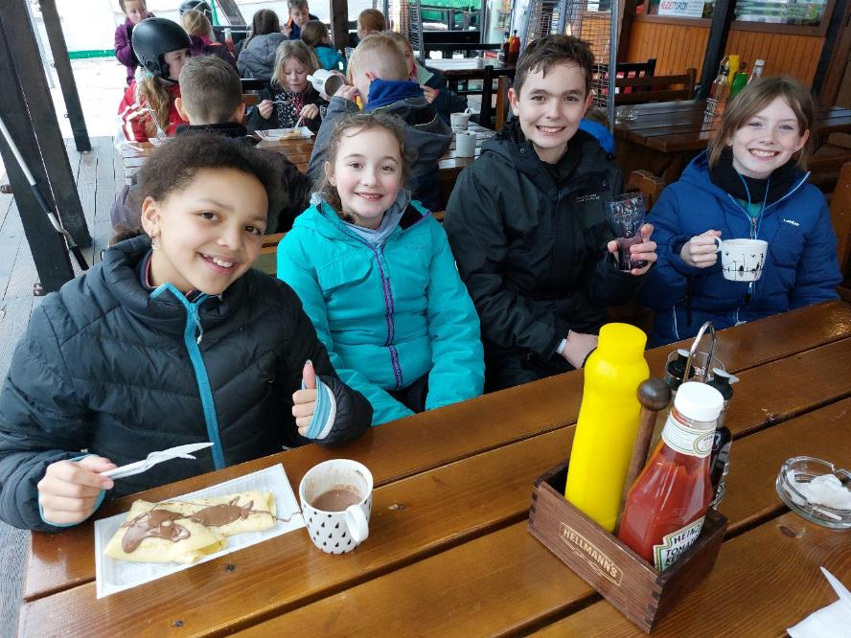

Slide 33
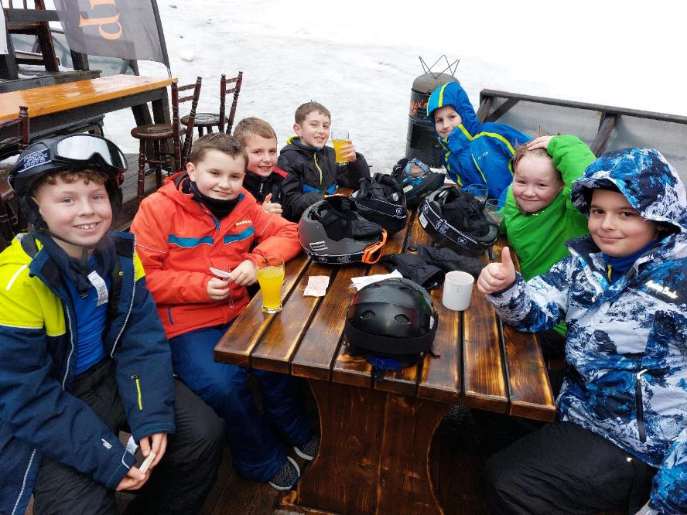

Slide 34
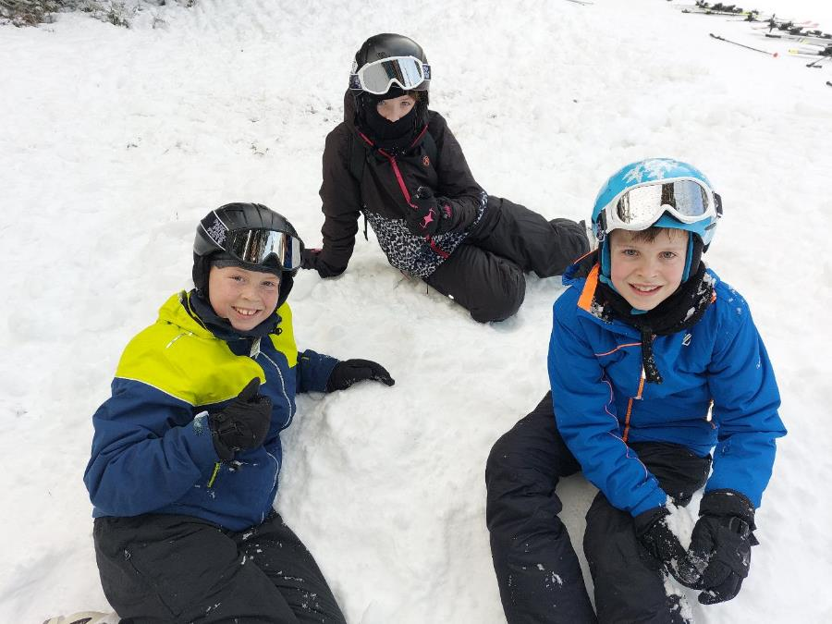

Slide 35
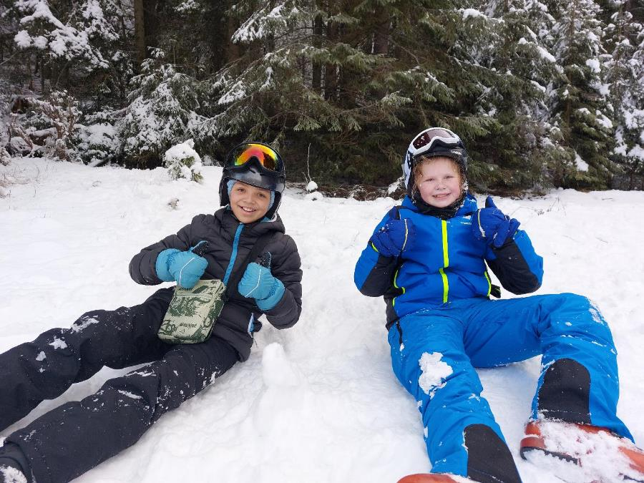

Slide 36
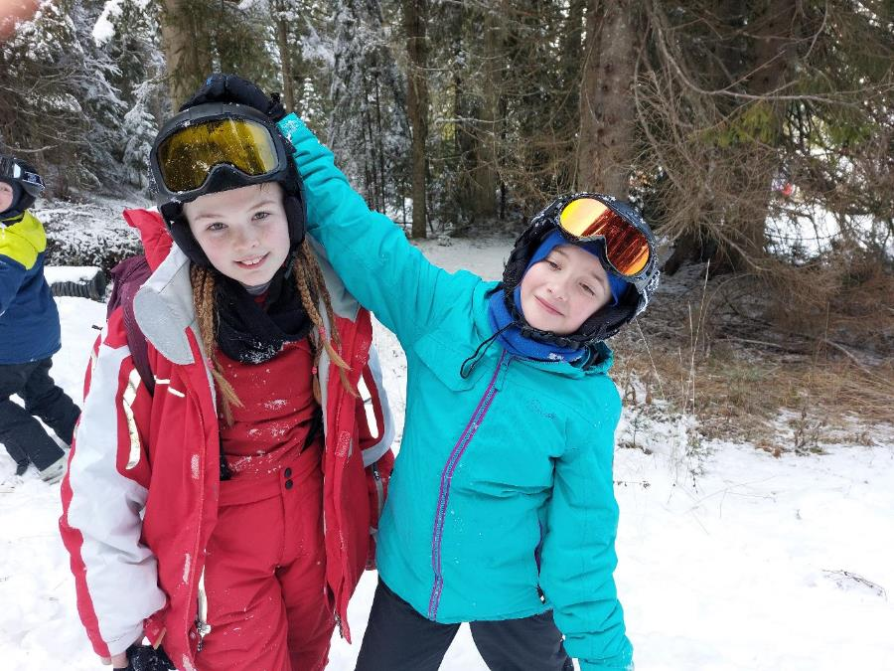

Slide 37
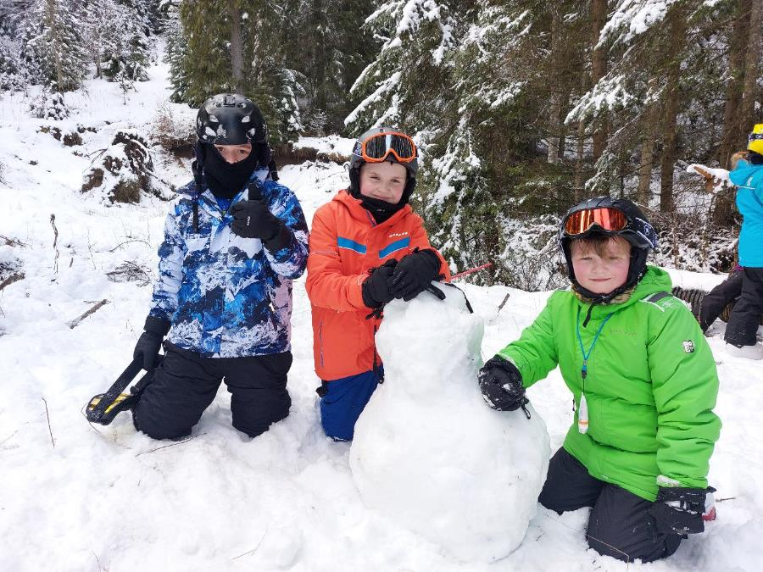

Slide 38
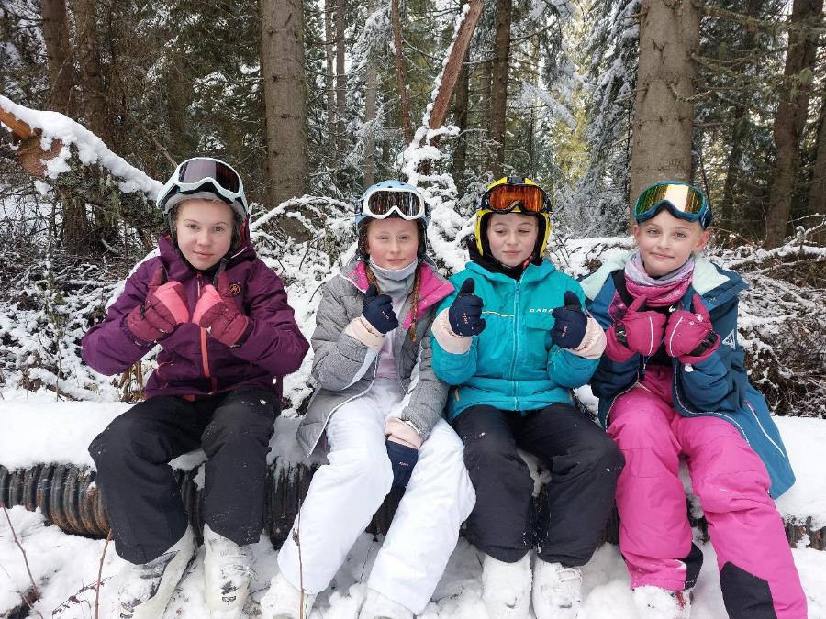

Slide 39
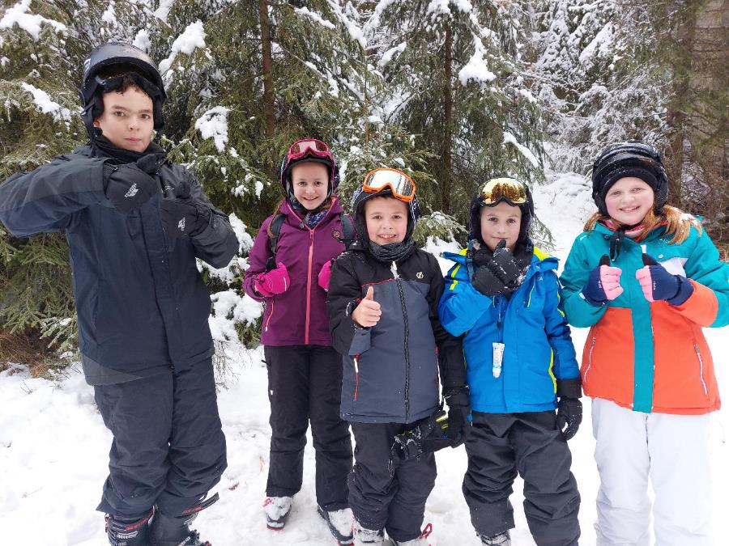

Slide 40
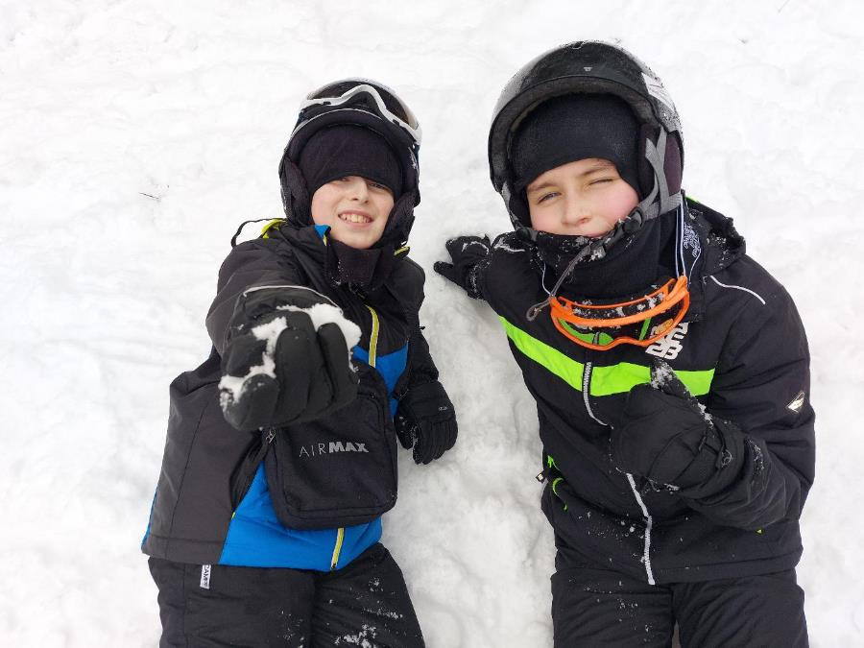

Slide 41
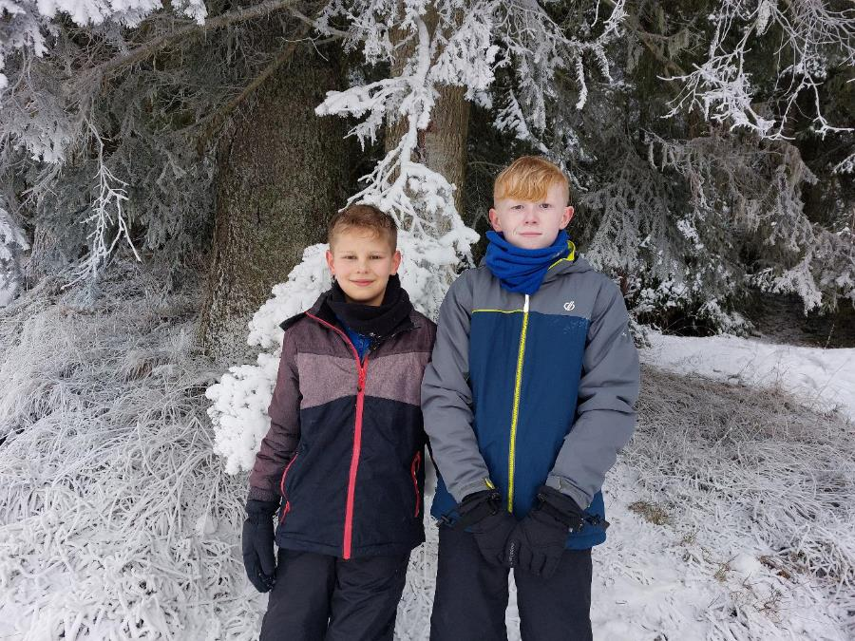

Slide 42
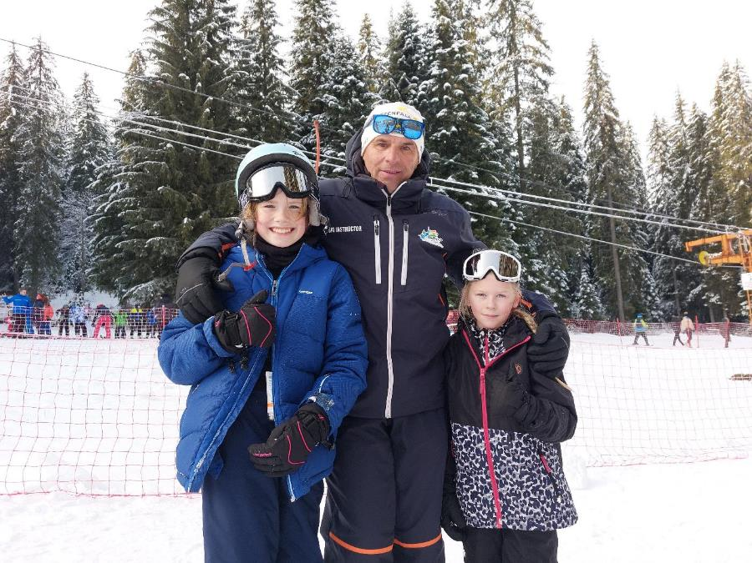

Slide 43
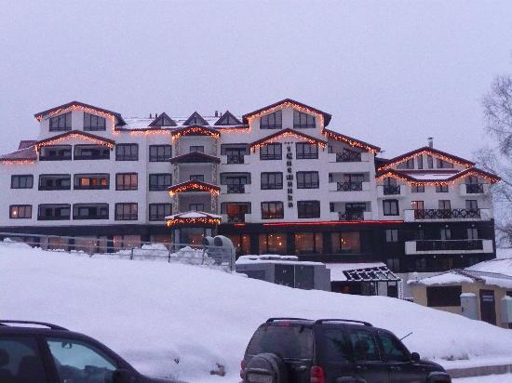
Hotel Snezhanka

Slide 44
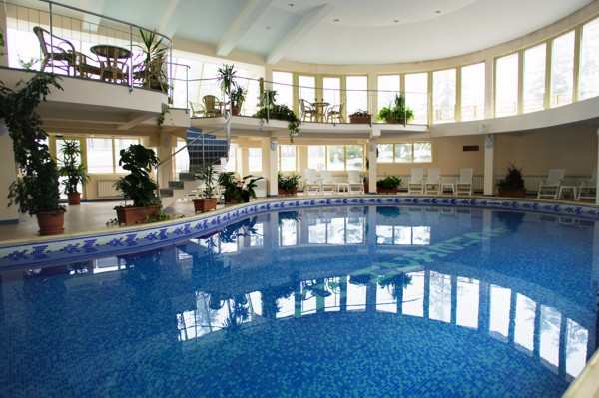

Slide 45

Bottom boarding!

Slide 46



Slide 47



Slide 48



Slide 49


Slide 50



Slide 51



Slide 52



Slide 53



Slide 54



Slide 55


Slide 56


Slide 57



Slide 58



Slide 59



Slide 60

Lunch in Alex’s Pub!

Slide 61


Slide 62


Slide 63


Slide 64


Slide 65


Slide 66

Back to the slopes!

Slide 67


Slide 68


Slide 69


Slide 70


Slide 71


Slide 72


Slide 73


Slide 74


Slide 75


Slide 76



Slide 77



Slide 78



Slide 79


Slide 80


Slide 81


Slide 82


Slide 83

Snowman building competition!

Slide 84


Slide 85


Slide 86


Slide 87


Slide 88


Slide 89


Slide 90

Another break!

Slide 91


Slide 92


Slide 93


Slide 94


Slide 95


Slide 96


Slide 97


Slide 98

Alexis got an early birthday surprise!

Slide 99


Slide 100


Slide 101

Final day on the slopes!

Slide 102



Slide 103



Slide 104


Slide 105


Slide 106


Slide 107


Slide 108


Slide 109


Slide 110


Slide 111


Slide 112


Slide 113

Awards night!

Slide 114


Slide 115


Slide 116

Heading home!

Slide 117


Slide 118


Slide 119


Slide 120


