Slide 1


Slide 2
Innovating the Future
The theme for British Science Week 2021 is ‘Innovating the Future’.
This theme encourages us to think about the incredible inventions that people have made in the past which can inspire young people everywhere to innovate for the future!
Let’s think.
What does the word ‘innovation’ mean?
An innovation is a new idea, method or way of doing something.
What is an invention?
An invention is something that has never been made before.

Slide 3

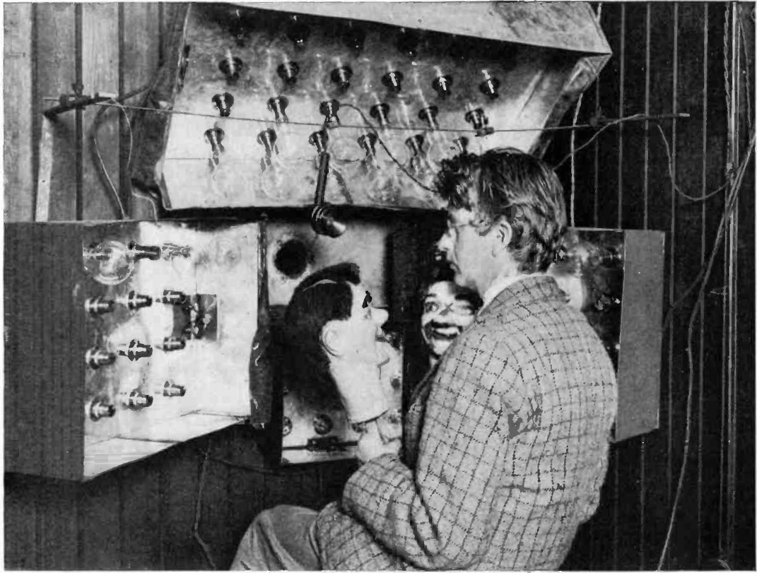
Inventions That Changed the World
Modern life is full of inventions that have changed how we live.
The television
John Logie Baird invented the first television in 1924. Televisions first went on sale in the late 1920s. They showed video in black and white only.
At first, the televisions couldn’t send moving pictures of humans so ventriloquist’s dummies were used instead!

Slide 4
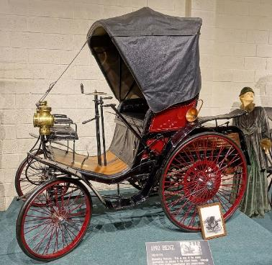
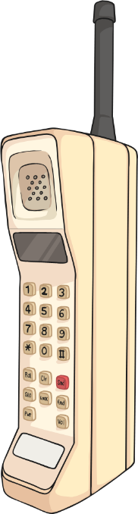
Inventions That Changed the World
Modern life is full of inventions that have changed how we live.
          The motor vehicle (car)
          The first ever petrol-powered ‘car’ was created in 1885 by Karl Benz in Germany. Its maximum speed was 6mph which is not much faster than a quick walking pace.
The mobile phone
The world’s first mobile phone call was
made on 3rd April, 1973, by Martin Cooper,
an engineer at Motorola. It weighed 1.1kg –
about the same as two loaves of bread.

Slide 5


One Person or a Team?
Many inventions in the past were made by one person.
Sometimes, just one person will notice something that will change the world for millions more.
For example, when George De Mestral
was walking through the countryside
one day, he noticed that some seeds
seemed to ‘stick’ to his clothing.
He remembered this, went home and
used this idea to create ‘Velcro’.

Slide 6

One Person or a Team?
Many inventions were never really invented by one person at all. Some changed and improved over many years, as many people worked on them.
Ancient Chinese civilisations were using an abacus to calculate problems about 5,000 years ago. Then, moving levers and gears of old calculators developed into electronic computers. These enormous early computers were developed into personal computers that could fit on a desk. Computers became smaller and smaller and now we have powerful smartphones which fit in our hands! This has been a team effort over thousands of years
    Did You Know…?
    Konrad Zuse, a German civil engineer, created the first programmable computer called Z1 in 1936. Many of the early computers were the size of a large room!

Slide 7





The Past 100 Years of Inventions
1920
1970
2020
1924 Clarence Birdseye discovered a quick-freezing method for making frozen food.
1972 Stephanie Kwolek invented Kevlar, the material in bullet-proof vests.
1989 Sir Tim Berners-Lee developed the ‘world
wide web’, also known as the Internet.
1928 Alexander Fleming discovered the antibiotic, penicillin.
1938 László Jozsef Bíró made the first ballpoint pen, also known as the ‘biro’.
2011 Apple introduced the first virtual assistant, Siri.

Slide 8
Skills to Be an Inventor
Some inventions happen by accident or through good luck.
Some happen with lots of people working together over a long time.
Let’s think.
What skills do you think you might need to be an inventor?
curiosity
perseverance
patience
Can you think of anymore?

Slide 9

The Story of Lonnie G Johnson
Lonnie George Johnson was born in the USA in 1949, the third of six children.
From a young age, he was very curious about how things worked and often took objects apart to look inside.
When he was at high school, he worked
hard to build a robot for the science
fair and won first prize for it.
He had pieced it together from a
combination of old junk he had found,
the inside of a walkie-talkie and an
old music recorder from his sister.

Slide 10
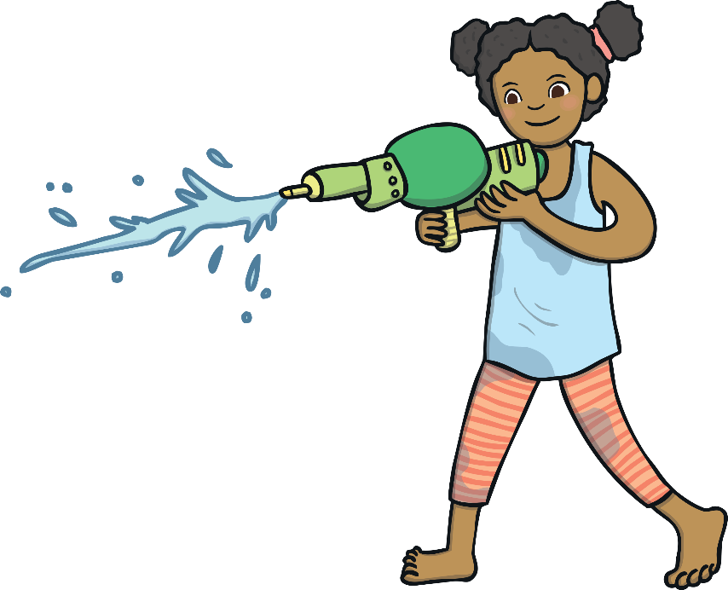
The Story of Lonnie G Johnson
Innovation by accident
When he grew up, Lonnie became an engineer.
One day, he was experimenting
with a new pump in his
bathroom at home.
Suddenly, he accidentally shot a stream of water
across the room! He realised this would make a fun toy!
And so, the Super Soaker water gun was invented!

Slide 11
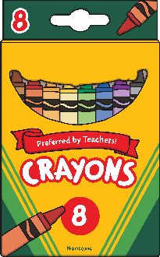

Can Children Be Inventors?
Here are some young inventors who saw a need and had a go at making something to help!
Yes! It isn’t just adults who invent
11-year-old Cassidy Goldstein was fed up with trying to draw
pictures with broken crayons. The pieces were too small to
hold onto so she found a plastic tube at home and put the
crayon stubs inside.
Her crayon holders are now sold in many toy shops.
On holiday in Hawaii, 11 year old Richie Stachowski went
swimming but couldn’t talk to his dad underwater.
He started researching, then testing and soon, he came up
with the Water Talkie – a cone-shaped megaphone-like
device that means people can talk to each other underwater!

Slide 12

Can Children Be Inventors?
Yes! It isn’t just adults who invent
Here are some young inventors who saw a need and had a go at making something to help!
16-year-old Boyan Slat went diving on holiday in Greece in 2011. Sadly, he saw more plastic than fish so he decided to do something about it.
He went home and designed a floating barrier that would catch the plastic on the surface of the sea.
His company, The Ocean Cleanup, now has more
than 90 people working to remove plastic from
the world’s oceans.

Slide 13
What Could You Invent?
Cassidy, Richie and Boyan all needed something to help them and so, they decided to invent something new to do the job.
A ‘necessity’ is something you need. Think about what this
saying might mean:
‘Necessity is the mother of all inventions.’
Now, it’s over to you. What do you need and what could you invent to help you?

Slide 14

Over to You!
The organisers of British Science Week would like you to enter a poster competition on the topic of ‘innovation for the future’. Go to britishscienceweek.org for more information.
Why not get involved?
Science is such a big part of our daily lives. You could have a think about some questions that interest you and try to find the answers to them online.
Why is
water wet?
Why is
the sky blue?
How can I invent smelly-vision?
How can I talk with my friends in Australia?

