Slide 1
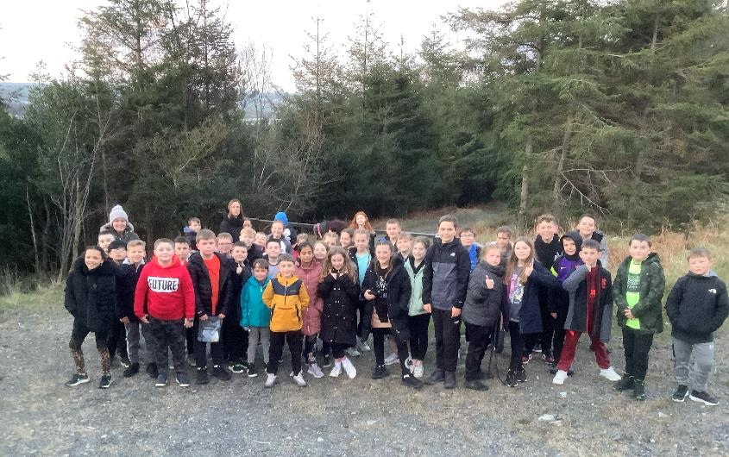
P6 visit to Greenhill YMCA
29th March – 1st April 2022

Slide 2
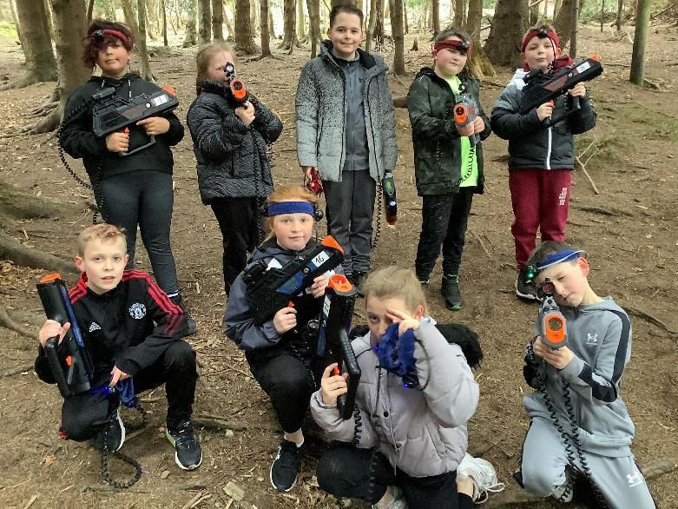
Laser tag!

Slide 3
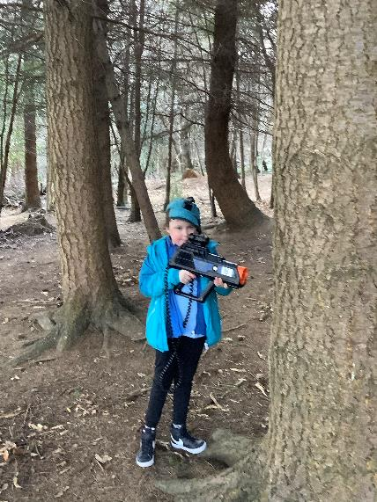
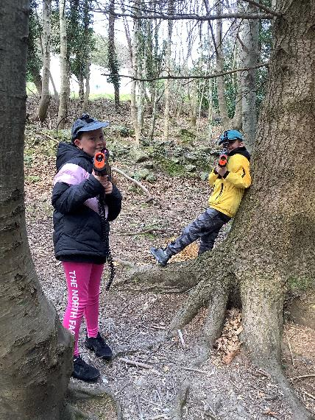

Slide 4
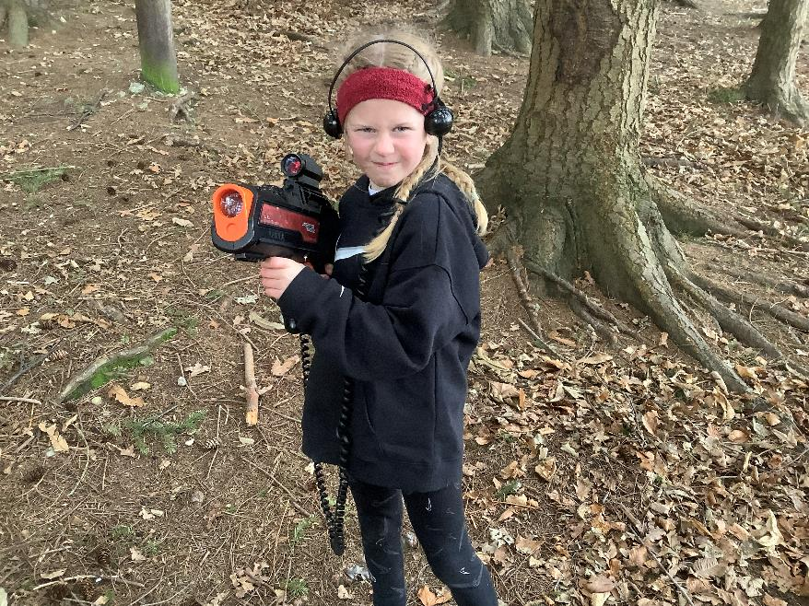

Slide 5
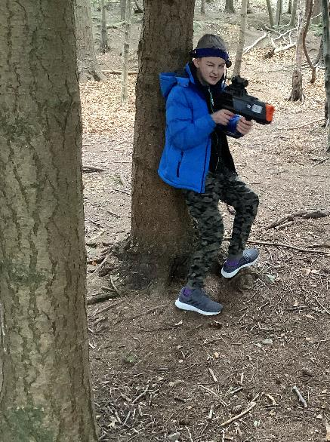
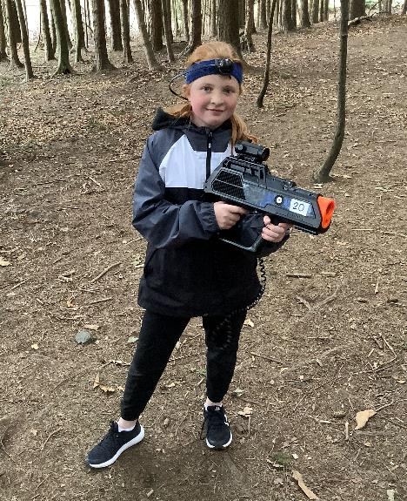

Slide 6
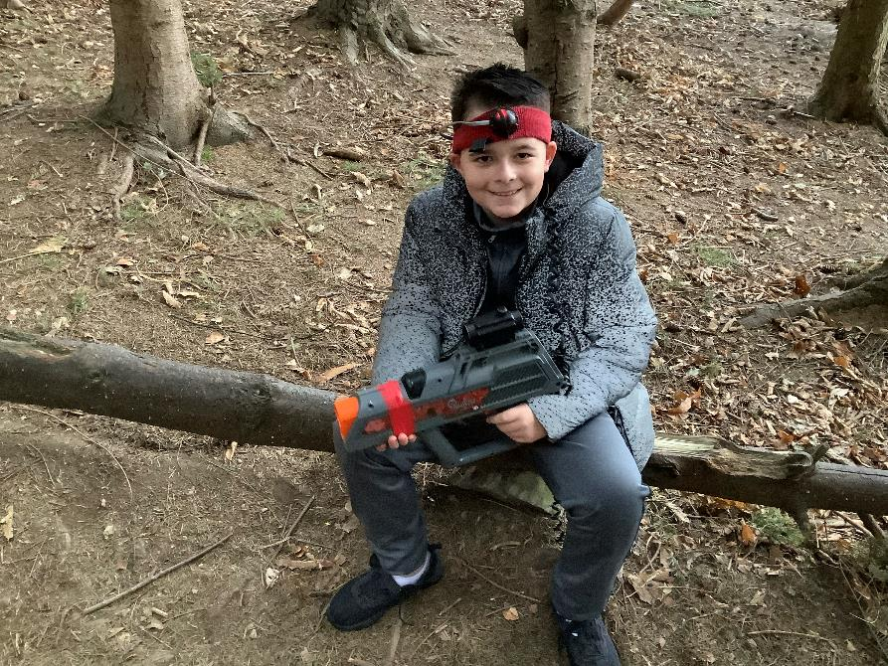

Slide 7
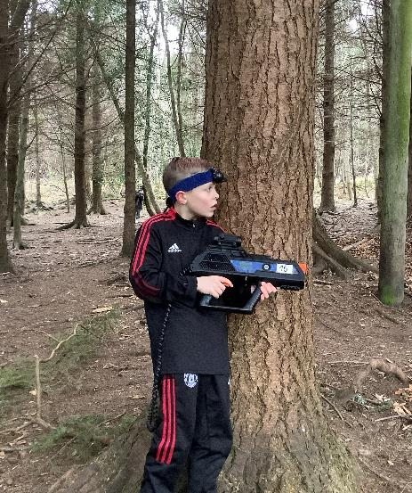
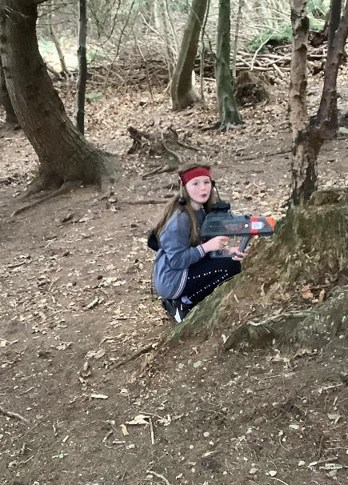

Slide 8
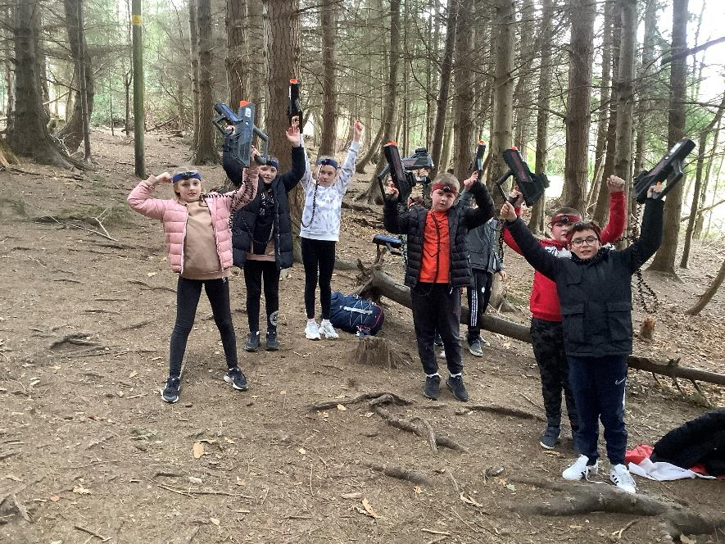

Slide 9
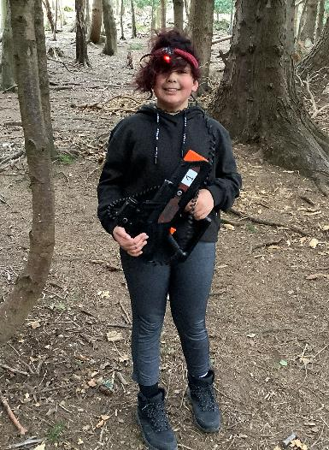
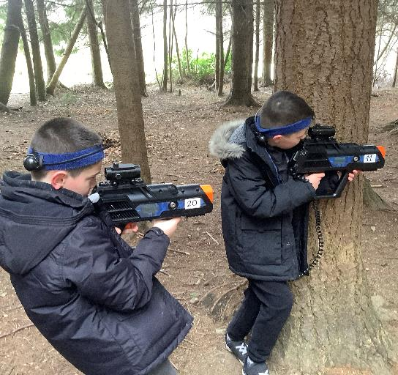

Slide 10
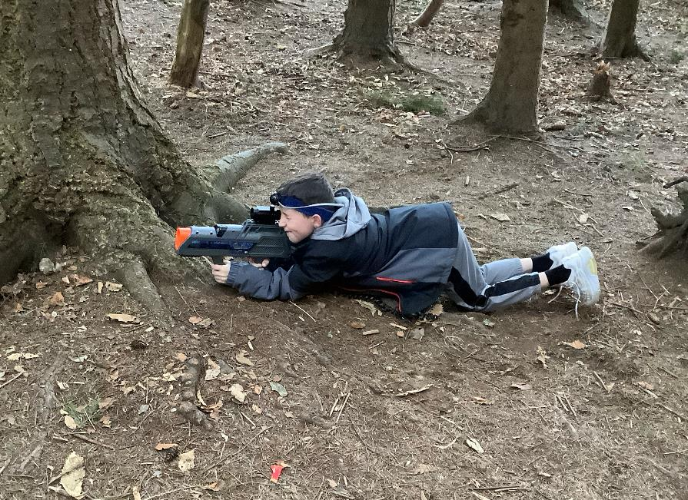

Slide 11
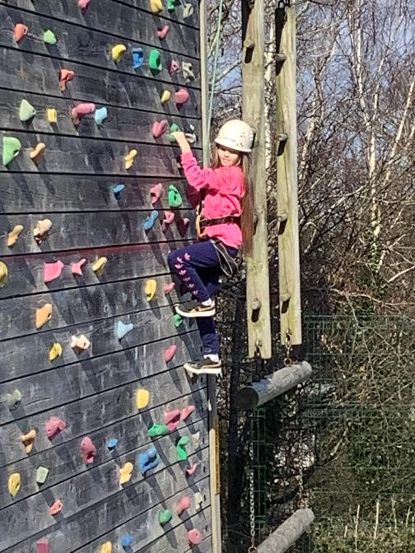
Climbing wall and abseiling!

Slide 12
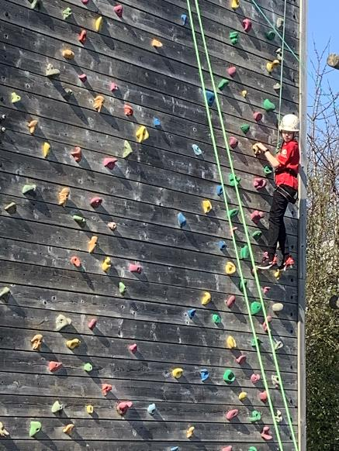
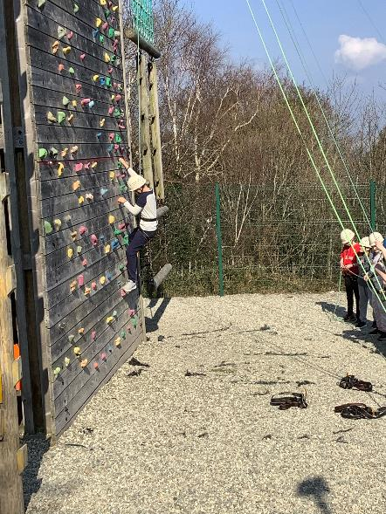

Slide 13
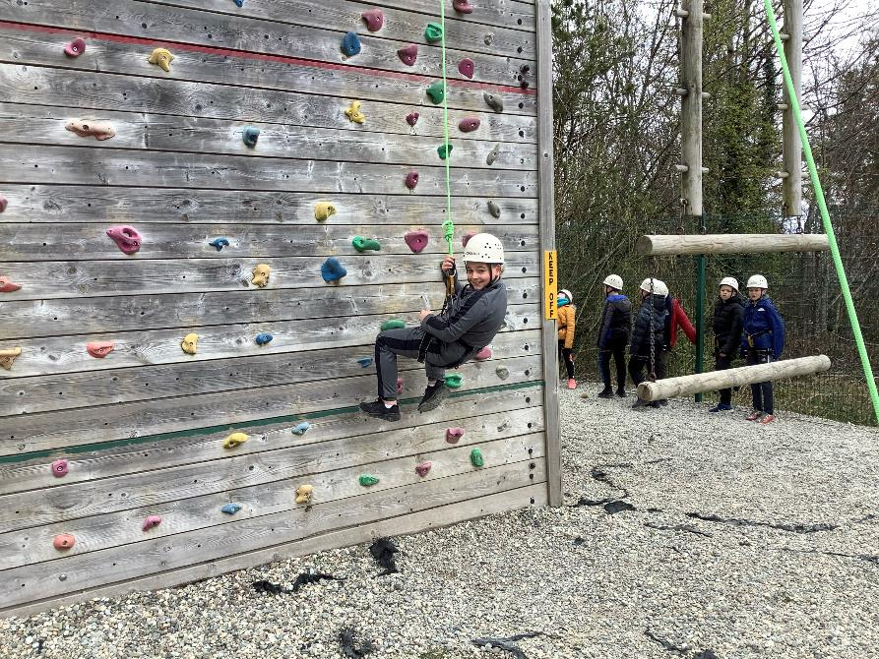

Slide 14
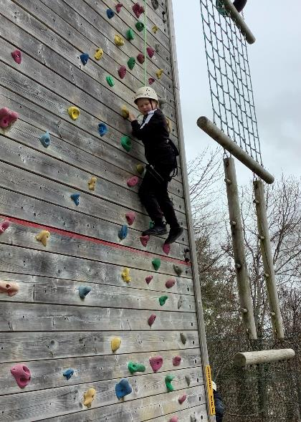
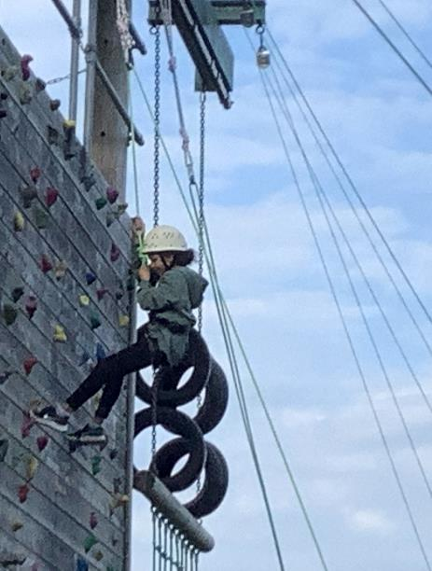

Slide 15
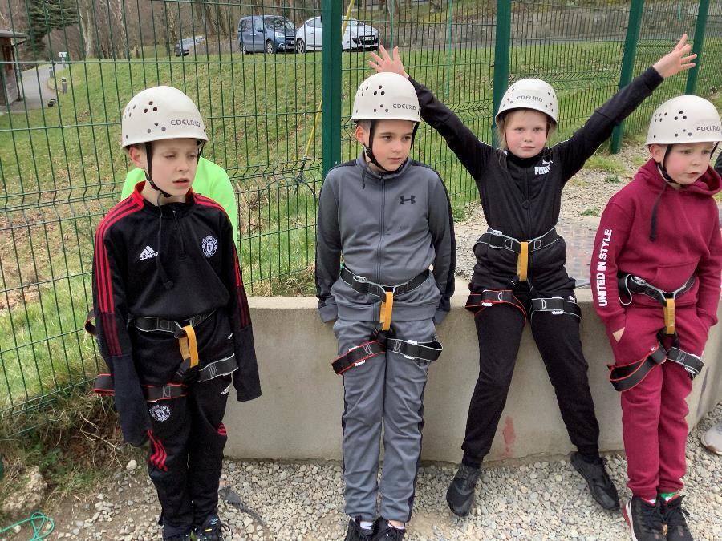

Slide 16
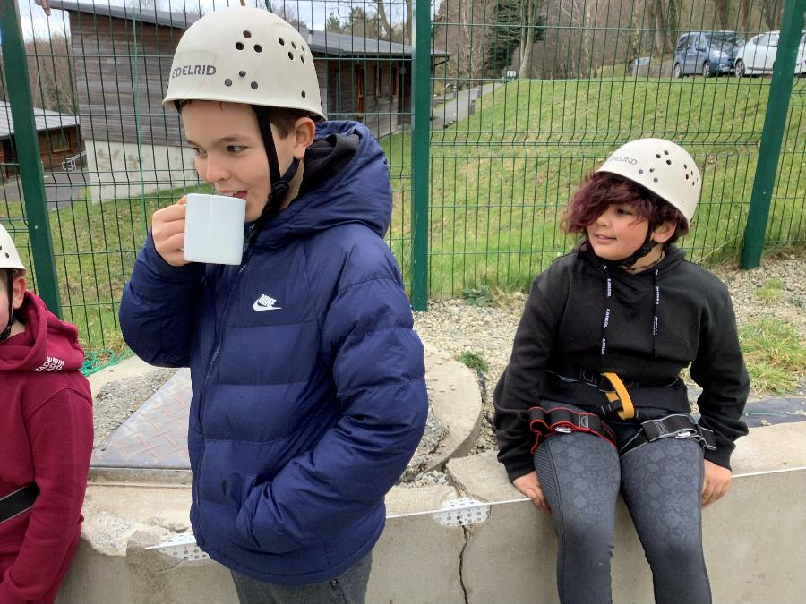

Slide 17
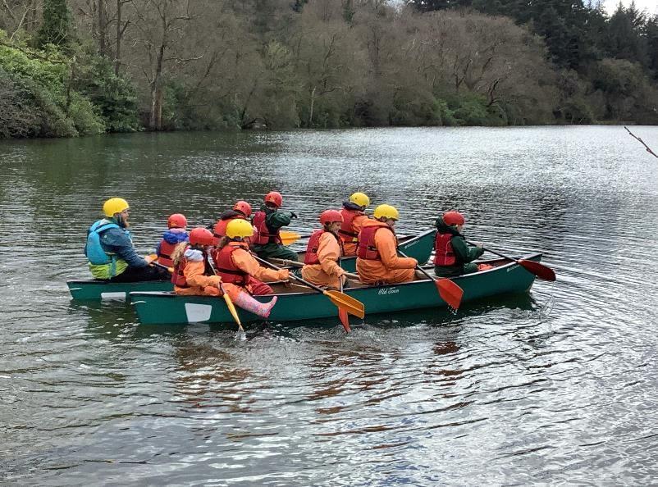
Canoeing!

Slide 18
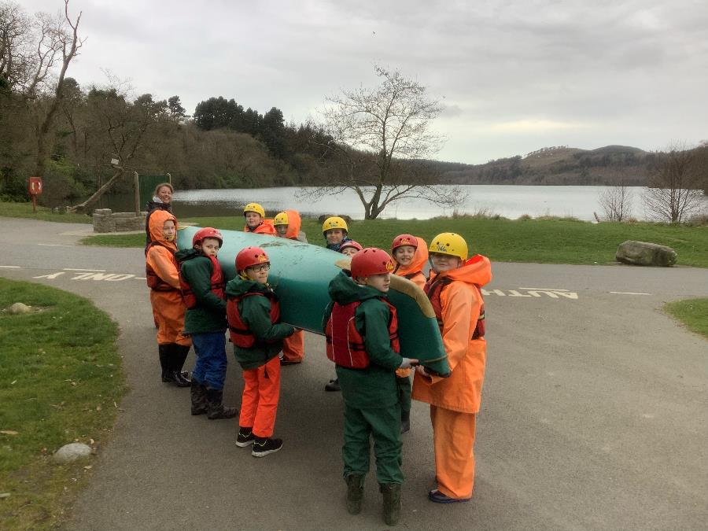

Slide 19
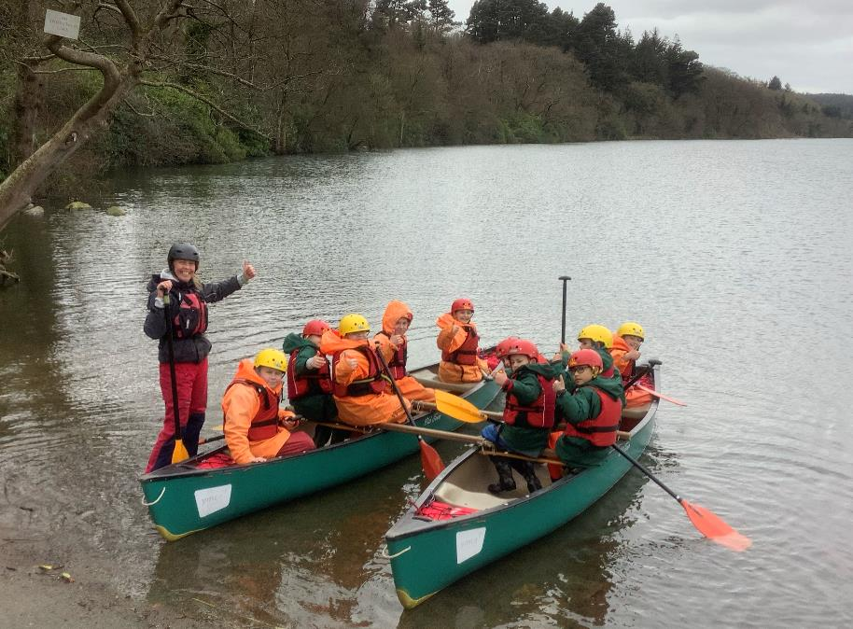

Slide 20
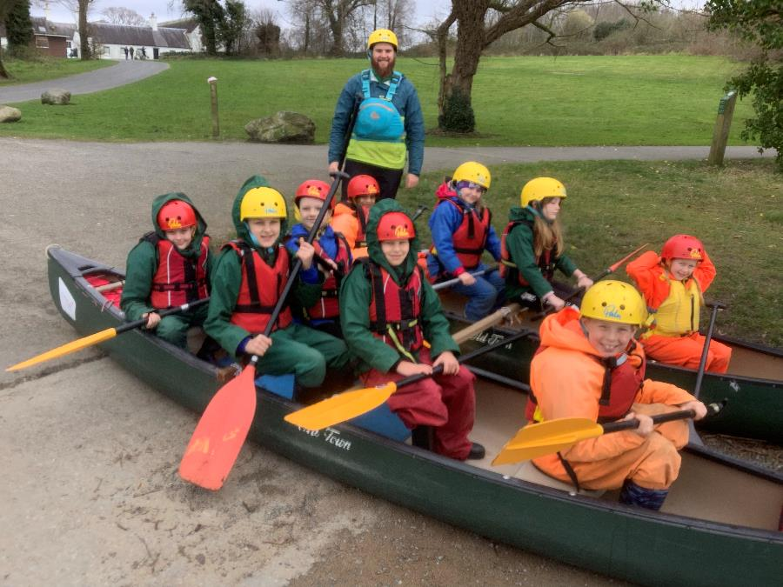

Slide 21
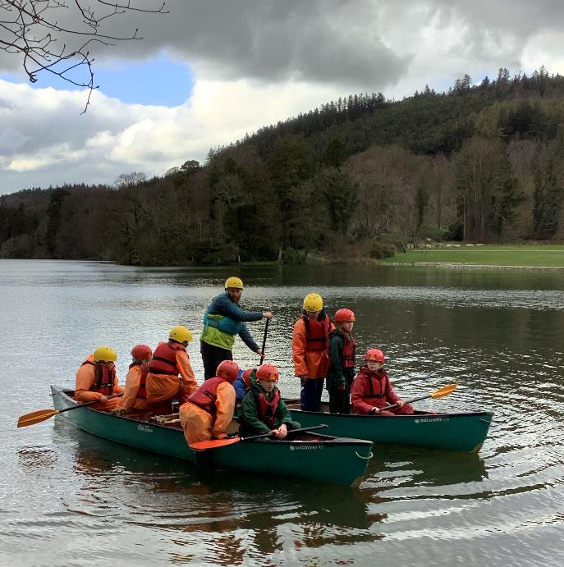

Slide 22
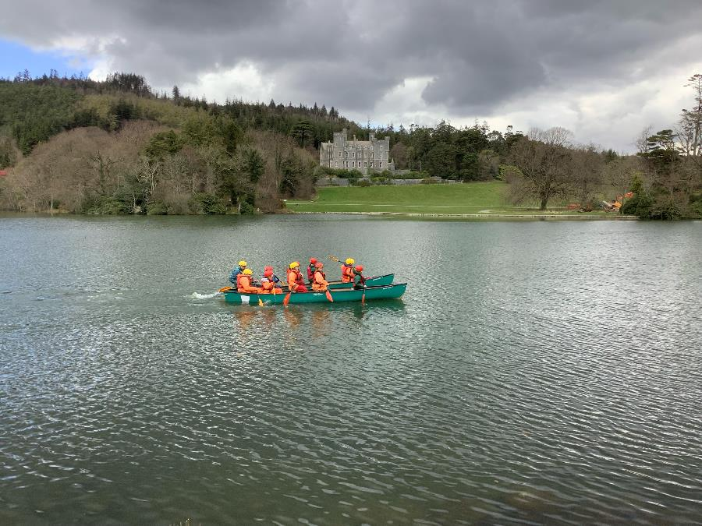

Slide 23
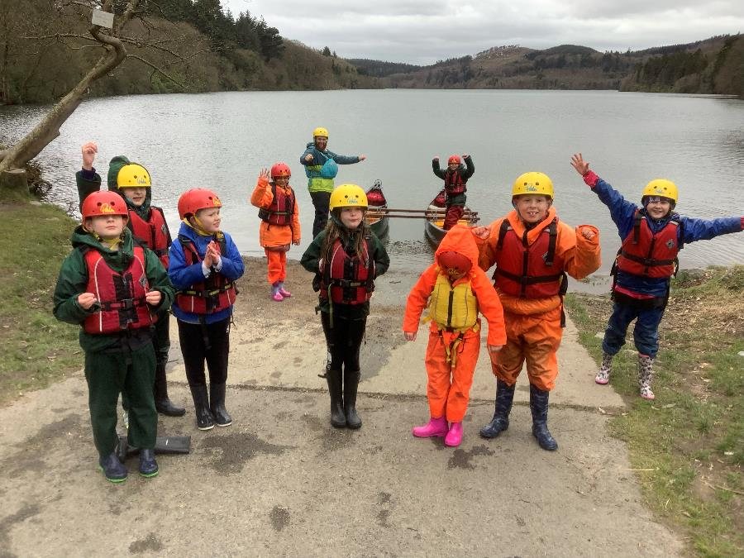

Slide 24
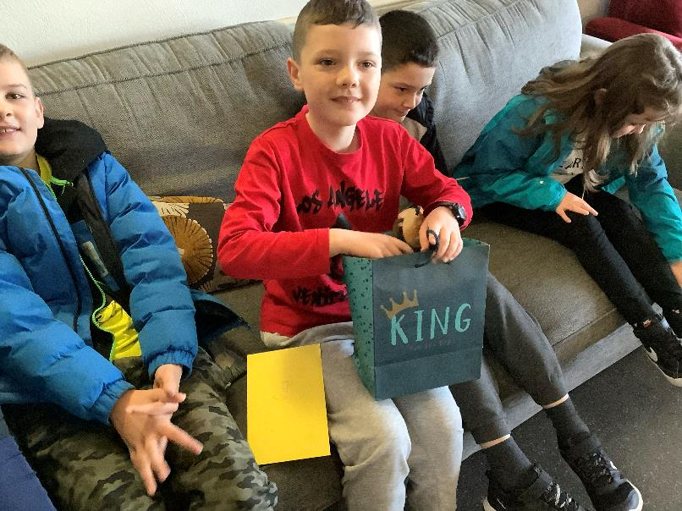
10th birthday!

Slide 25
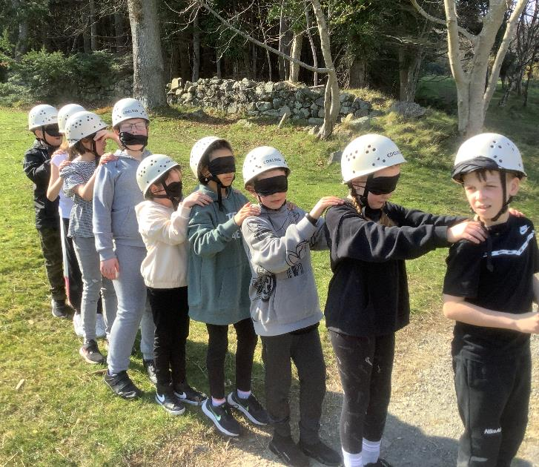
Blind trail!

Slide 26
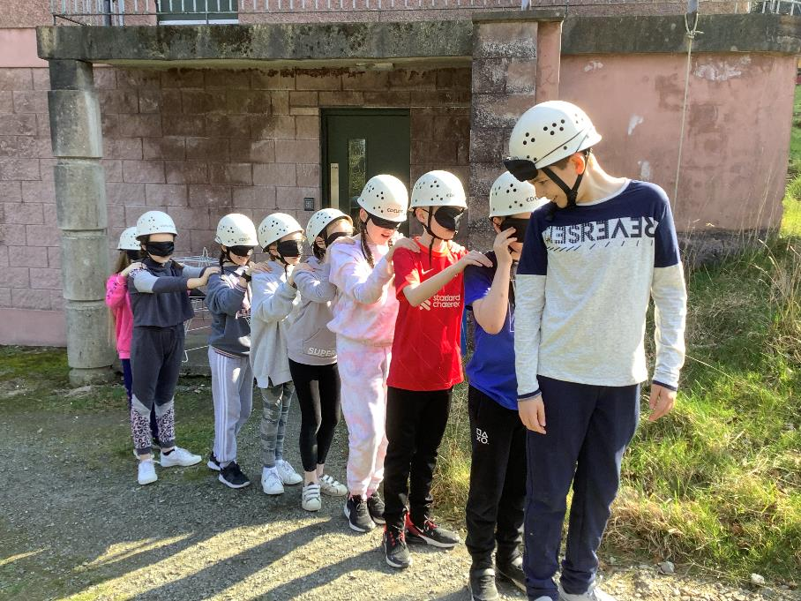

Slide 27
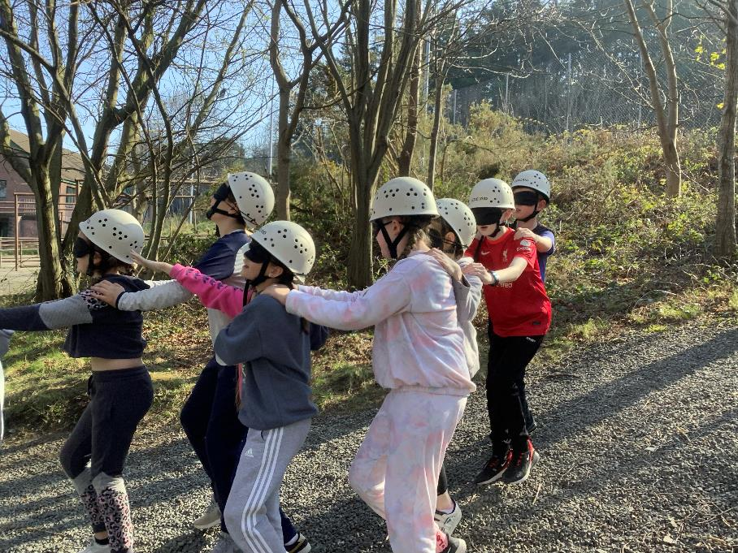

Slide 28
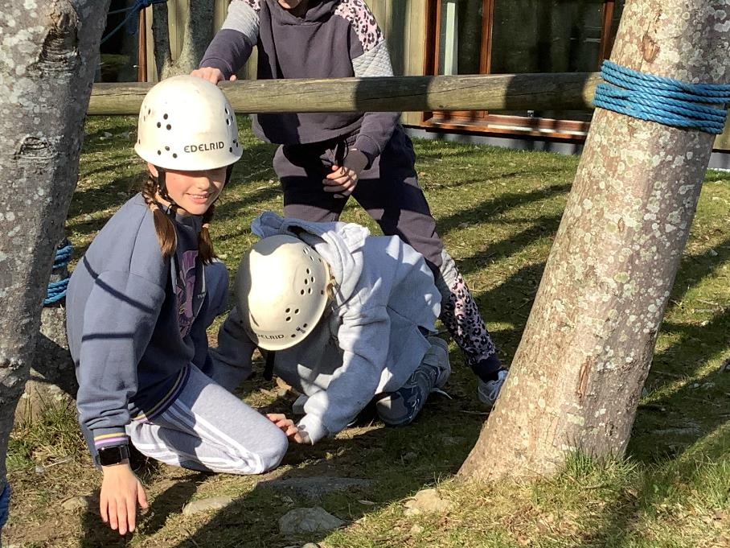

Slide 29
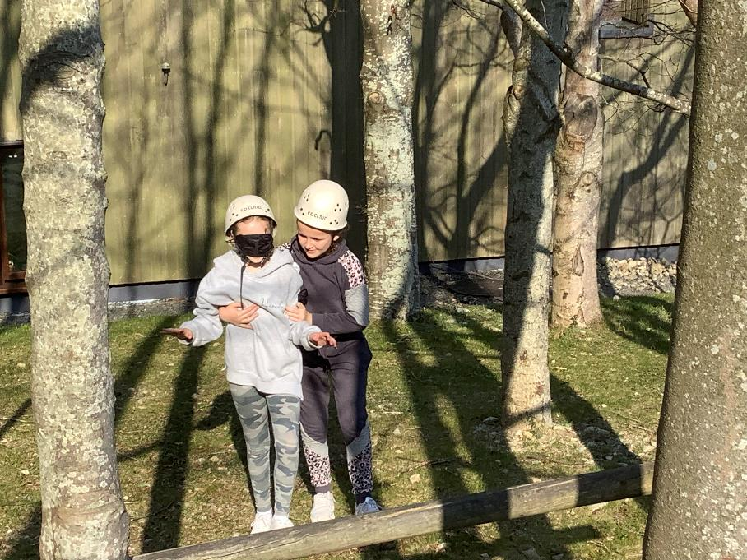

Slide 30
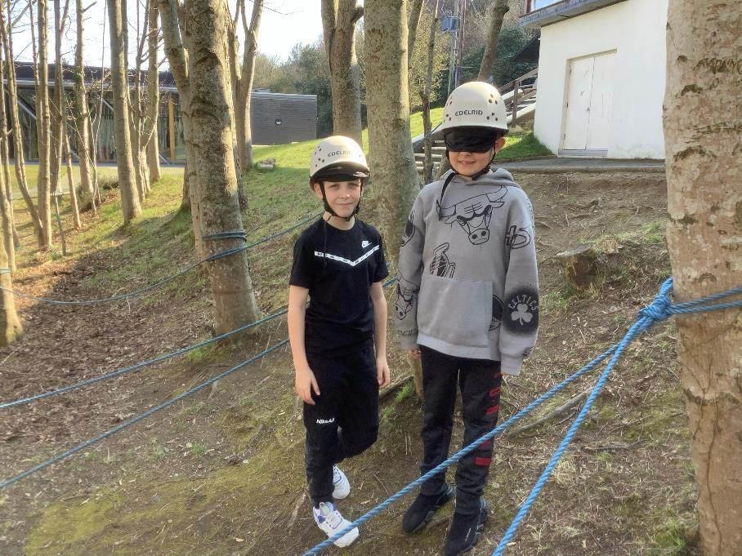

Slide 31
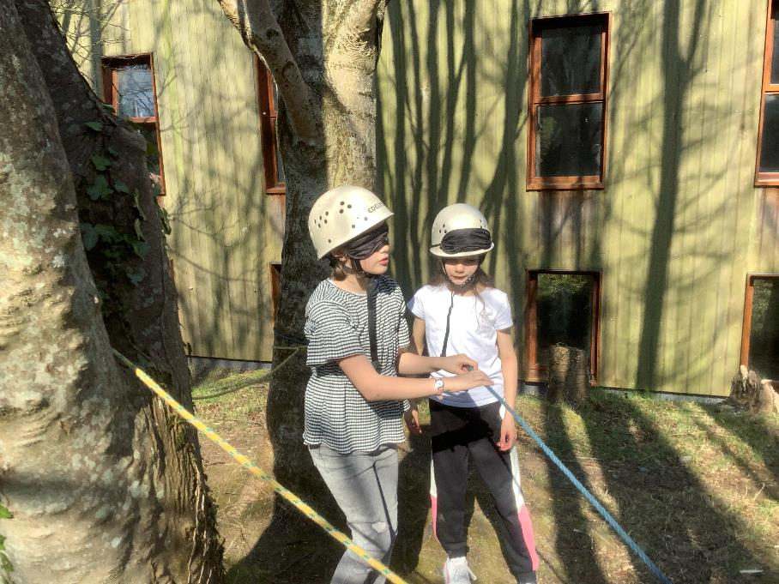

Slide 32
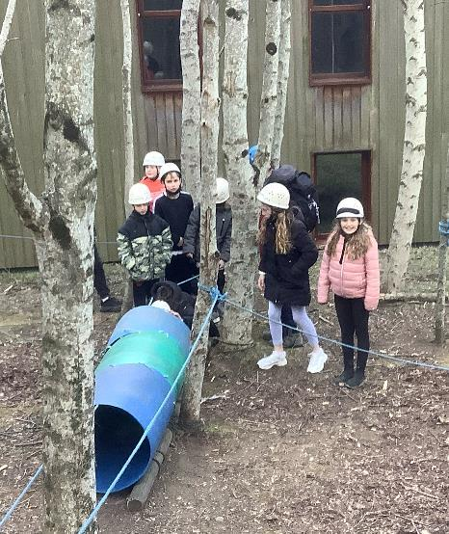
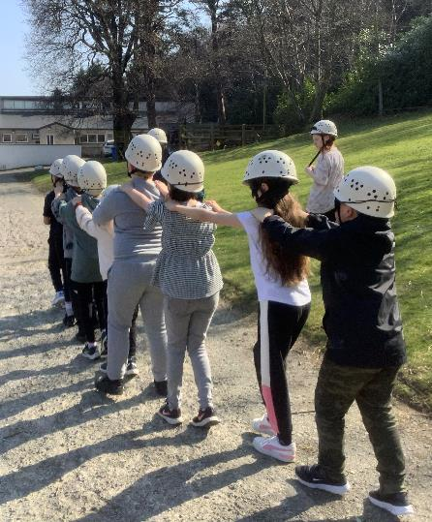

Slide 33
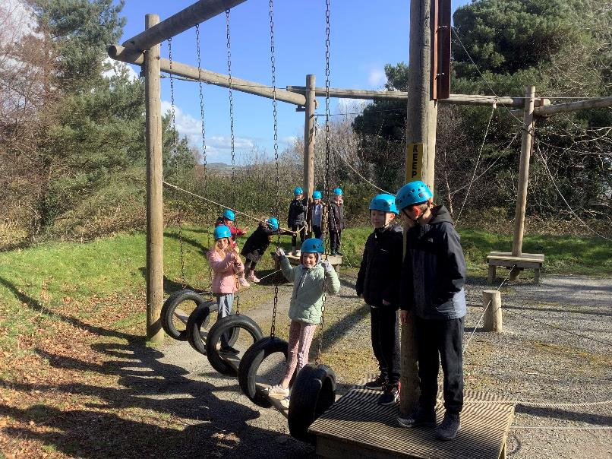
Team Ropes Challenge!

Slide 34
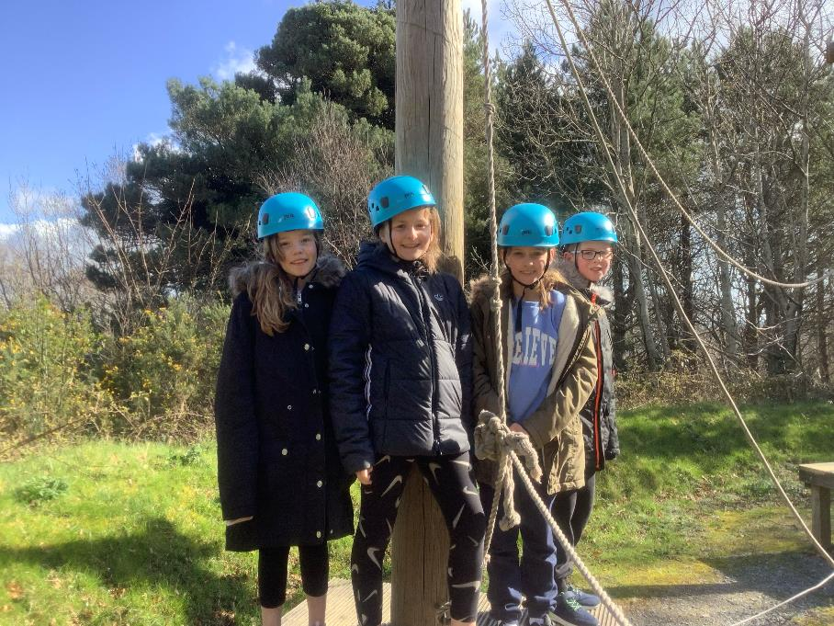

Slide 35
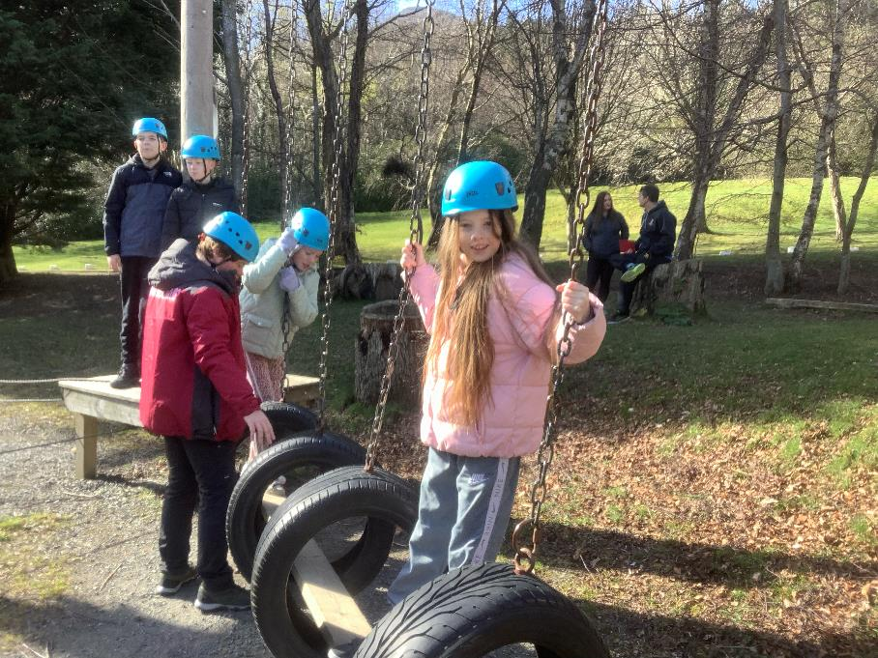

Slide 36
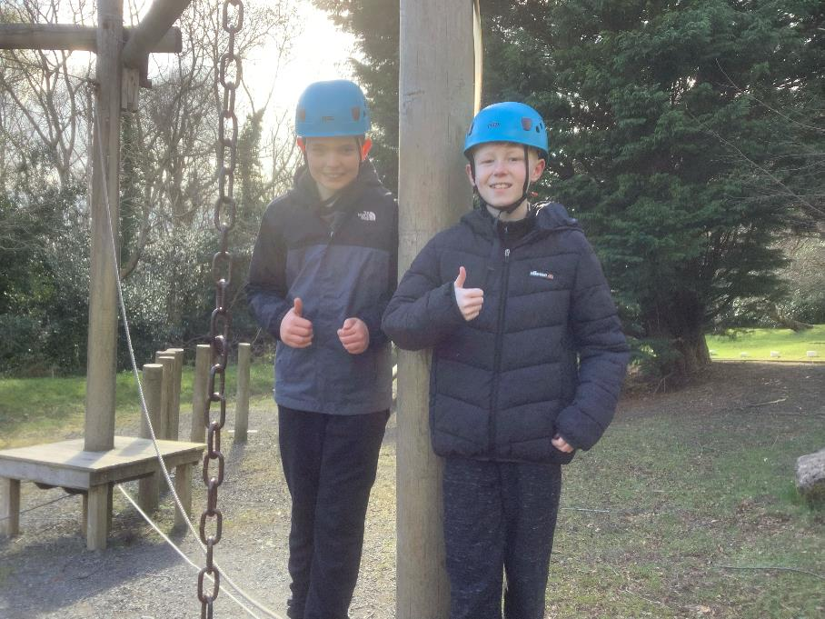

Slide 37
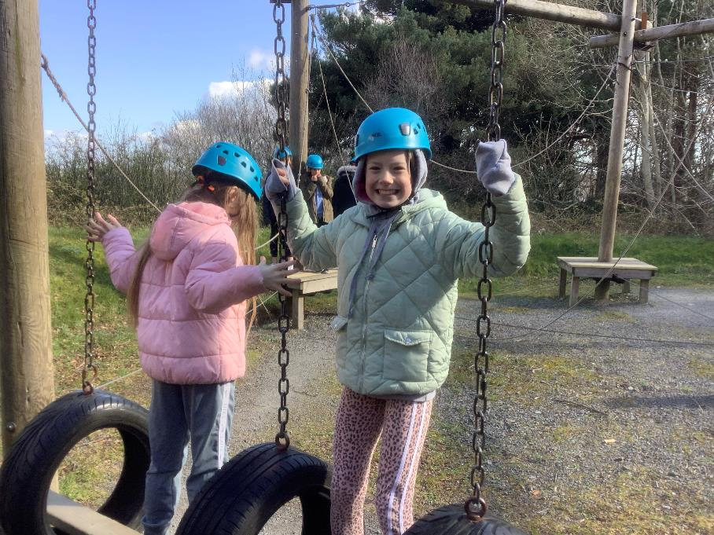

Slide 38
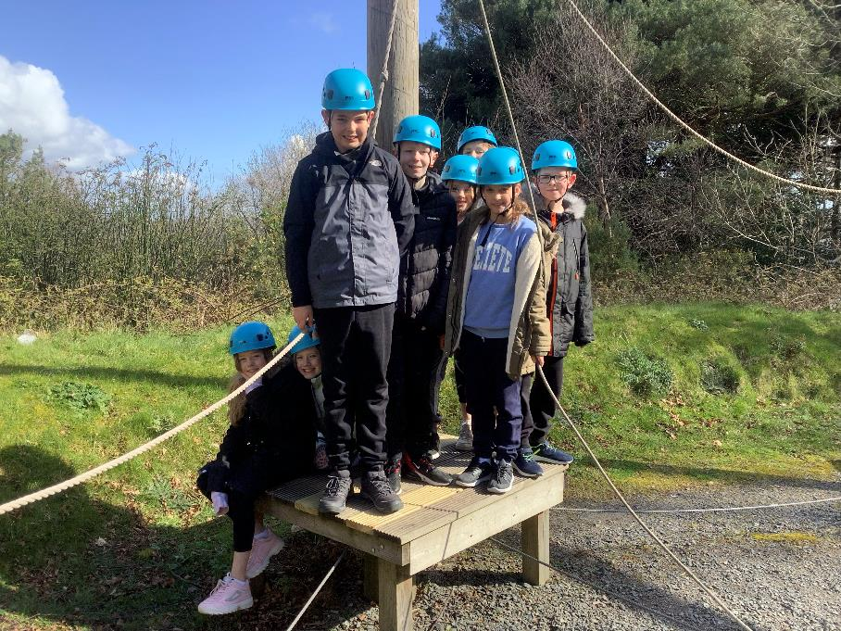

Slide 39
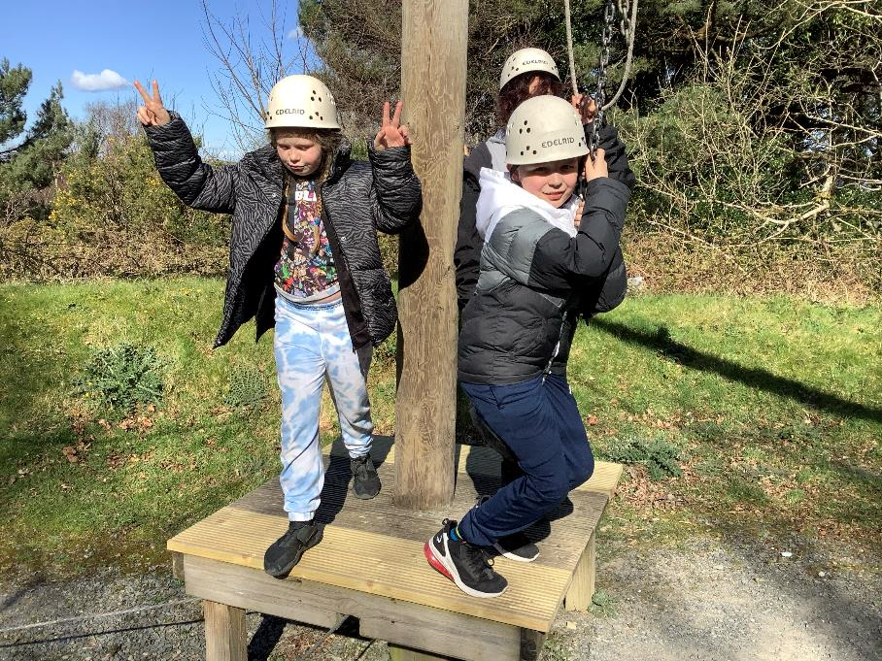

Slide 40
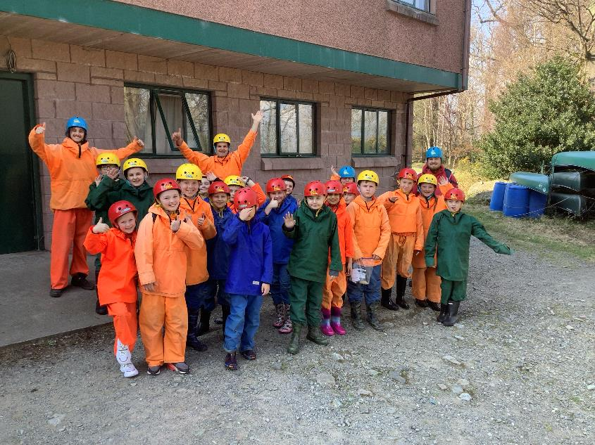
Adventure walk!

Slide 41
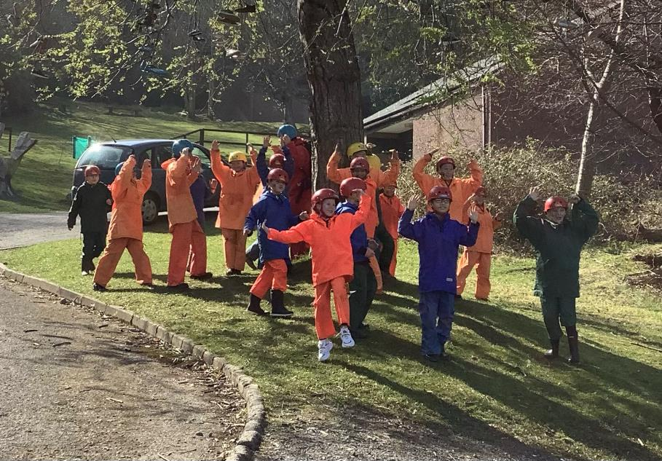

Slide 42
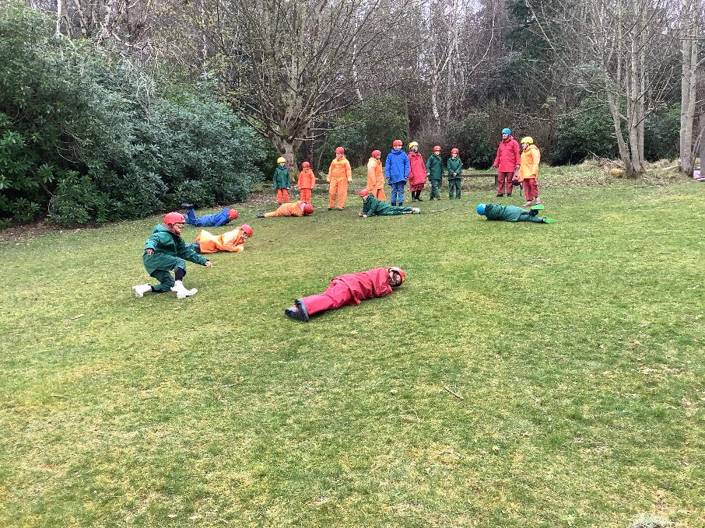

Slide 43
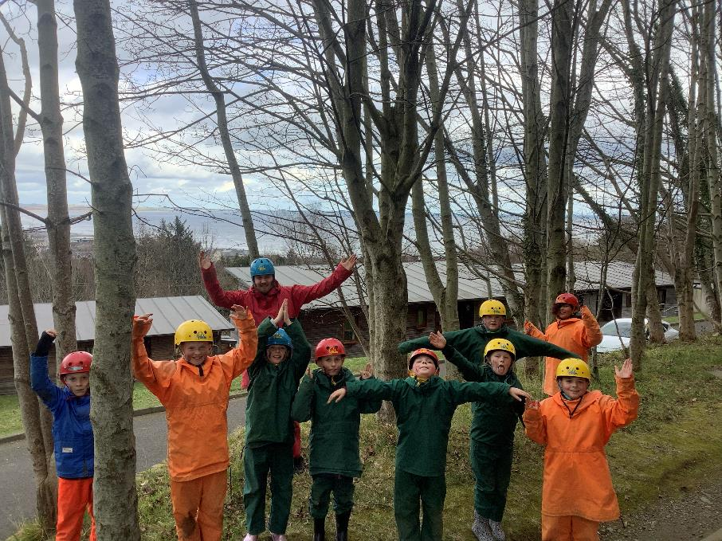

Slide 44


Slide 45


Slide 46


Slide 47


Slide 48


Slide 49


Slide 50


Slide 51


Slide 52

Scavenger hunt and orienteering!

Slide 53


Slide 54


Slide 55


Slide 56


Slide 57


Slide 58


Slide 59


Slide 60


Slide 61


Slide 62


Slide 63


Slide 64


Slide 65


Slide 66


Slide 67


Slide 68


Slide 69

Time to eat!

Slide 70


Slide 71


Slide 72


Slide 73


Slide 74

Talent show and rap battle!

Slide 75



Slide 76



Slide 77



Slide 78


Slide 79


Slide 80



Slide 81

The frog thing! Design

Slide 82


Slide 83


Slide 84


Slide 85


Slide 86

The frog thing! Heats

Slide 87


Slide 88


Slide 89


Slide 90


Slide 91


Slide 92

The frog thing! Finalists!

Slide 93


Slide 94

The frog thing! Podium!

Slide 95

The frog thing! Champion 2022!

Slide 96

Our last day!

Slide 97


Slide 98


Slide 99


Slide 100


Slide 101

Campfire cookout!

Slide 102


Slide 103


Slide 104



Slide 105


Slide 106


Slide 107


Slide 108


Slide 109


Slide 110


Slide 111


Slide 112


Slide 113


Slide 114


Slide 115


Slide 116


Slide 117


