Slide 1
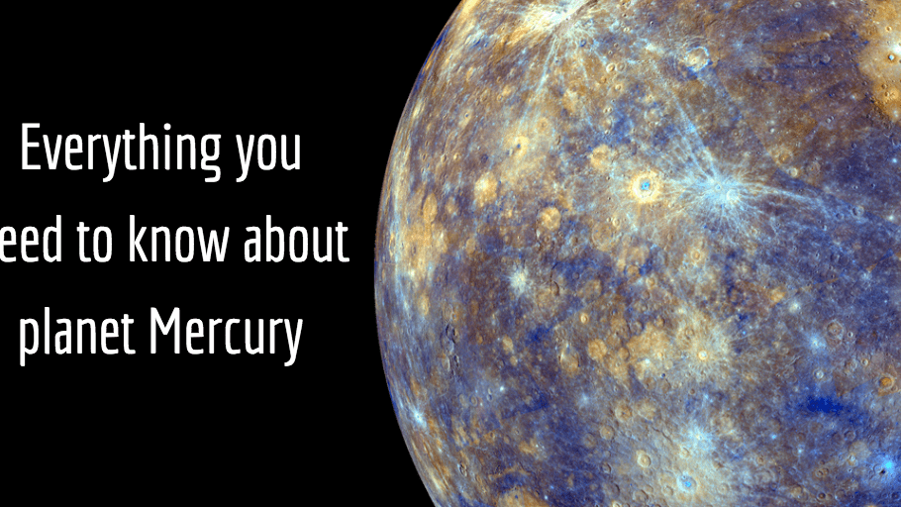

All about the planet mercury
Olivia castillo P4 F
A beginner’s guide.

Slide 2
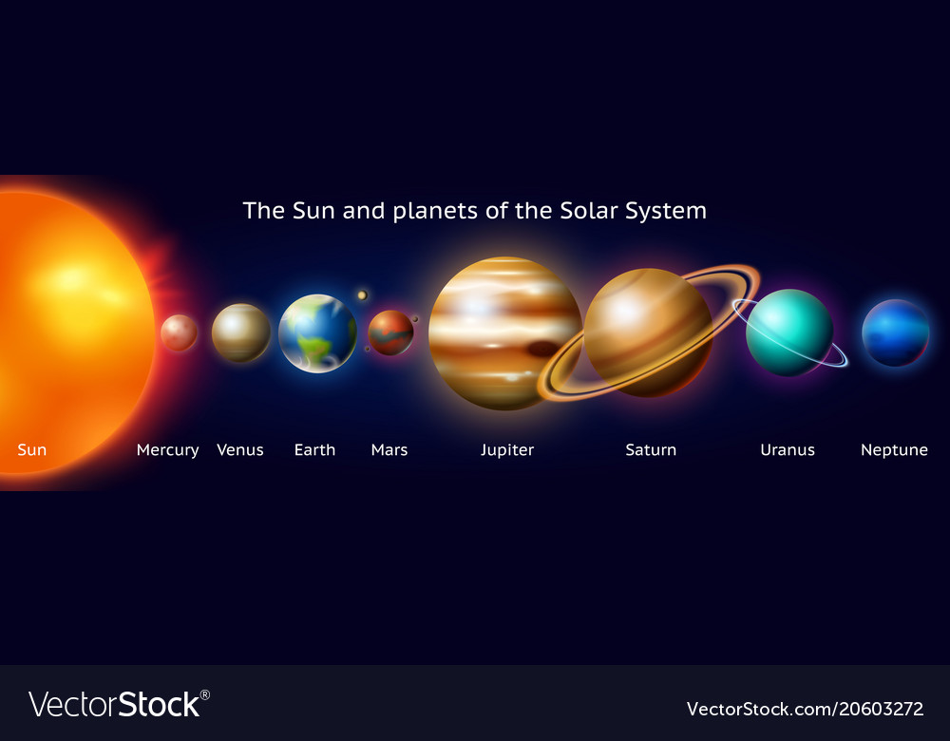
Where is mercury found in the solar system?
Mercury is the closest planet to the sun!
It is followed by Venus
It is 36 million miles away from the sun!

Slide 3
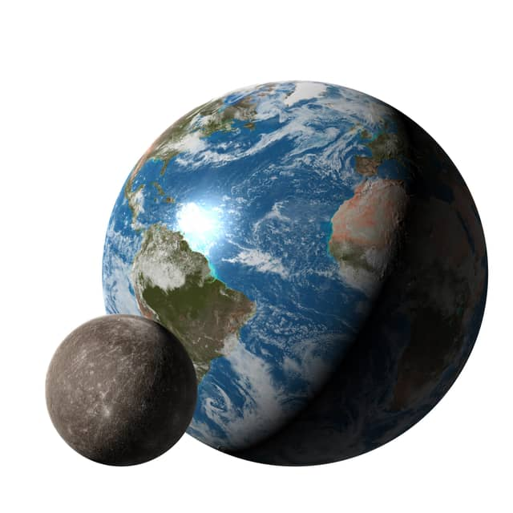
What size is it?
Mercury is about 3031 miles wide (that’s the diameter, a fancy new word for me!)
That means Mercury is about the size of the United States of America 🇺🇸

Slide 4
Did you know?
Mercury is the smallest planet and it is shrinking!!!🌑

Slide 5
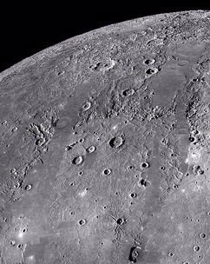
What type of planet is it?
Mercury is a rocky planet
It’s surface is very rough
The surface is solid and has craters like our moon 🌚
It orbits the sun, faster than any other planet, so...
One day is 58.7 earth days and one year is 88 earth days - that’s so short!

Slide 6
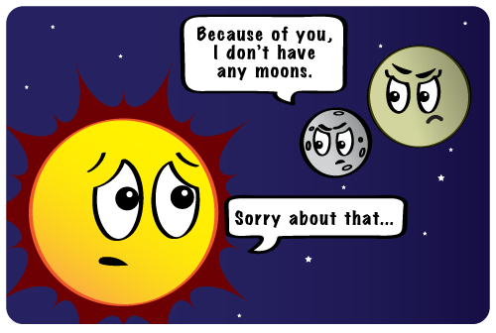
Does it have any moons of it’s own?
Mercury has no moon 🌙
It has no moons because the sun’s gravity would pull it away!
Poor planet 😢

Slide 7
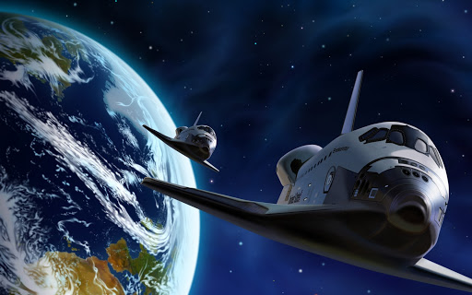
Could anybody travel there?
If we went by car it would take us 120 years to get there!!!
Even if we went in the Apollo spacecraft it would take about 80 days 👩🏽‍🚀
A spacecraft called Messenger has been to Mercury
Humans couldn’t go there because there is no air and the temperatures are really really hot 🥵 or really really cold 🥶

Slide 8
Interesting fact
If we went to mercury it would look very like the moon 🌙

Slide 9
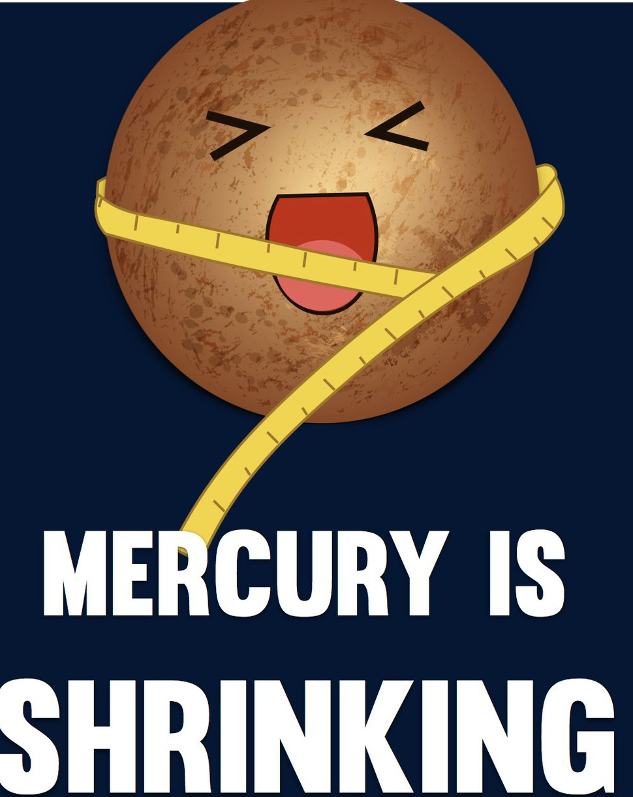
What is my favourite fact about mercury?
Mercury is SHRINKING!

Slide 10
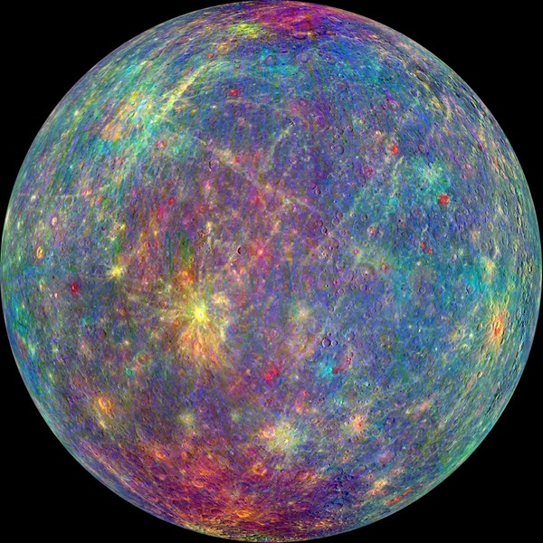
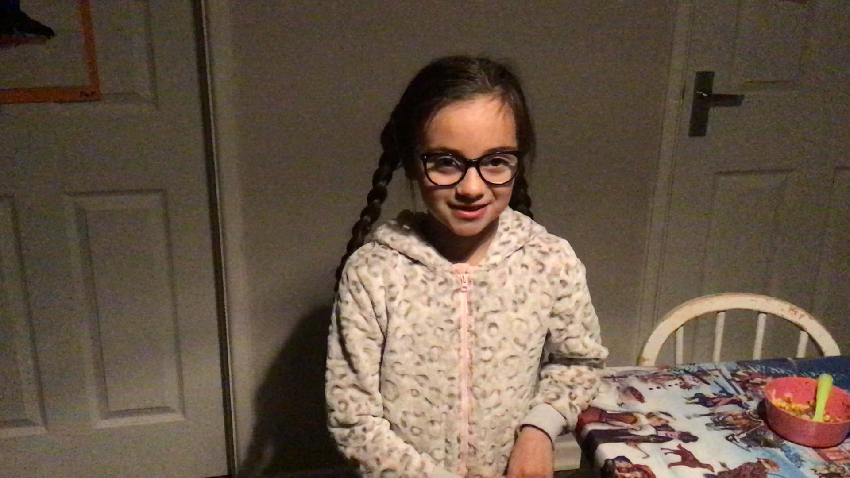
I hope you enjoyed finding out about mercury with me 🤩

