Slide 1


Slide 2

What Is World Book Day?
It is a day set aside each year to celebrate books, authors, and reading!
What are some of your favorite books?

Slide 3

What Is World Book Day?
World Book Day is about children exploring the amazing world of books and reading!
Celebrations are held around the world:
In the U.S., and in more than 100 countries around the world, World Book Day is held on April 23rd.
In the U.K. and Ireland, World Book Day is always held on the first Thursday in March.

Slide 4

World Book Day Beginnings
World Book Day began with a decree by UNESCO, the United Nations Educational, Scientific and Cultural Organization.
The first World Book Day was held in April 1995 - over 20 years ago!
The idea for World Book Day came from the Spanish celebration of “The Rose Day.” It was a day where people gave each other a rose to show their love (very similar to Valentine’s Day).

Slide 5
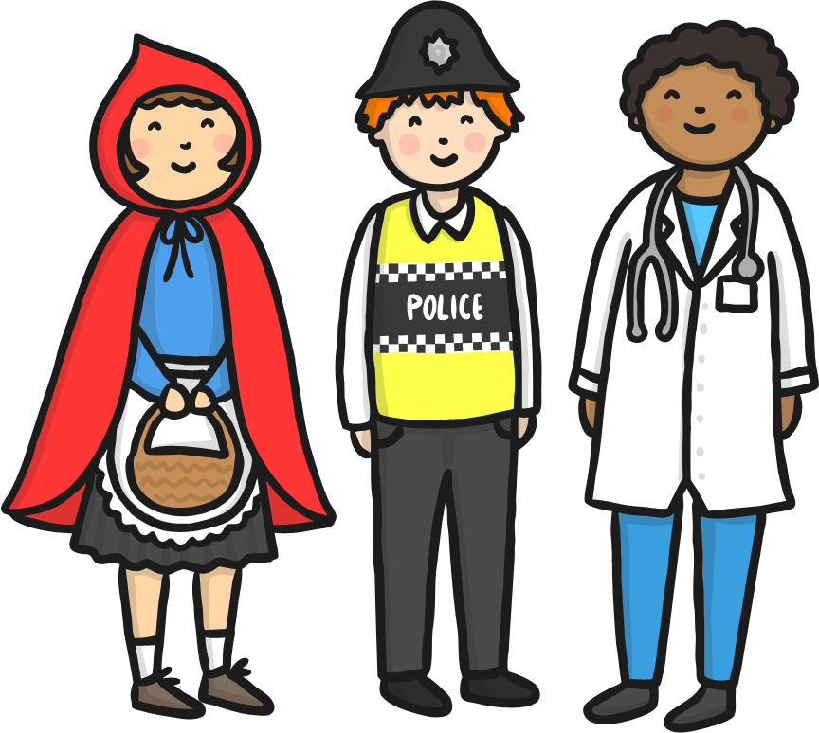
World Book Day Celebrations
World Book Day is a full day of fun! Here are just a few ways the world celebrates its love of books:
Children dress up as their favorite book characters. Ask your teacher which character he or she would pick. Which would you pick and why?
In the U.K. and Ireland, children are given a token and can “buy” a book.
Authors visit schools and share their love of reading.
How would you suggest your class celebrates World Book Day?
Make a list of your favorite authors or books!

Slide 6

Six Reasons to Celebrate World Book Day!
Books make you smarter!
Books are magical and you can visit other worlds and times.
New authors that spark your imagination.
Books are relaxing to read after a long day at school.
You can raise money for charity!
Find a special book and have a “friend” for life.

Slide 7
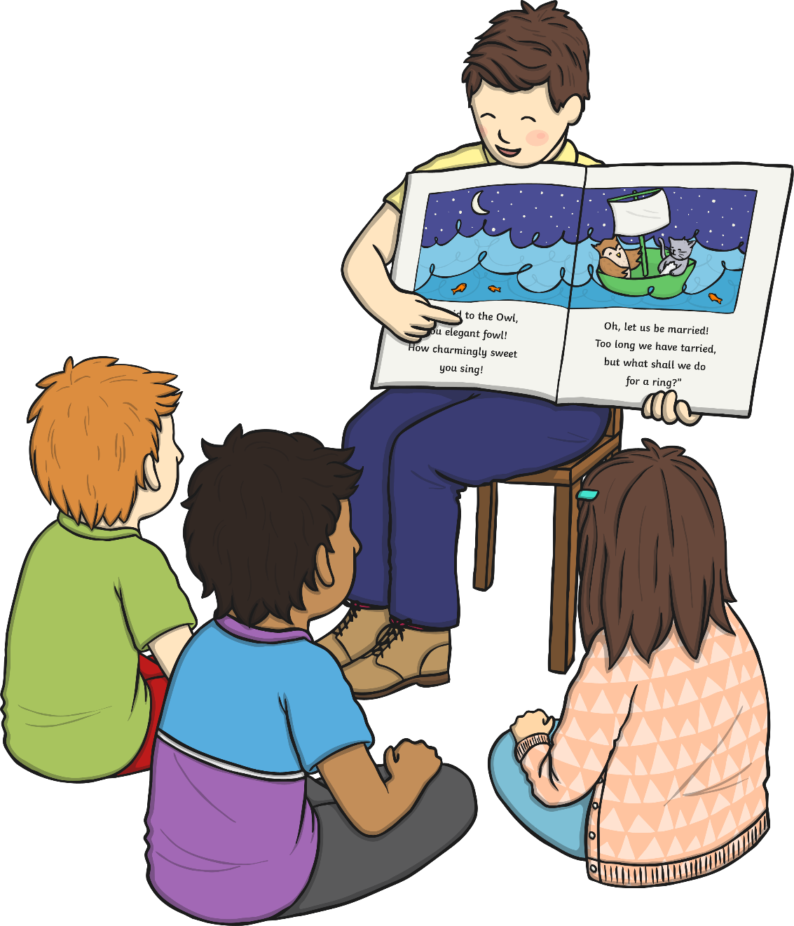
Where to Find Your Next Favorite Book!
There are lots of different ways to find an exciting book:
Visit your school or local library. The librarians there would be so happy to help you find a great read!
Ask your teacher about their favorite books.
Ask your parents!
Ask your friends!
Make your own book!
With your parent’s permission, visit websites for more ideas.

Slide 8


