Slide 2
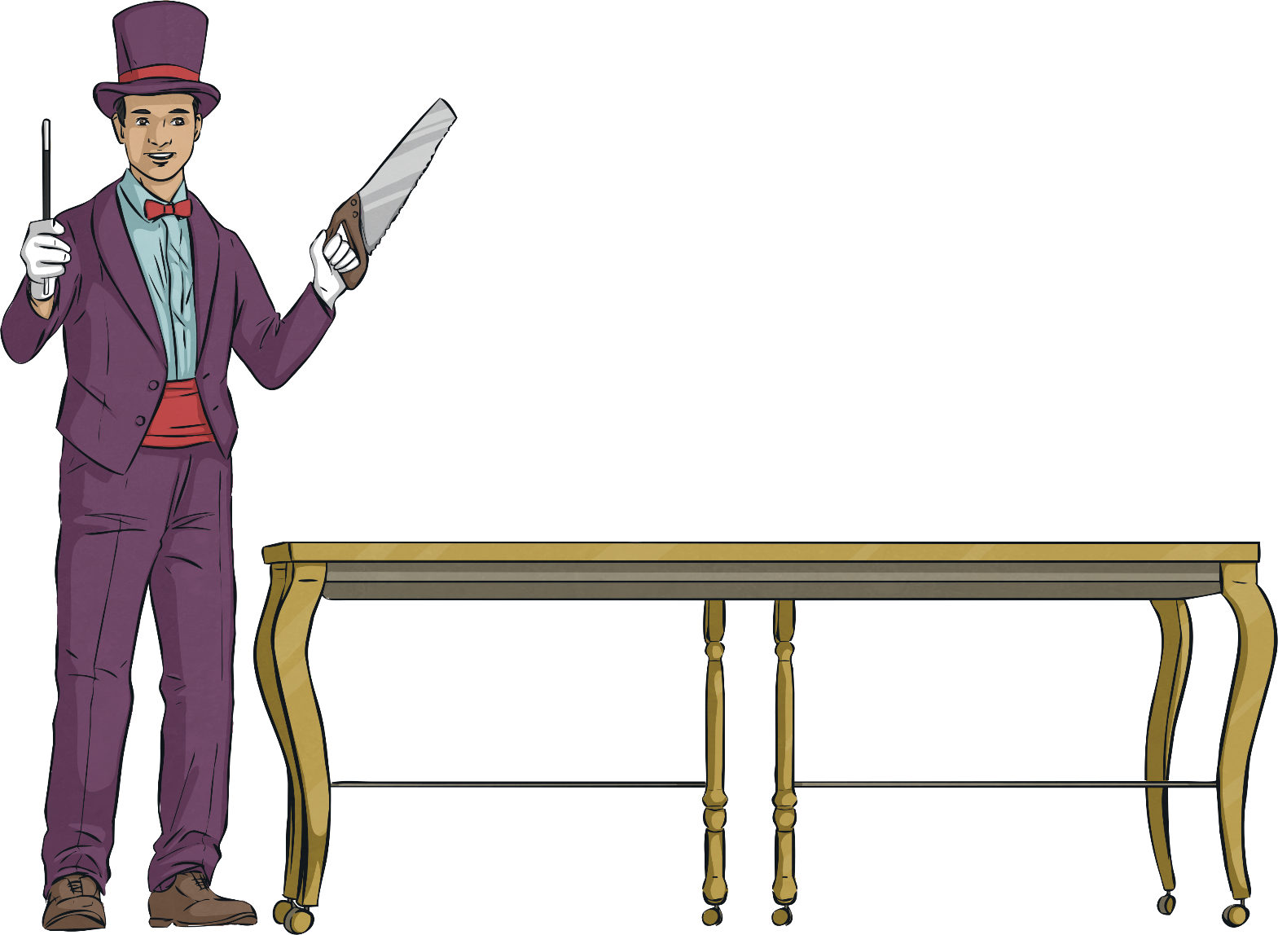
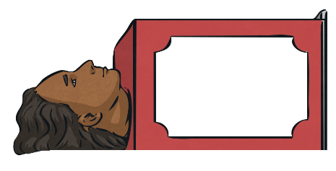
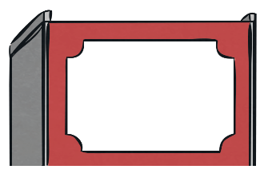
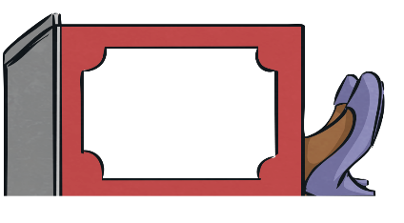
Partitioning Hundreds,
Tens and Ones
Can you put these numbers into hundreds, tens and ones?
237 =
2
3
7
200
30
7

Slide 3
Partitioning Hundreds,
Tens and Ones
Can you put these numbers into hundreds, tens and ones?
413 =
4
1
3
400
10
3
4

Slide 4
Partitioning Hundreds,
Tens and Ones
Can you put these numbers into hundreds, tens and ones?
358 =
3
5
8
300
50
8
4

Slide 5
Partitioning Hundreds,
Tens and Ones
Can you put these numbers into hundreds, tens and ones?
261 =
2
6
1
200
60
1
4

Slide 6
Partitioning Hundreds,
Tens and Ones
Can you put these numbers into hundreds, tens and ones?
119 =
1
1
9
100
10
9
4

Slide 7
Partitioning Hundreds,
Tens and Ones
Can you put these numbers into hundreds, tens and ones?
185 =
1
8
5
100
80
5
4

Slide 8
Partitioning Hundreds,
Tens and Ones
Can you put these numbers into hundreds, tens and ones?
593 =
5
9
3
500
90
3
4

