Slide 1
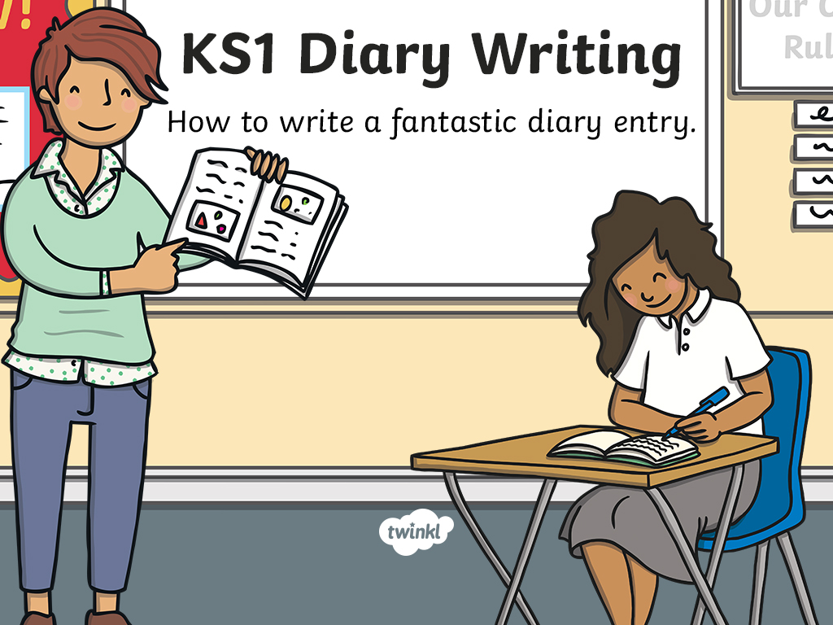

Slide 2

Writing a Diary Entry
When you write a diary entry, you are writing about a day in the life of a real person or character.
The diary entry needs to sound as if the person or character has written it, so it needs to be written from their point of view.
It also needs to be exciting
and interesting to read.
To get this right,
just follow a few easy steps...

Slide 3
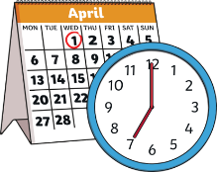
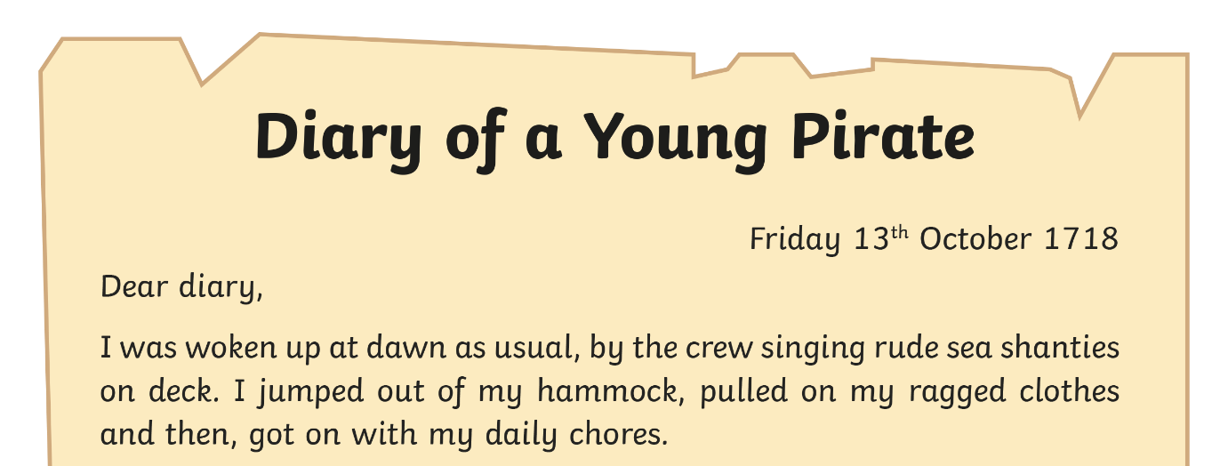
Diary Writing Must...
include the date and/or time
The date or time can be written at the top of the page like this...
or it can be included in the first few sentences of a diary entry like this...
‘It is past midnight but I am still wide awake because my day has been so exciting.’
This is important because it tells the reader exactly when the diary is being written.

Slide 4
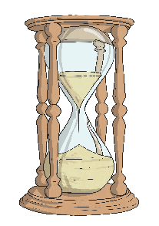

Diary Writing Must...
be written in the past tense
When we write a diary, we write in the past tense. This is because we are writing about something that has
already happened.
Look at the sentence below. How would you change it into the past tense?
I can not sleep very well as I am so excited about my birthday party! I wake up at 5am and get dressed…
I could not sleep very well as I was so excited about my birthday party! I woke up at 5am and got dressed…

Slide 5


Diary Writing Must...
use the words ‘I’, ‘my’, ‘we’ and ‘our’
These words are special because they tell us the diary is being
written by someone and they are talking about themselves.
We call this kind of writing ‘first person’. Look at these two examples. Which one uses the correct words to be written in ‘first person’?
I played with the new football I got for my birthday.
When my brother came home, we went inside our house. First person!
First person!
She played with the new football she got for her birthday.
When her brother got home, they went inside their house. Not first person!
Not first person!

Slide 6
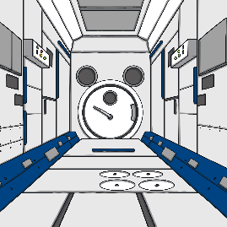
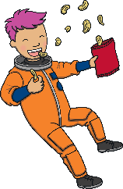
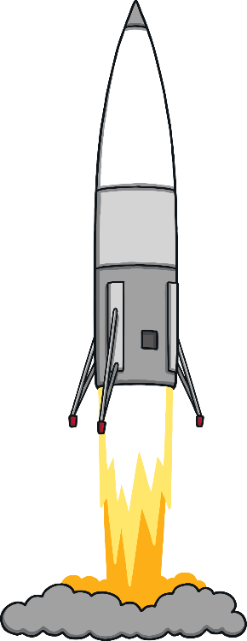


Diary Writing Must...
write as if you were there
When we write a diary, we have to make
the reader think we were really there.
We can do this by including lots of detail and description.
Look at the example below.
What extra detail and description could you add to make it sound as if it was written by someone who was really there?
noisy, trustworthy
rocky,
My noisy, trustworthy rocket landed on the rocky, uninviting moon at exactly 5 o’clock. I met some hilarious, spotty aliens who live in dark, gloomy craters and we had a picnic of jam sandwiches and moon cakes.
uninviting
exactly
hilarious, spotty
who live in dark, gloomy craters
of jam sandwiches and moon cakes

Slide 7
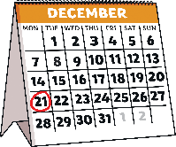

Diary Writing Must...
put the most important events in order
In a diary, we usually write about the events of our day in the order they happened, starting with what we did first when we woke up
and finishing with the end of our day.
We only include the most important or interesting events.
Look at the sentences below.
What order should they go in if they were part of a diary entry?
I woke up early and joined the other knights in the main hall for a breakfast.
In the afternoon I went up to the battlements to practise my arrow skills.
I spent the morning practising sword fighting in the castle yard.
I woke up early and joined the other knights in the main hall for a breakfast.
I fell asleep worrying about what tomorrow could bring...
In the afternoon I went up to the battlements to practise my arrow skills.
I fell asleep worrying about what tomorrow could bring...
I spent the morning practising sword fighting in the castle yard.
Click to reveal the correct order

Slide 8
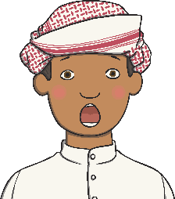

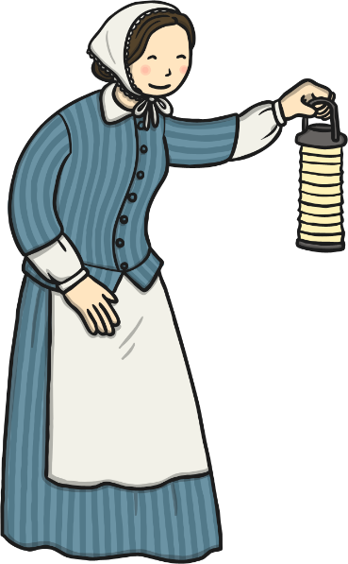


Diary Writing Must...
describe feelings
A diary is usually a secret place to write how you feel about what has happened to you in the day.
In a diary, you might include feelings, hopes or fears that you wouldn’t want anyone to know about.
Look at the examples below.
Where have these diary writers described their feelings?
I changed the poorly soldiers’ bandages and cleaned their wounds. Some of the injuries made me feel sick to look at but I didn’t let my disgust show.
made me feel sick
disgust
I couldn’t believe we’d won The World Cup! I was flooded with disbelief
and my whole body tingled with excitement and pride.
flooded with disbelief
excitement and pride

Slide 9

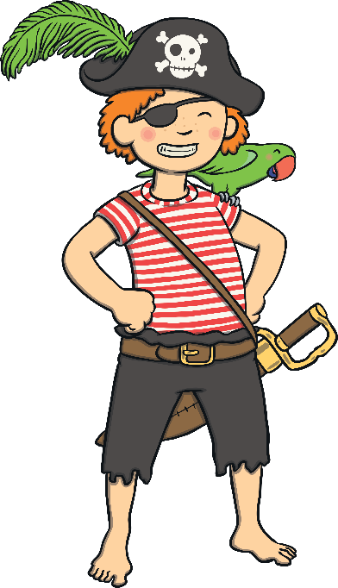


Diary Writing Must...
use time linking words, e.g. ‘next’, ‘first’ and ‘then’
A diary is usually describing lots of events.
To make sense of when these events happened it is helpful to include time linking words, such as ‘next’, ‘first’ and ‘then’.
If we just use one word, such as ‘and’ to link the events
in our diary it can get very boring!
Look at the example below. Can you think of different time words the writer could use at the start of each sentence to make their diary entry more interesting?
(First,)
(Next,)
(First,) I scrubbed the deck. (Next,) I climbed the rigging to keep a lookout. (Then,) (then,) We stood to attention for the captain to talk to us.
(After that,) The captain made someone walk the plank!
(Then,)
(After that,)

Slide 10


Diary Writing Must...
talk about where events happened.
As well as explaining when events take place,
it is also helpful to explain where they took place.
We might want to include the country, city, building, room
or even planet where events take place!
Look at the example below. How could you include where these
events took place to help the reader understand?
I arrived in this tiny English village, early this morning. The journey from London was very long and tiring. We waited around for ages in a church hall until different families came to choose us. I was chosen by a lady called Mrs Moggs. Now, I am writing this in a strange bed, in my new room at her thatched cottage, missing my home in the East End.
in this tiny English village,
from London
in a
church hall
in a strange bed, in my
new room at her thatched cottage,
in the East End

Slide 11




Diary Writing Checklist
Can you remember all the things you need to do to write a fantastic diary entry?
Diary writing must...
include the date and/or time;
be written in the past tense
use the words ‘I’, ‘my’, ‘we’ and ‘our’;
write as if I was there;
write about the most important events in order;
describe feelings;
use time linking words, e.g. ‘next’, ‘first’ and ‘then’;
talk about where events happened.

