Slide 1


Maths
Number and Place Value
Year One
Maths | Year 4 | Number and Place Value | Rounding | Lesson 1 of 5: Space

Slide 2


Rocket Rounding

Slide 3

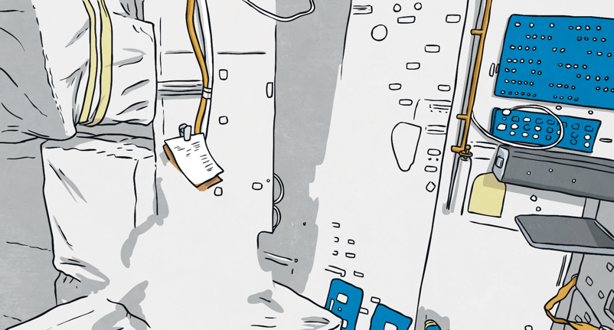
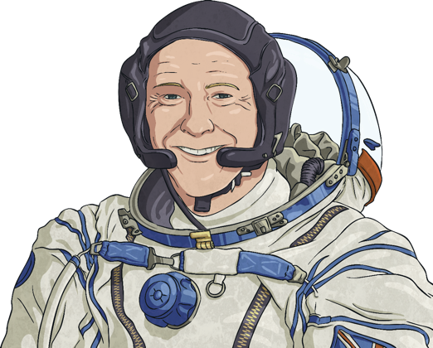

Rocket Rounding
The rocket has run out of fuel! But don’t worry because we
can collect the right kind of space rocks to get it going again.
We need to
collect some space rocks.
But we must be careful
to only collect the right
ones as they may just explode!
Hello space cadet.
Today we will be taking a space walk.

Slide 4




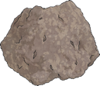
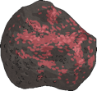
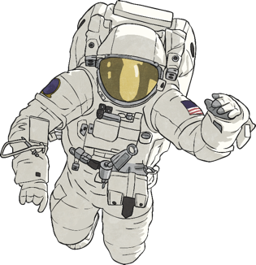
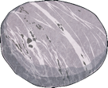
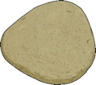
Rocket Rounding
Find the rock which rounds 537 to the nearest 10.
Brilliant!
Let’s keep searching for more space
rocks!
350
330
440
520
540

Slide 5


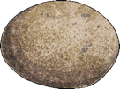
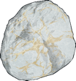
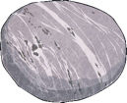

Rocket Rounding
Find the rock which rounds 704 to the nearest 10.
Brilliant!
Let’s keep searching for more space
rocks!
700
407
701
710
740

Slide 6





Rocket Rounding
Which number, when rounded to the nearest 10, will be 670?
Brilliant!
Let’s keep searching for more space
rocks!
666
760
675
664
607

Slide 7




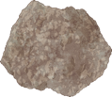

Rocket Rounding
Find the rock which rounds 345 to the nearest 10.
Brilliant!
Let’s keep searching for more space
rocks!
450
340
430
440
350

Slide 8
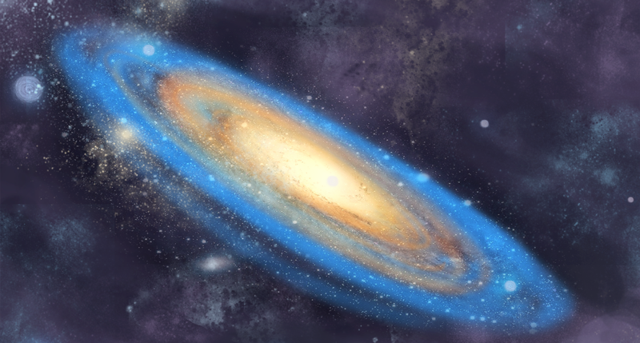
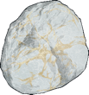
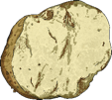


Rocket Rounding
Find the rock which rounds 487 to the nearest 10.
Brilliant!
Let’s keep searching for more space
rocks!
480
890
490
470
485

Slide 9
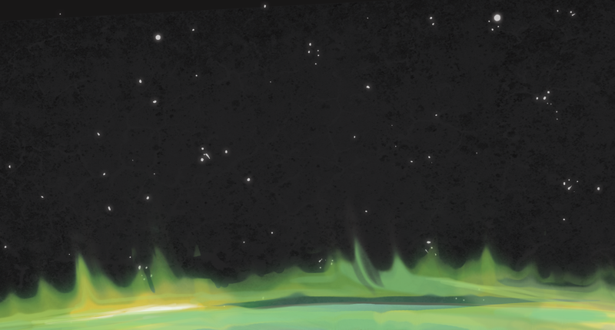

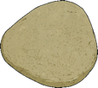


Rocket Rounding
Which number, when rounded to the nearest 10, will be 220?
Brilliant!
Let’s keep searching for more space
rocks!
217
212
202
115
226

Slide 10
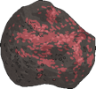



Rocket Rounding
Find the rock which rounds 195 to the nearest 10.
Brilliant!
Let’s keep searching for more space
rocks!
130
210
200
290
190

Slide 11





Rocket Rounding
Find the rock which rounds 843 to the nearest 10.
Brilliant!
Let’s keep searching for more space
rocks!
834
850
840
820
830

Slide 12




Rocket Rounding
Which number, when rounded to the nearest 10, will be 600?
Brilliant!
Let’s keep searching for more space
rocks!
650
594
610
606
598

Slide 13



Rocket Rounding
Find the rock which rounds 934 to the nearest 10.
Brilliant!
Let’s keep searching for more space
rocks!
950
830
930
940
390

Slide 14





Rocket Rounding
Find the rock which rounds 335 to the nearest 10.
320
330
Brilliant!
Let’s keep searching for more space
rocks!
310
350
340

Slide 15




Rocket Rounding
Which number, when rounded to the nearest 10, will be 760?
Brilliant!
Let’s keep searching for more space
rocks!
766
662
655
755
750

Slide 16




Rocket Rounding
Find the rock which rounds 294 to the nearest 10.
Brilliant!
Let’s keep searching for more space
rocks!
390
240
280
290
300

Slide 17




Rocket Rounding
Find the rock which rounds 873 to the nearest 10.
Brilliant!
Let’s keep searching for more space
rocks!
770
860
780
870
880

Slide 18




Rocket Rounding
Which number, when rounded to the nearest 10, will be 870?
Brilliant!
I think that we may just have enough rocks now!
878
859
865
766
876

Slide 19



Rocket Rounding
Congratulations space cadet, you’ve collected enough
space rocks to power the rocket ship!
You’re a
rounding wizard!
Thank you for all
your help.

Slide 20


