Slide 1
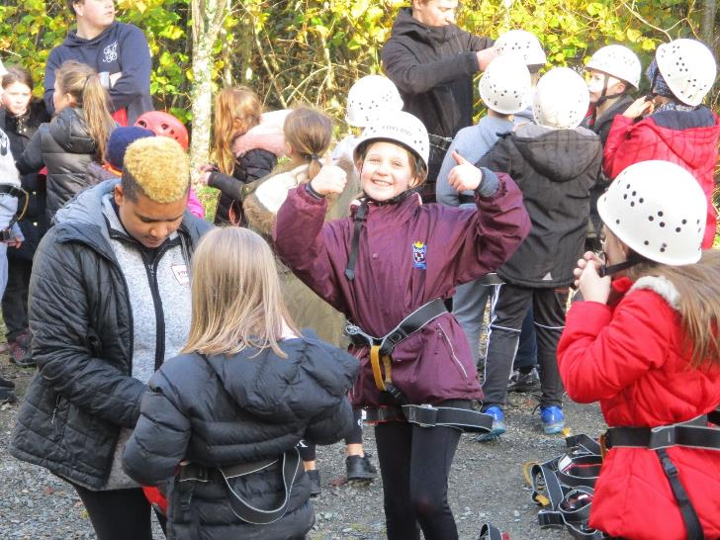
P6 visit to Greenhill YMCA
5th – 8th November 2019

Slide 2
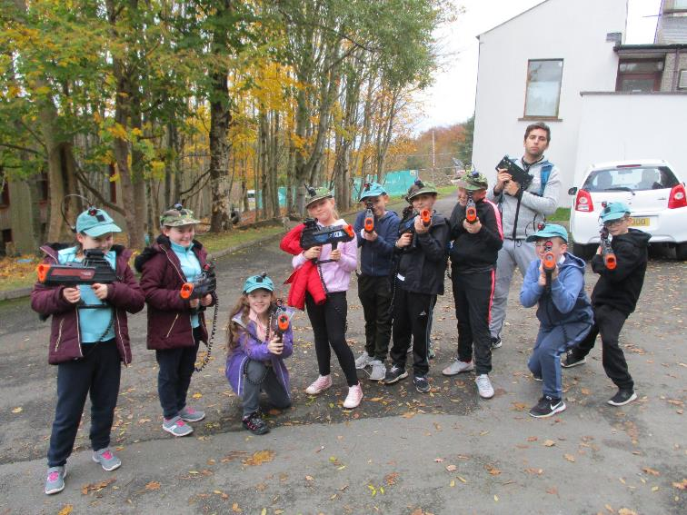
Laser tag!

Slide 3
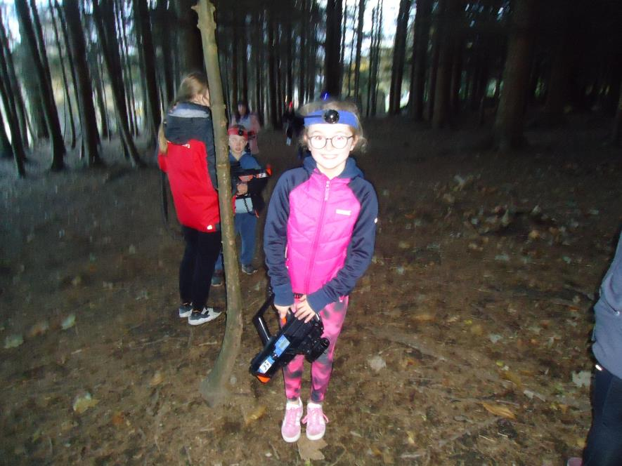

Slide 4
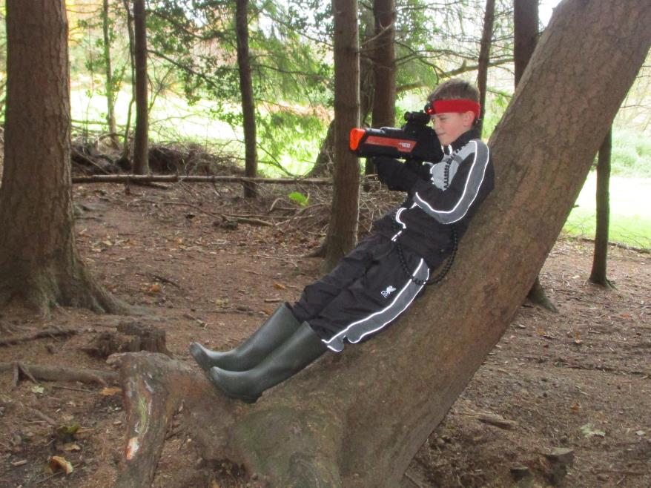

Slide 5
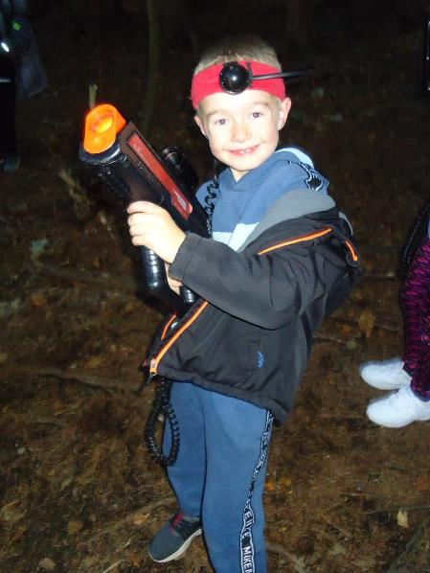
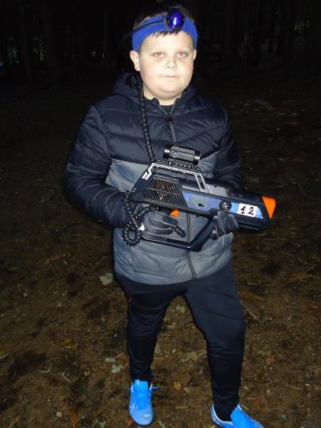

Slide 6
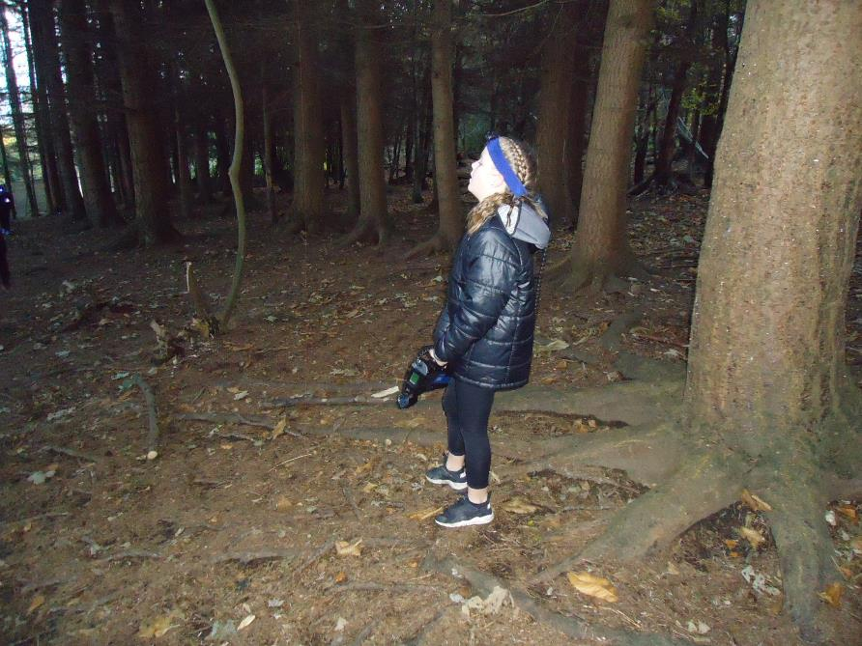

Slide 7
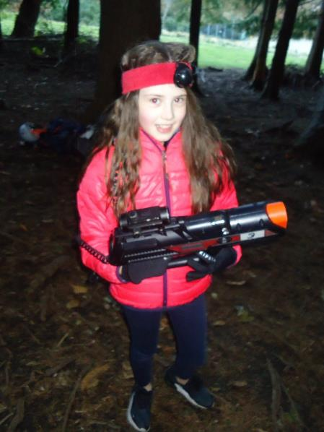
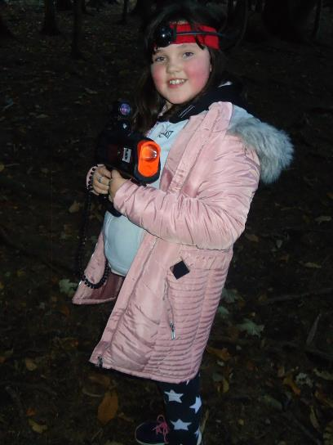

Slide 8
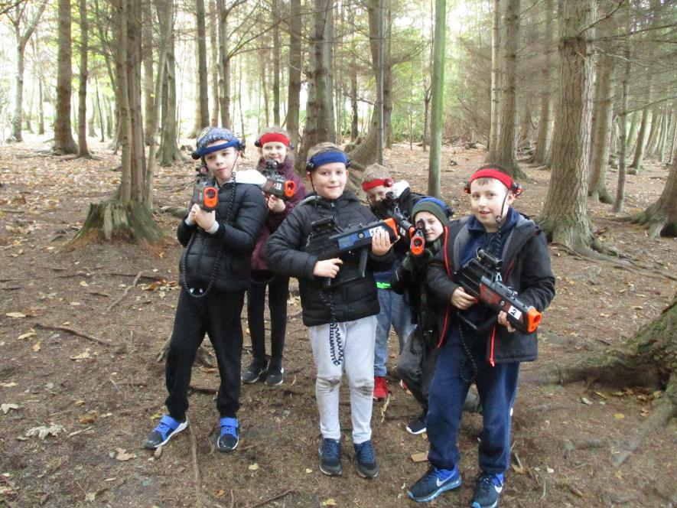

Slide 9
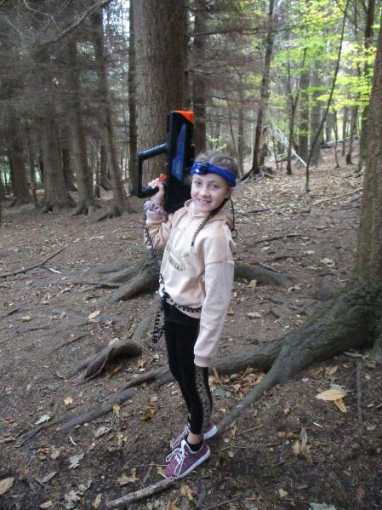
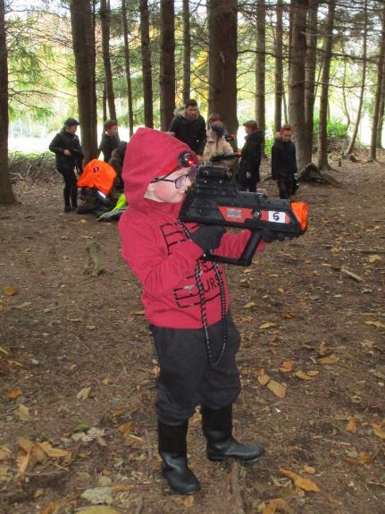

Slide 10
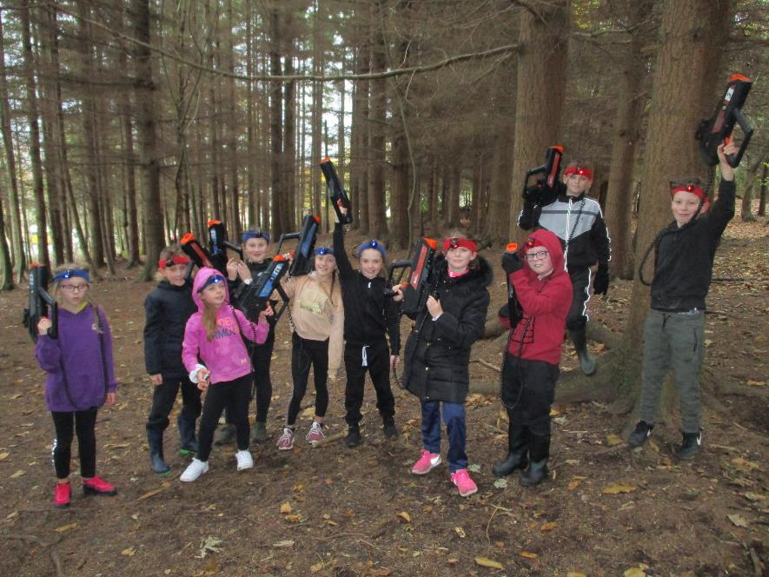

Slide 11
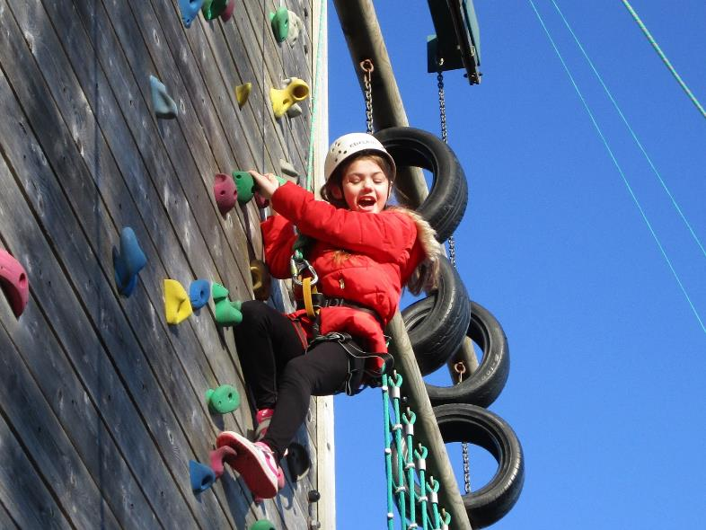
Climbing wall!

Slide 12
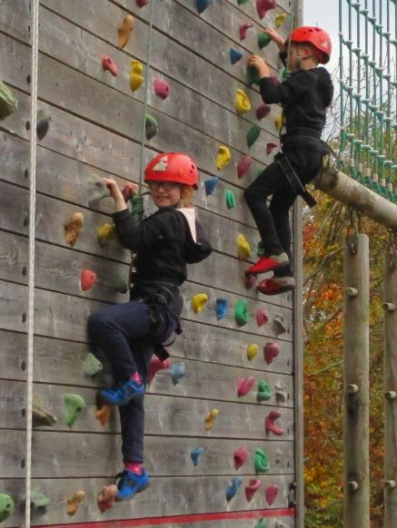
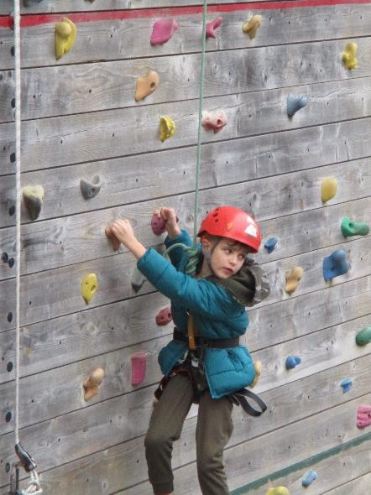

Slide 13
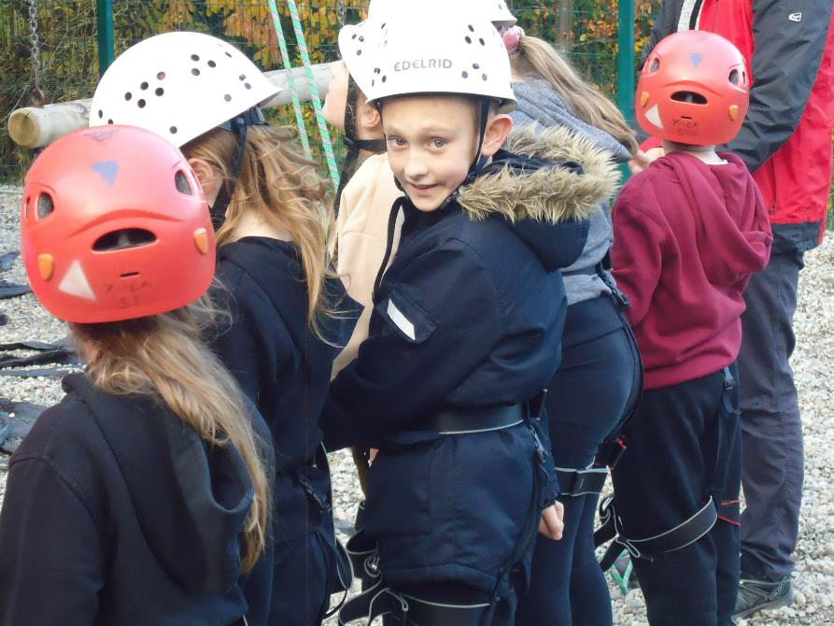

Slide 14
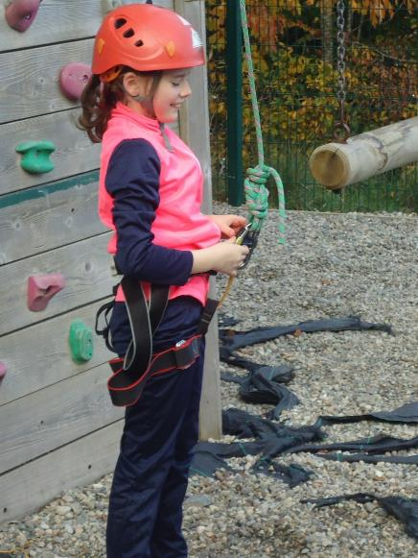
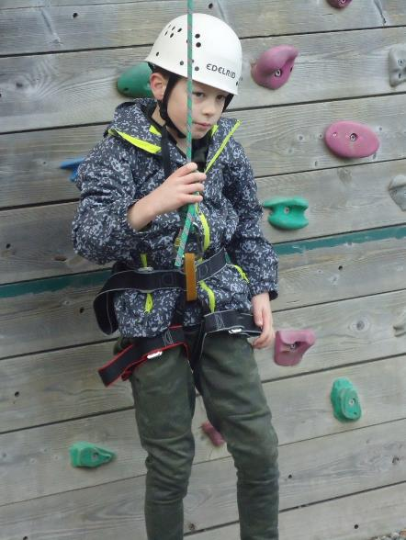

Slide 15
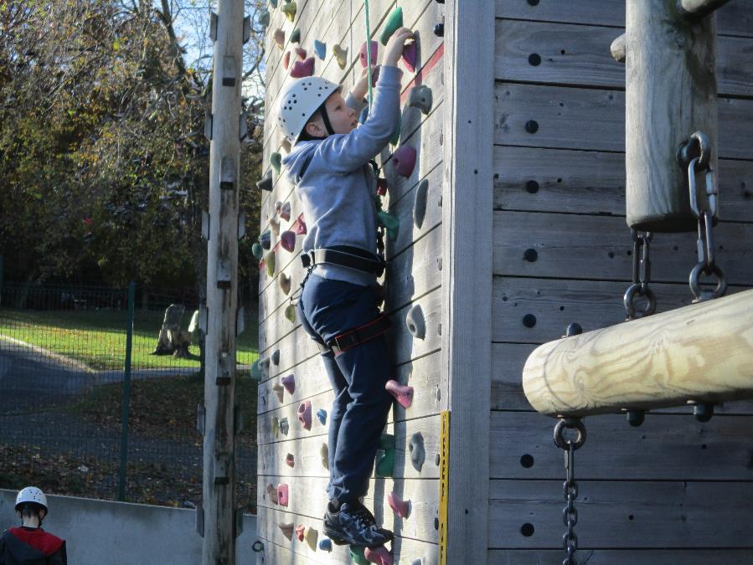

Slide 16
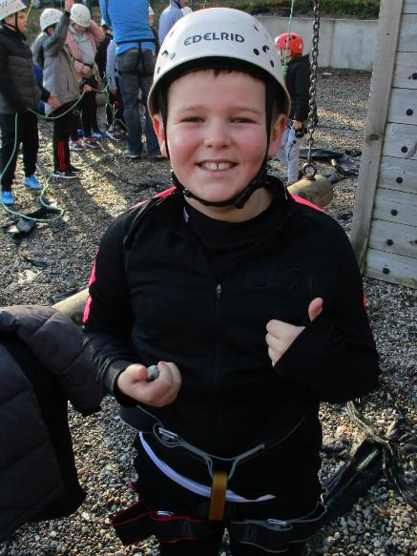
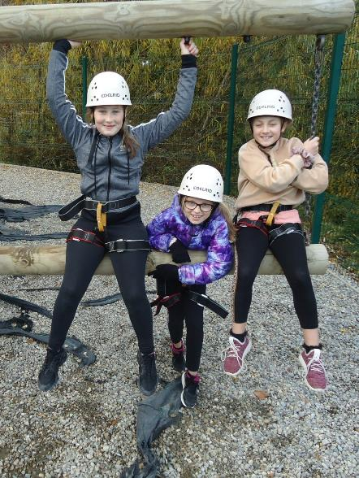

Slide 17
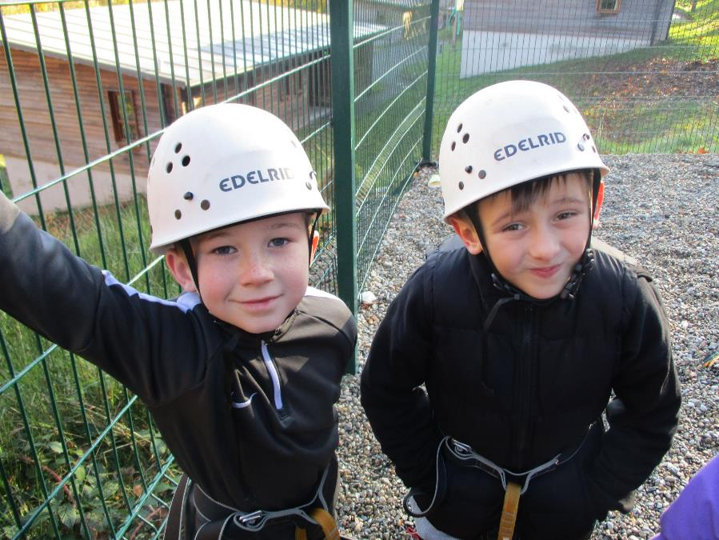

Slide 18
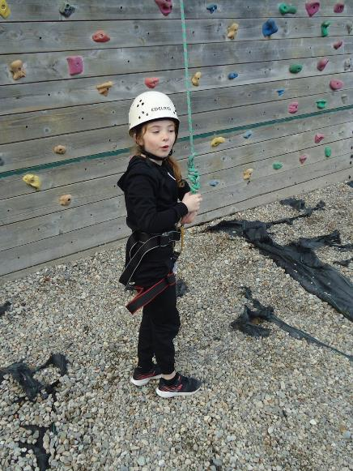
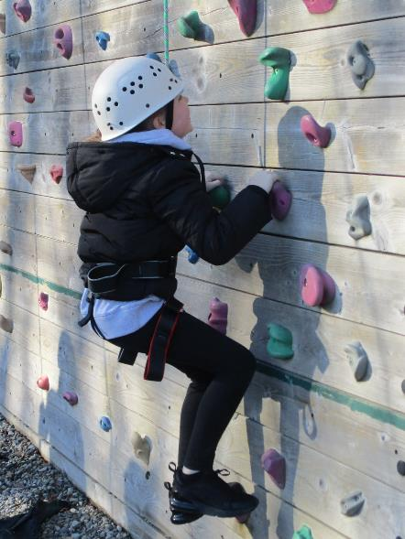

Slide 19
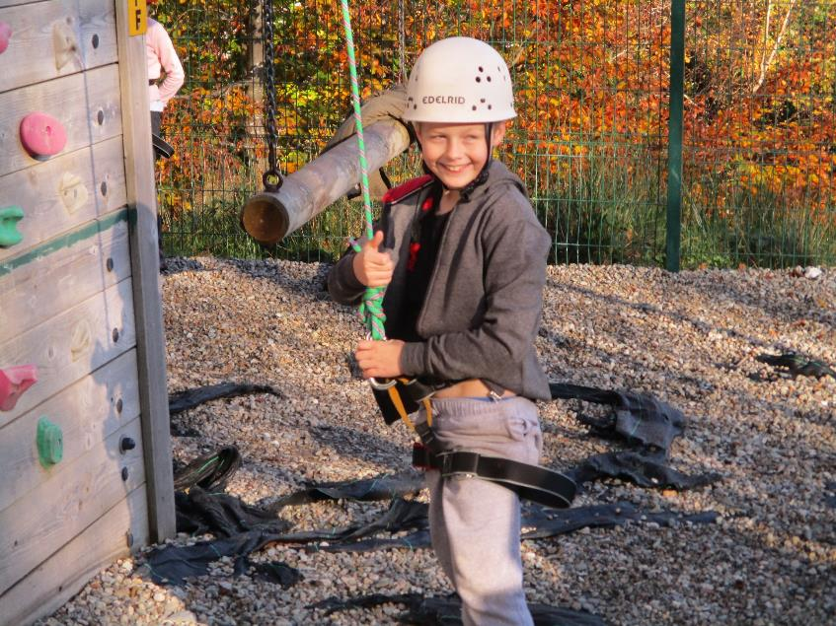

Slide 20
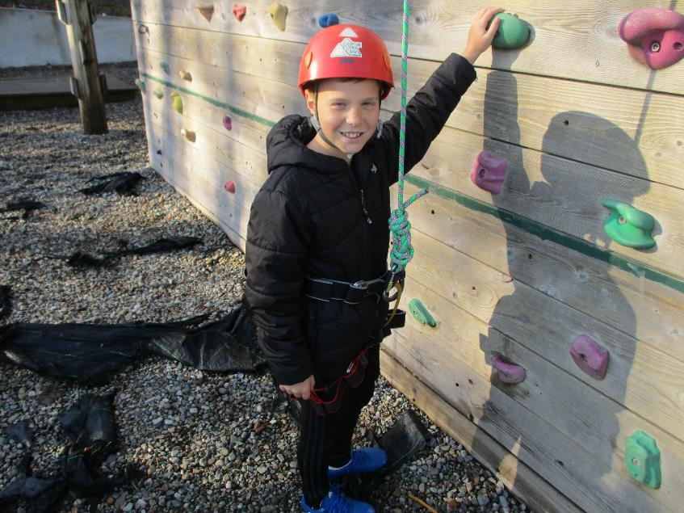

Slide 21
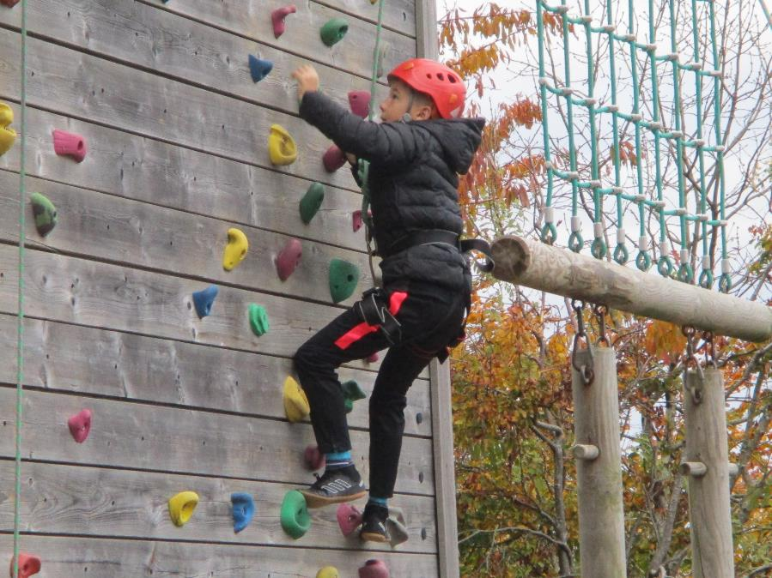

Slide 22
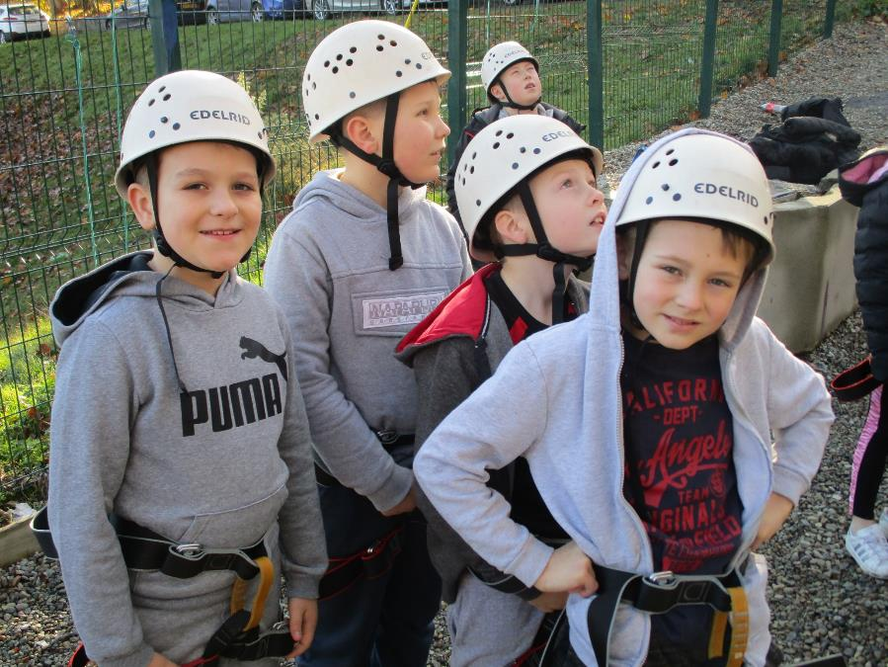

Slide 23
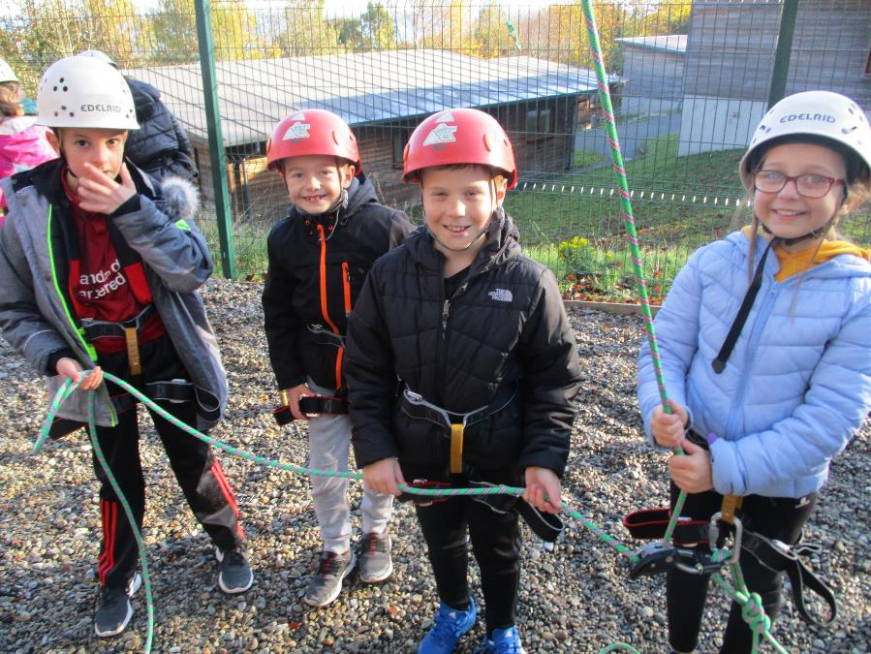

Slide 24
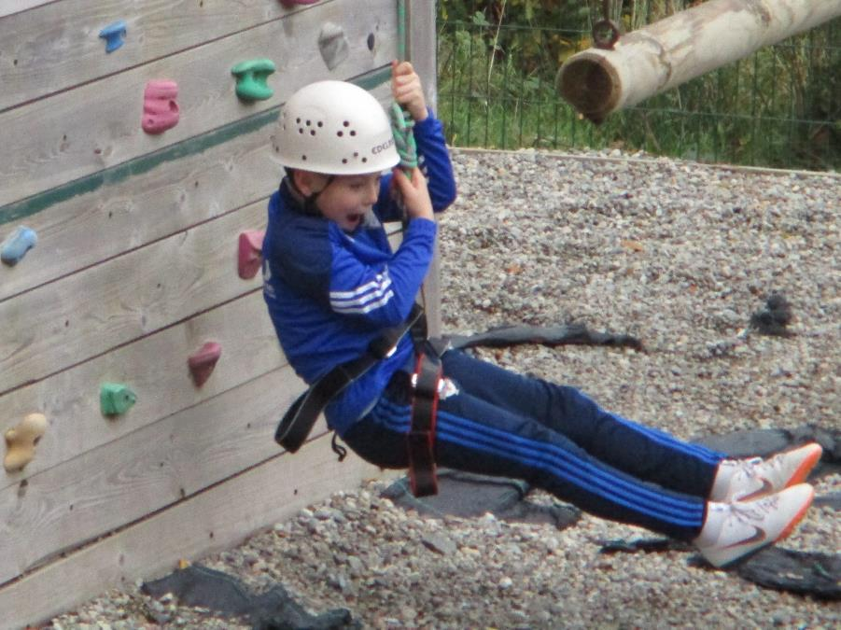

Slide 25
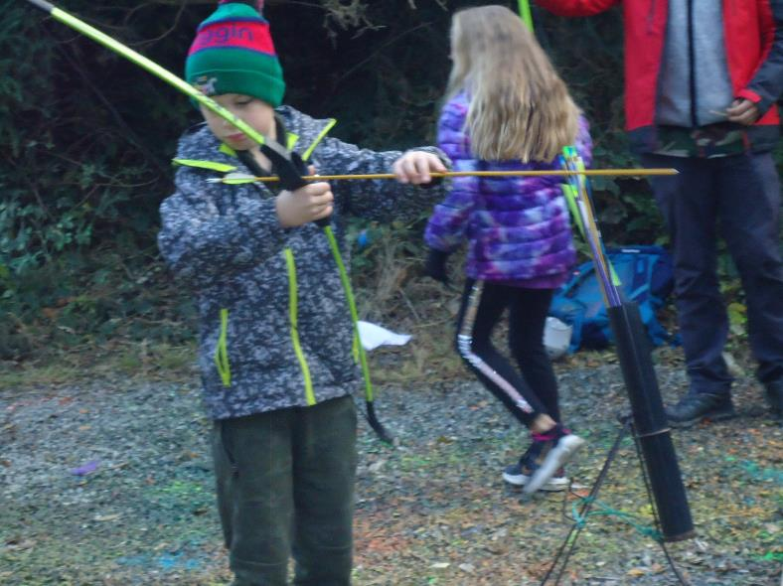
Archery!

Slide 26
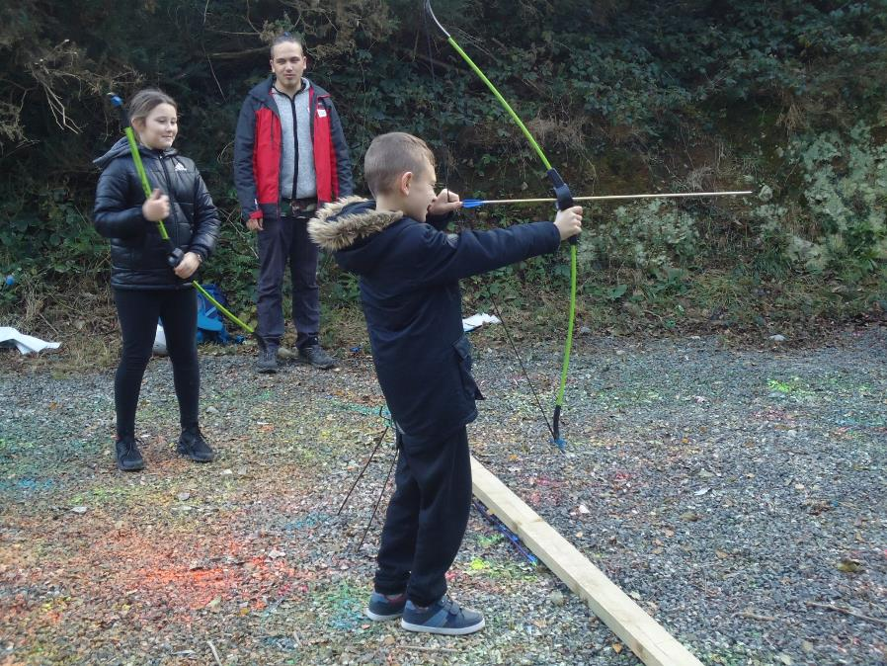

Slide 27
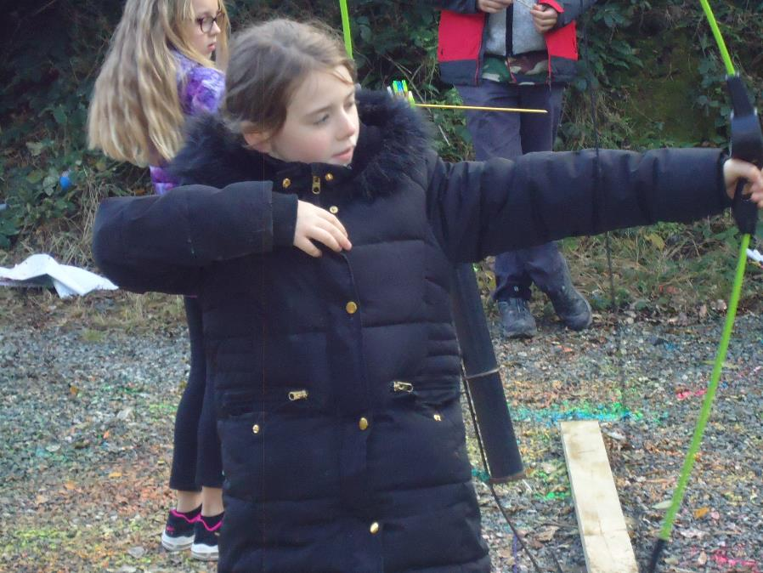

Slide 28
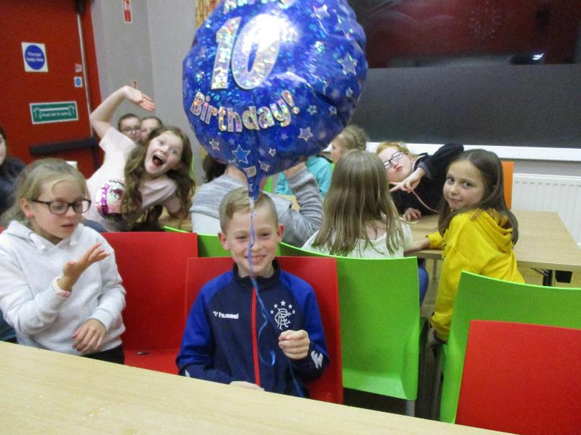
Josh’s 10th birthday!

Slide 29
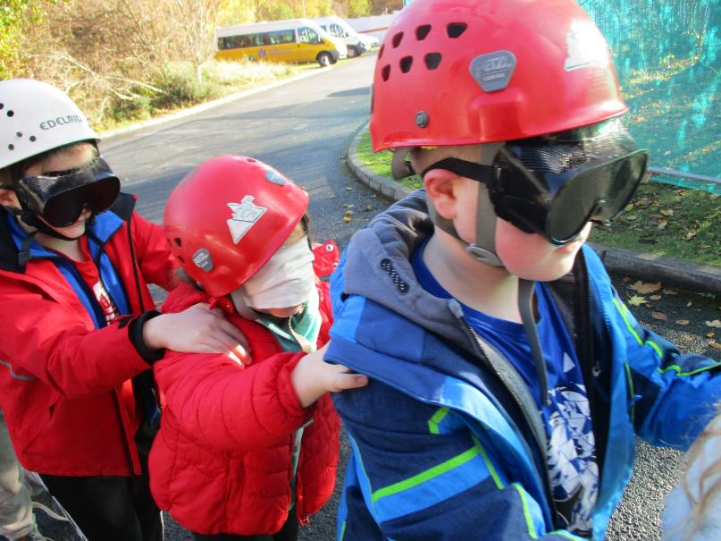
Blind trail!

Slide 30
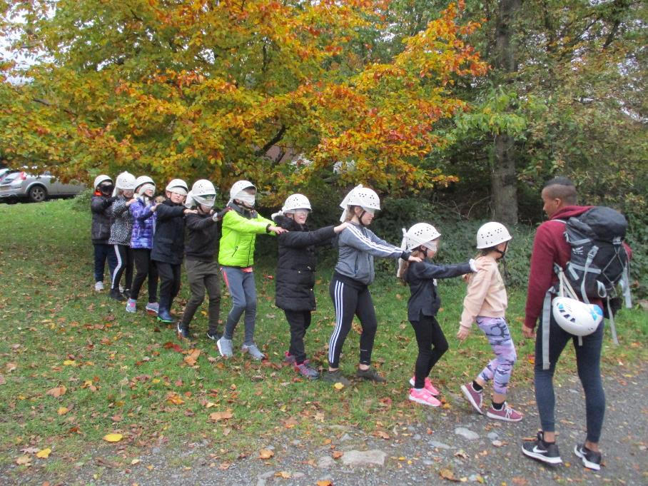

Slide 31
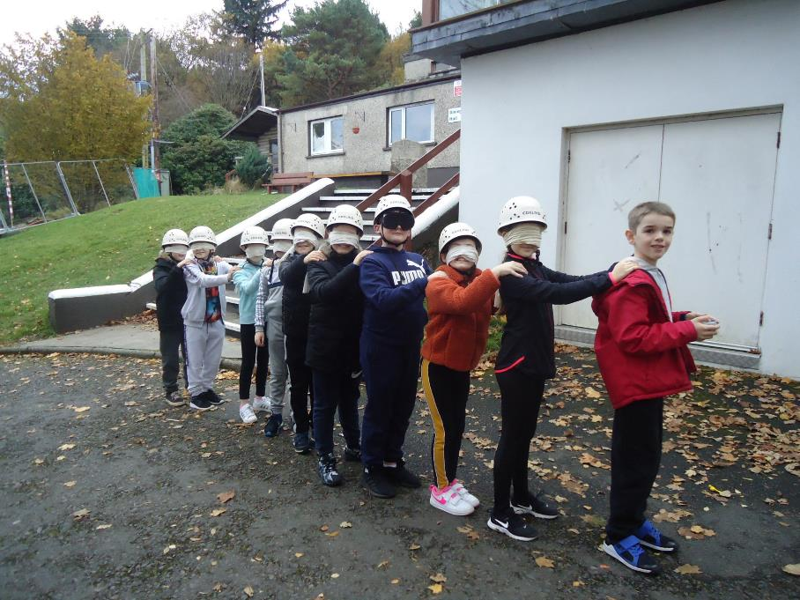

Slide 32
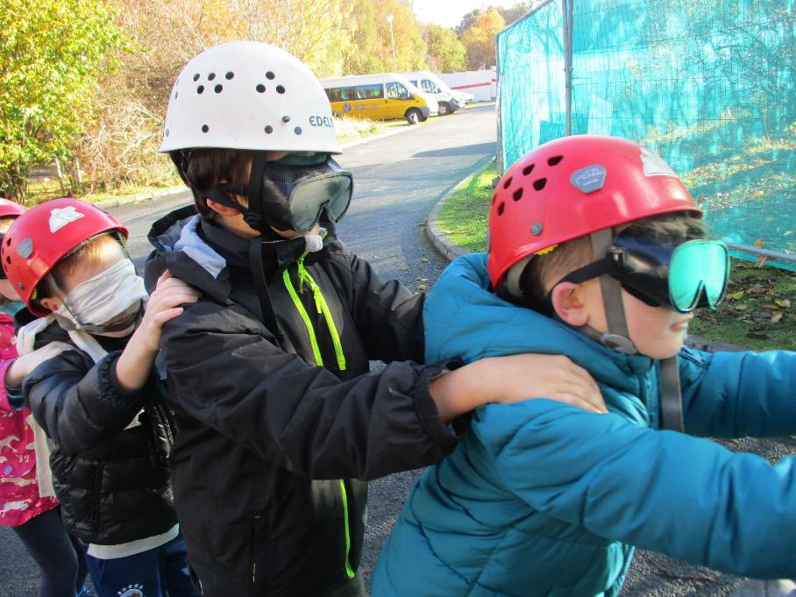

Slide 33
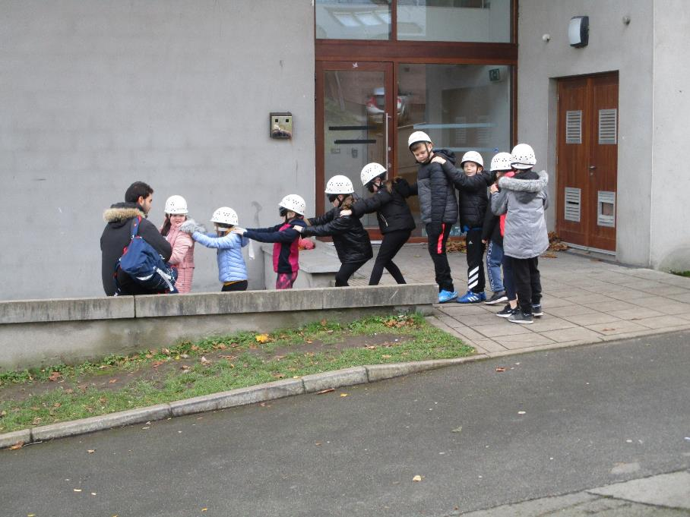

Slide 34
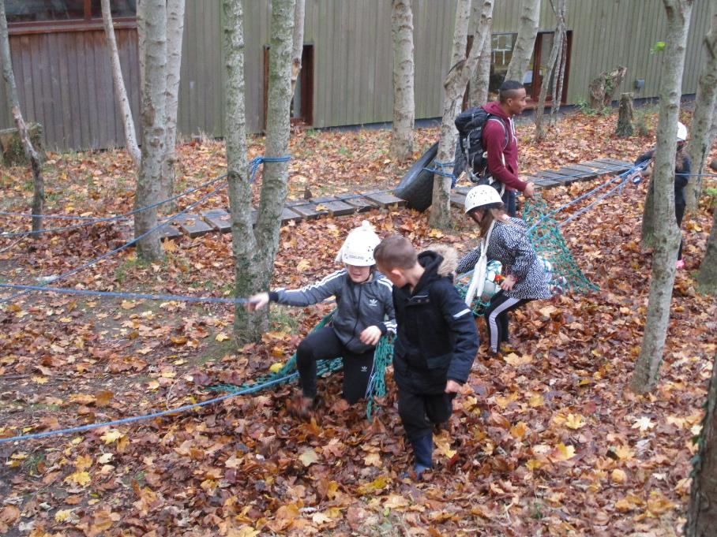

Slide 35
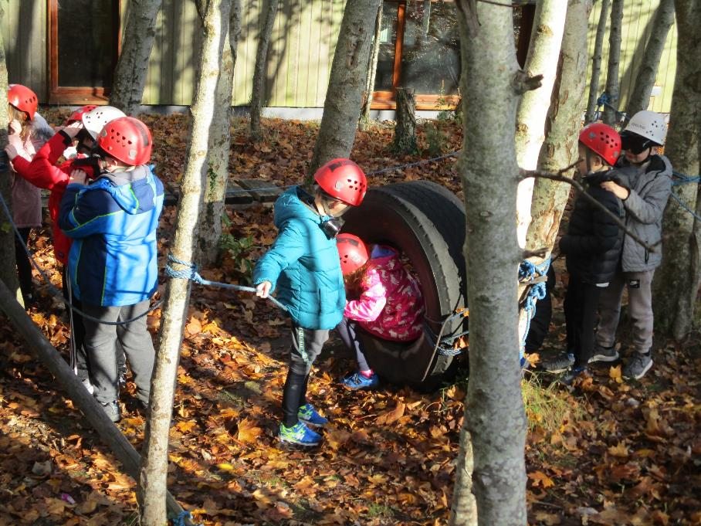

Slide 36
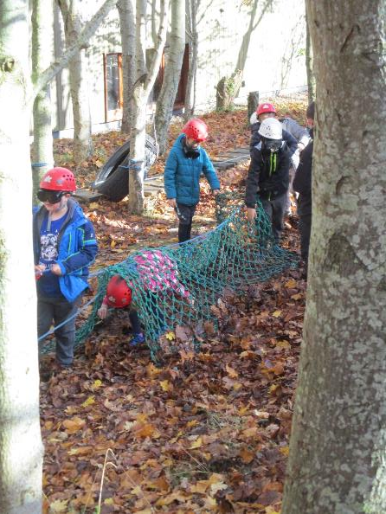
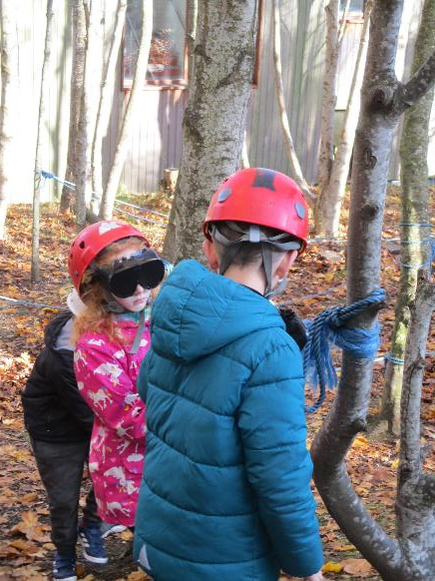

Slide 37
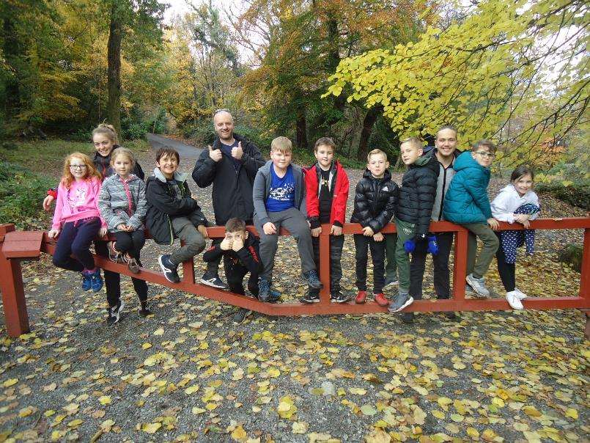
Mountain walk!

Slide 38
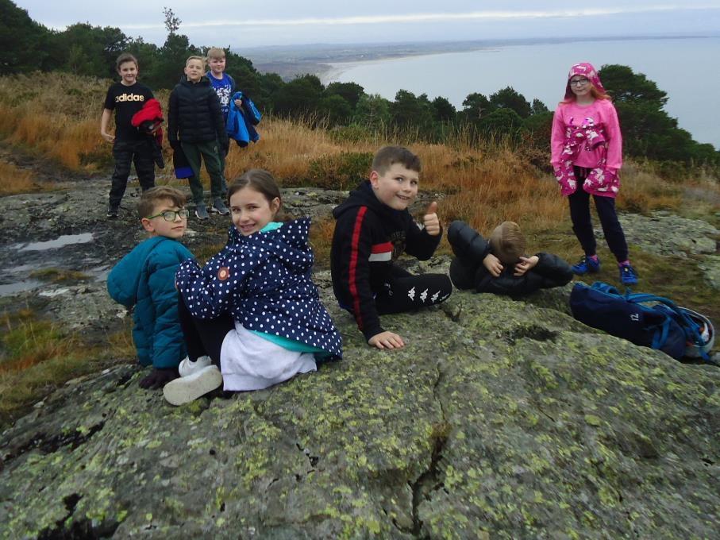

Slide 39
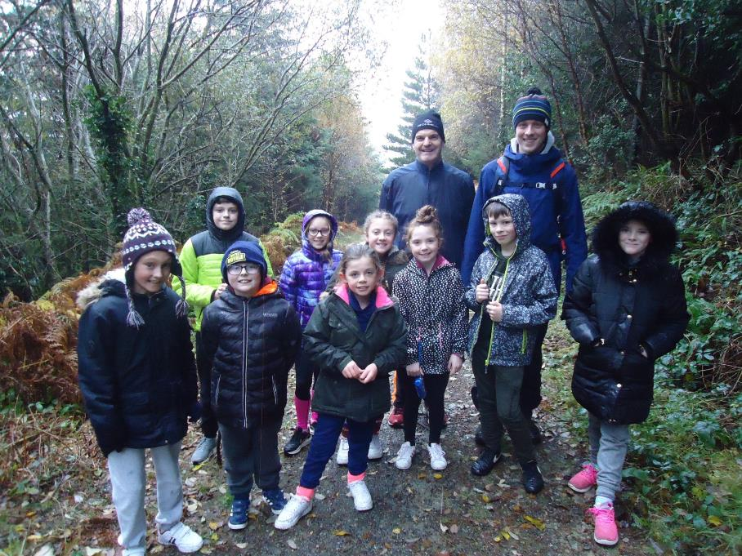

Slide 40
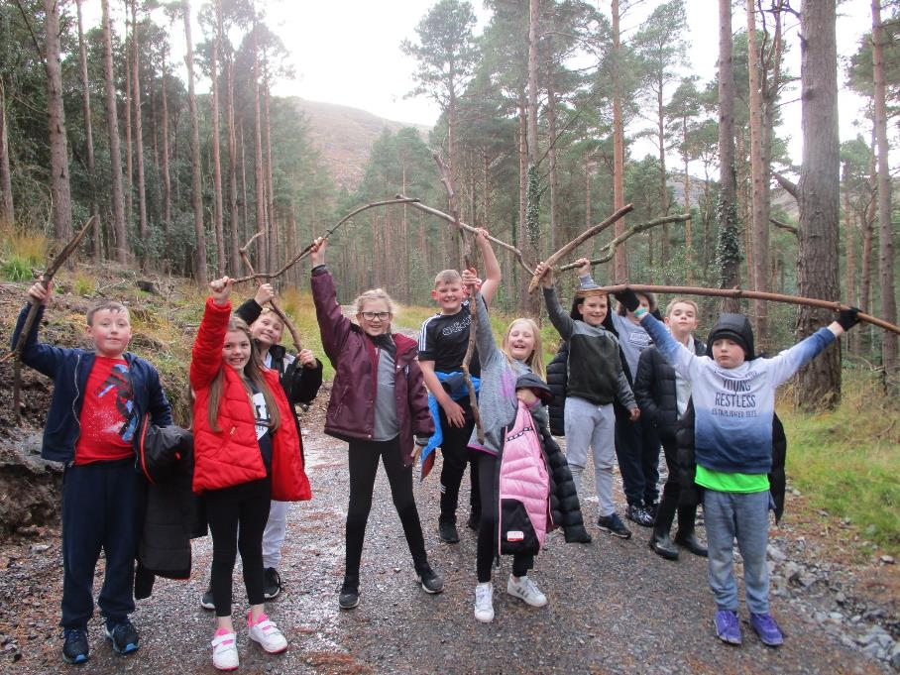

Slide 41
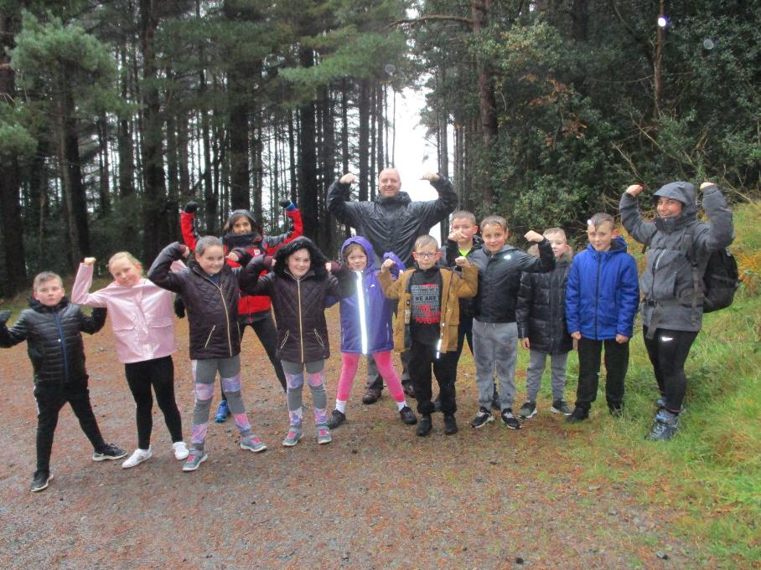

Slide 42
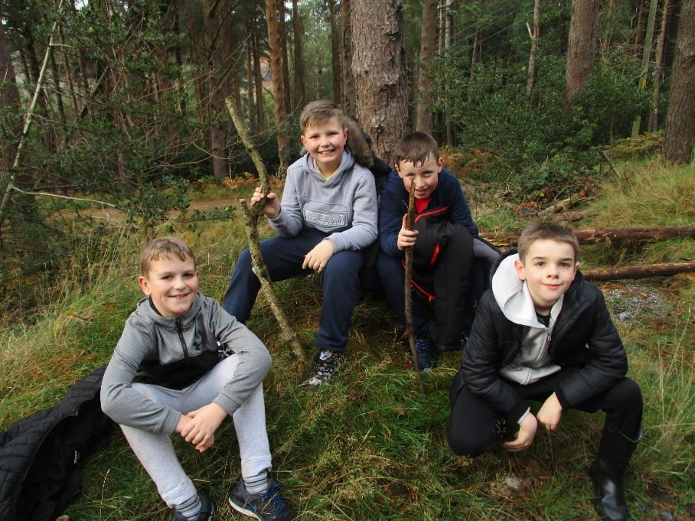

Slide 43


Slide 44


Slide 45


Slide 46



Slide 47


Slide 48


Slide 49

Visit from Mrs Lowham!

Slide 50


Slide 51

Team ropes challenge!

Slide 52


Slide 53


Slide 54


Slide 55


Slide 56


Slide 57

Scavenger hunt and orienteering!

Slide 58


Slide 59


Slide 60


Slide 61


Slide 62


Slide 63


Slide 64


Slide 65


Slide 66

Time to eat!

Slide 67


Slide 68


Slide 69


Slide 70

Bridge building

Slide 71


Slide 72


Slide 73



Slide 74



Slide 75


Slide 76



Slide 77


Slide 78


Slide 79


Slide 80


Slide 81


Slide 82


Slide 83


Slide 84

Abseiling!

Slide 85


Slide 86



Slide 87


Slide 88


Slide 89


Slide 90

The frog thing! Design

Slide 91


Slide 92


Slide 93


Slide 94


Slide 95


Slide 96


Slide 97


Slide 98

The frog thing!
Pledge of allegiance

Slide 99

The frog thing! Heats

Slide 100


Slide 101


Slide 102


Slide 103


Slide 104



Slide 105


Slide 106


Slide 107


Slide 108


Slide 109


Slide 110


Slide 111


Slide 112


Slide 113

The frog thing! Finalists!

Slide 114


Slide 115

The frog thing! Podium!

Slide 116

The frog thing! Champion 2019!

Slide 117

Our last day!

Slide 118


Slide 119


Slide 120


Slide 121


Slide 122


Slide 123



Slide 124


Slide 125


Slide 126


