Slide 2


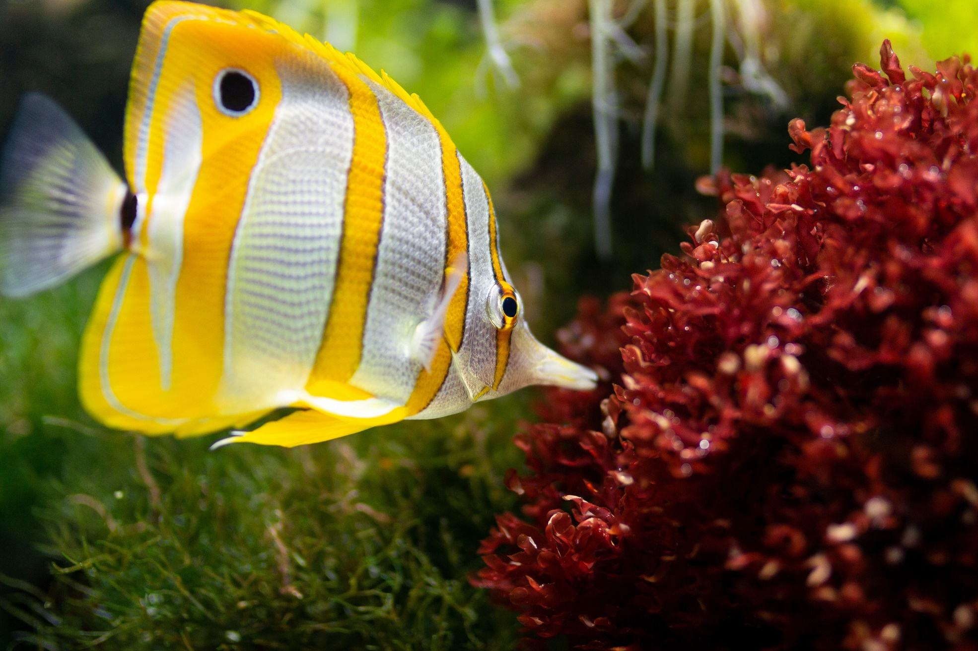
What am I looking at?
Reveal Answer
Play Again
Play
Reveal Answer

Slide 3
What am I looking at?
An angelfish!
Experts claim that angelfish
are very intelligent creatures
that can recognize their
owners!
Next

Slide 4
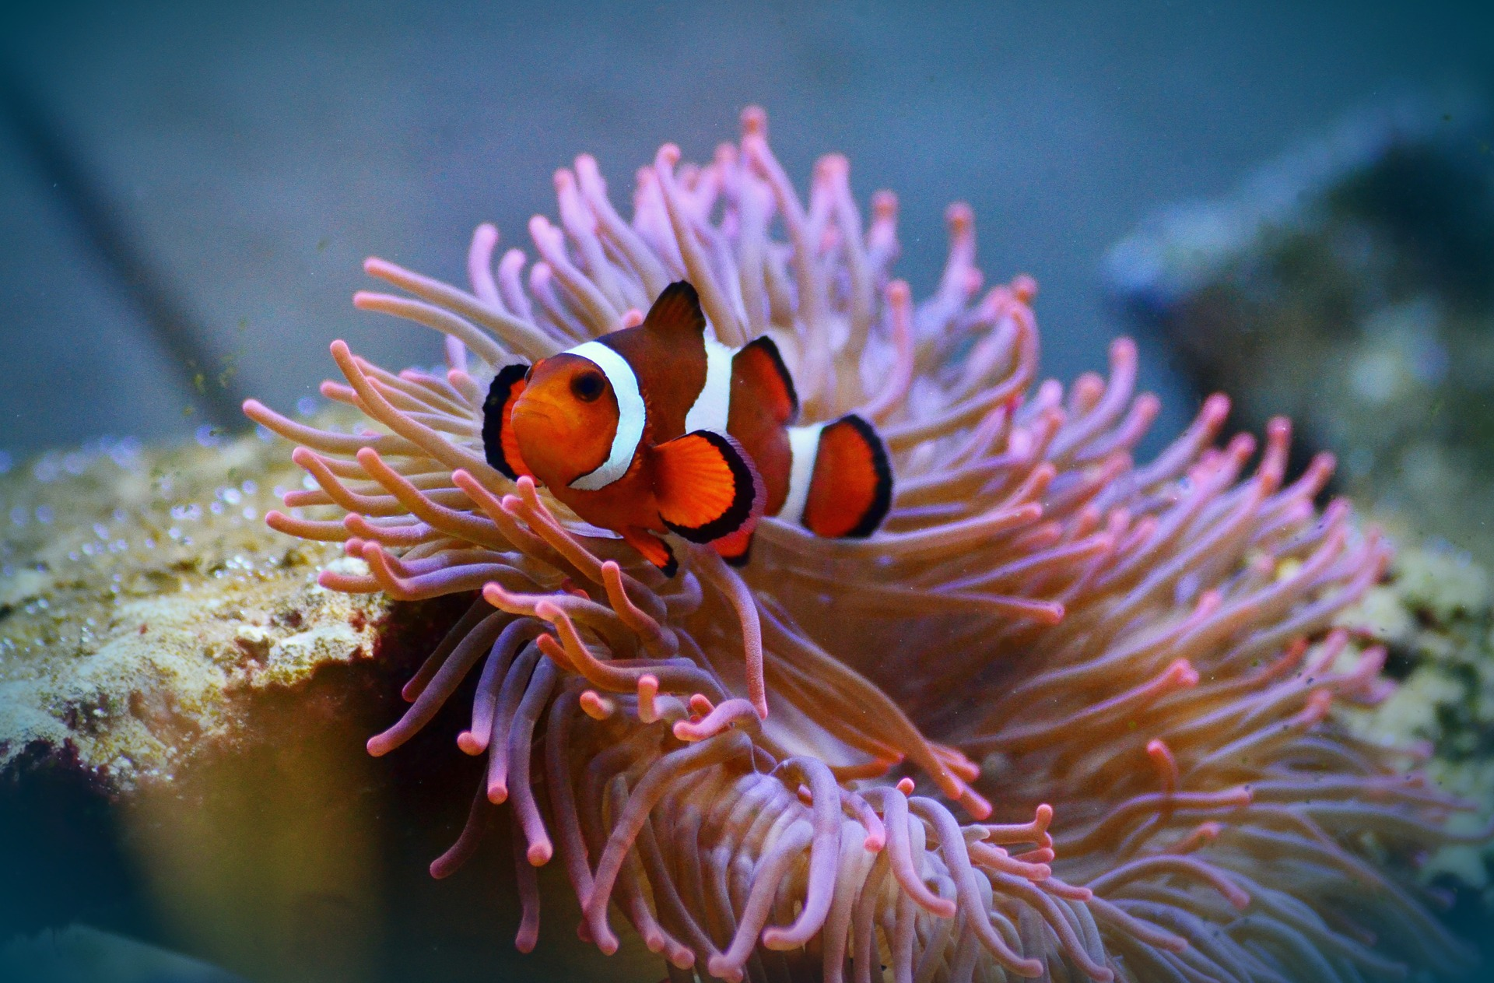
What am I looking at?
Reveal Answer
Play Again
Play
Reveal Answer

Slide 5
What am I looking at?
A clownfish!
Clownfish are also known as
‘anemonefish’ because they live in
a community with sea anemones.
Next

Slide 6
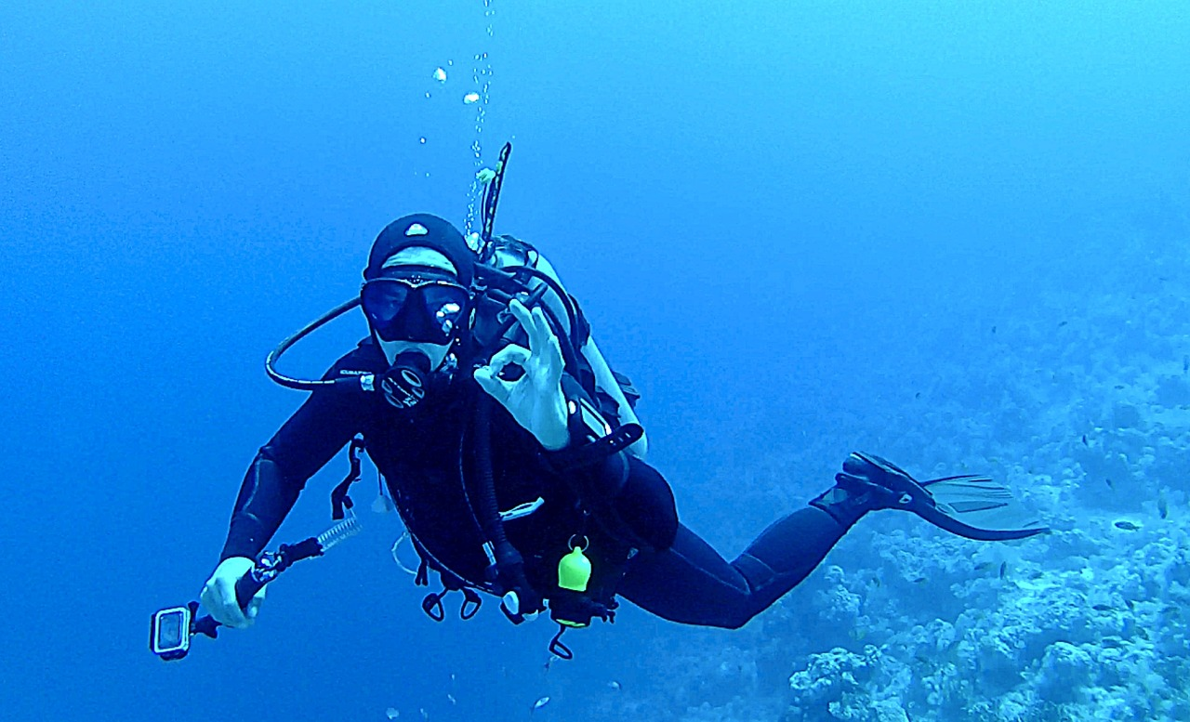
What am I looking at?
Reveal Answer
Play Again
Play
Reveal Answer

Slide 7
What am I looking at?
A diver!
Next

Slide 8
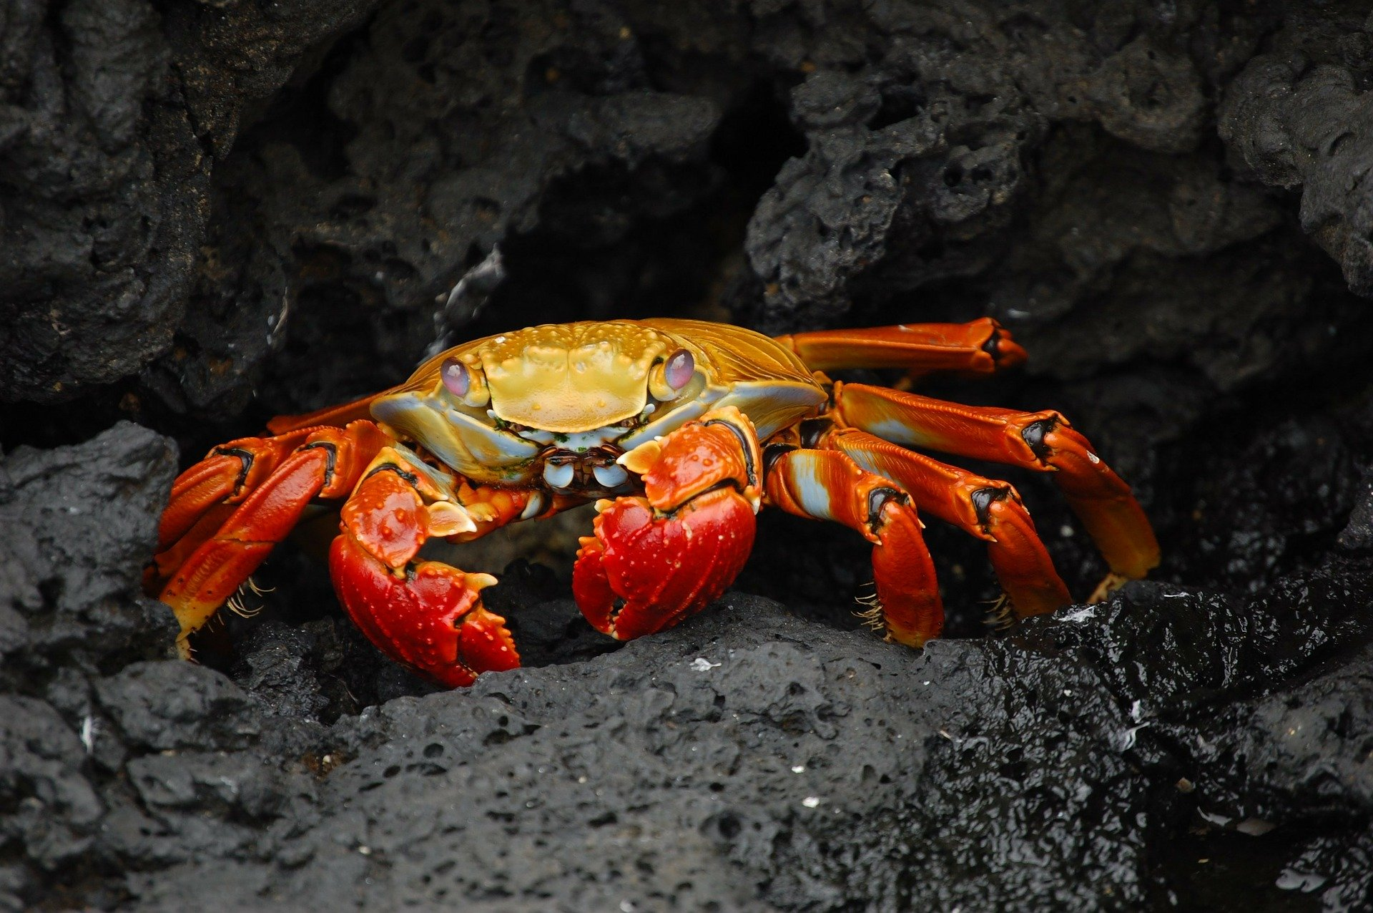
What am I looking at?
Reveal Answer
Play Again
Play
Reveal Answer

Slide 9
What am I looking at?
A crab!
Crabs have 10 legs, however, the
first pair are its claws which are
called chelae.
Next

Slide 10
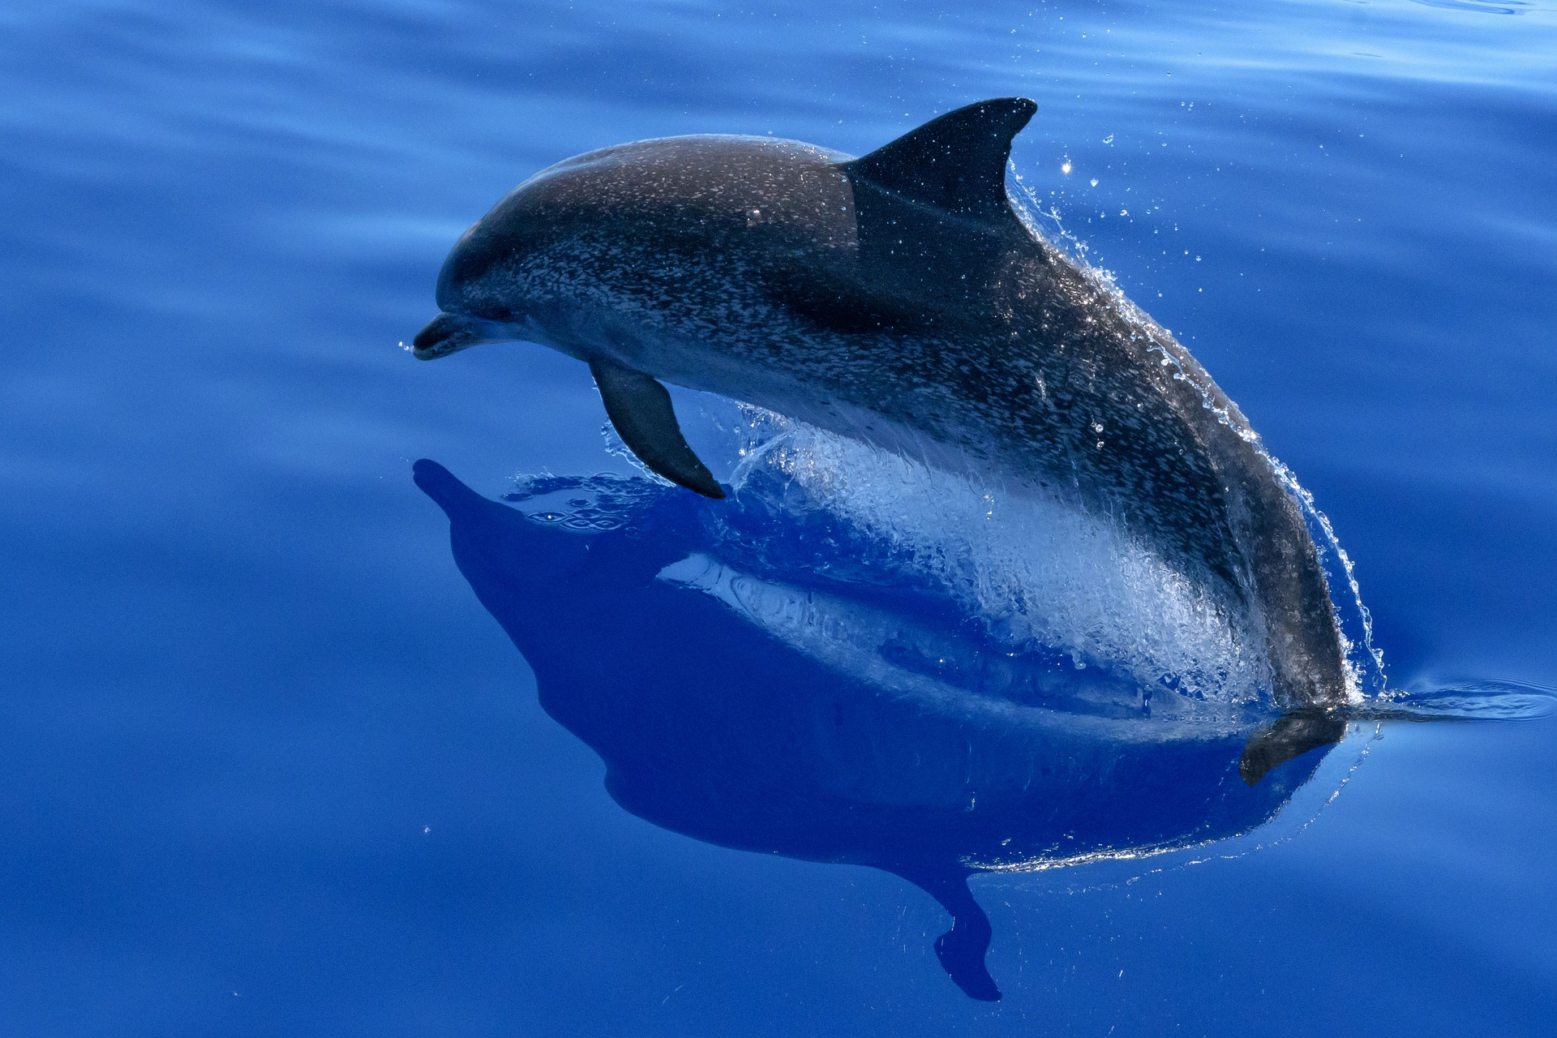
What am I looking at?
Reveal Answer
Play Again
Play
Reveal Answer

Slide 11
What am I looking at?
A dolphin!
Dolphins do not drink water like
we do because most of the water
they swim in is saltwater. Instead,
dolphins get all of the water they
need from the fish they eat.
Next

Slide 12
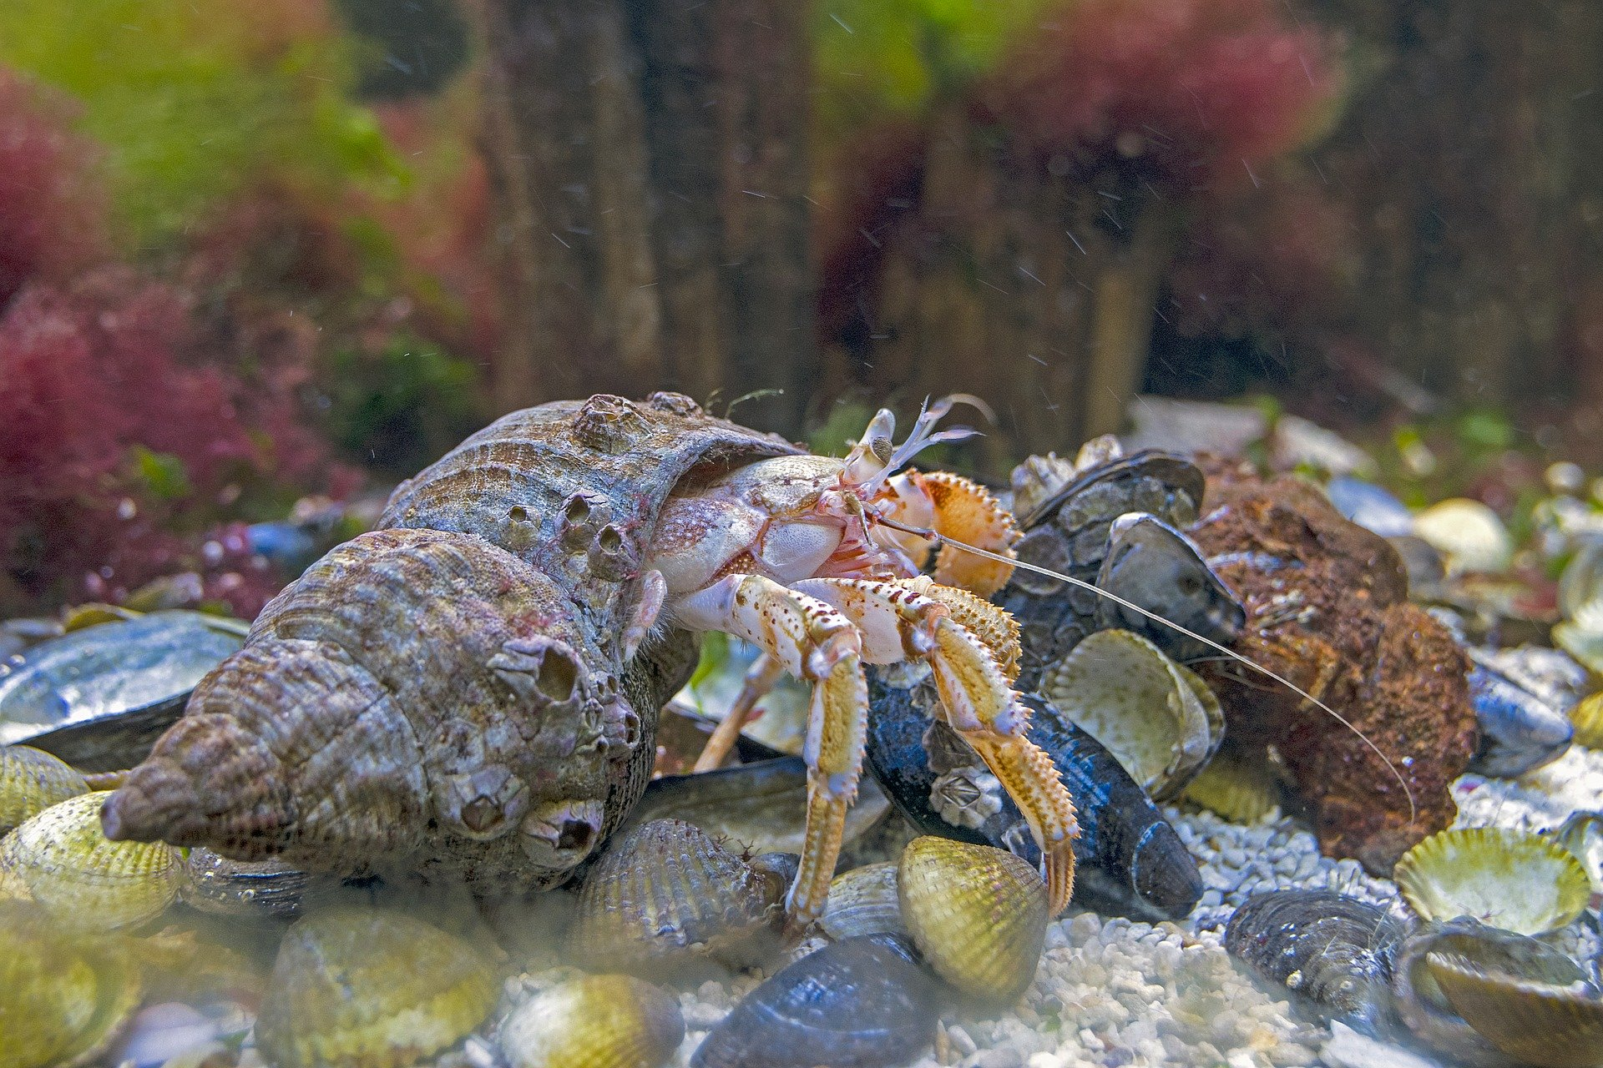
What am I looking at?
Reveal Answer
Play Again
Play
Reveal Answer

Slide 13
What am I looking at?
A hermit crab!
Hermit crabs often exchange (and
occasionally fight) with other hermit
crabs to conquer better shells.
Next

Slide 14
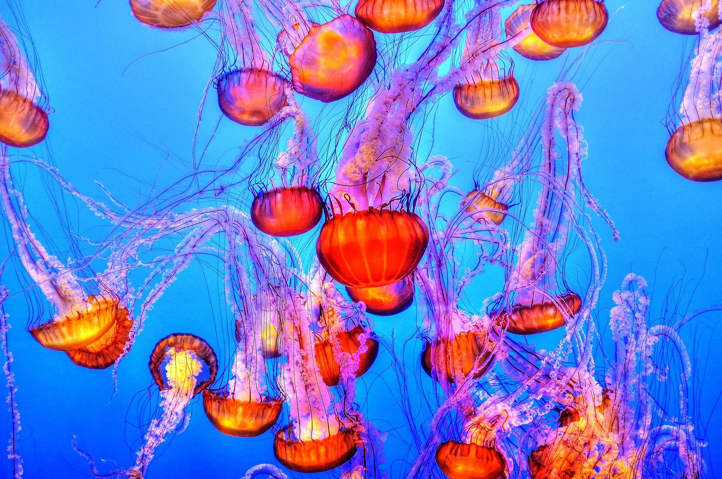
What am I looking at?
Reveal Answer
Play Again
Play
Reveal Answer

Slide 15
What am I looking at?
Jellyfish!
Jellyfish can clone themselves. If a jellyfish
is cut in two, the pieces of the jellyfish can
regenerate and create two new jellyfish.
Next

Slide 16
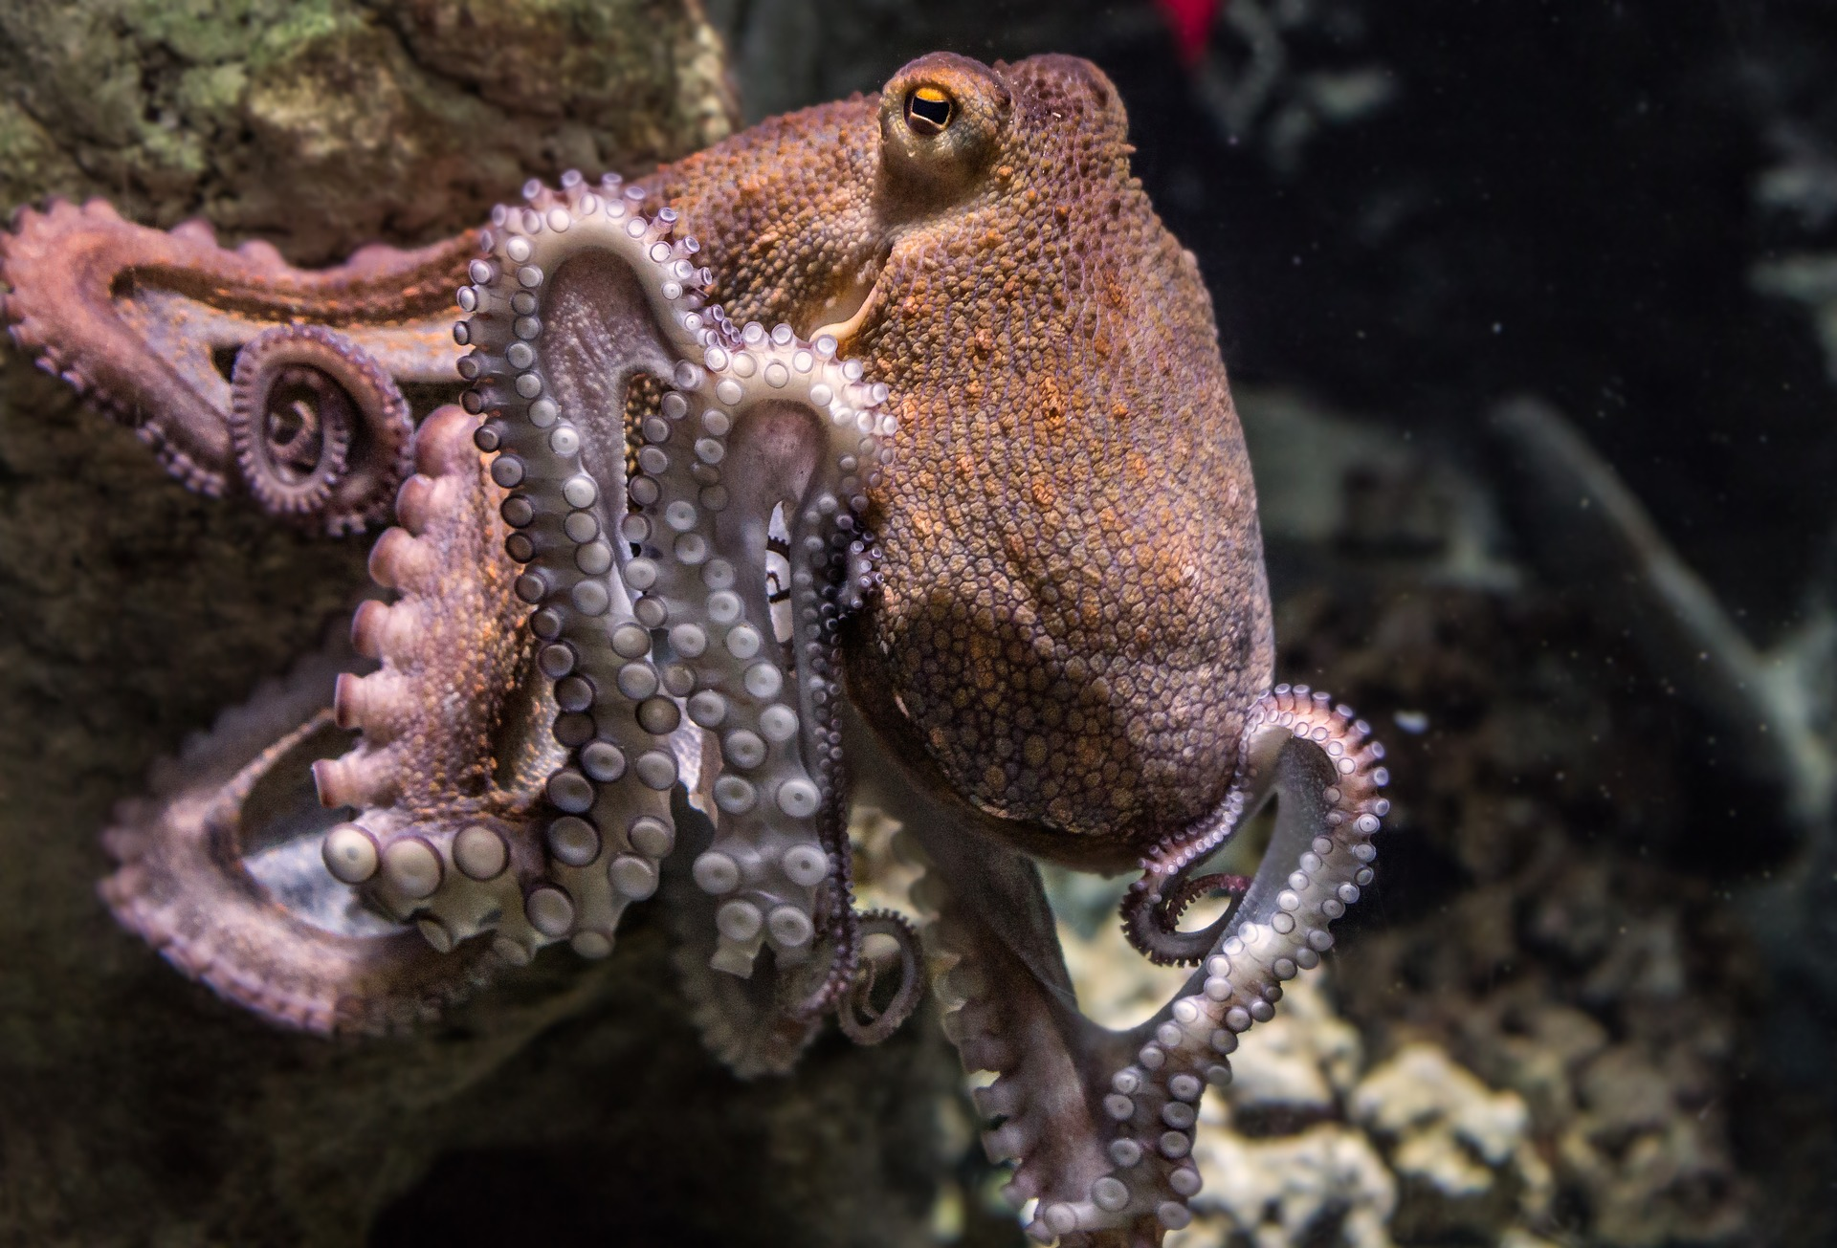
What am I looking at?
Reveal Answer
Play Again
Play
Reveal Answer

Slide 17
What am I looking at?
An Octopus
The only hard structure in an
octopus’ body is their beak,
which looks like a parrot beak.
They use their beaks for eating.
Next

Slide 18
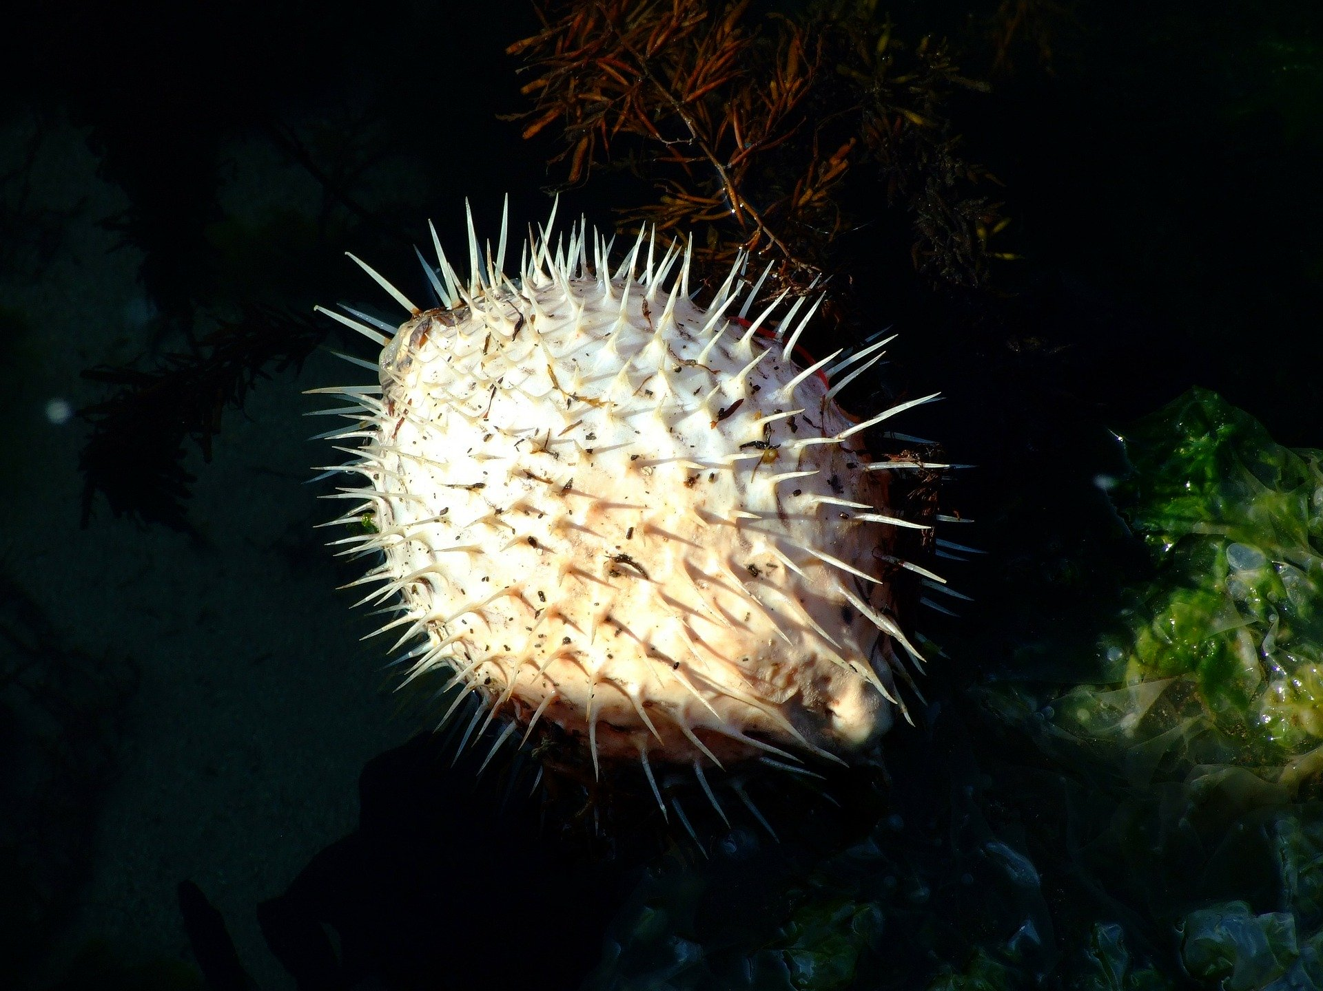
What am I looking at?
Reveal Answer
Play Again
Play
Reveal Answer

Slide 19
What am I looking at?
A pufferfish
Pufferfish vary in size, from the
one inch long pufferfish, to a two
feet-long freshwater giant pufferfish.
Next

Slide 20
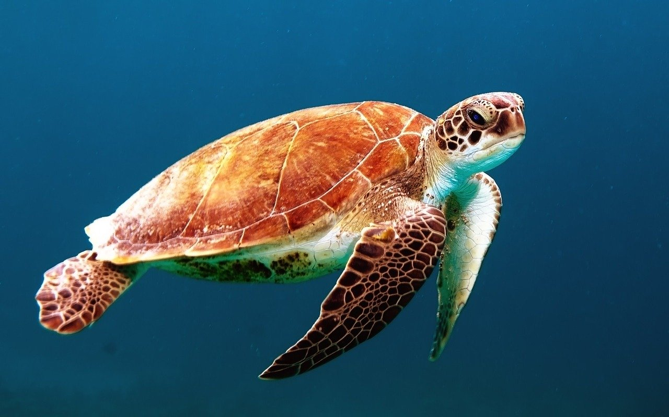
What am I looking at?
Reveal Answer
Play Again
Play
Reveal Answer

Slide 21
What am I looking at?
A sea turtle!
Some turtles are carnivores (eating a varied diet including shrimp, jellyfish and snails). Other species are herbivores, and some are omnivores (this means they eat both plants and animals!).
Next

Slide 22
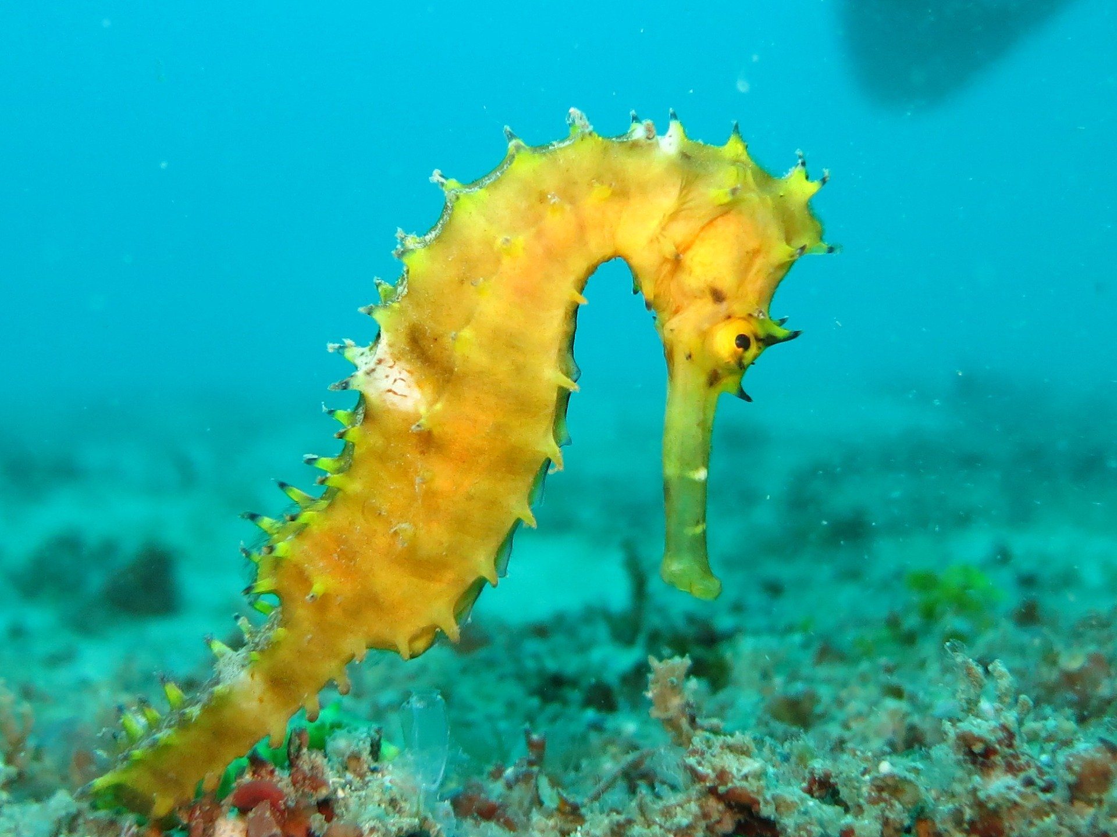
What am I looking at?
Reveal Answer
Play Again
Play
Reveal Answer

Slide 23
What am I looking at?
A seahorse!
It is the male seahorses that carry
the babies, not the females.
Next

Slide 24
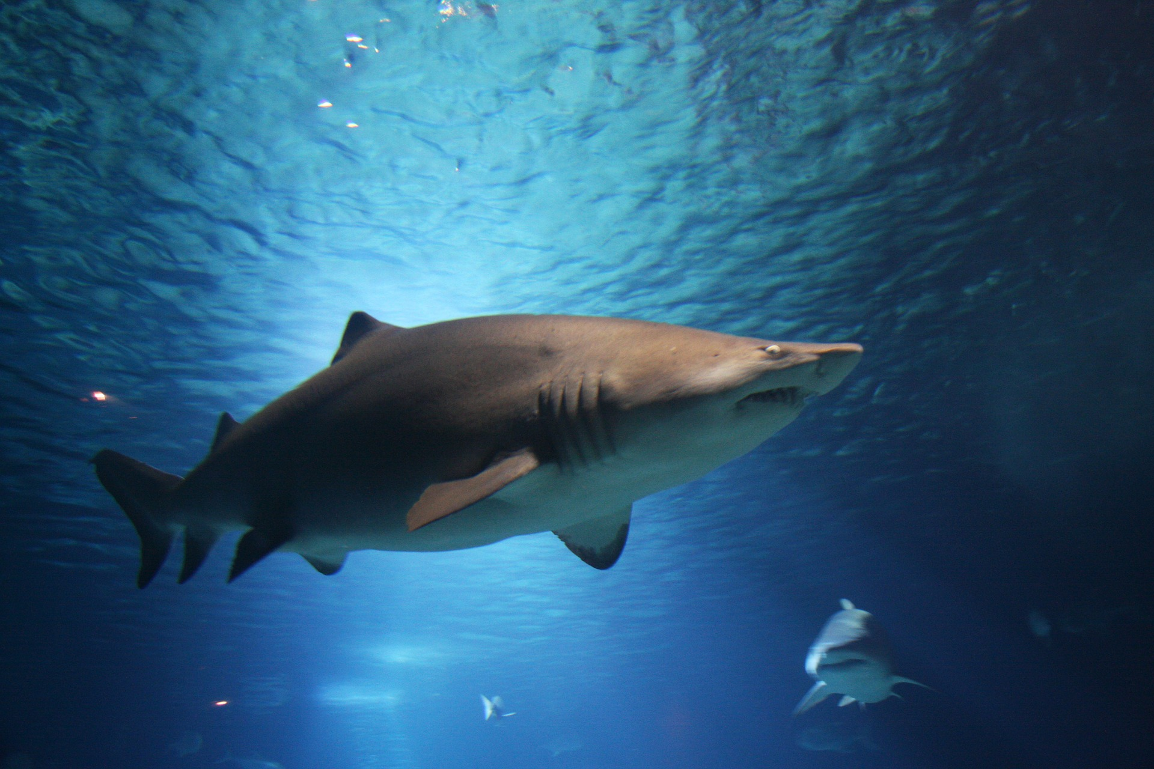
What am I looking at?
Reveal Answer
Play Again
Play
Reveal Answer

Slide 25
What am I looking at?
A shark!
Shark skin is made of tiny, hard, tooth-like structures called placoid scales. They are shaped like curved, grooved teeth and make the skin a very tough armour with a texture like sandpaper.
Next

Slide 26
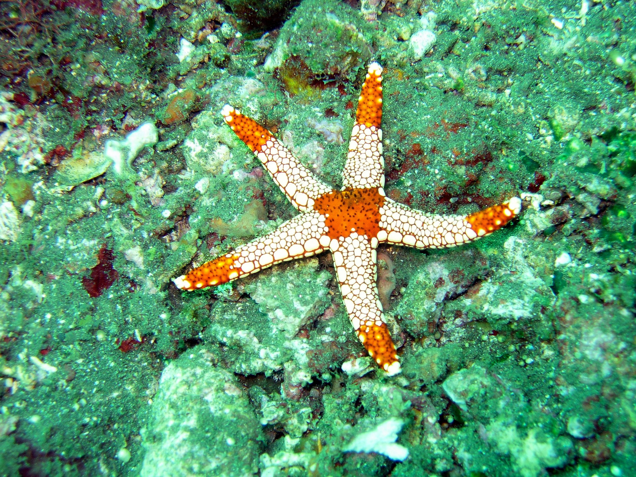
What am I looking at?
Reveal Answer
Play Again
Play
Reveal Answer

Slide 27
What am I looking at?
A starfish!
Starfish do not have a brain. They also do not have
blood like other animals. Instead of blood, sea water
circulates through their body with the help of sieve plate.
Next

Slide 28
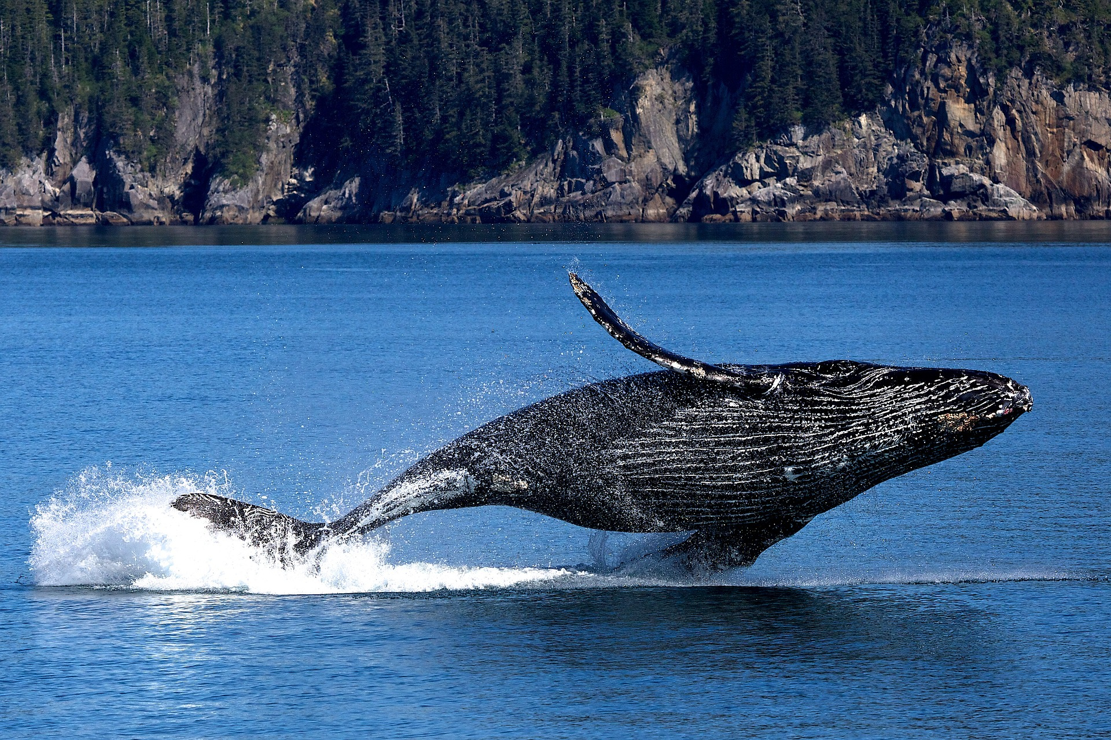
What am I looking at?
Reveal Answer
Play Again
Play
Reveal Answer

Slide 29
What am I looking at?
A whale!
The blue whale is the largest
animal ever to have lived on earth.
Next

