Slide 1
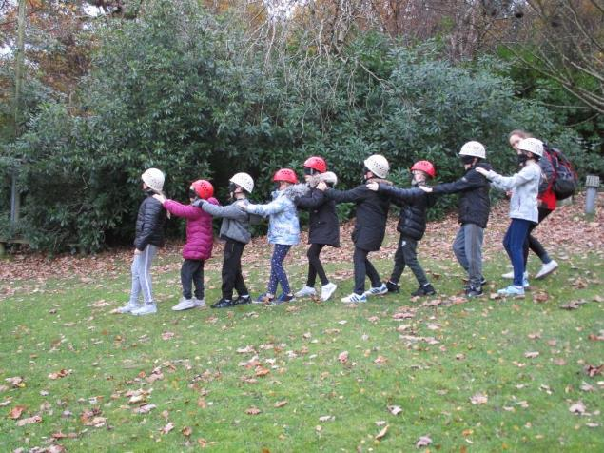
P6 visit to Greenhill YMCA
13th – 16th November 2018

Slide 2
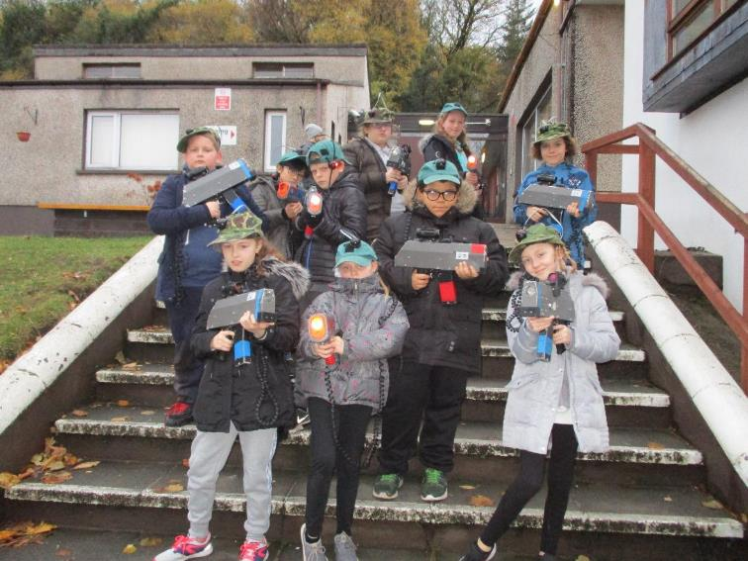
Laser tag!

Slide 3
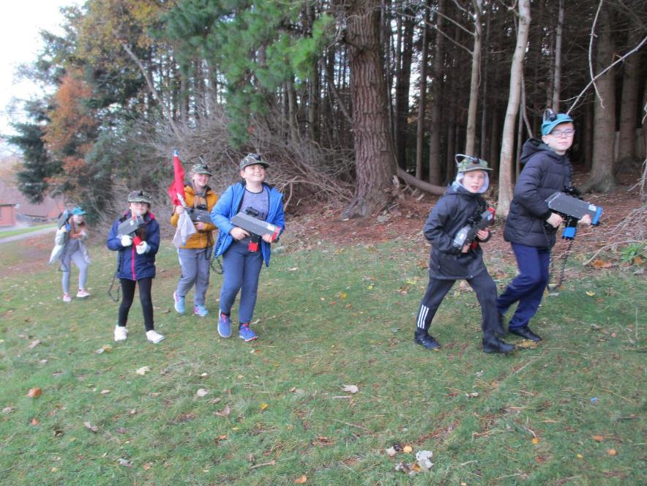

Slide 4
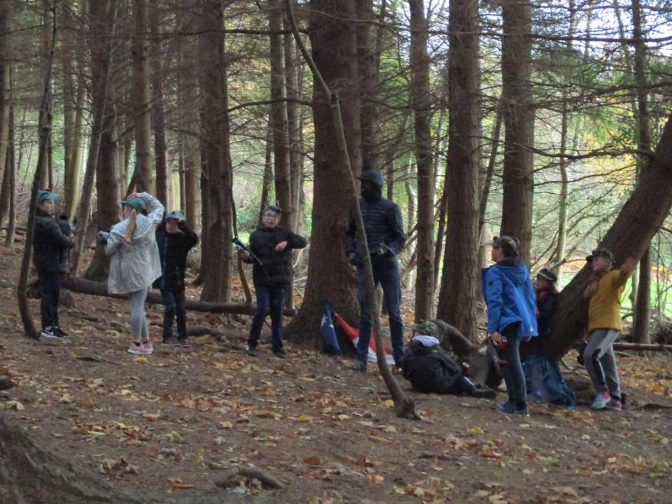

Slide 5
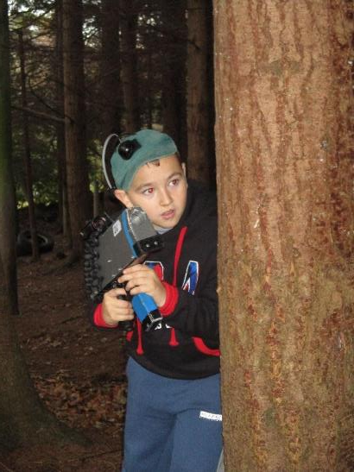
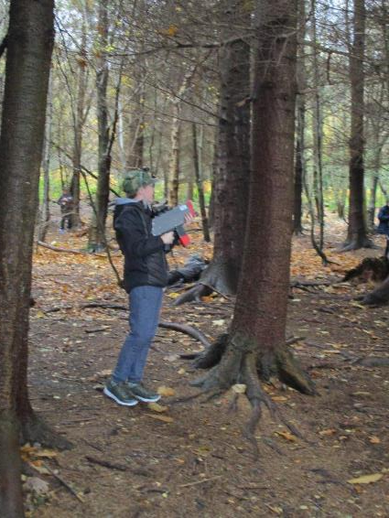

Slide 6
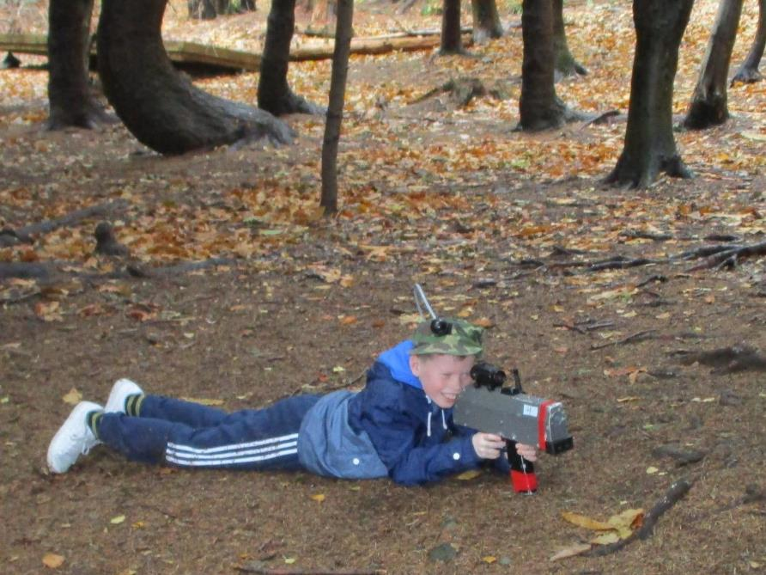

Slide 7
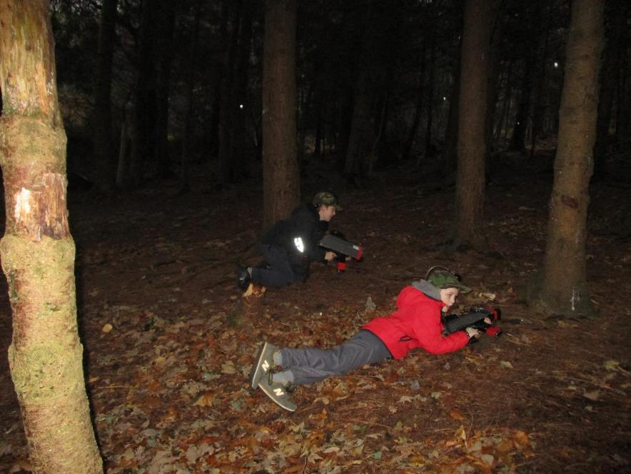

Slide 8
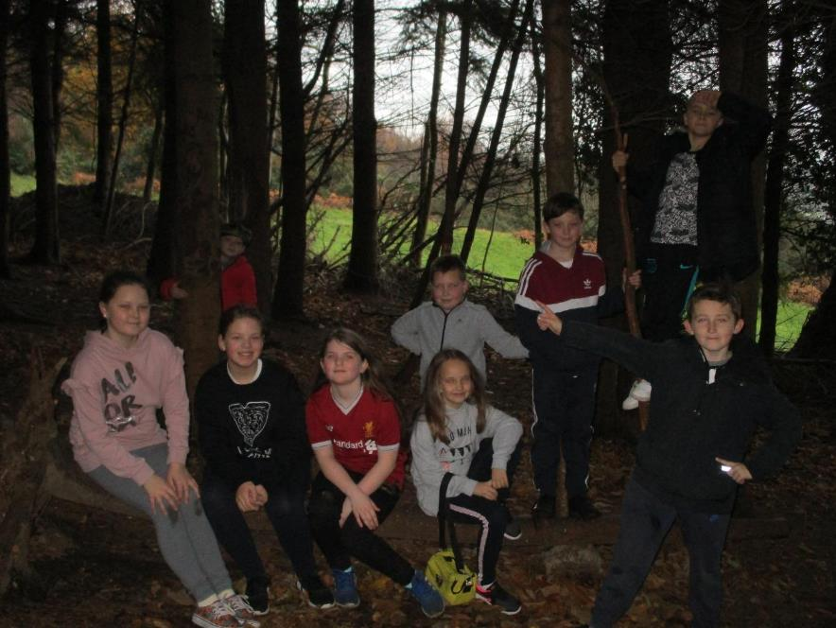

Slide 9
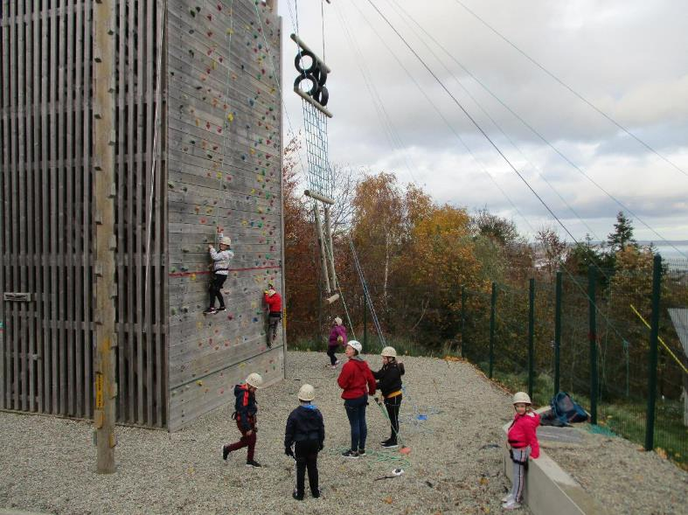
Climbing wall!

Slide 10
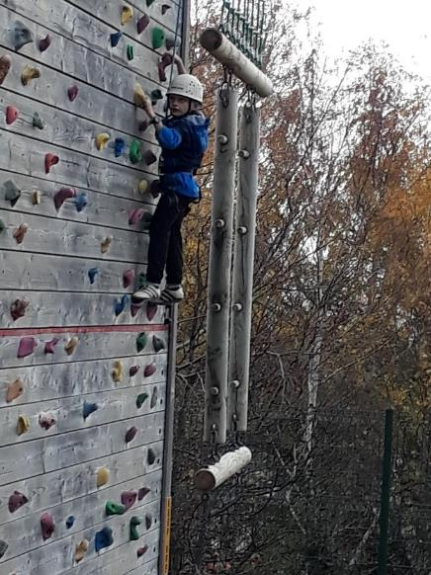
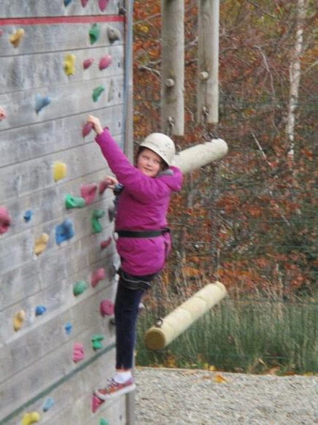

Slide 11
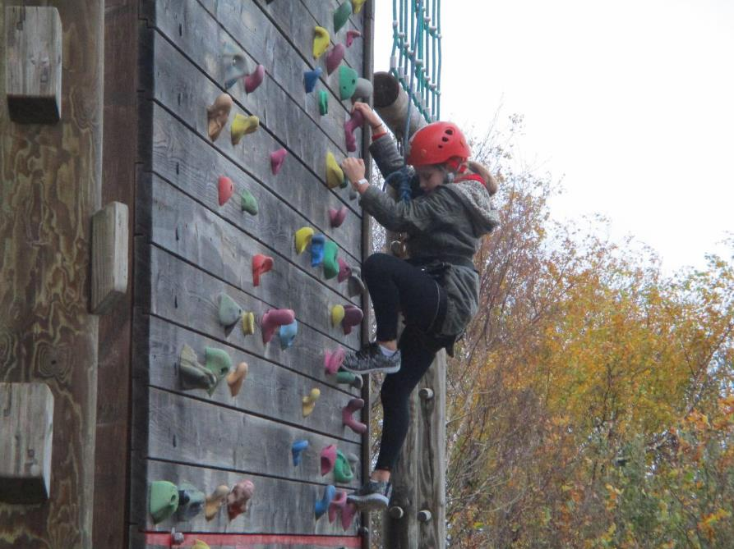

Slide 12
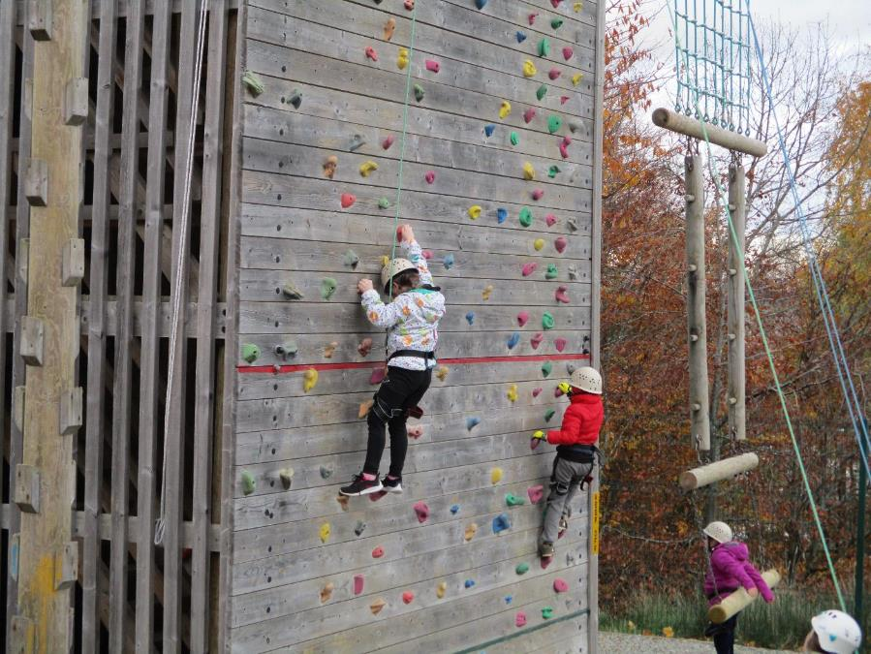

Slide 13
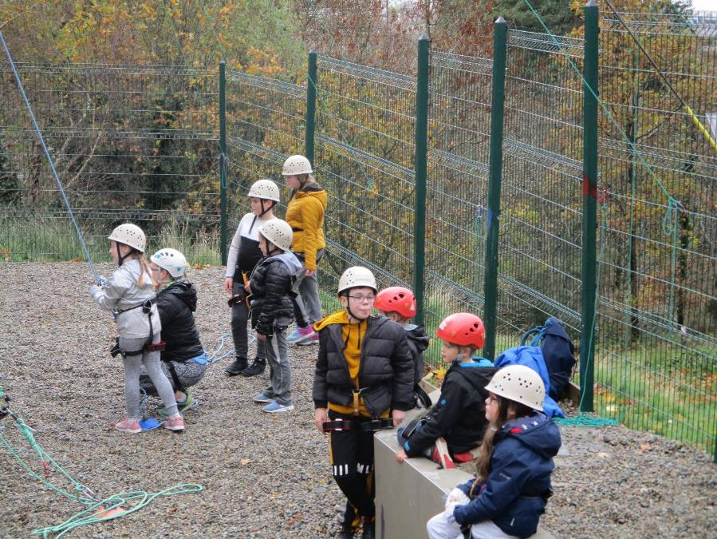

Slide 14
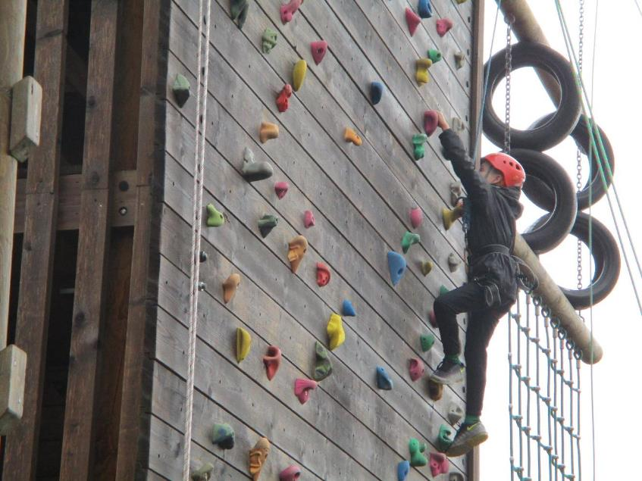

Slide 15
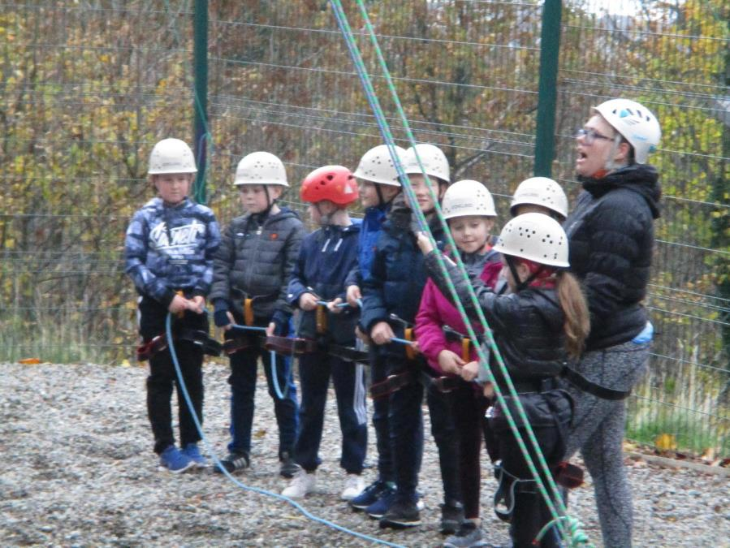

Slide 16
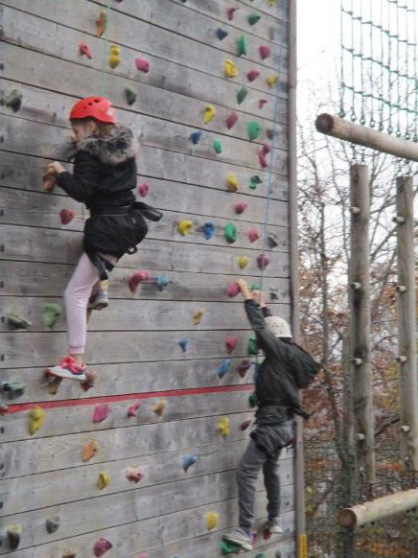
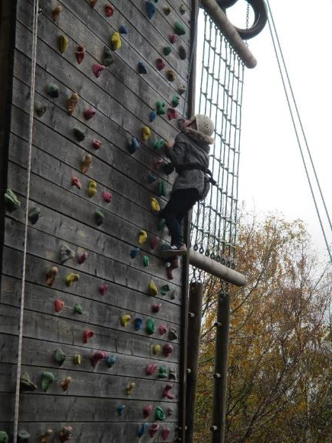

Slide 17
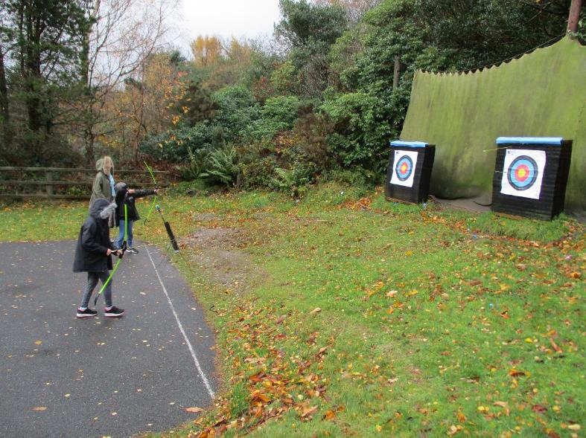
Archery!

Slide 18
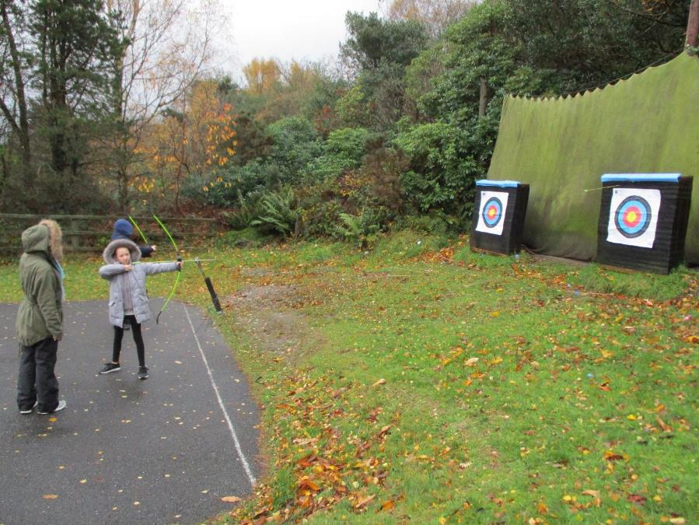

Slide 19
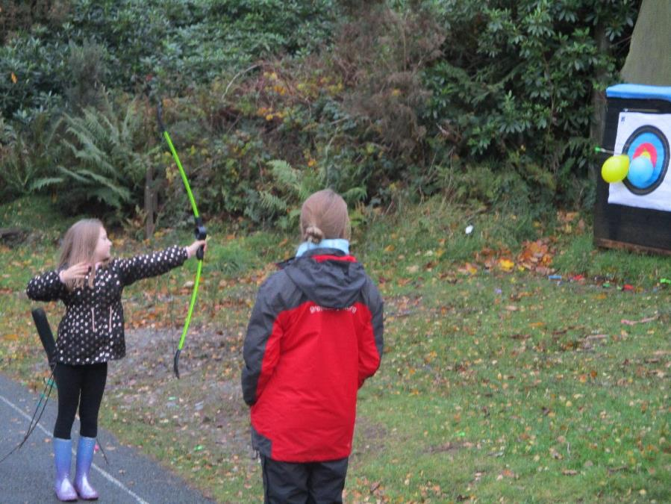

Slide 20
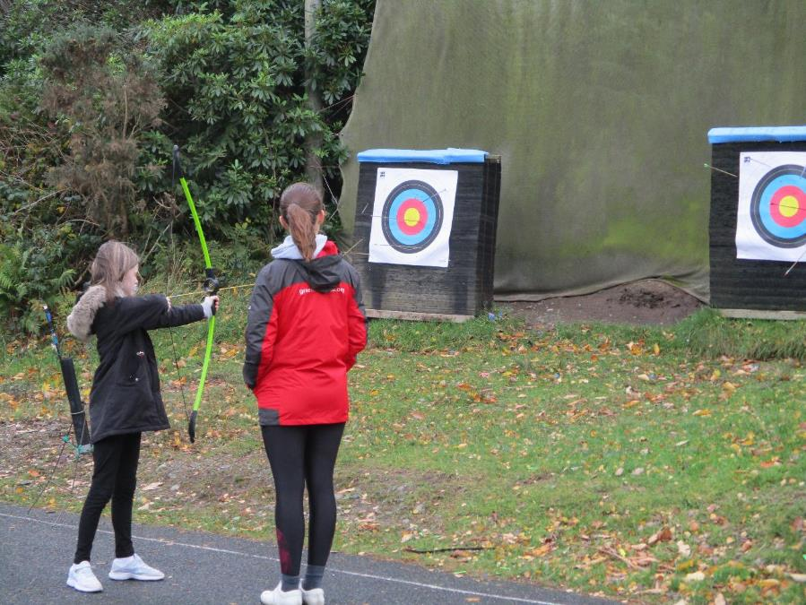

Slide 21
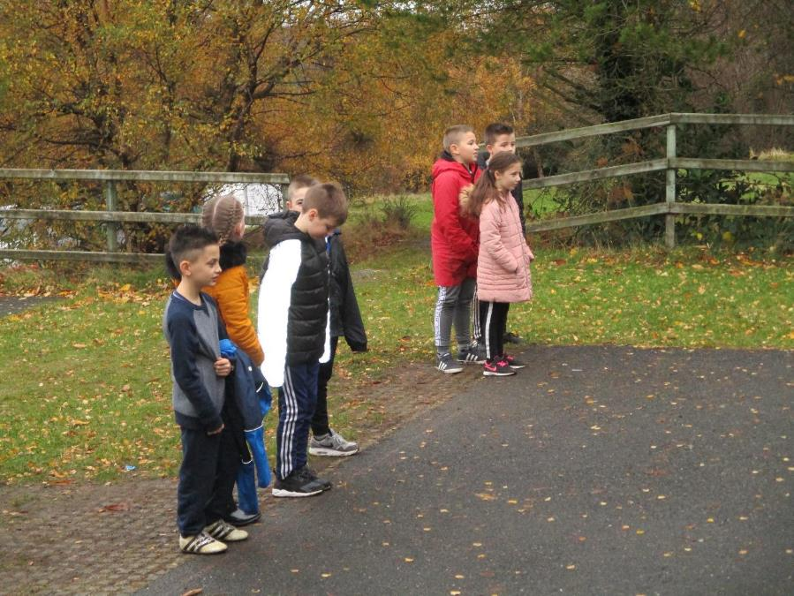

Slide 22
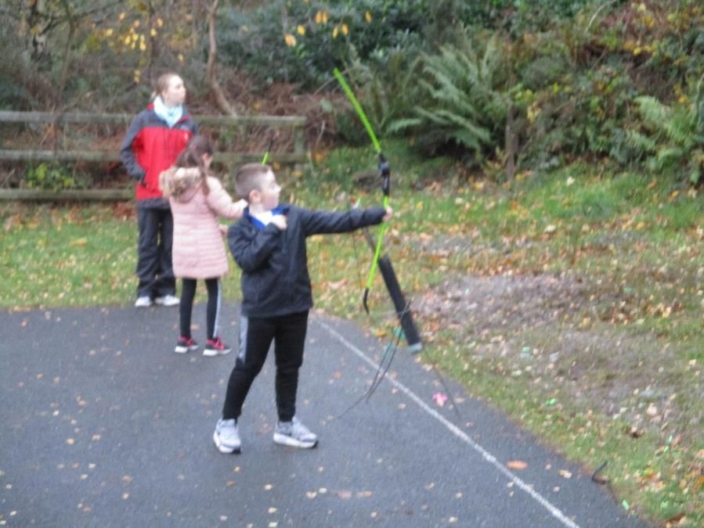

Slide 23
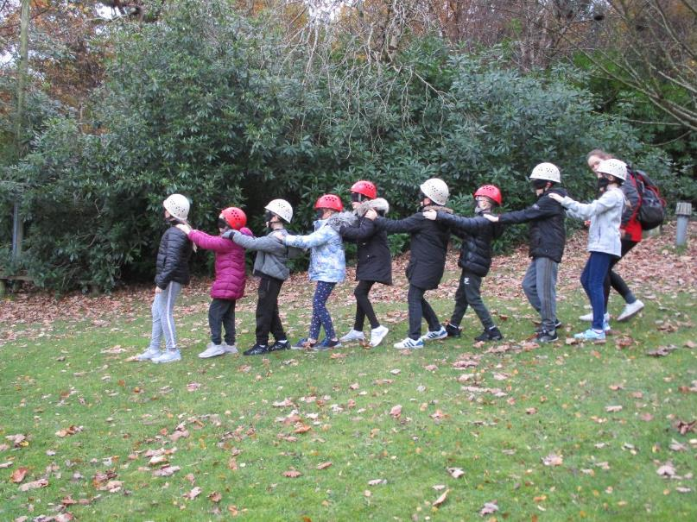
Blind trail!

Slide 24
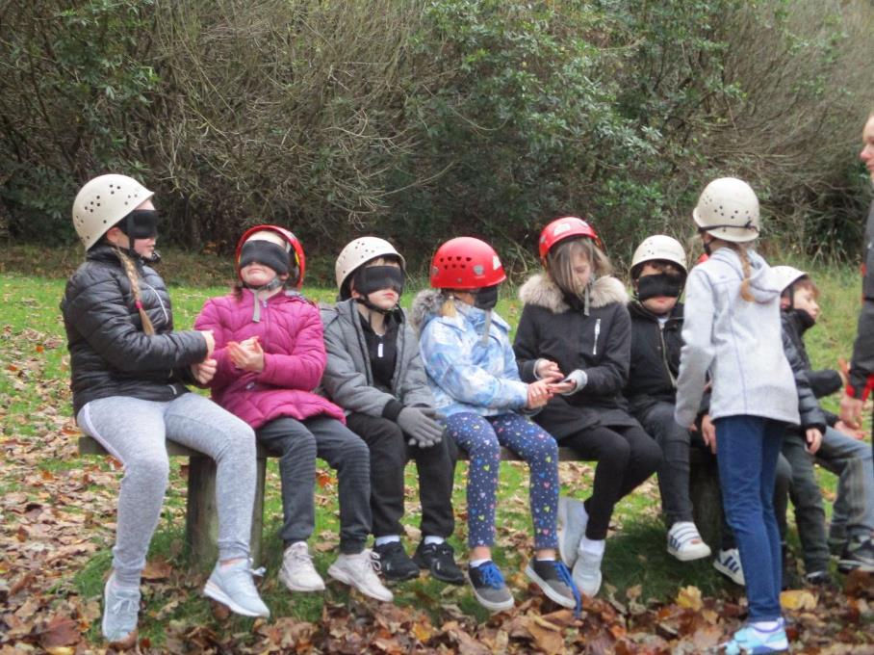

Slide 25
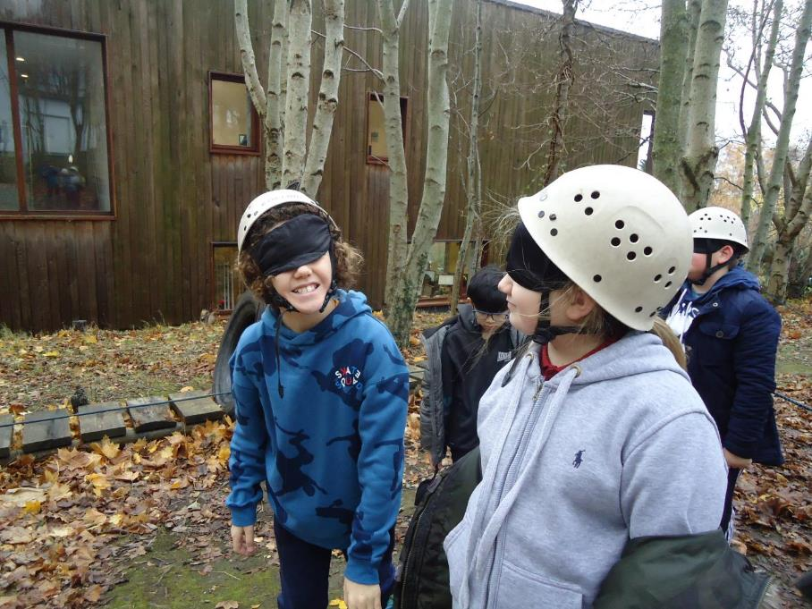

Slide 26
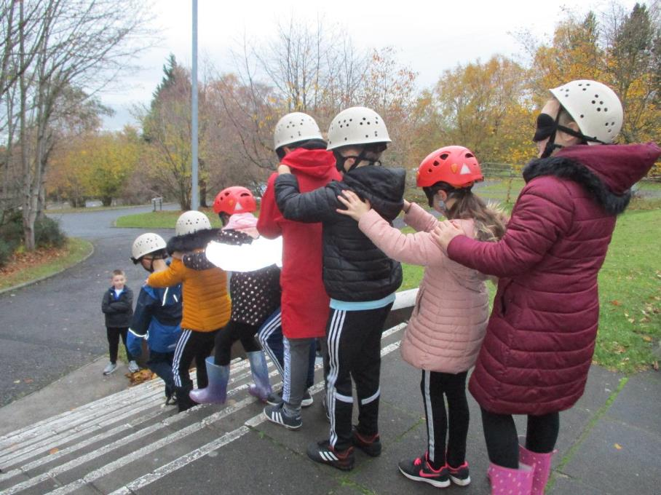

Slide 27
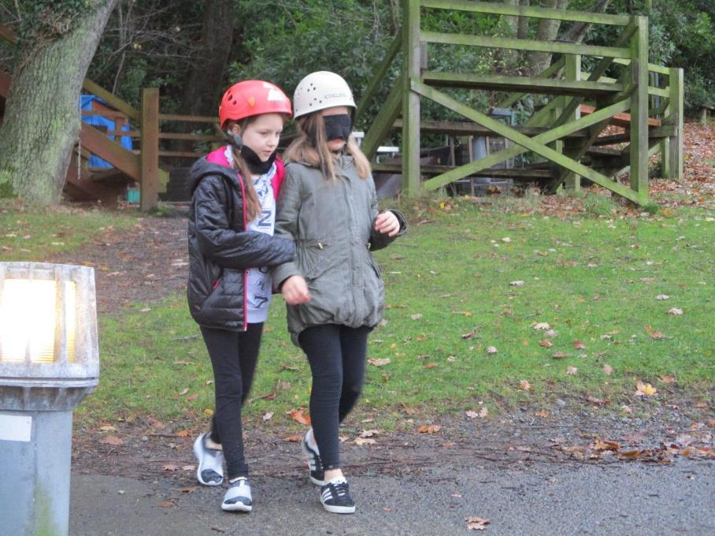

Slide 28
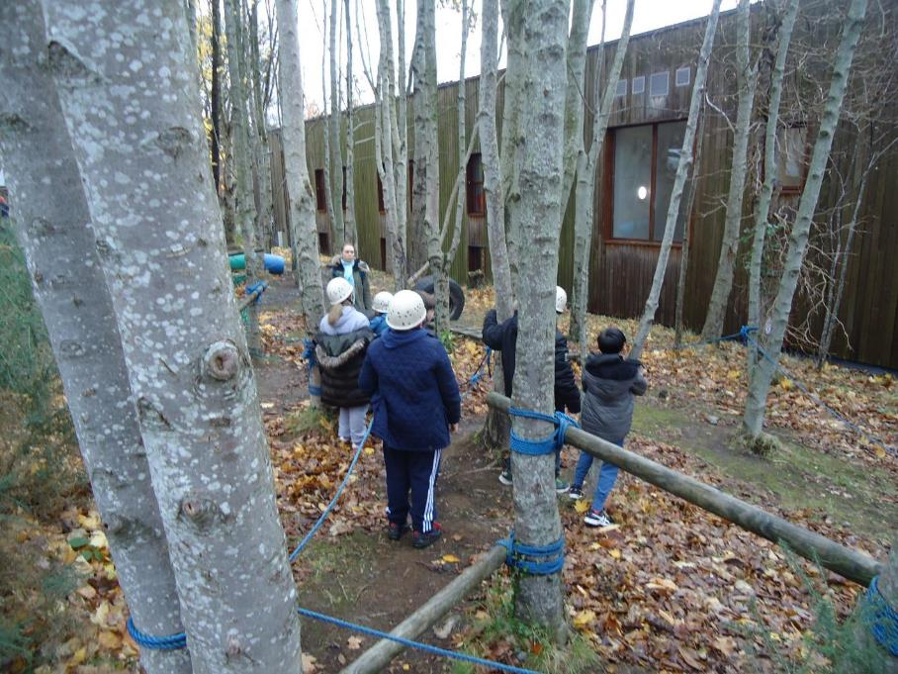

Slide 29
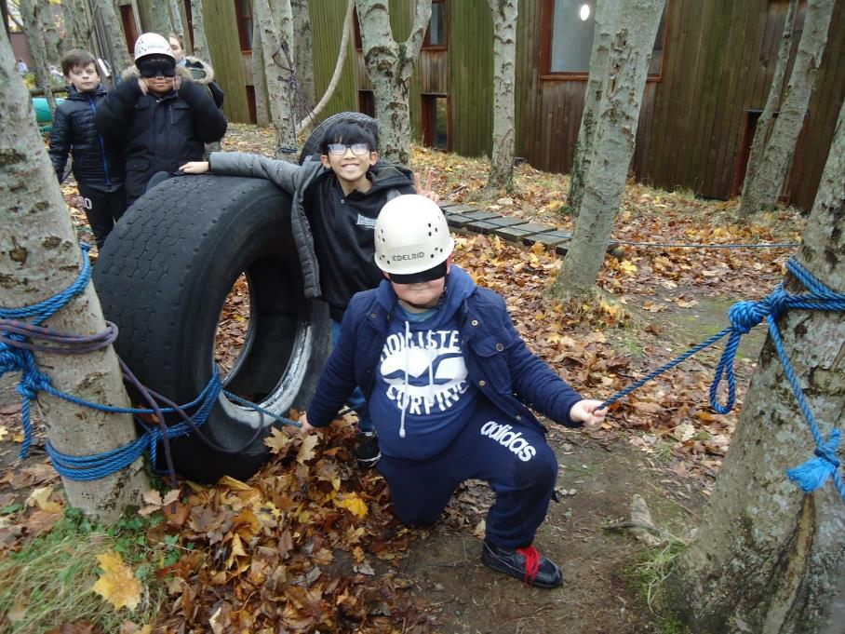

Slide 30
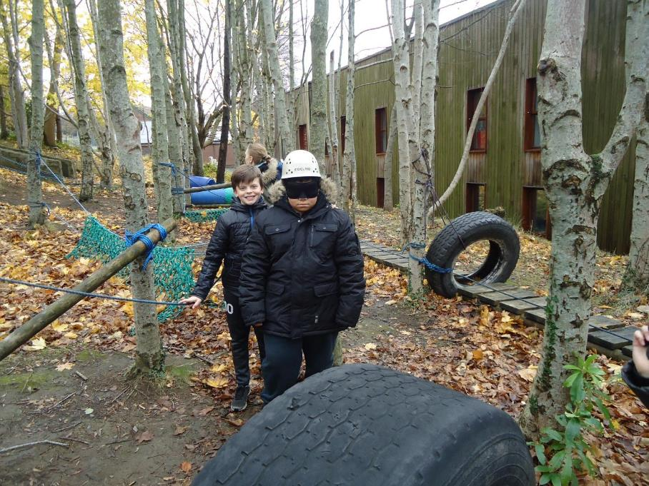

Slide 31
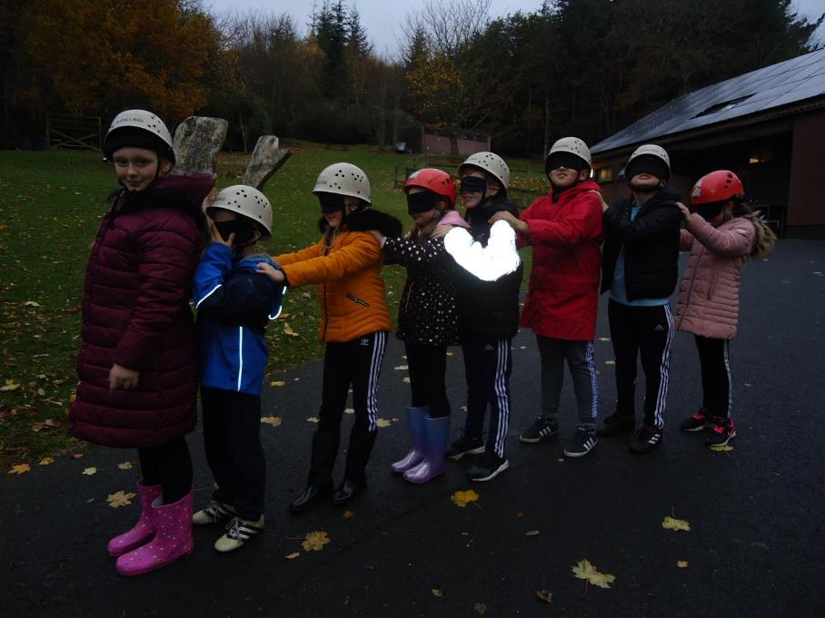

Slide 32
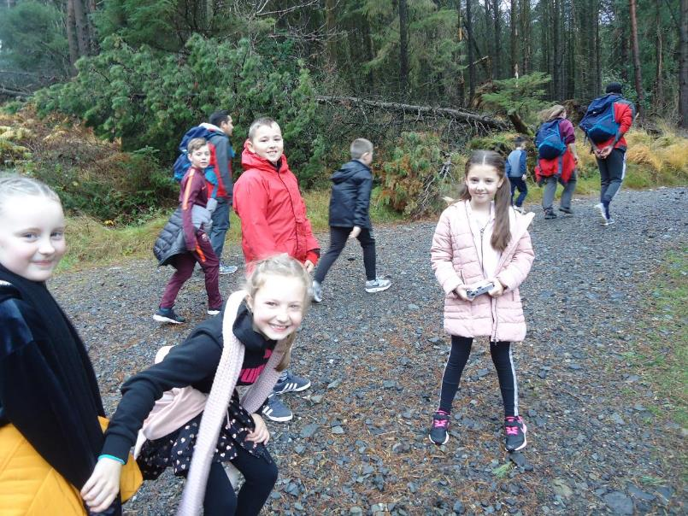
Mountain walk!

Slide 33
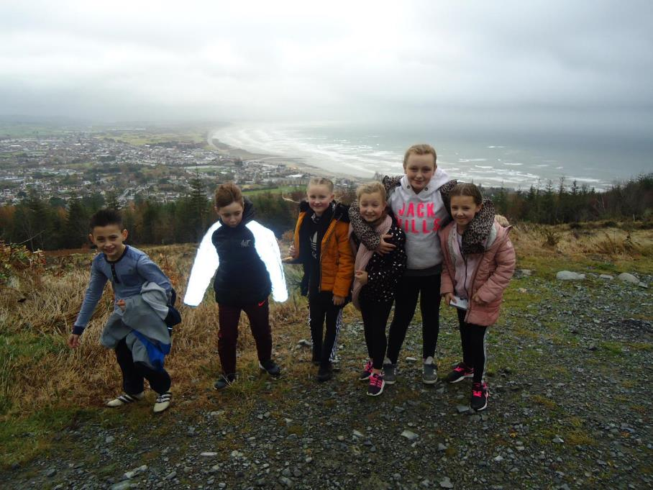

Slide 34
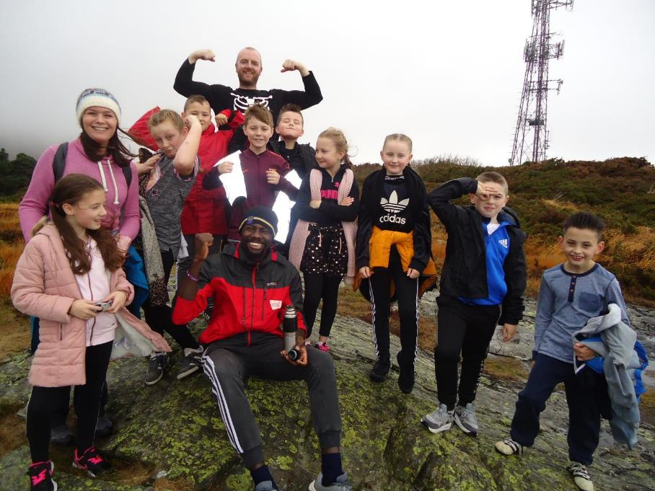

Slide 35
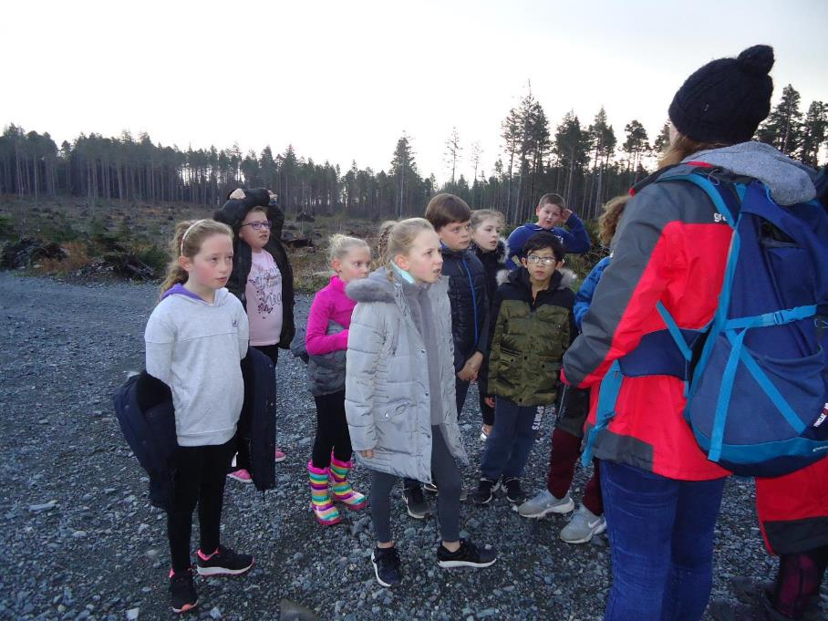

Slide 36
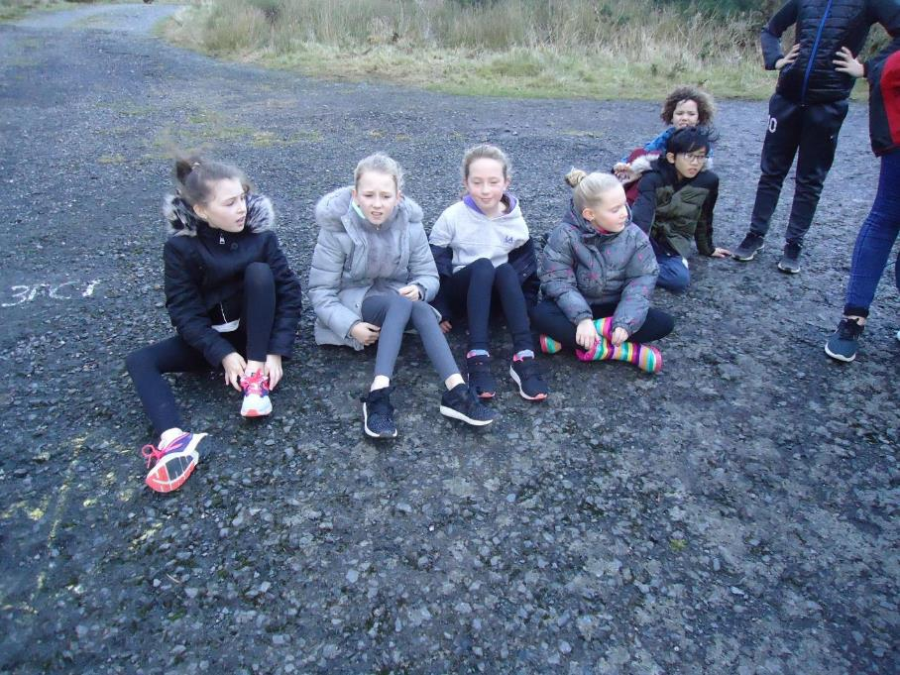

Slide 37
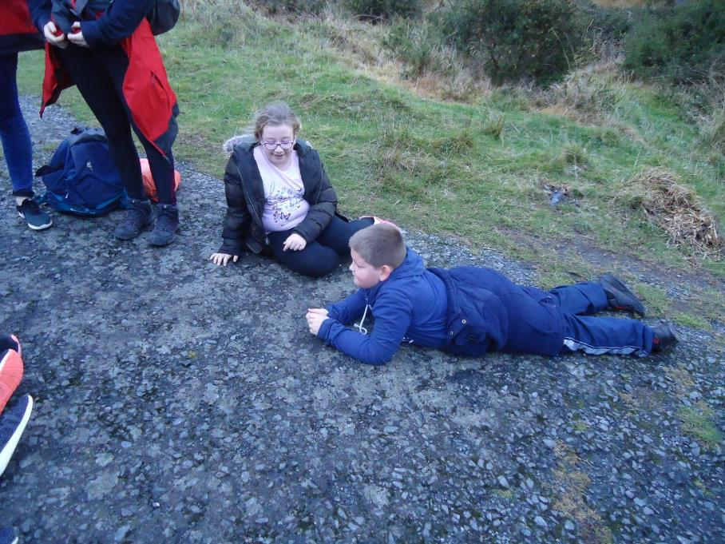

Slide 38
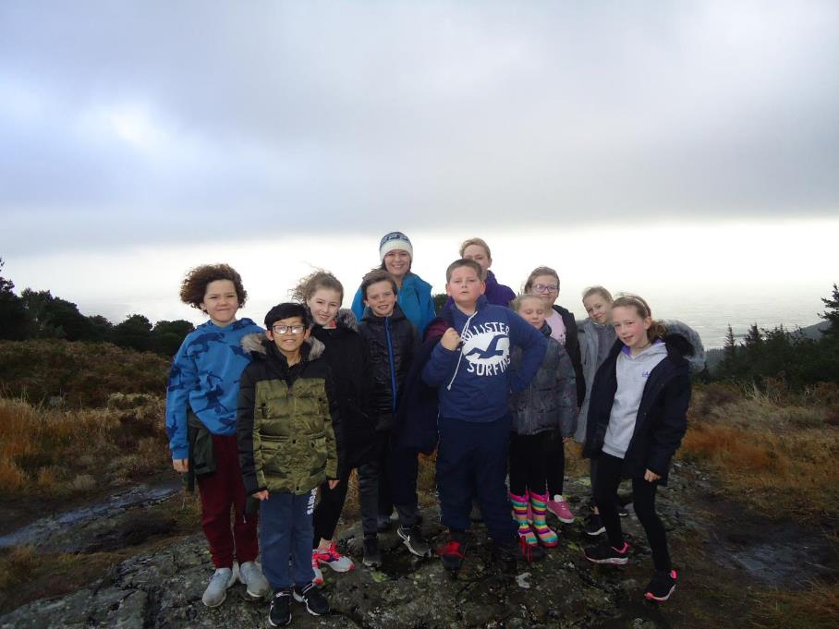

Slide 39
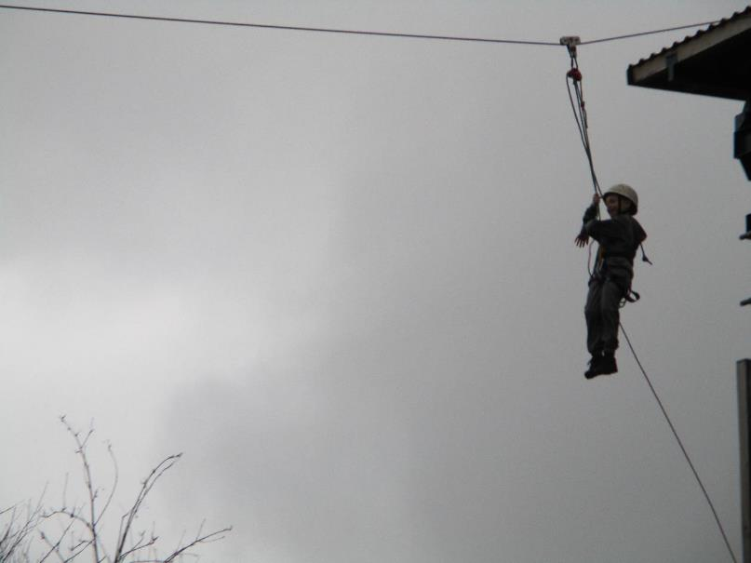
Zipline!

Slide 40
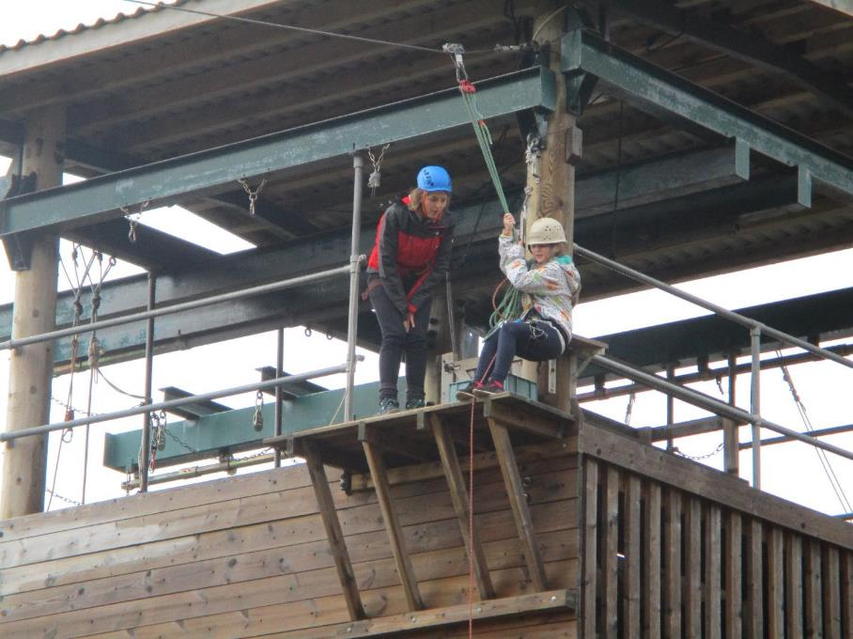

Slide 41
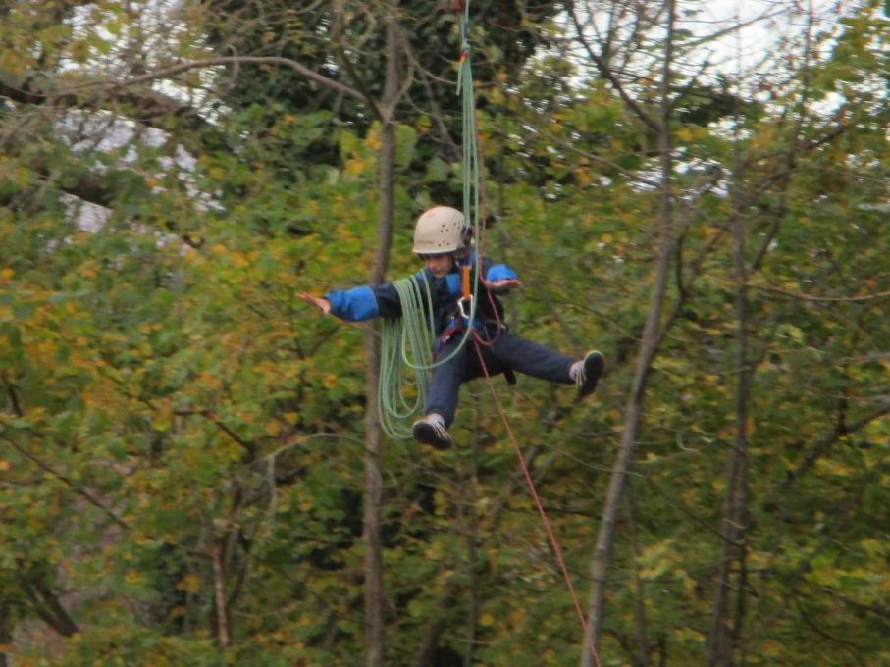

Slide 42
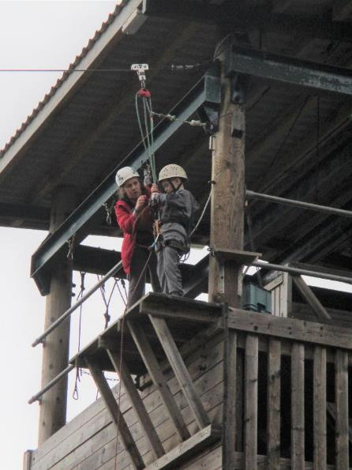
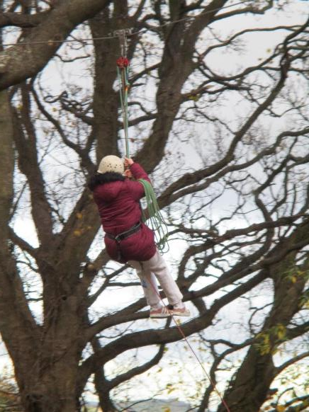

Slide 43
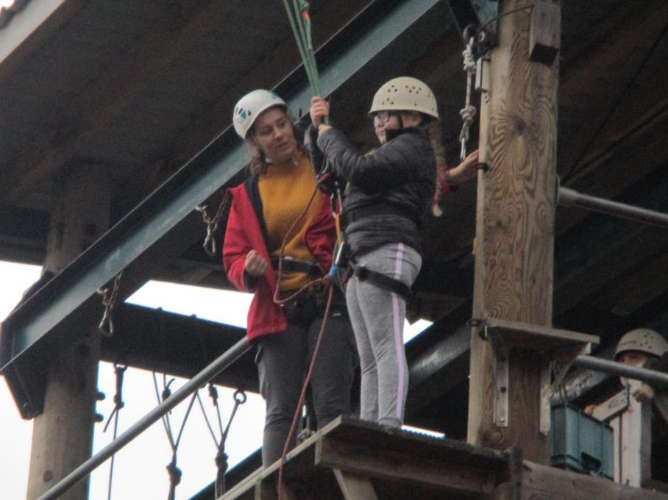

Slide 44
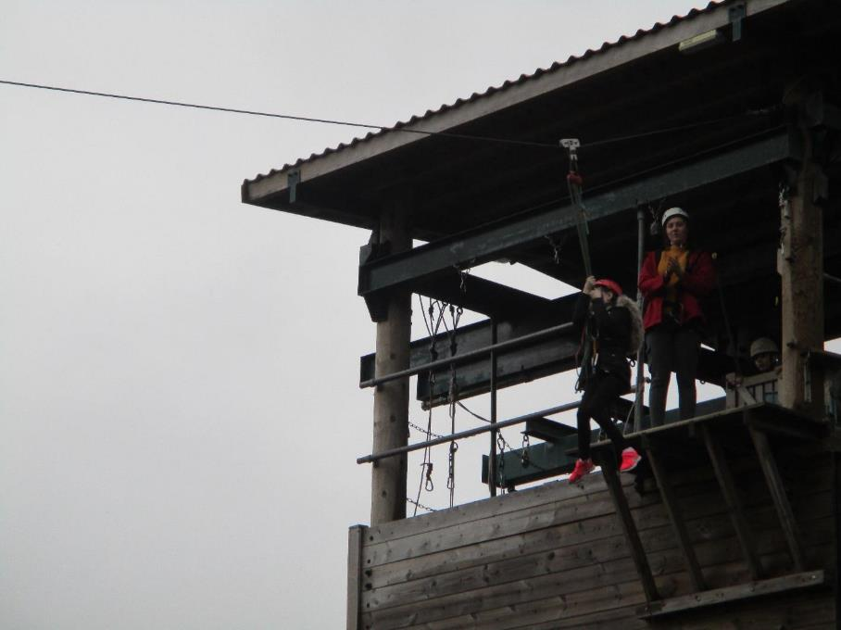

Slide 45
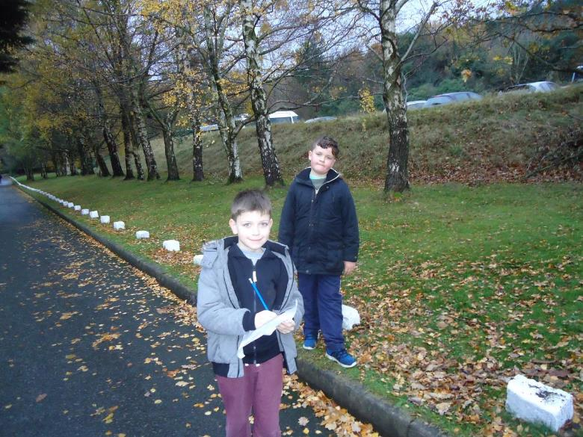
Scavenger hunt and orienteering!

Slide 46
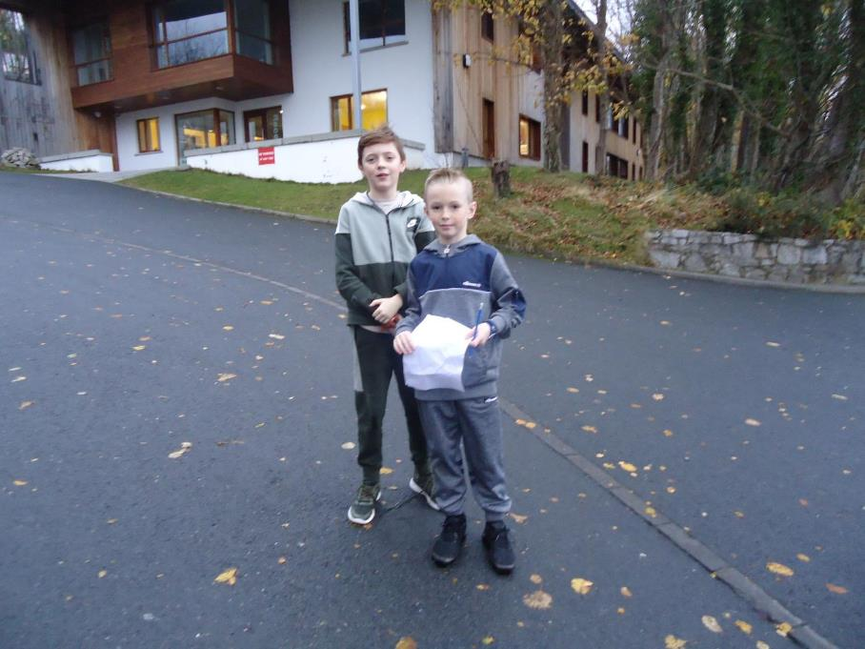

Slide 47


Slide 48


Slide 49


Slide 50


Slide 51


Slide 52


Slide 53


Slide 54


Slide 55


Slide 56


Slide 57


Slide 58


Slide 59


Slide 60

Time to eat!

Slide 61


Slide 62


Slide 63


Slide 64


Slide 65

Bouldering!

Slide 66


Slide 67


Slide 68



Slide 69


Slide 70



Slide 71


Slide 72


Slide 73


Slide 74


Slide 75


Slide 76


Slide 77


Slide 78


Slide 79


Slide 80


Slide 81


Slide 82


Slide 83


Slide 84


Slide 85


Slide 86


Slide 87


Slide 88



Slide 89

The frog thing! Design

Slide 90


Slide 91


Slide 92


Slide 93


Slide 94


Slide 95


Slide 96


Slide 97


Slide 98


Slide 99

The frog thing! Heats

Slide 100


Slide 101


Slide 102


Slide 103


Slide 104


Slide 105


Slide 106


Slide 107


Slide 108


Slide 109

The frog thing! Finalists!

Slide 110


Slide 111


Slide 112

The frog thing! Winners!

Slide 113

Our last day!

Slide 114


Slide 115


Slide 116


Slide 117


Slide 118


