Slide 1
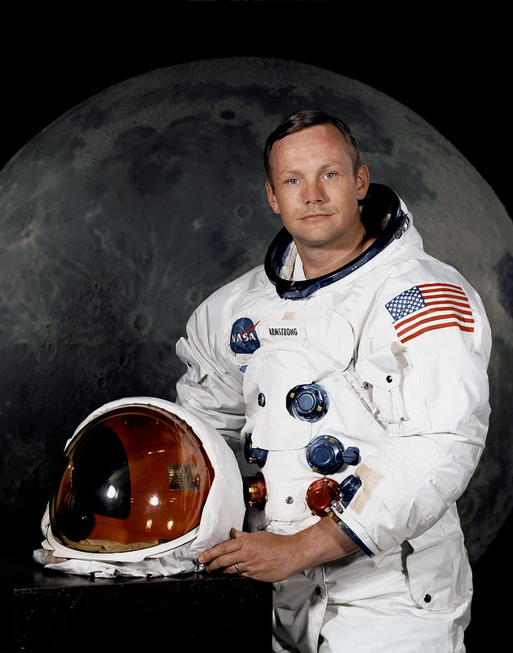
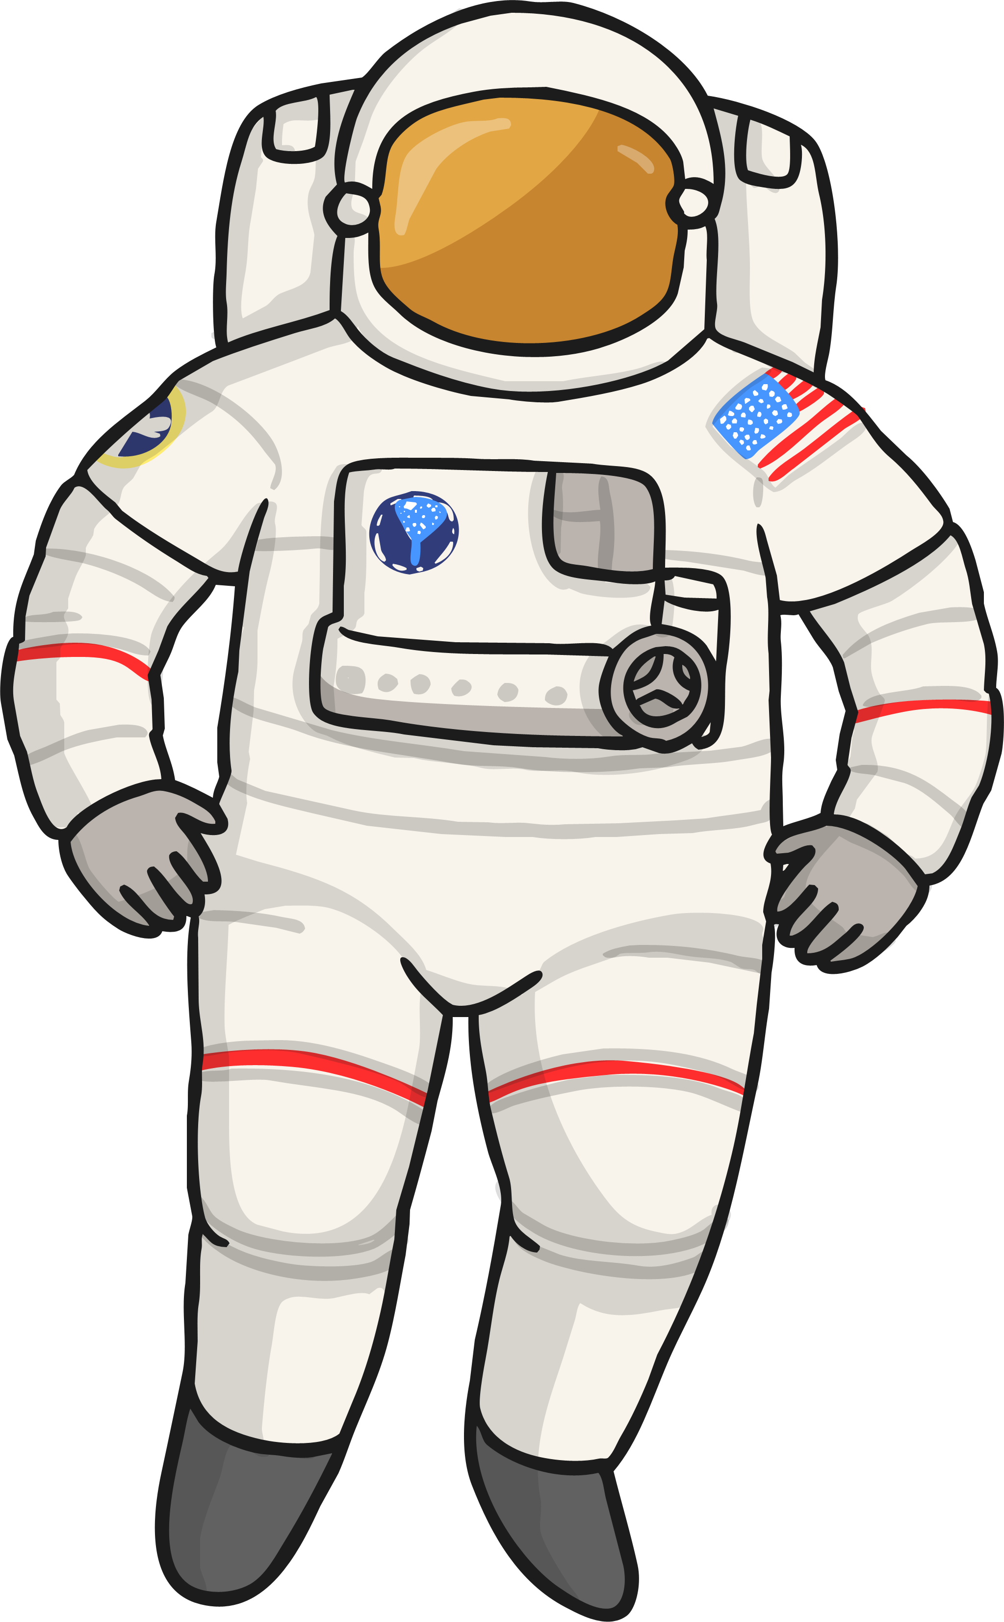

Neil Armstrong
Photo courtesy of NASA on The Commons(@flickr.com) - granted under creative commons licence - attribution

Slide 2
Who is Neil Armstrong?
Neil Armstrong was a famous American astronaut.
He is famous for being the first man on the Moon.
Photo courtesy of NASA on The Commons(@flickr.com) - granted under creative commons licence - attribution

Slide 3
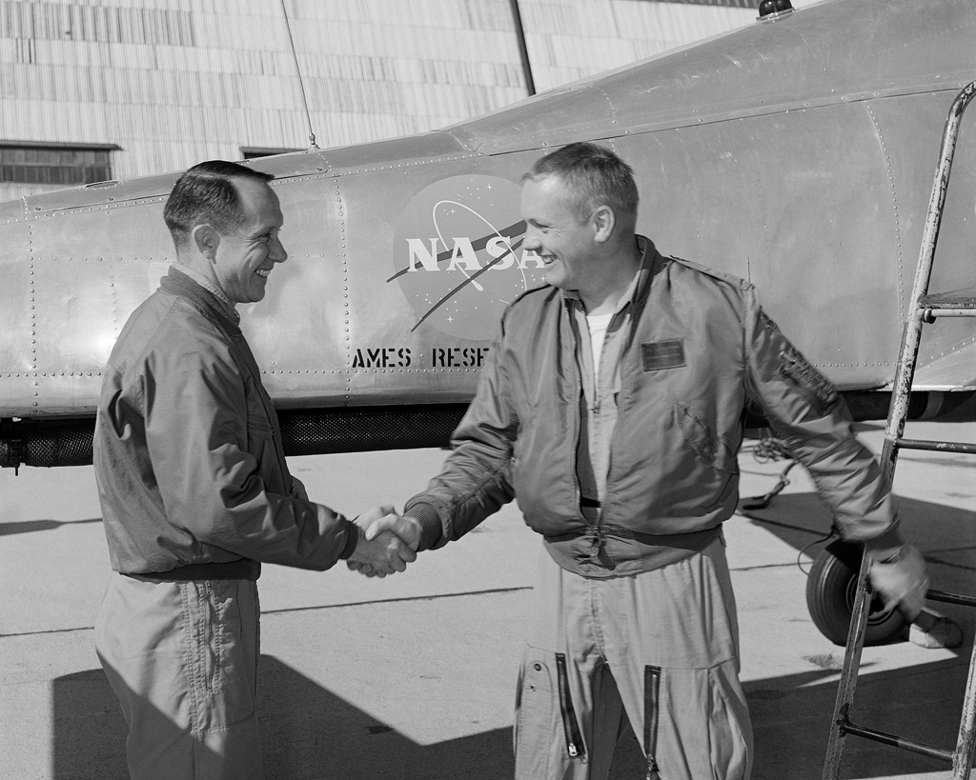
Neil Armstrong’s life
He was born in 1930, in the state of Ohio in America.
He was 15 years old when he got his first pilot’s license.
After attending university he became a test pilot and flew over 200 different aircrafts in his career.
He was accepted to be part of the NASA Astronaut corps in September 1962.
Photo courtesy of NASA on The Commons(@flickr.com) - granted under creative commons licence - attribution

Slide 4
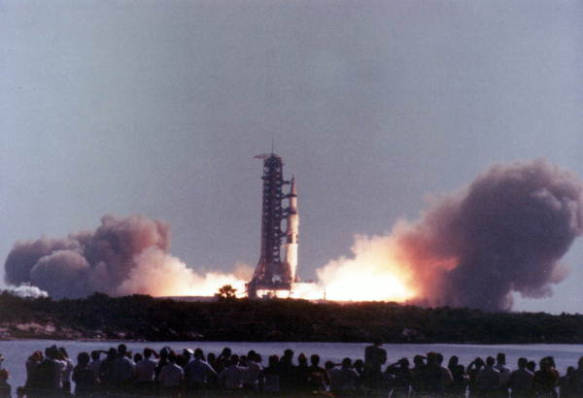
Neil Armstrong’s Life
His first trip into space was aboard Gemini 8.
Then in 1969 he went aboard Apollo 11 and became the first man to walk on the Moon.
He died in 2012 in Ohio, America.
Photo courtesy of Florida Memory(@flickr.com) - granted under creative commons licence - attribution

Slide 5
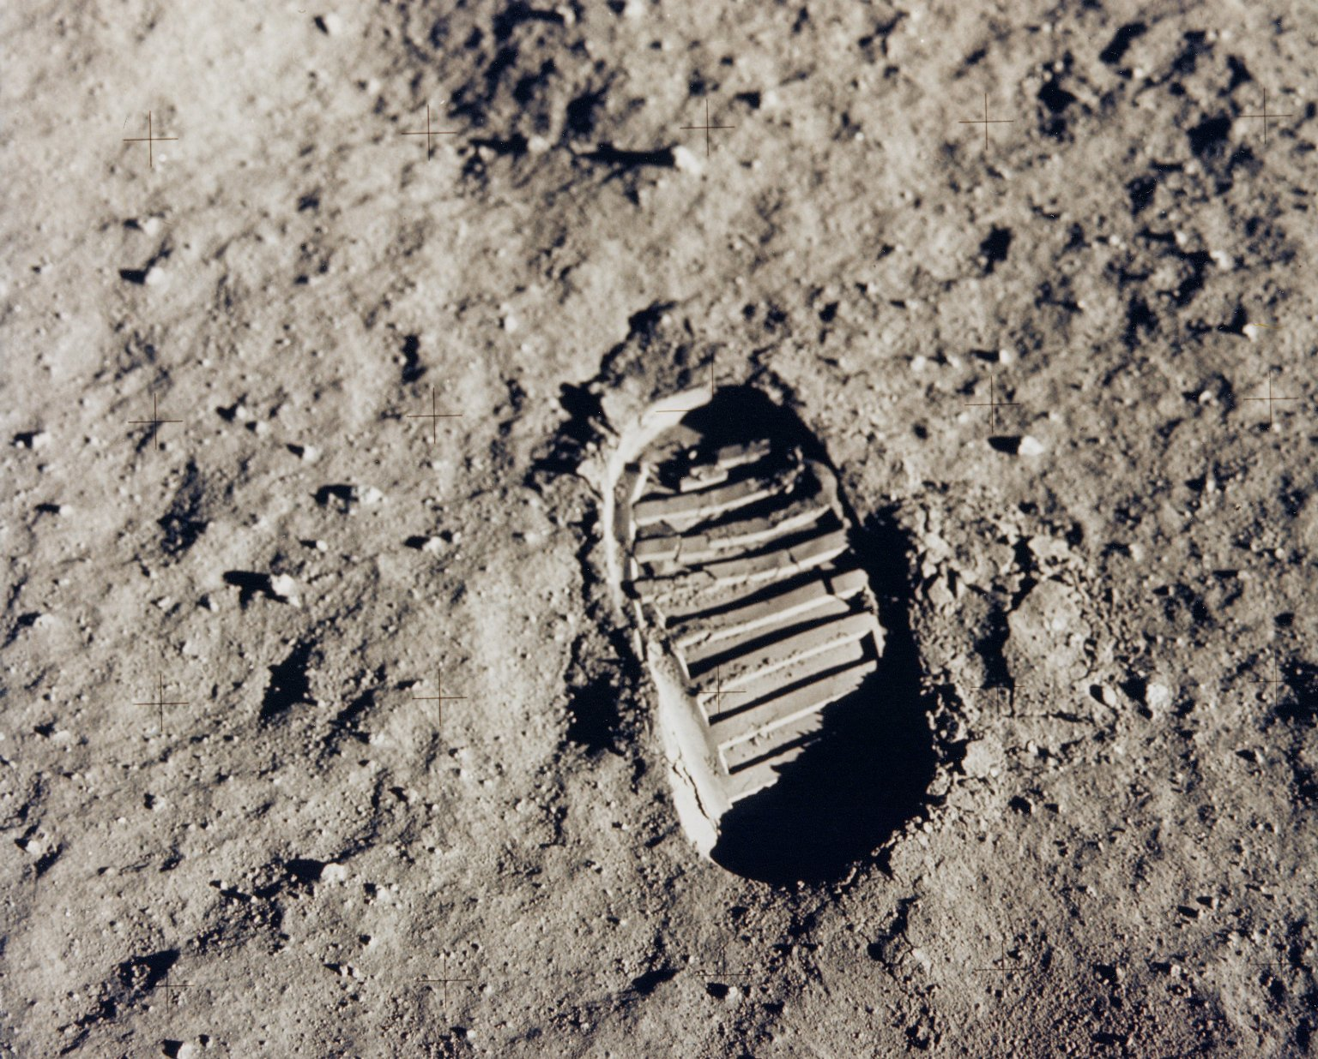
Walking on the Moon
On December 23, 1968, Neil Armstrong was offered the chance to command the space shuttle Apollo 11. This would be the first manned landing on the Moon. After months of practice and preparation the Apollo 11 spacecraft launched from the Kennedy Space Centre in Florida on July 16th 1969.
They landed on the moon and Neil Armstrong became the first man to walk on the Moon on July 21st 1969. The astronauts arrived back on earth on July 24th 1969.
Photo courtesy of NASA on The Commons(@flickr.com) - granted under creative commons licence - attribution

Slide 6
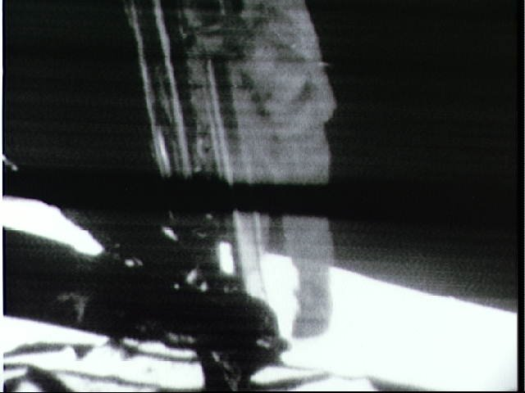
Neil Armstrong's Famous words
After stepping onto the Moon Neil Armstrong was heard saying –
“That’s one small step for man, one giant leap for mankind.”
Photo courtesy of NASA on The Commons(@flickr.com) - granted under creative commons licence - attribution

Slide 7

Task
Your task is to put together a timeline of events from Neil Armstrong's life
What to include:
Timeline

Slide 8

Plenary
What was Neil Armstrong famous for?
What was the name of the spacecraft he went to the Moon in?
Complete his famous words –
“That’s one ______ step for man, one giant leap for ______.”

Slide 9
THE END

