Slide 1
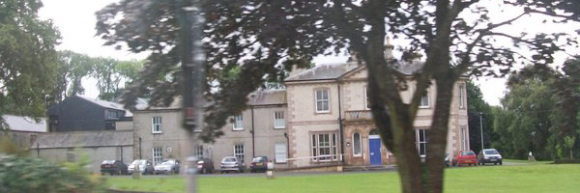
P6 visit to Ardnabannon
21st - 24th November 2017

Slide 2
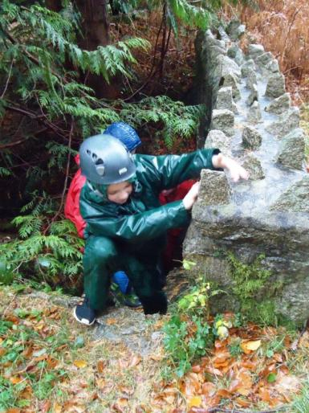
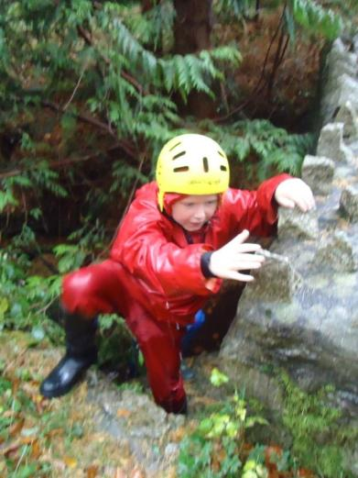
Adventure Walk

Slide 3
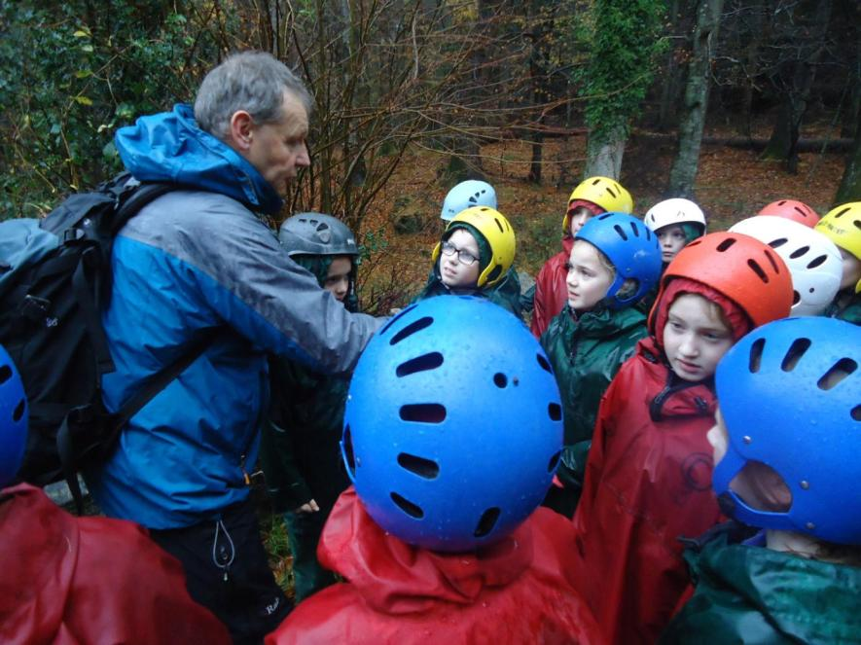

Slide 4
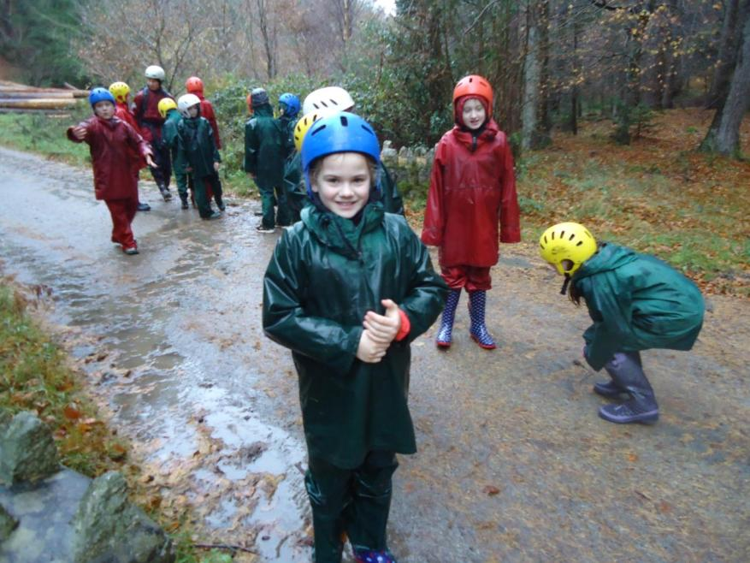

Slide 5
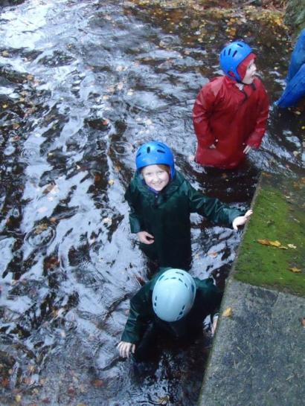
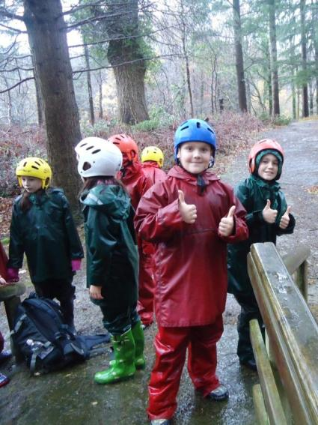

Slide 6
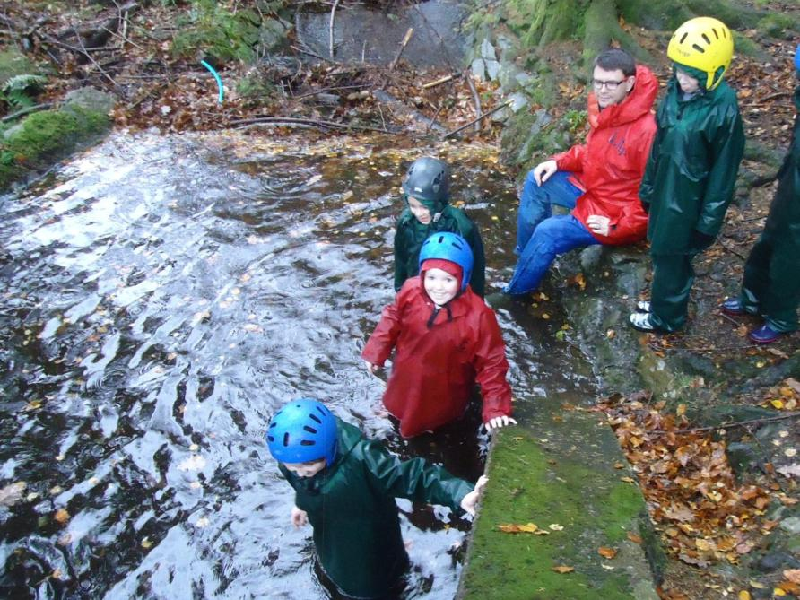

Slide 7
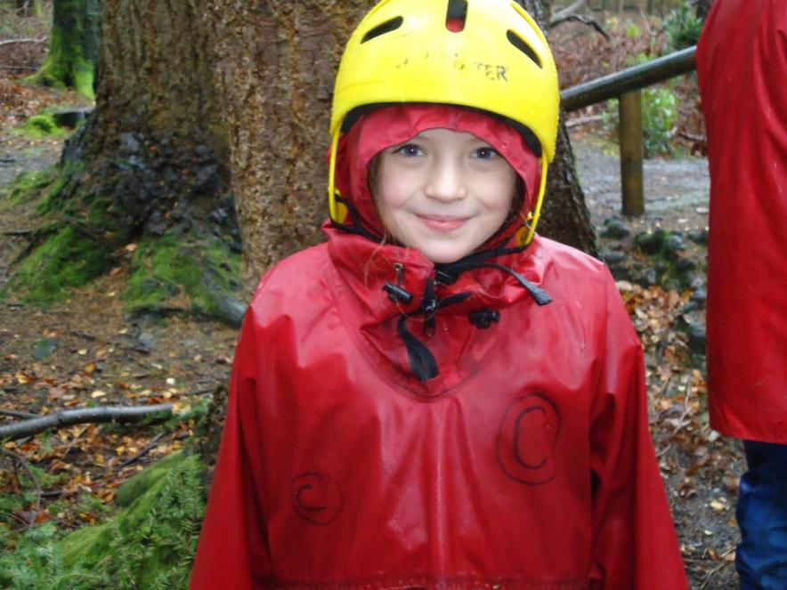

Slide 8
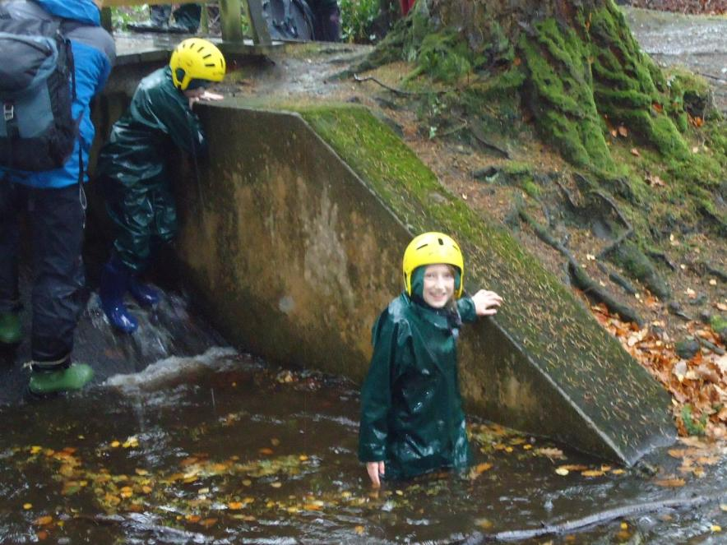

Slide 9
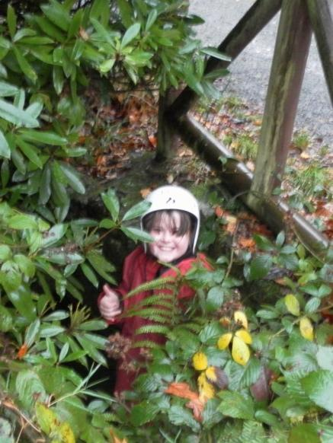
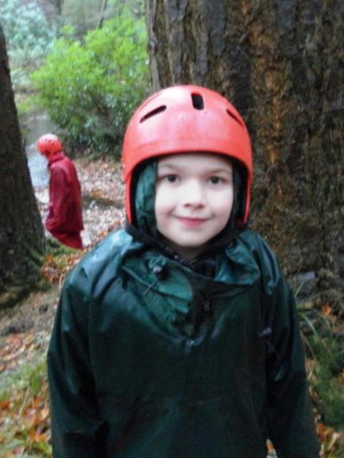

Slide 10
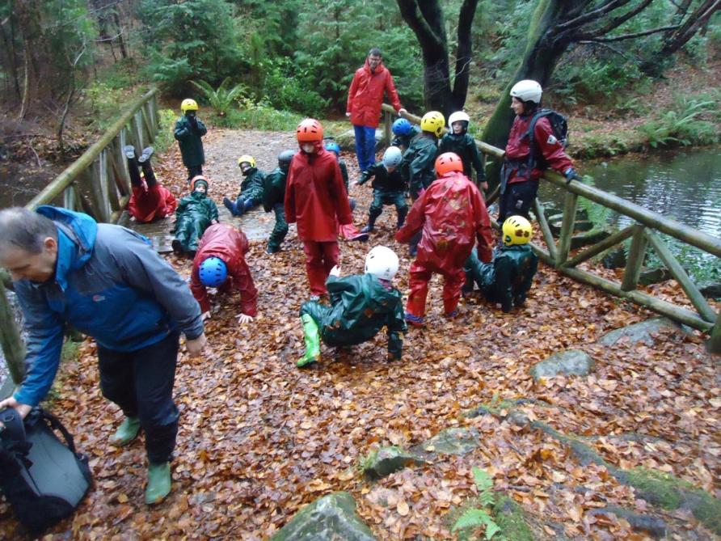

Slide 11
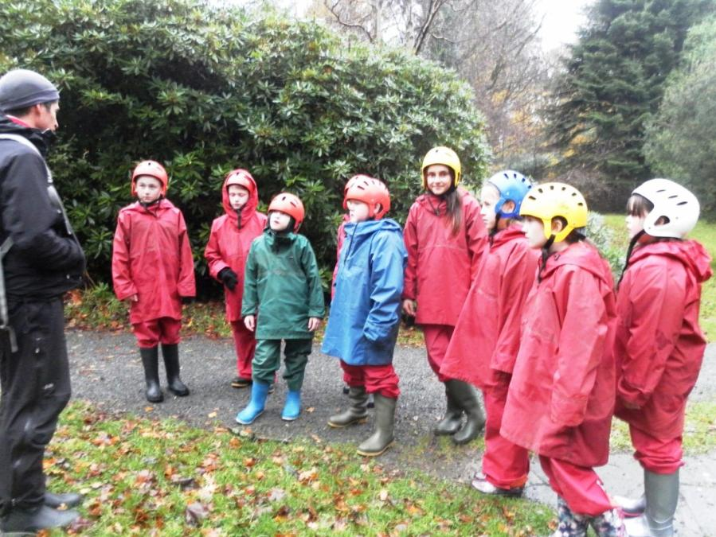

Slide 12
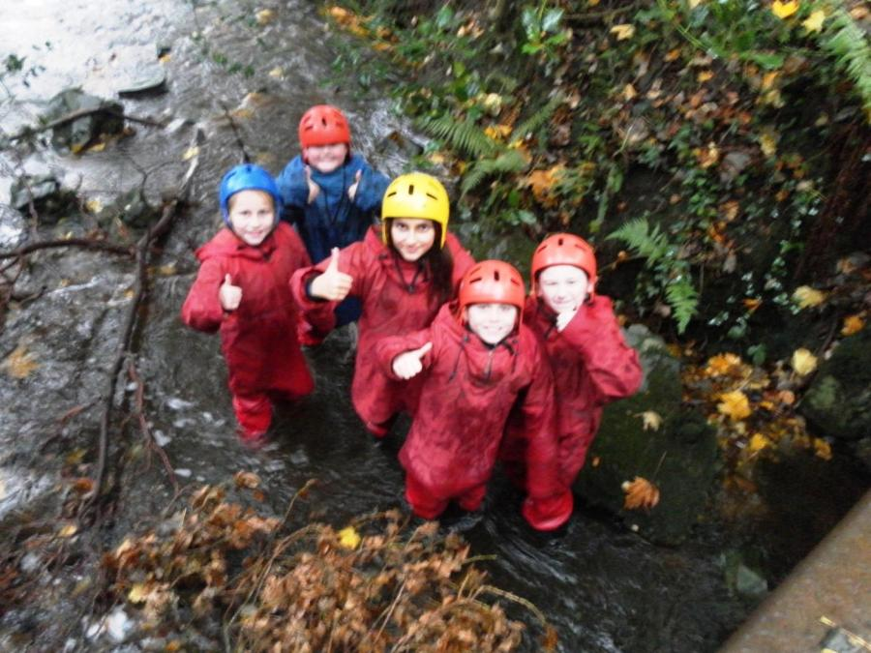

Slide 13
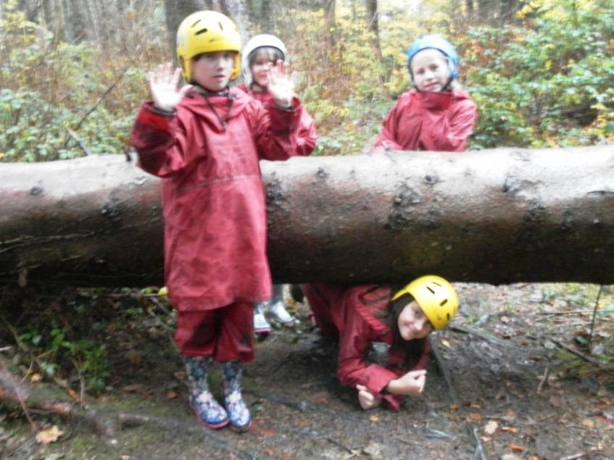

Slide 14
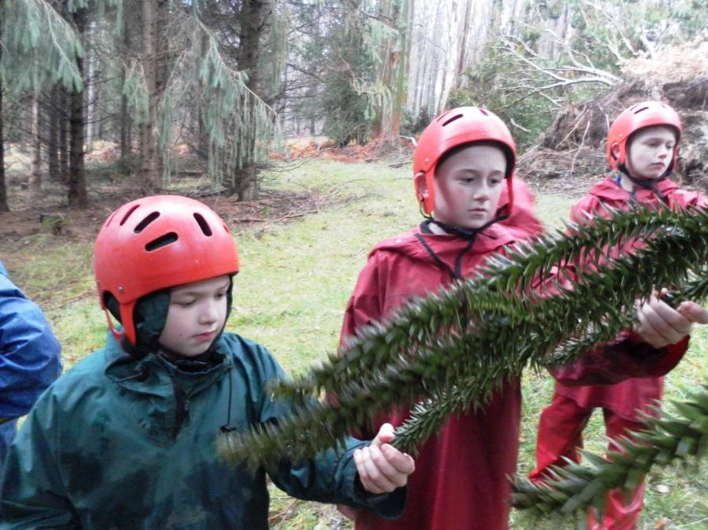

Slide 15
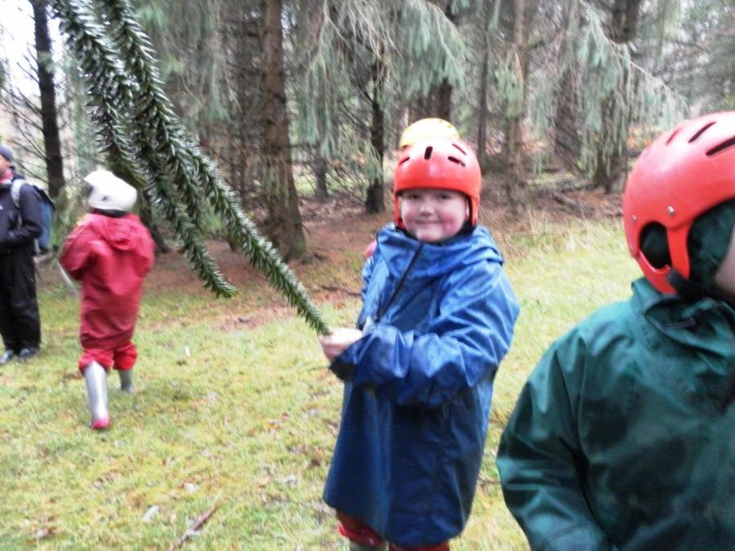

Slide 16
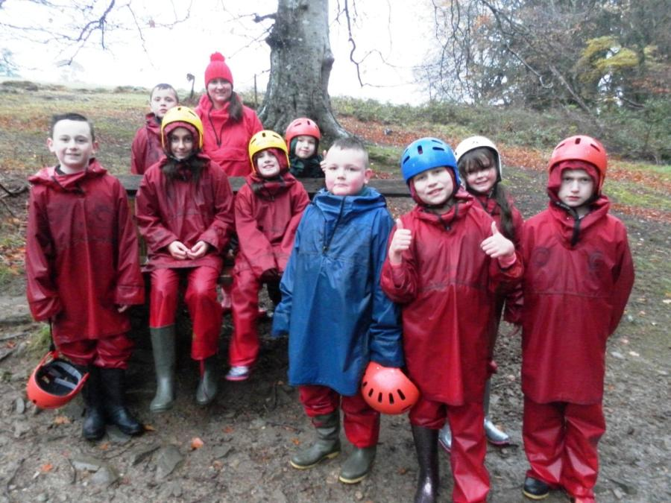

Slide 17
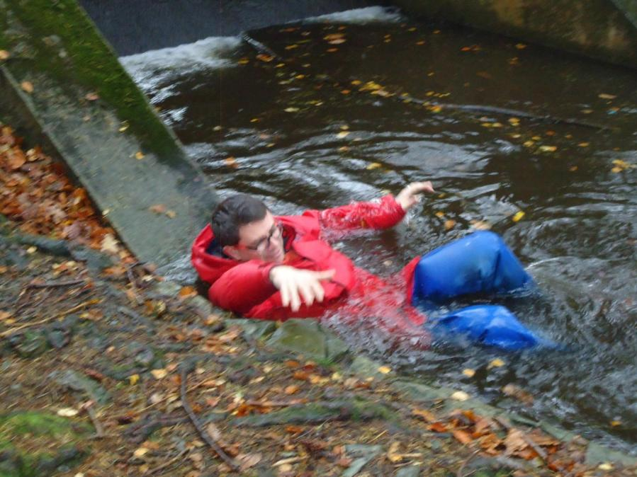

Slide 18
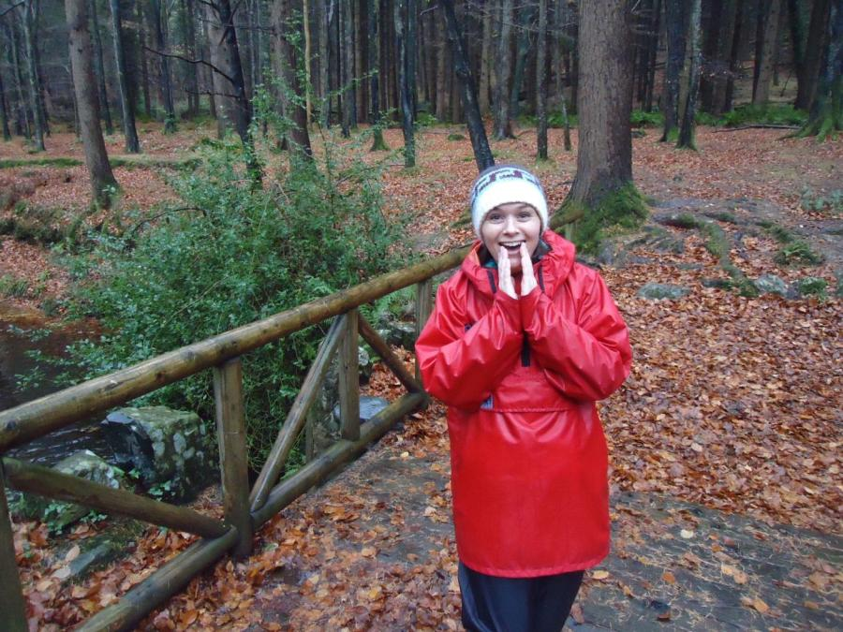

Slide 19
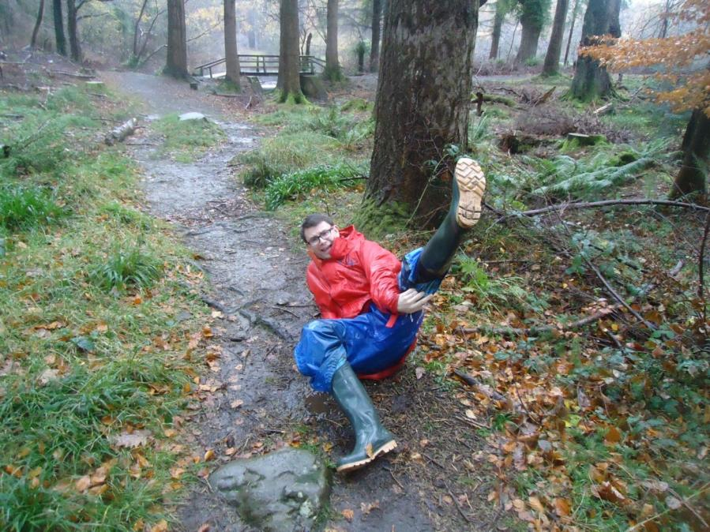

Slide 20
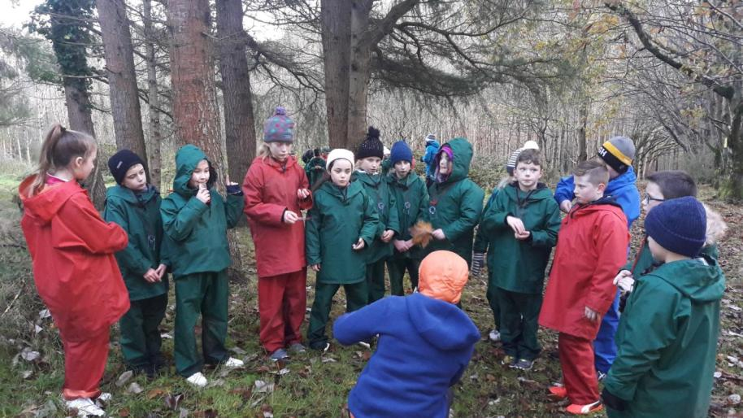
Compass trail

Slide 21
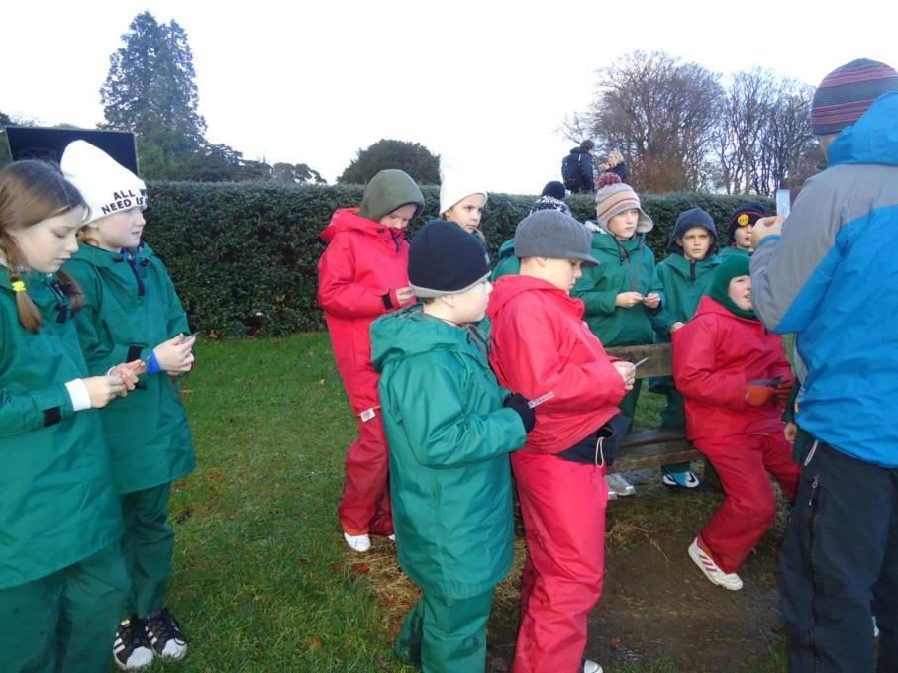

Slide 22
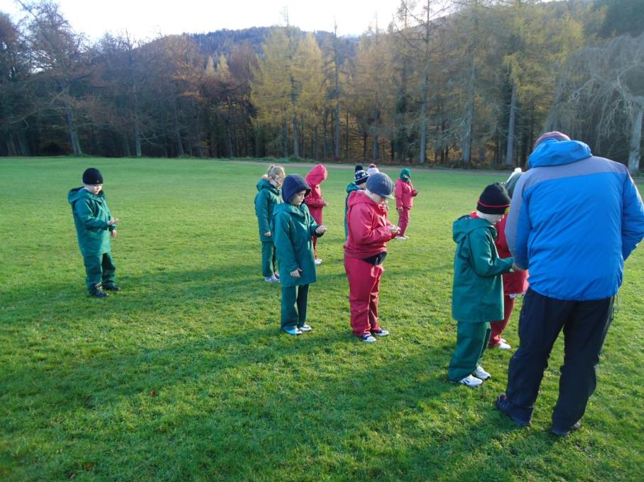

Slide 23
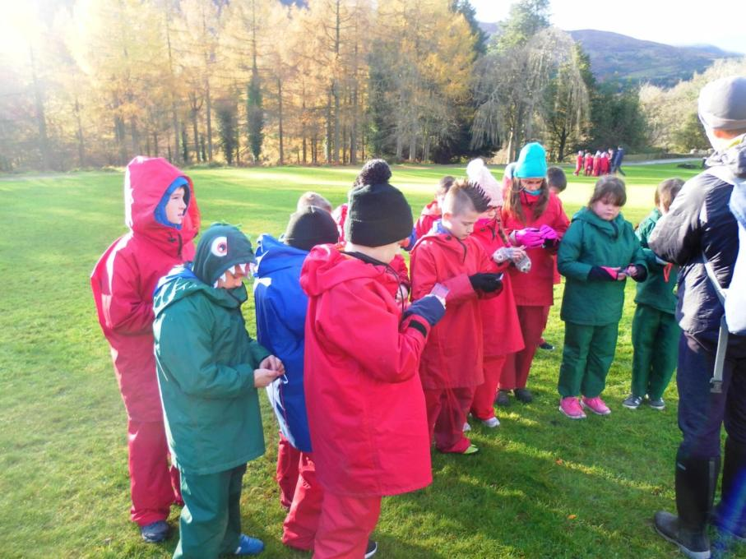

Slide 24
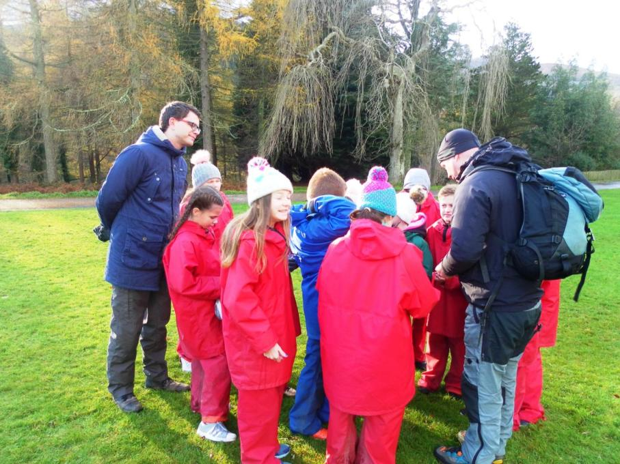

Slide 25
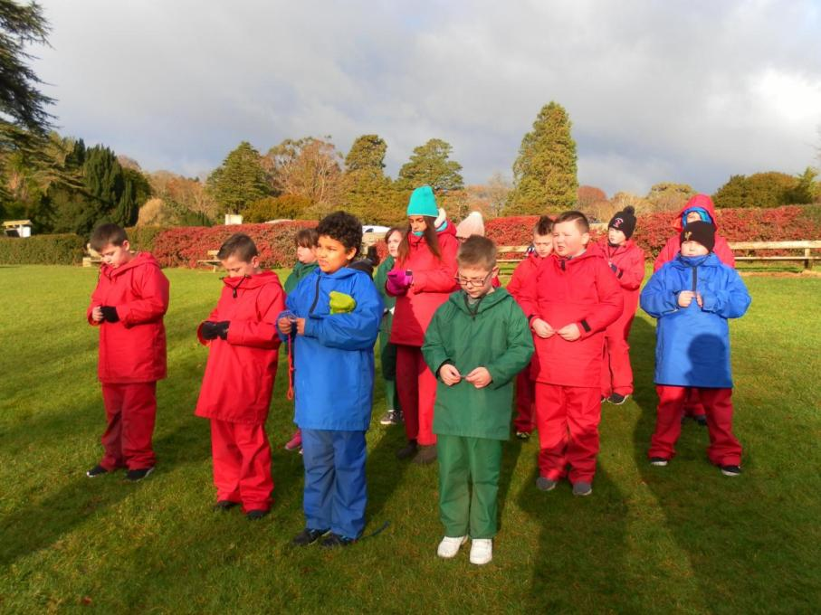

Slide 26
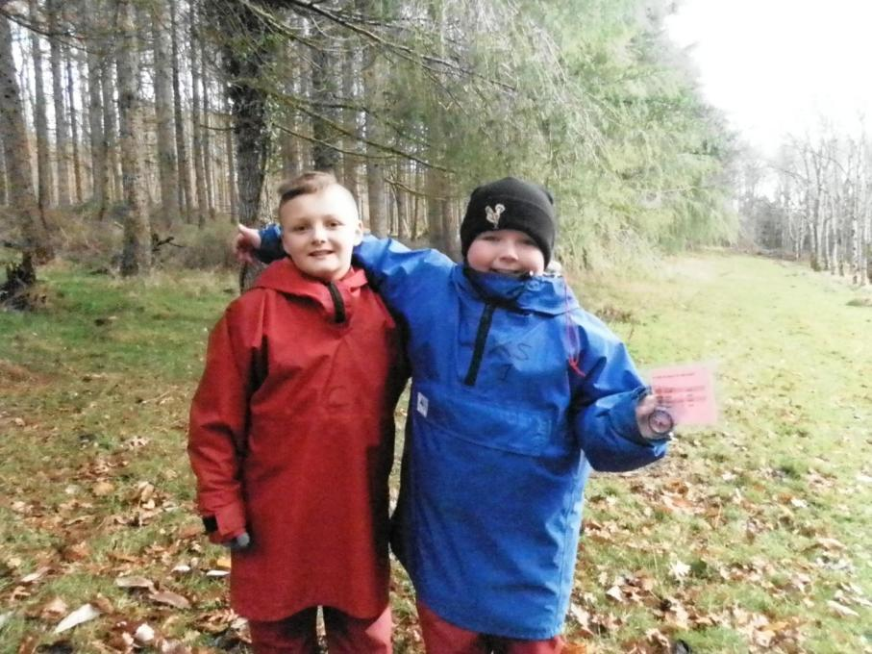

Slide 27
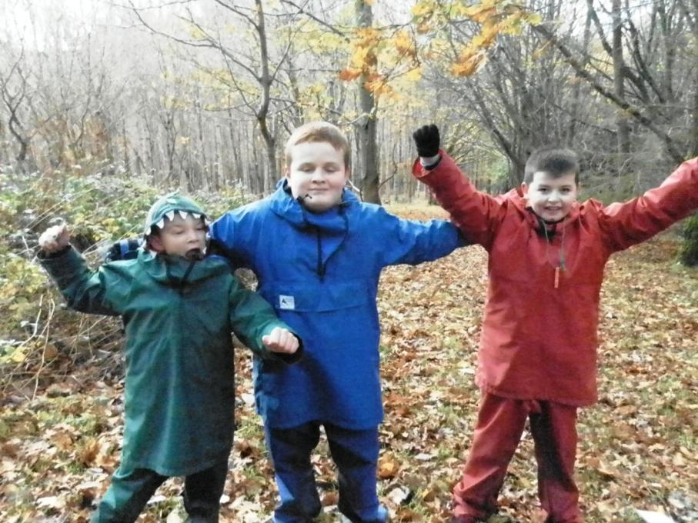

Slide 28
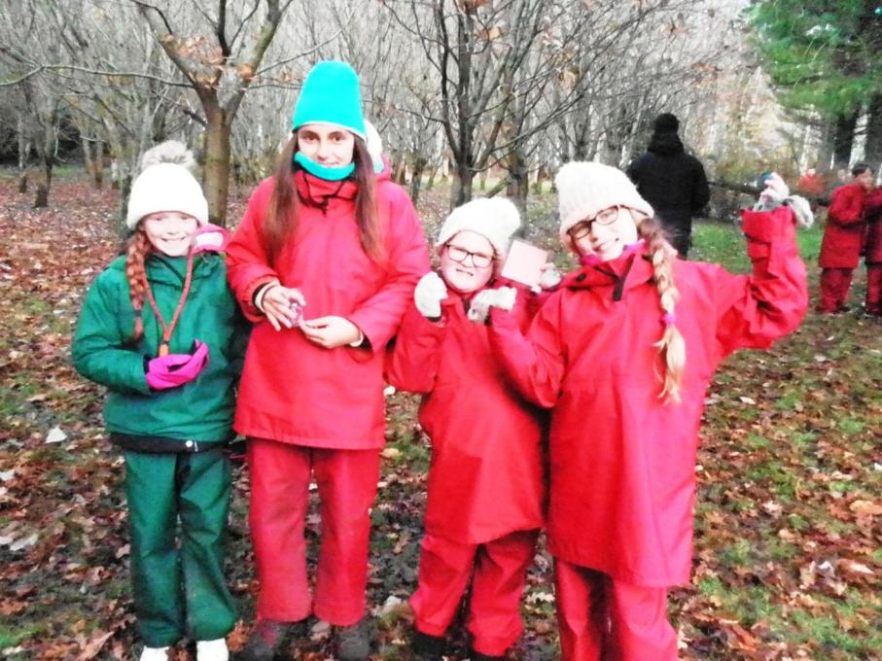

Slide 29
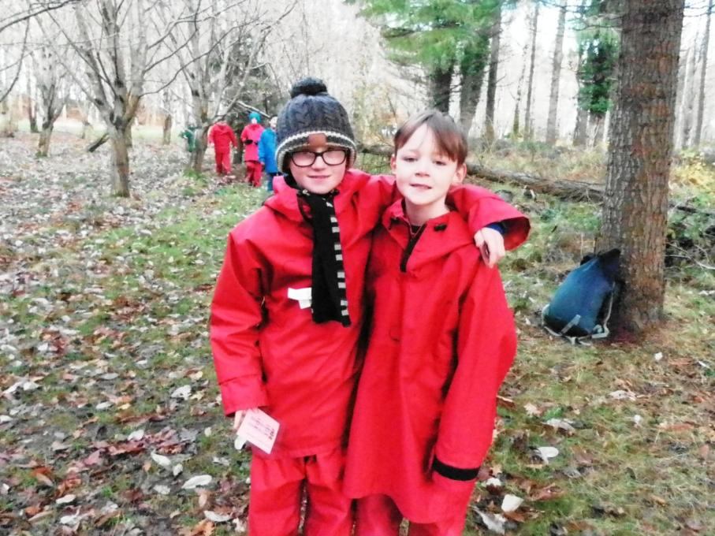

Slide 30
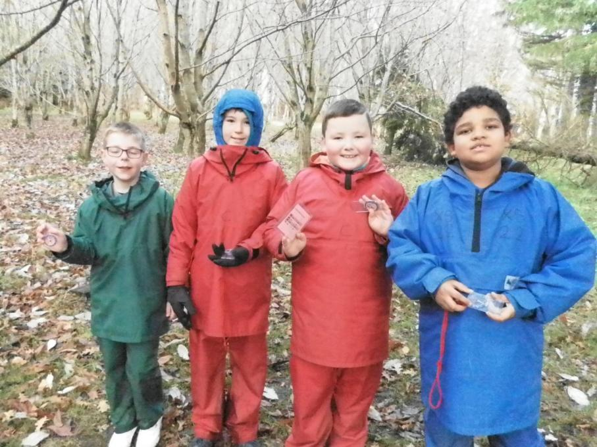

Slide 31
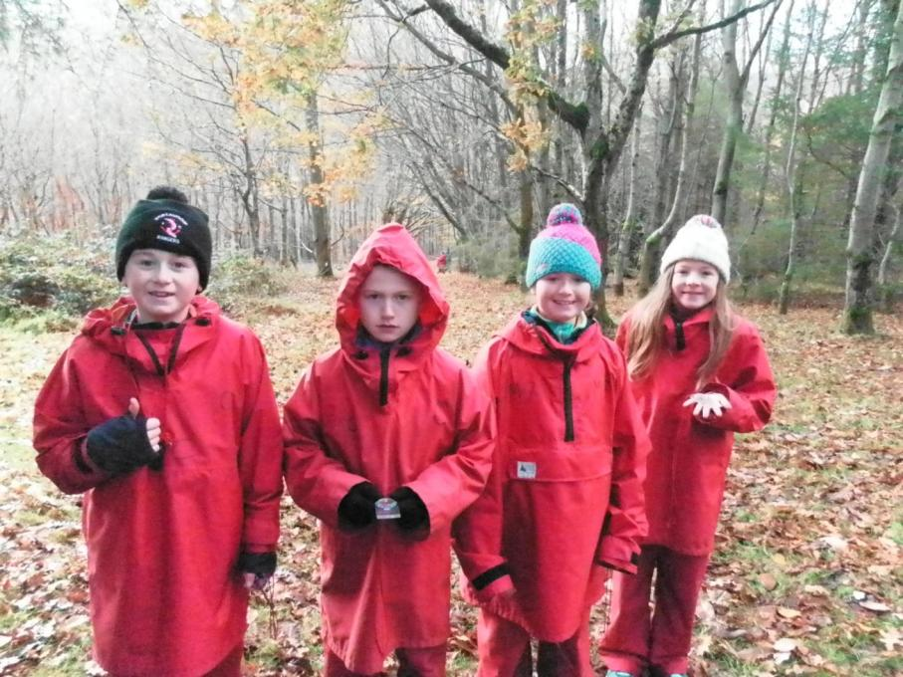

Slide 32
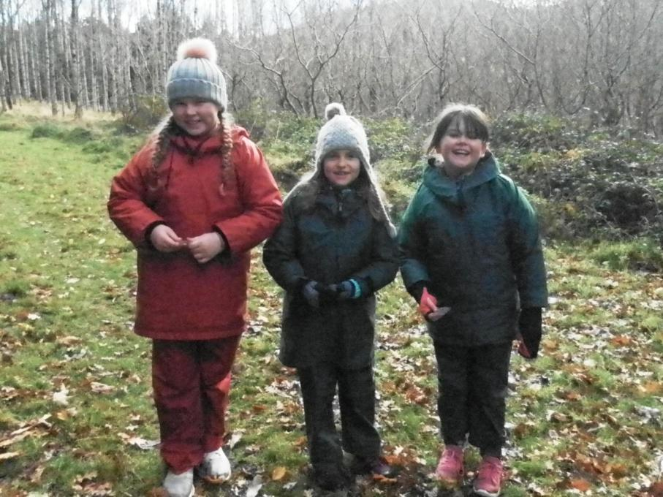

Slide 33
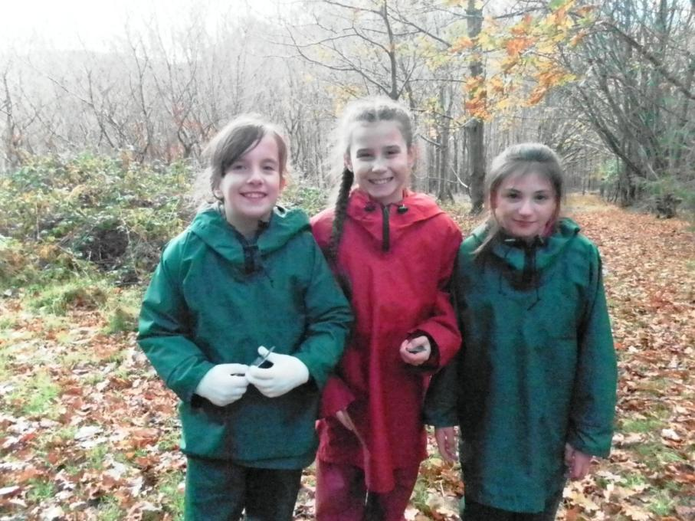

Slide 34
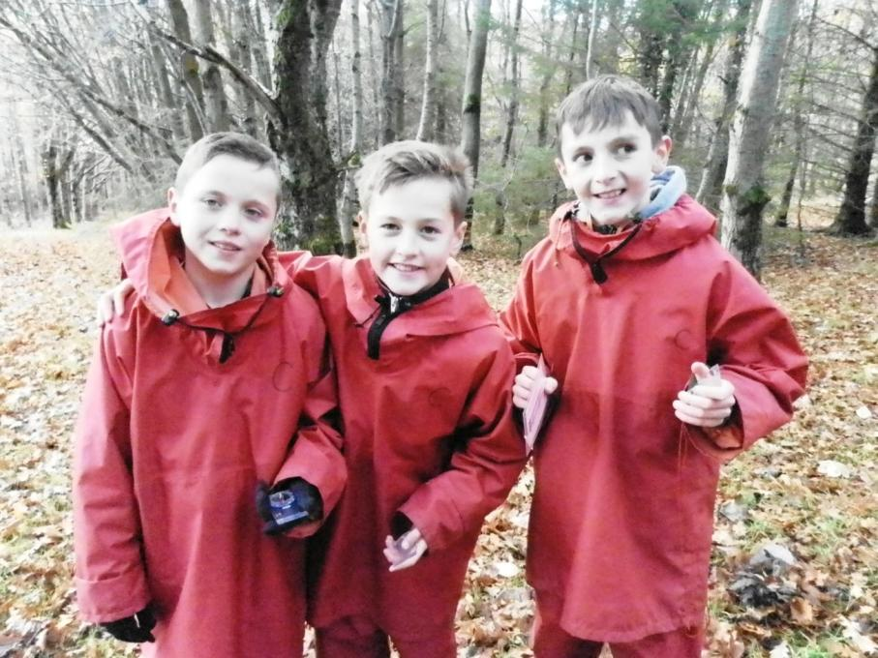

Slide 35
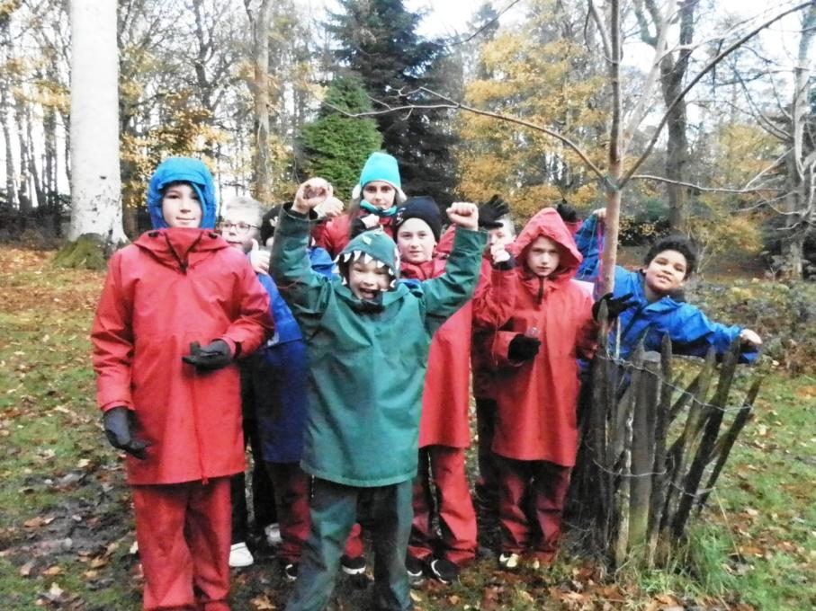

Slide 36
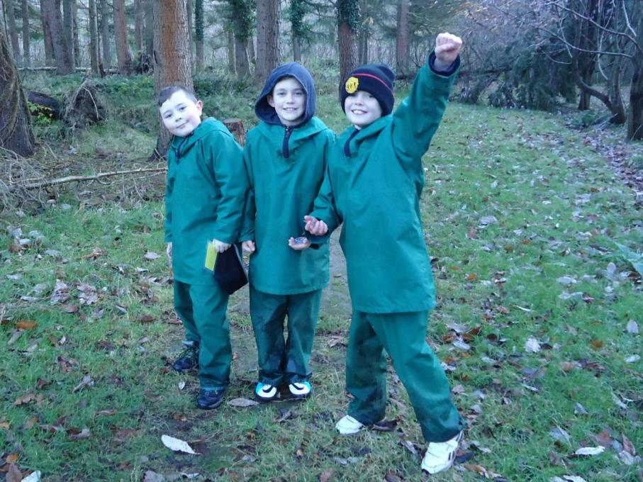

Slide 37
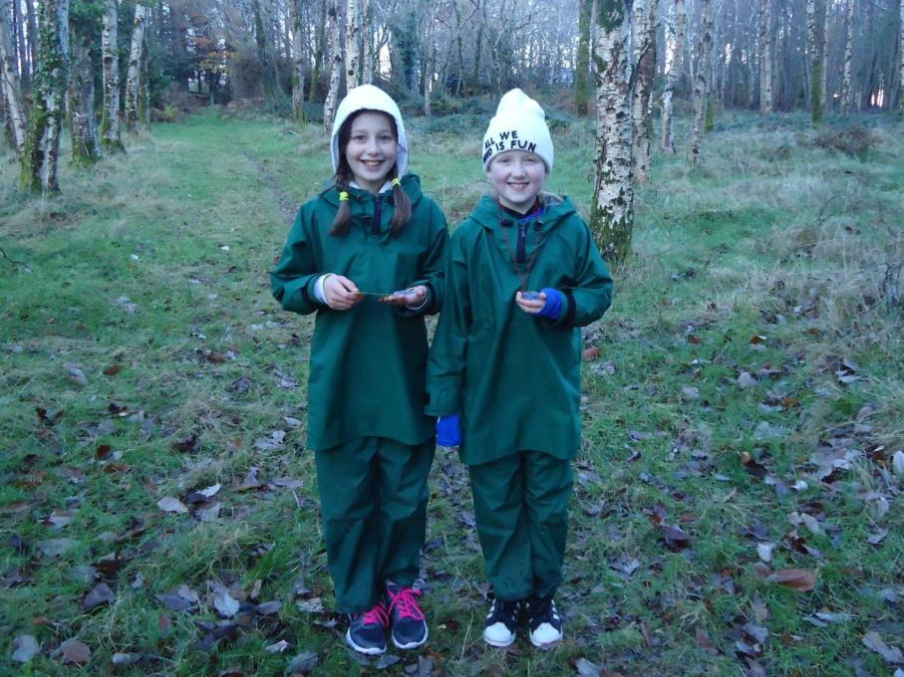

Slide 38
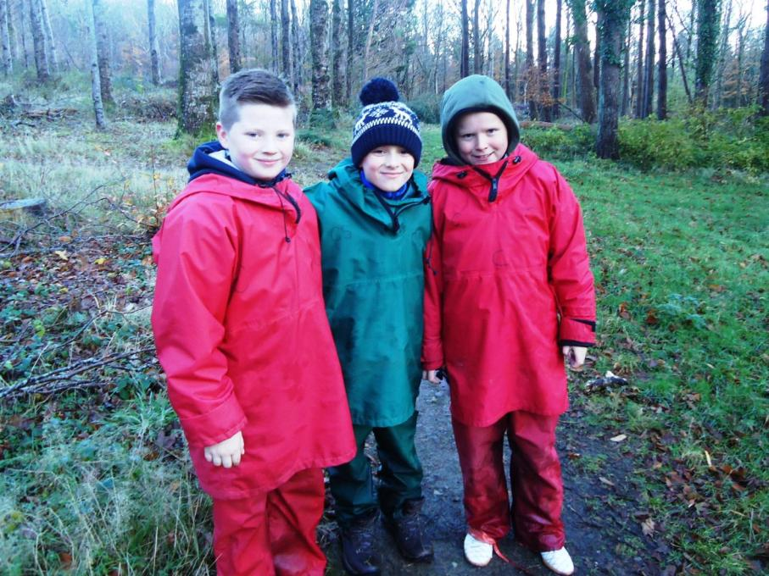

Slide 39
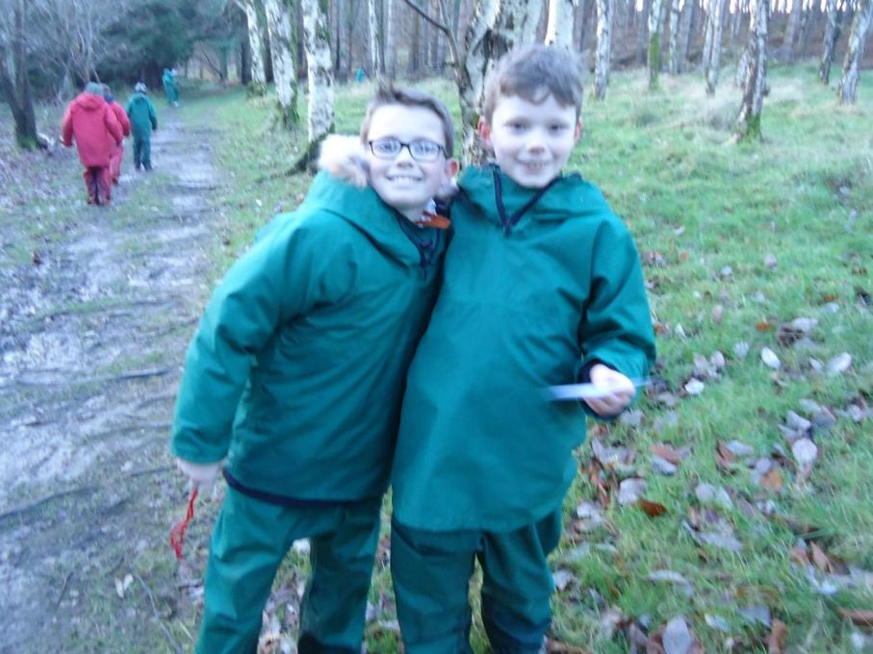

Slide 40
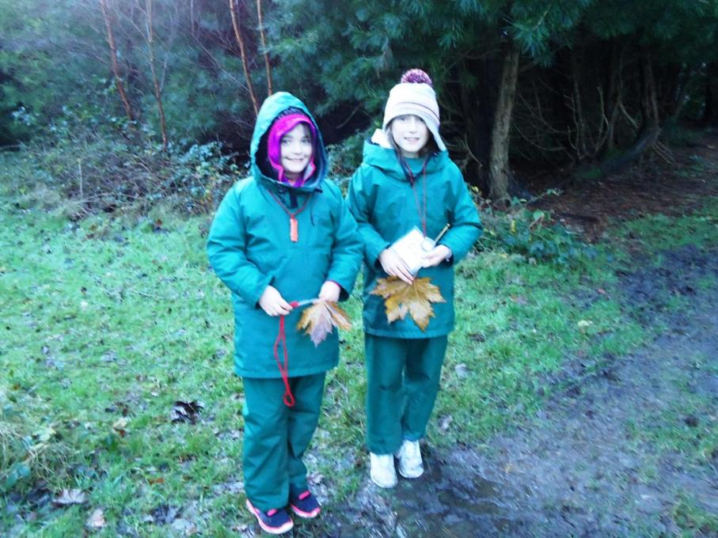

Slide 41
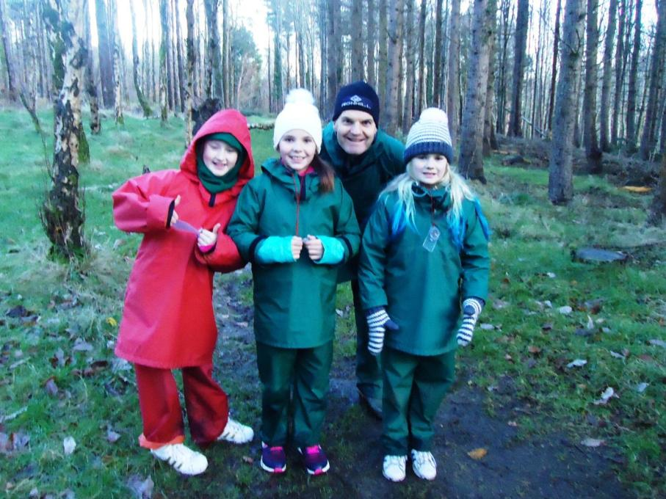

Slide 42
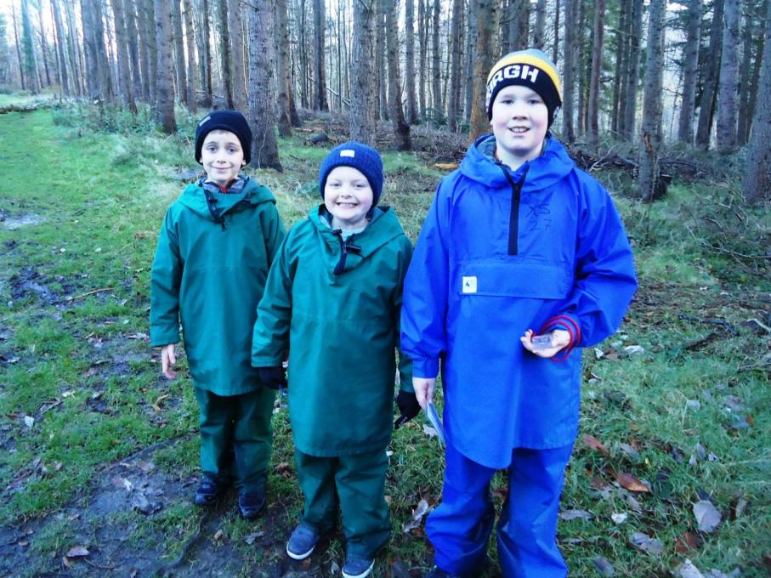

Slide 43
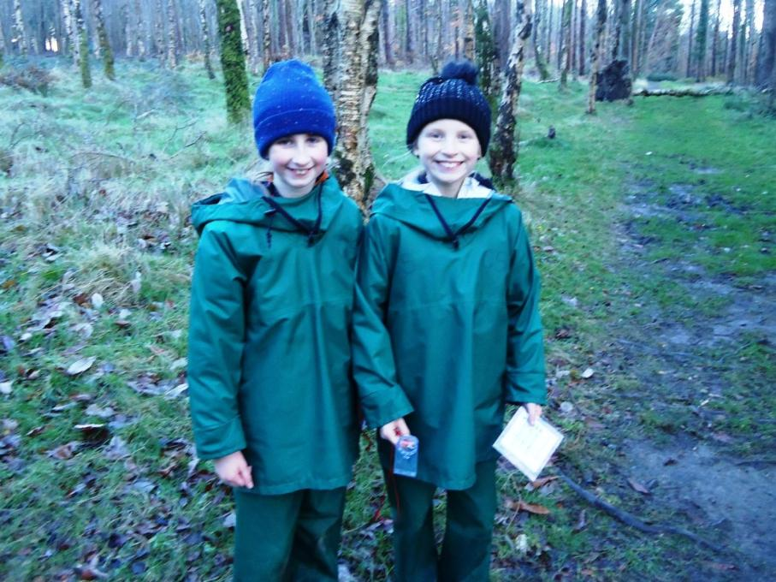

Slide 44
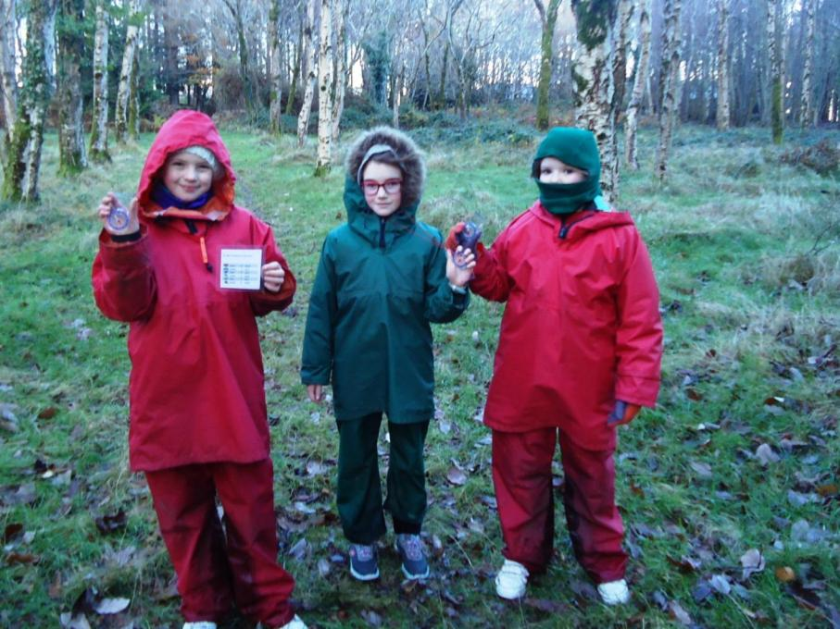

Slide 45
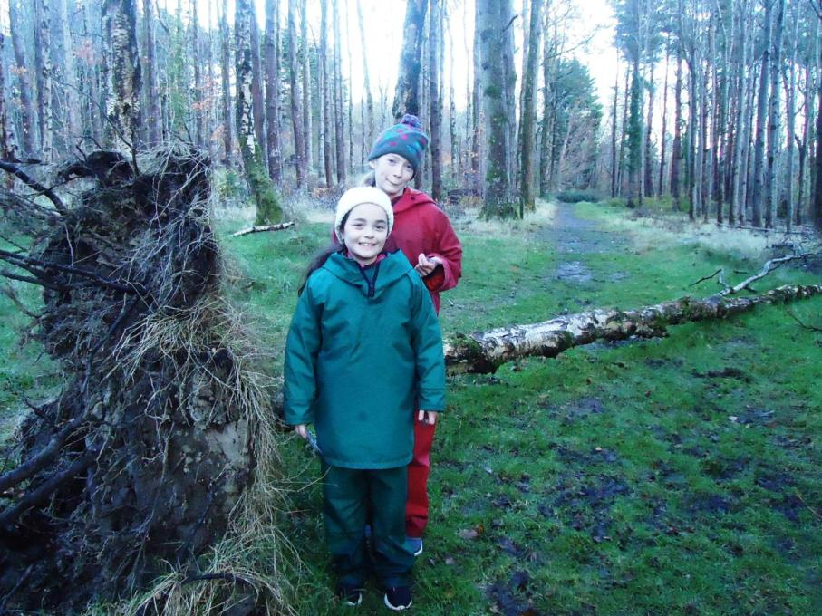

Slide 46
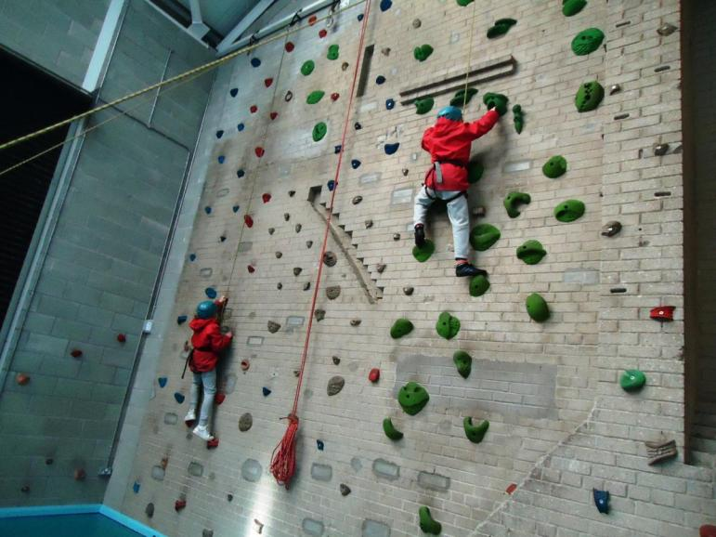
Climbing wall

Slide 47
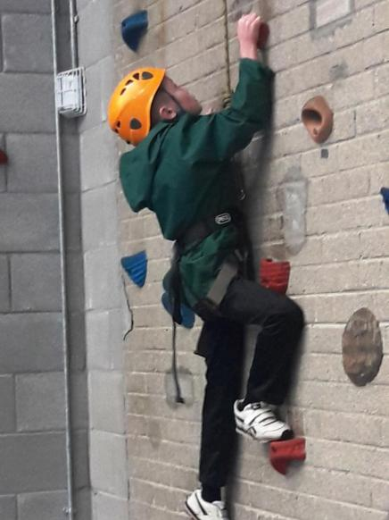


Slide 48


Slide 49


Slide 50



Slide 51


Slide 52

Outdoor climbing pole

Slide 53


Slide 54


Slide 55



Slide 56


Slide 57


Slide 58


Slide 59


Slide 60

Zip line

Slide 61


Slide 62


Slide 63



Slide 64


Slide 65


Slide 66


Slide 67


Slide 68


Slide 69


Slide 70



Slide 71


Slide 72



Slide 73


Slide 74

Castlewellan Castle and Lake

Slide 75


Slide 76


Slide 77



Slide 78


Slide 79


Slide 80



Slide 81


Slide 82


Slide 83


Slide 84


Slide 85


Slide 86



Slide 87


Slide 88

Bouldering

Slide 89


Slide 90



Slide 91


Slide 92


Slide 93


Slide 94


Slide 95


Slide 96


Slide 97


Slide 98


Slide 99



Slide 100


Slide 101


Slide 102


Slide 103


Slide 104


Slide 105



Slide 106

Archery

Slide 107



Slide 108



Slide 109



Slide 110


Slide 111


Slide 112


Slide 113


Slide 114

The frog thing! Design

Slide 115


Slide 116


Slide 117


Slide 118


Slide 119


Slide 120


Slide 121


Slide 122


Slide 123

The frog thing! Heats

Slide 124


Slide 125


Slide 126


Slide 127



Slide 128


Slide 129


Slide 130


Slide 131



Slide 132


Slide 133


Slide 134

The frog thing! Winners!

Slide 135

Our last day!

Slide 136


Slide 137


Slide 138


Slide 139


Slide 140


Slide 141


Slide 142


Slide 143


Slide 144



Slide 145


Slide 146


Slide 147


Slide 148


Slide 149


Slide 150


Slide 151


Slide 152


Slide 153


Slide 154



Slide 155


Slide 156


Slide 157


Slide 158


Slide 159


Slide 160


Slide 161


Slide 162


Slide 163


Slide 164


