Slide 1
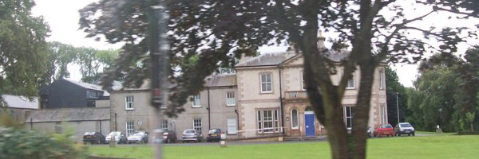
P6 visit to Ardnabannon
8th – 11th November 2016

Slide 2
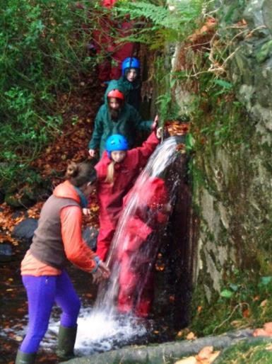
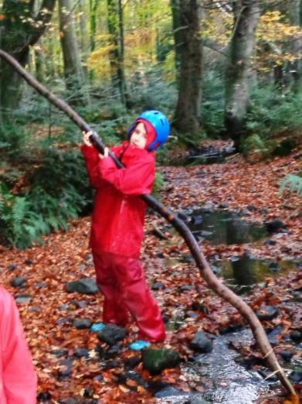
Adventure Walk

Slide 3
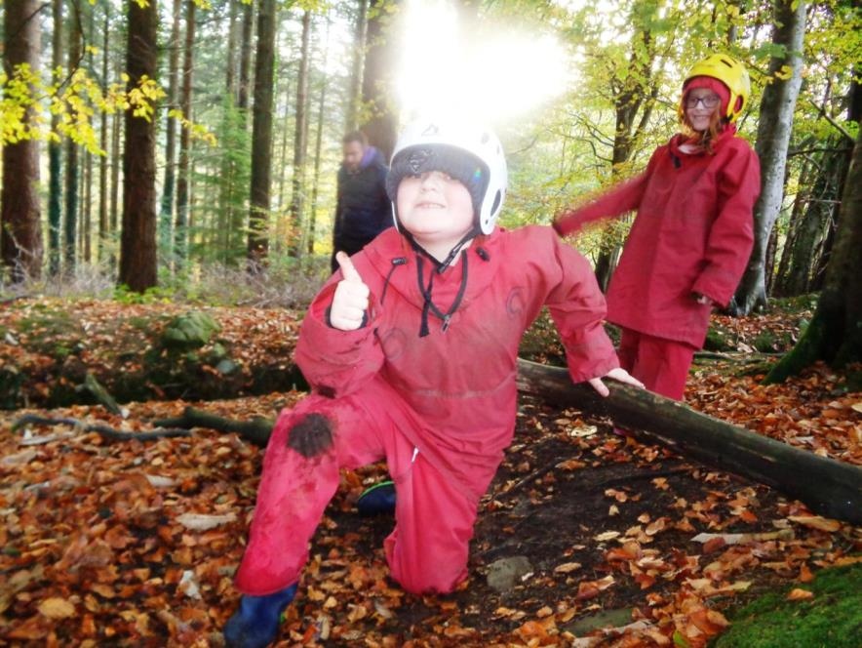

Slide 4
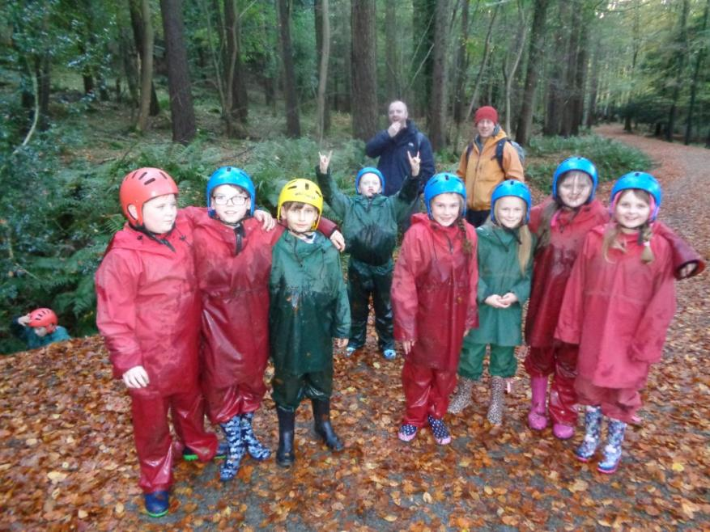

Slide 5
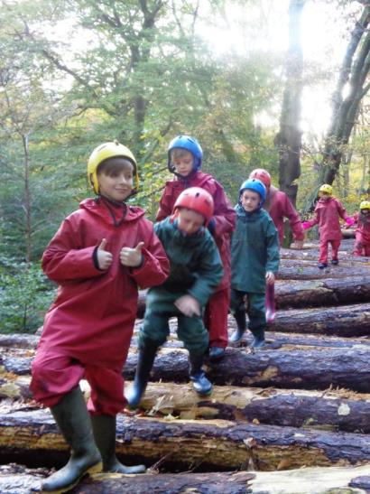
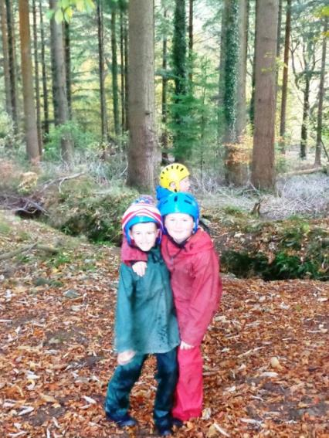

Slide 6
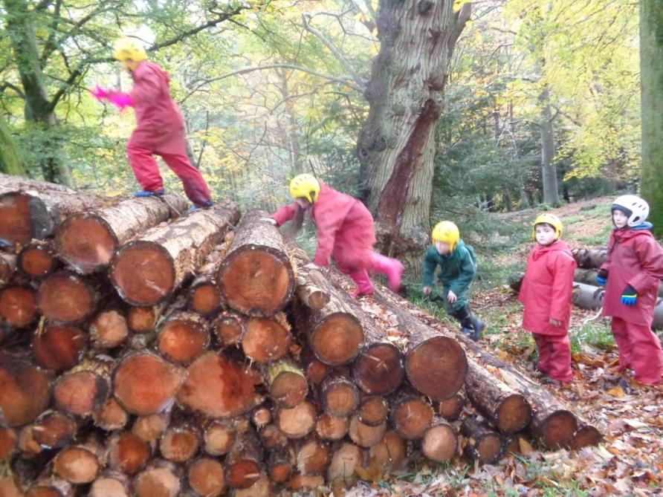

Slide 7
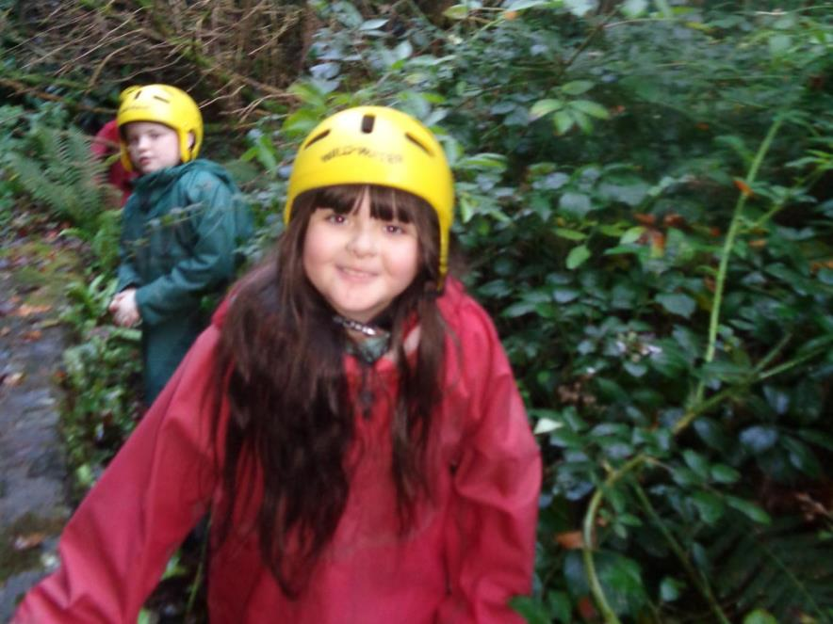

Slide 8
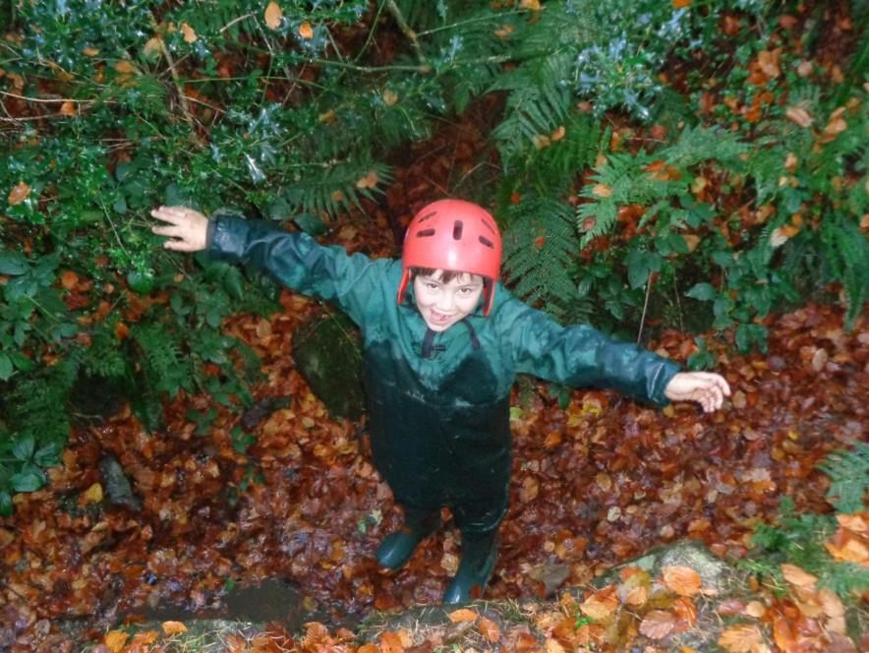

Slide 9
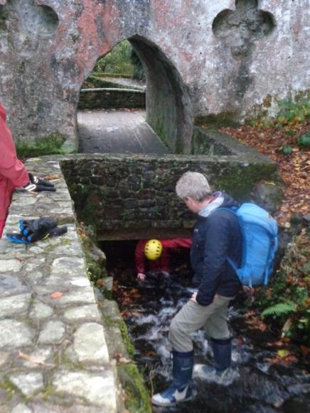
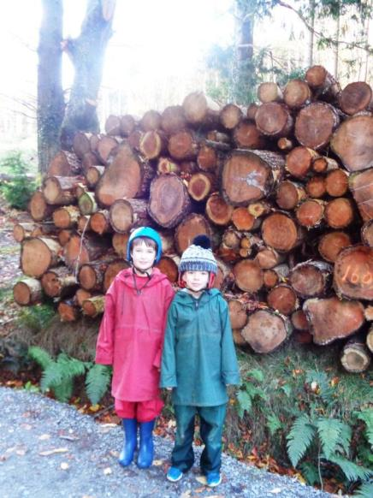

Slide 10
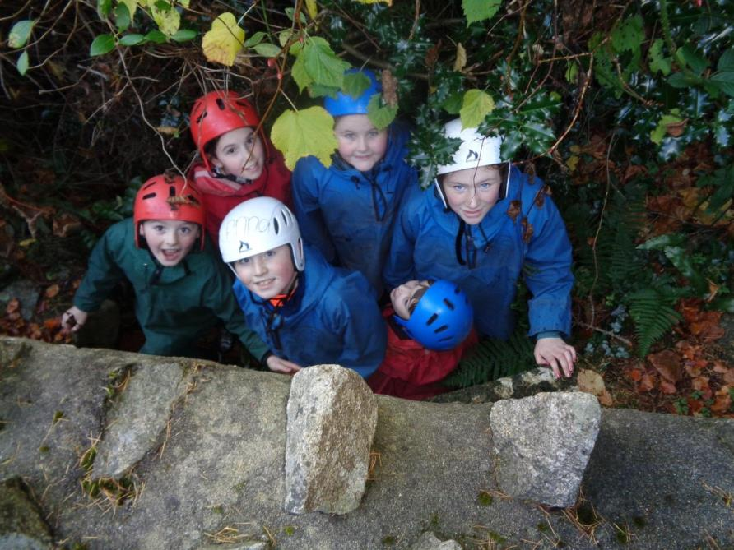

Slide 11
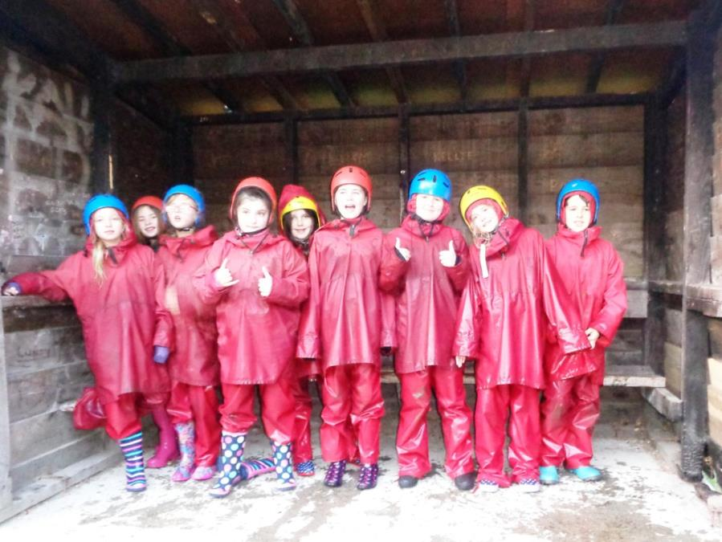

Slide 12
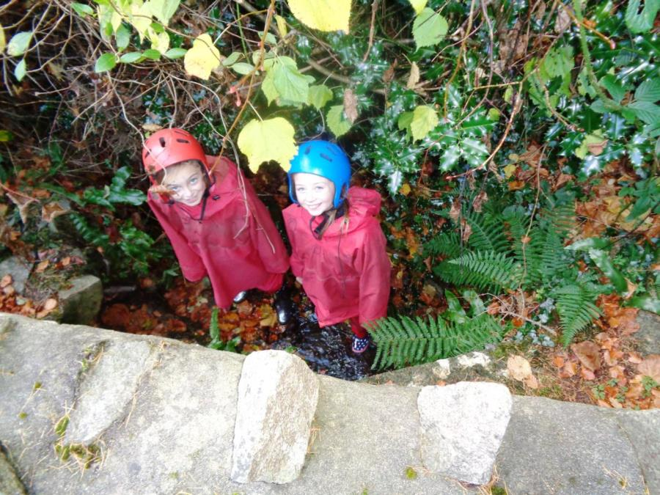

Slide 13
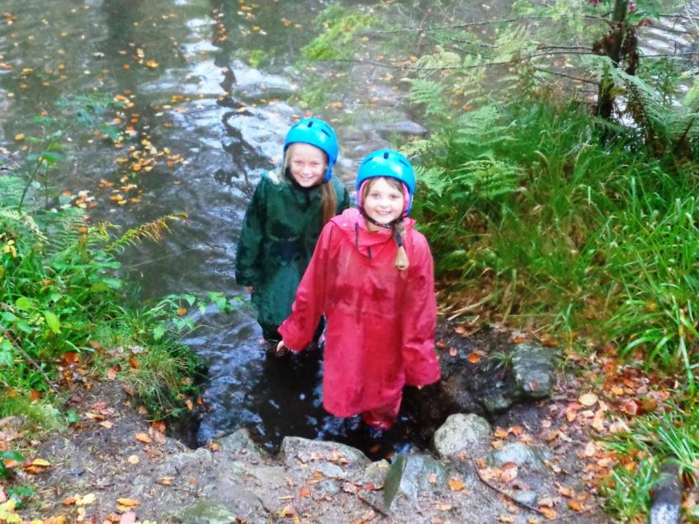

Slide 14
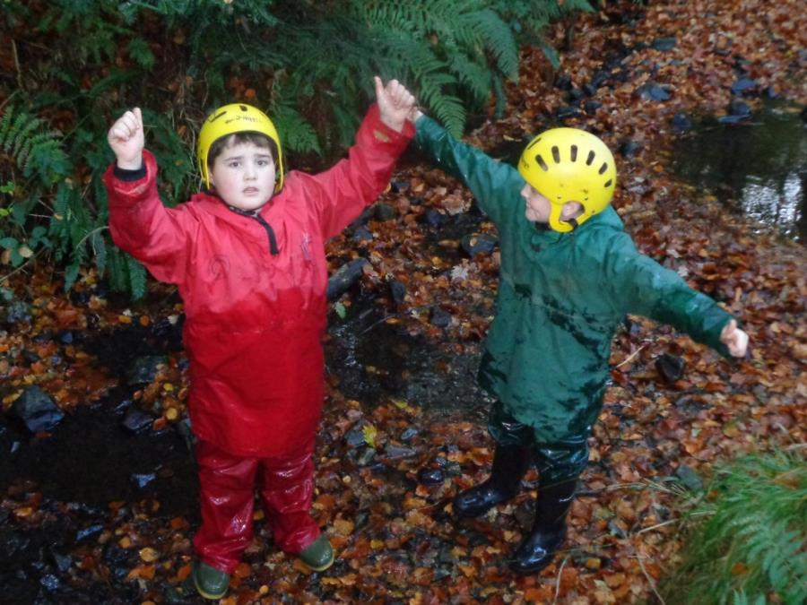

Slide 15
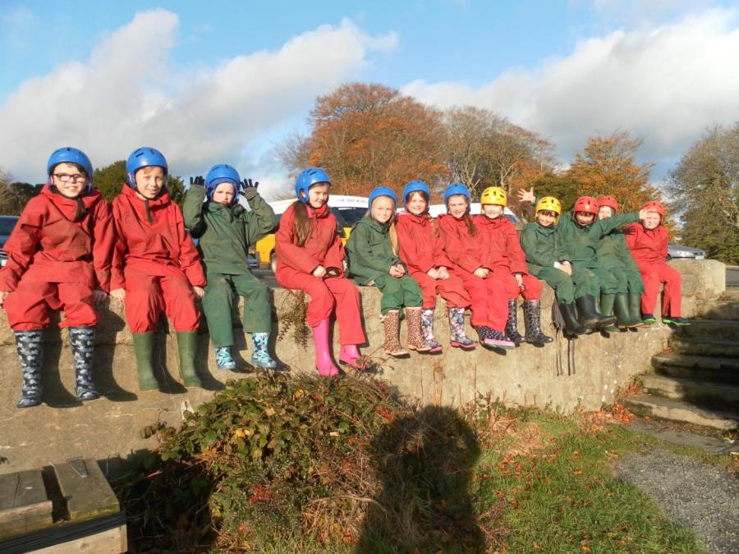

Slide 16
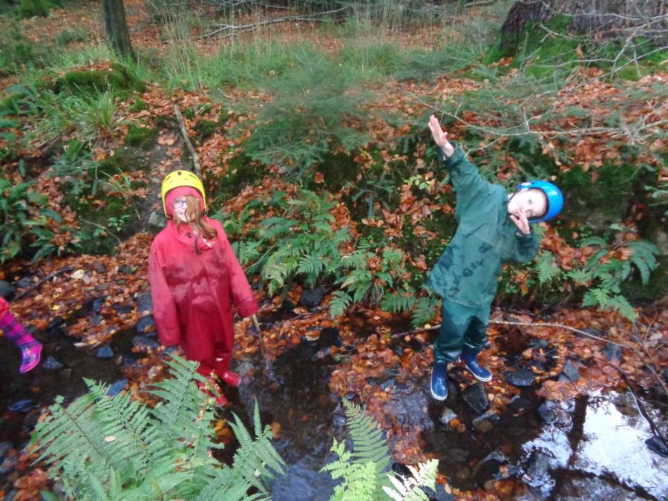

Slide 17
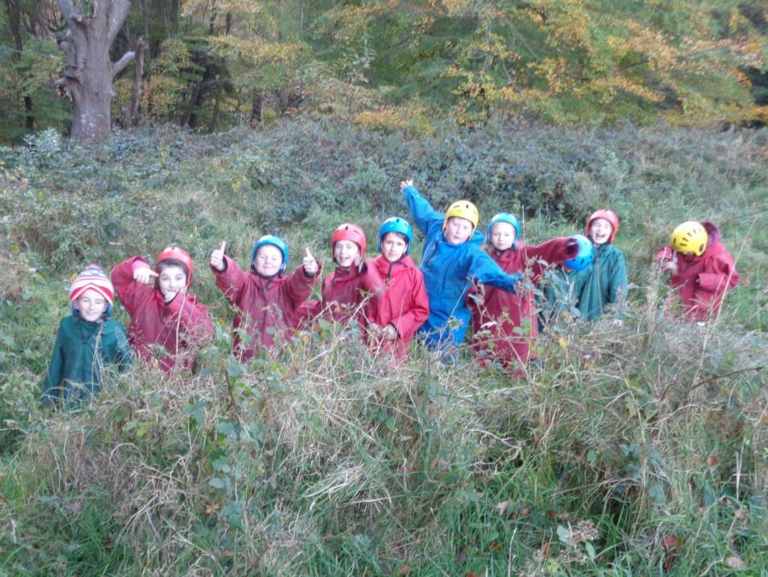

Slide 18
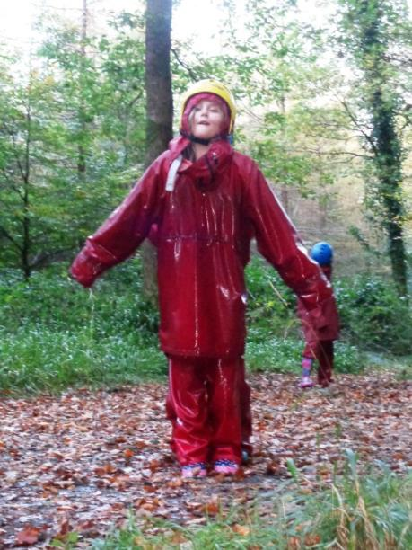
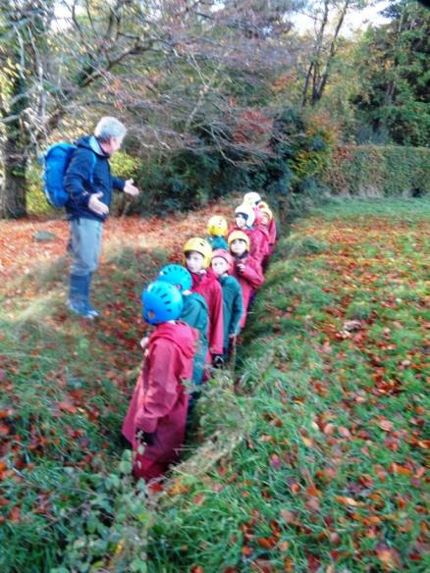

Slide 19
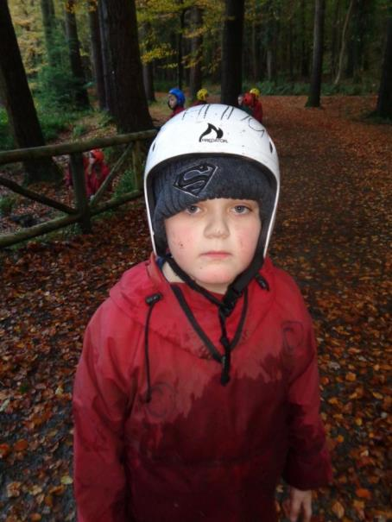
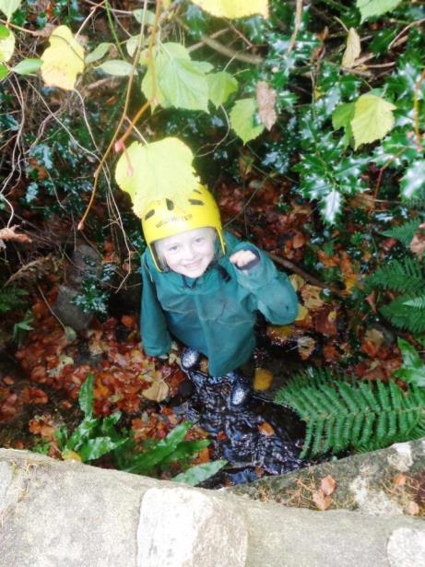

Slide 20
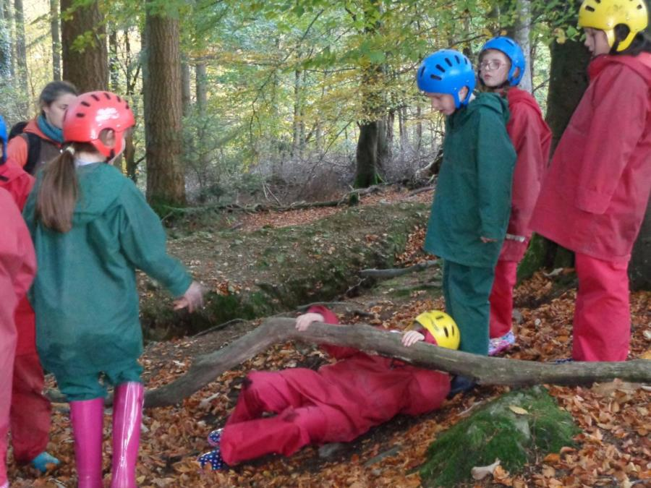

Slide 21
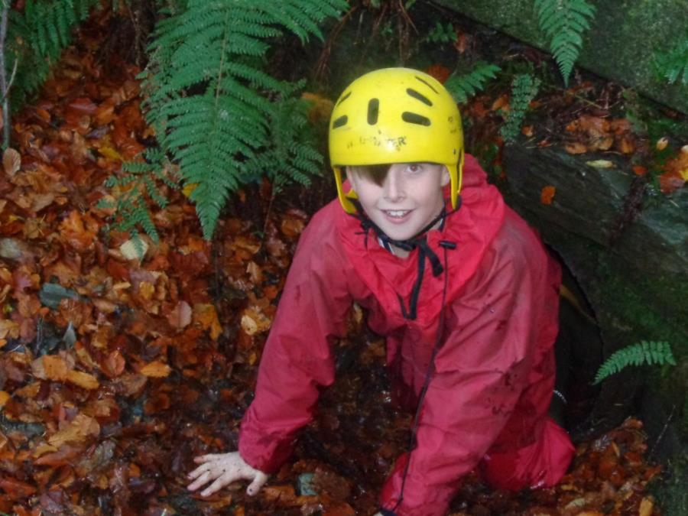

Slide 22
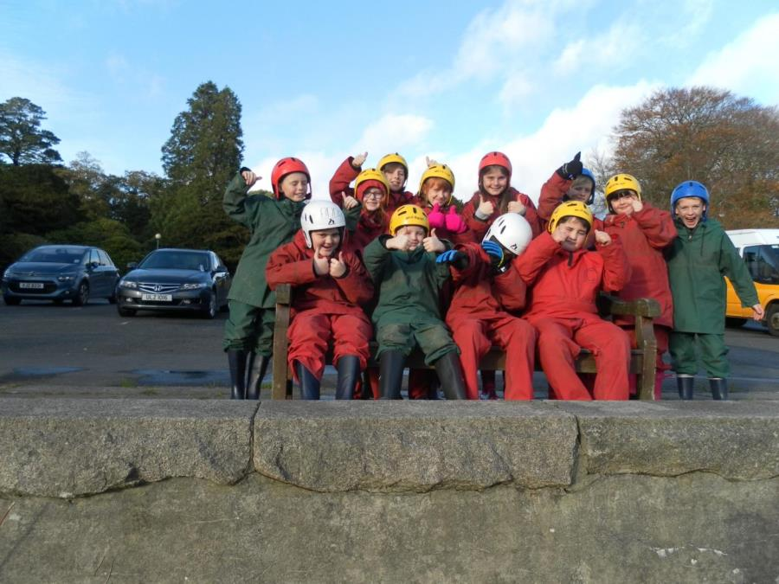

Slide 23
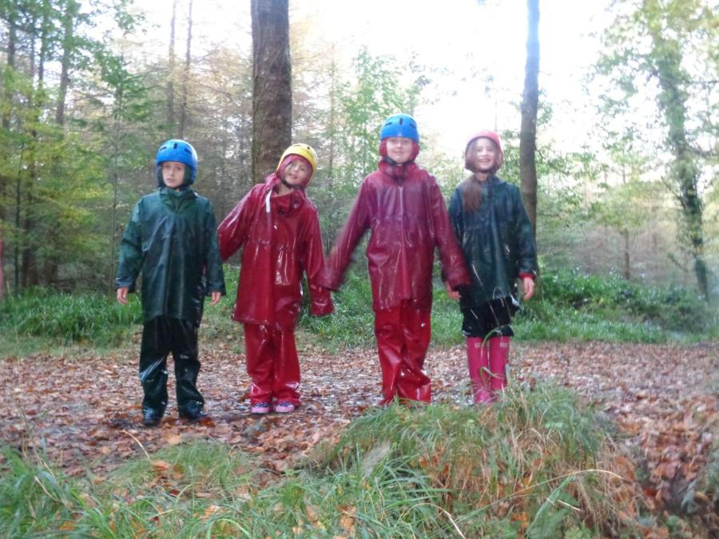

Slide 24
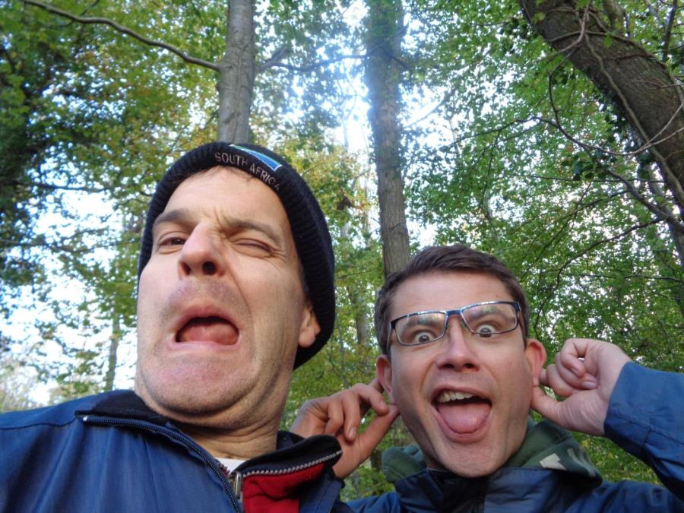

Slide 25
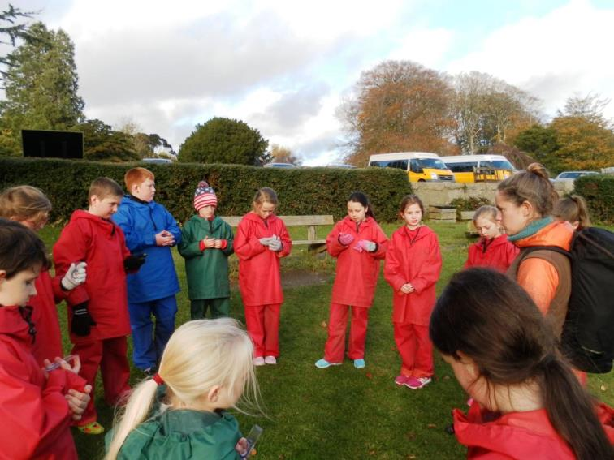
Compass trail

Slide 26
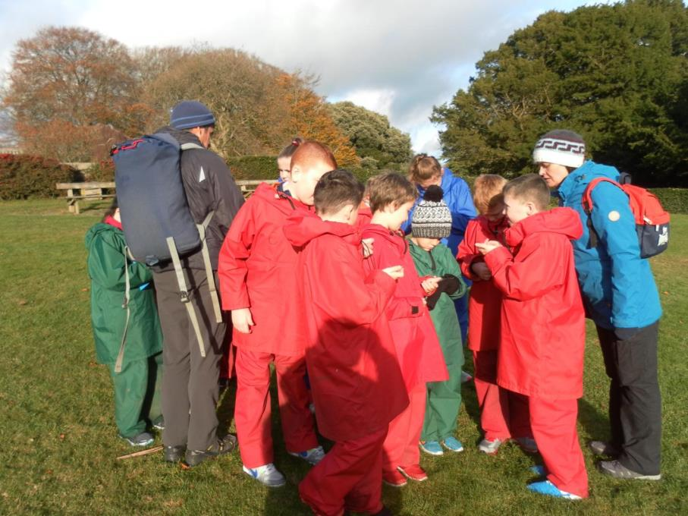

Slide 27
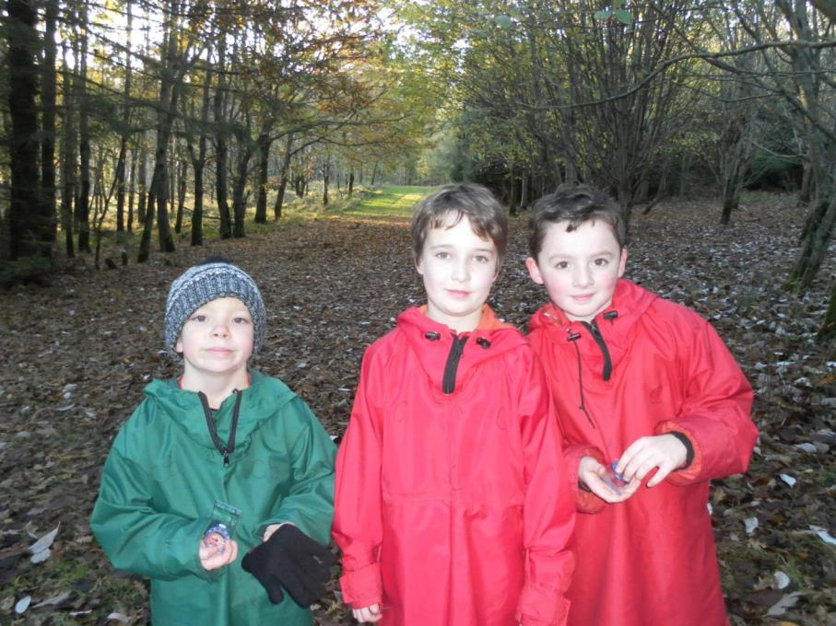

Slide 28
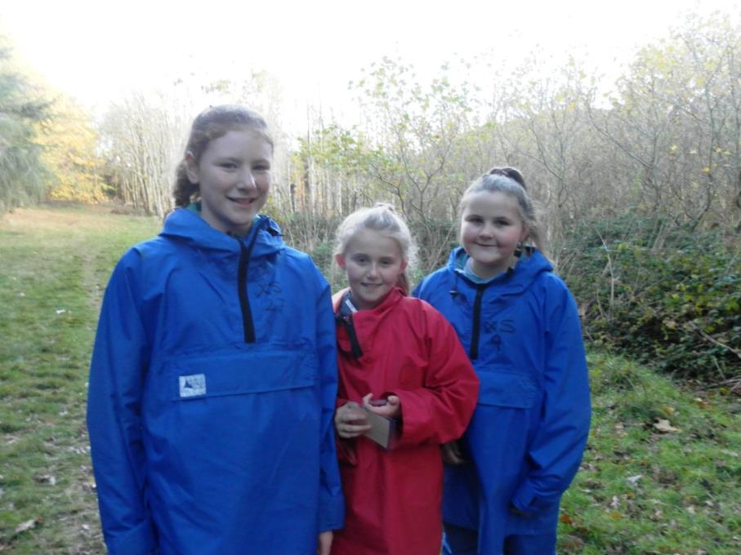

Slide 29
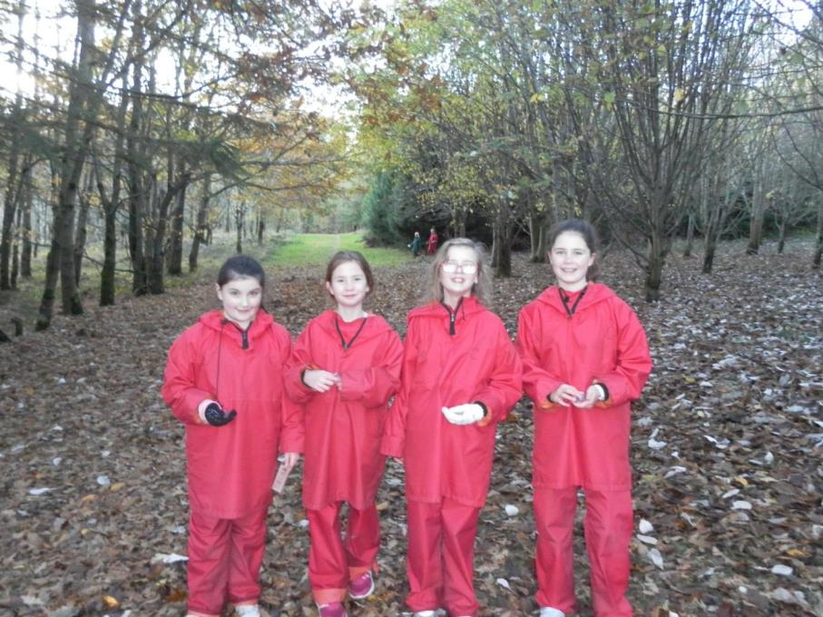

Slide 30
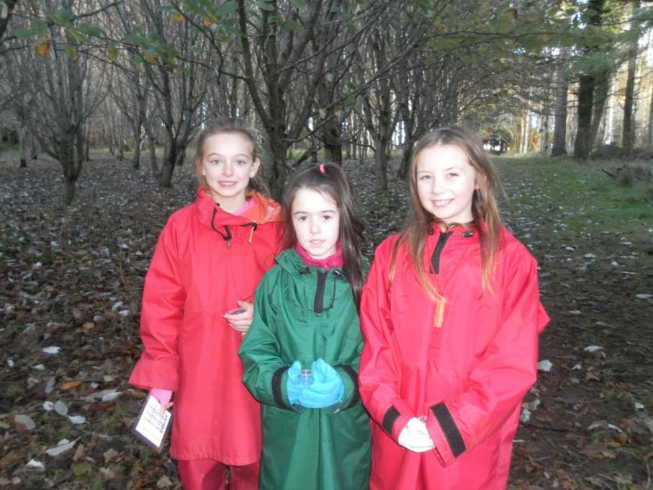

Slide 31
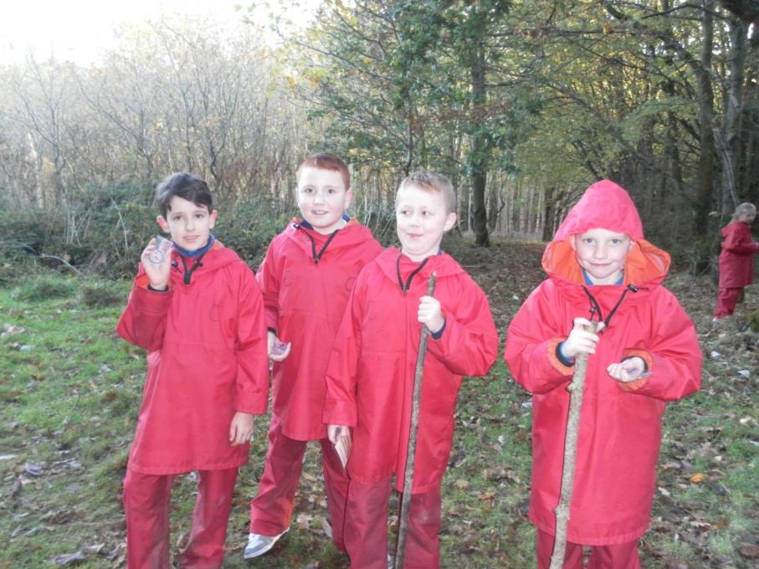

Slide 32
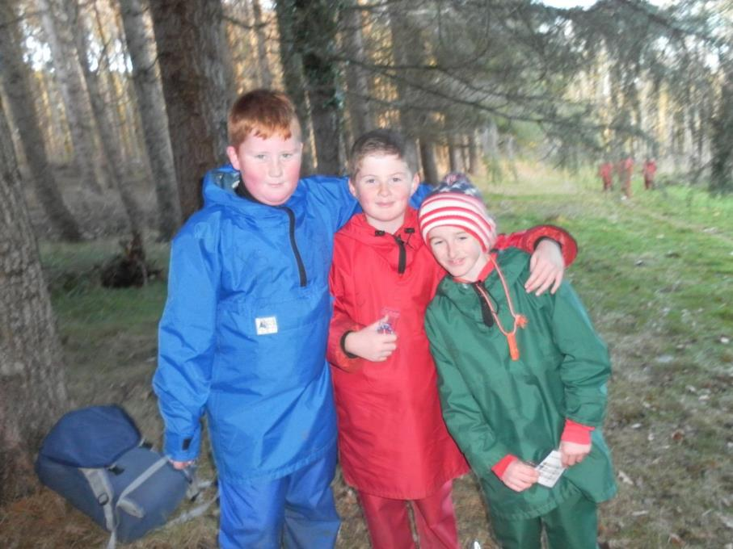

Slide 33
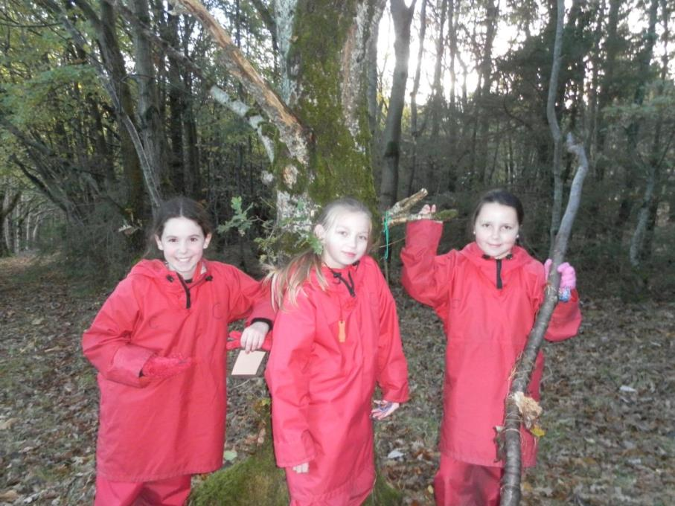

Slide 34
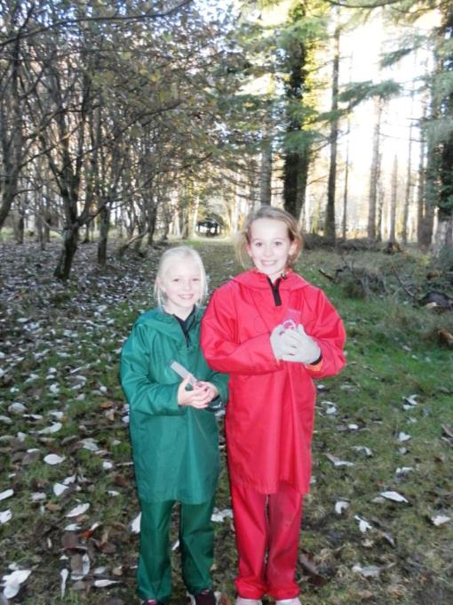

Slide 35
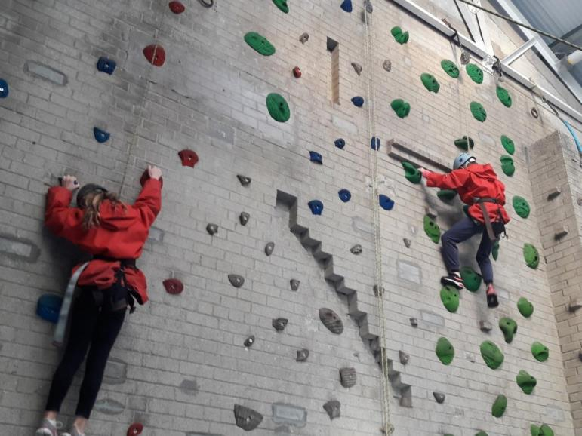
Climbing wall

Slide 36
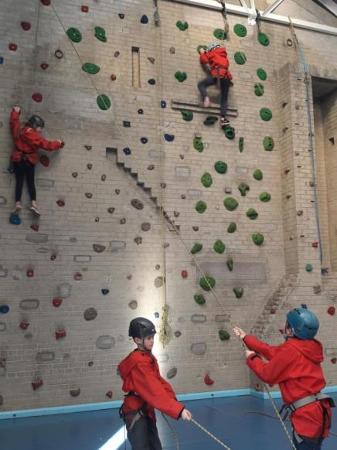
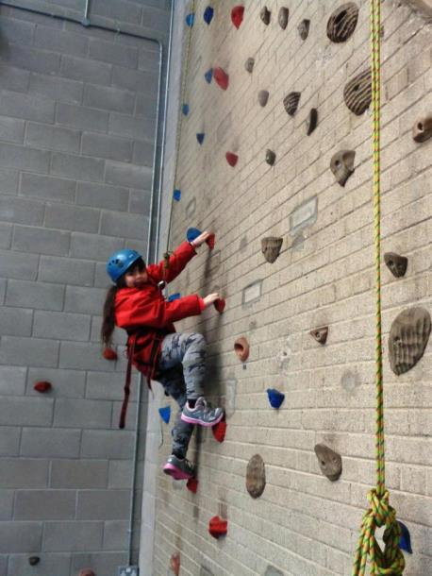

Slide 37
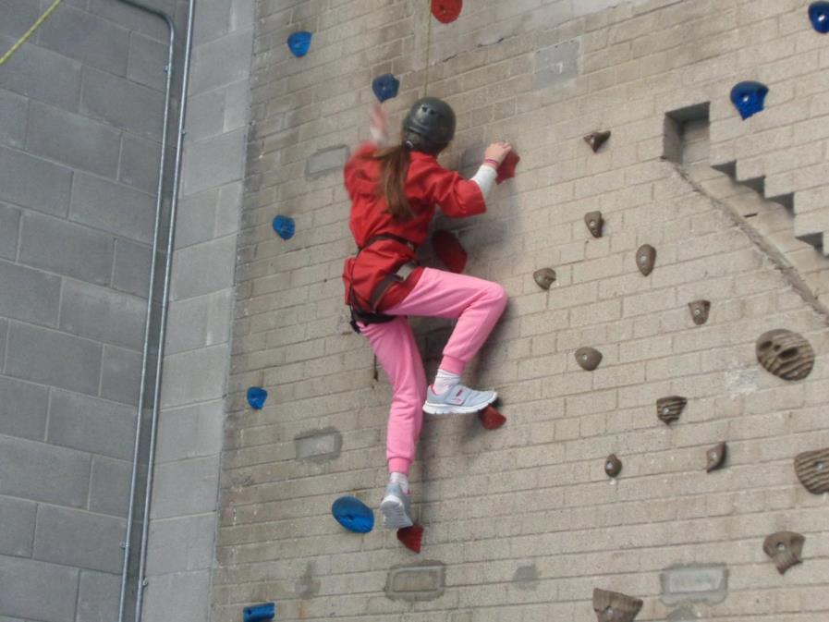

Slide 38
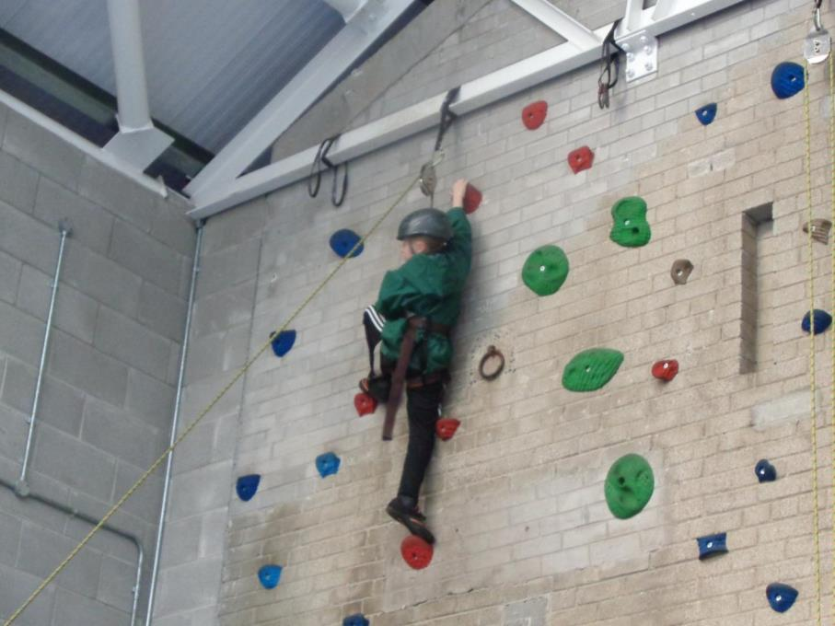

Slide 39
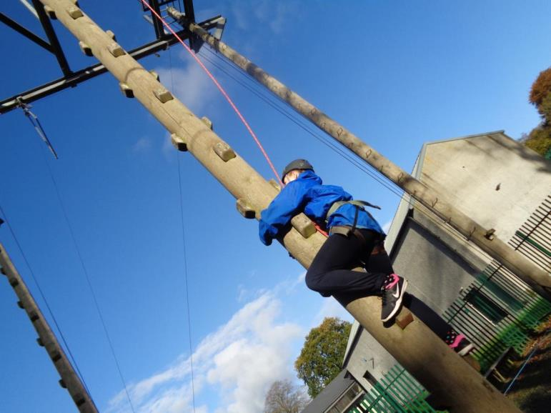
Outdoor climbing pole

Slide 40
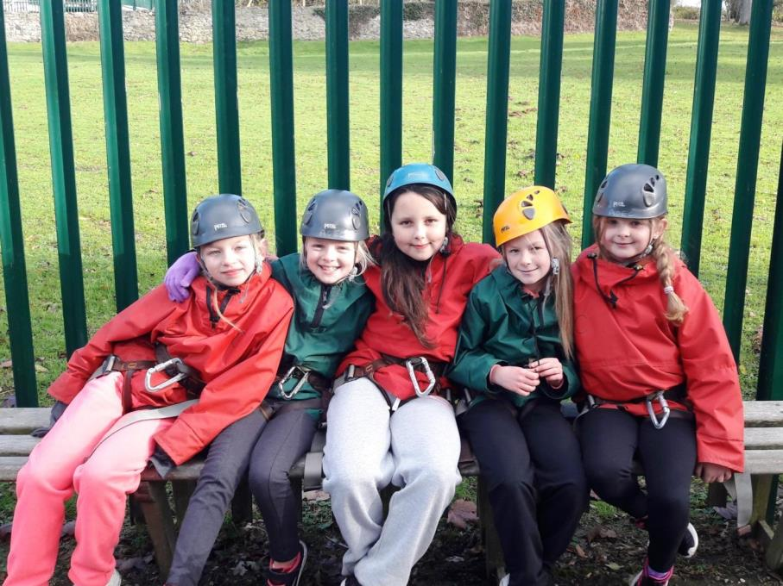

Slide 41
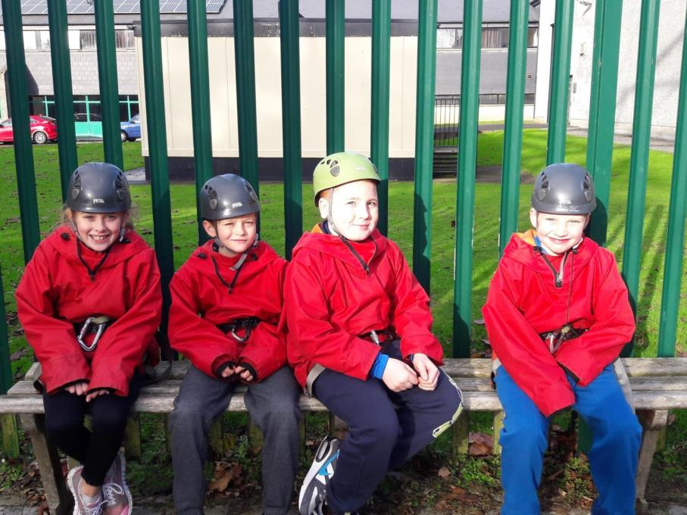

Slide 42
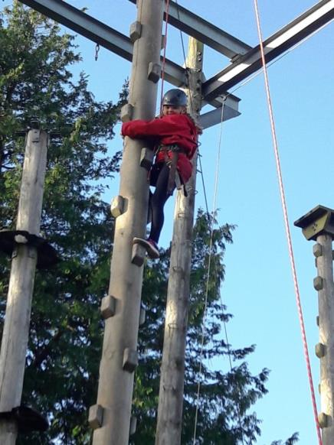
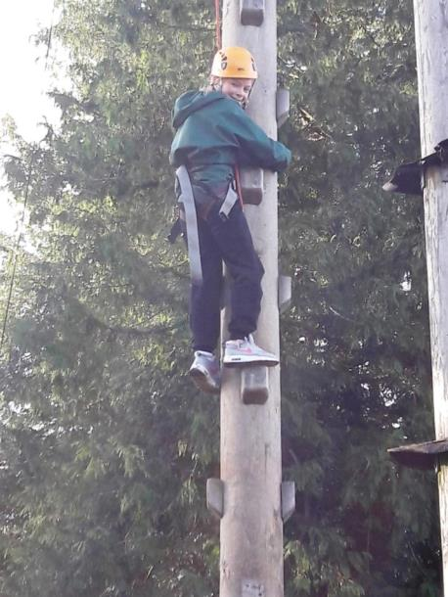

Slide 43
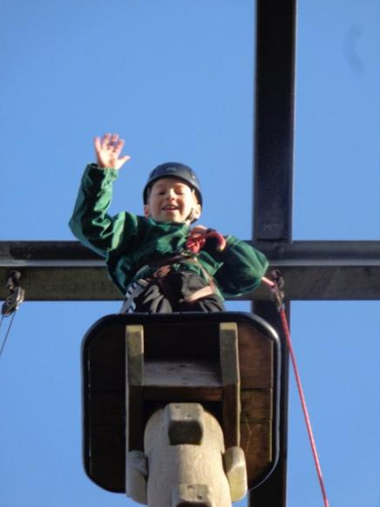


Slide 44


Slide 45


Slide 46


Slide 47



Slide 48



Slide 49

Zip line

Slide 50


Slide 51


Slide 52


Slide 53


Slide 54


Slide 55


Slide 56


Slide 57


Slide 58


Slide 59

Castlewellan Castle and Lake

Slide 60


Slide 61


Slide 62


Slide 63


Slide 64


Slide 65


Slide 66


Slide 67


Slide 68


Slide 69


Slide 70


Slide 71

Bouldering

Slide 72


Slide 73



Slide 74


Slide 75



Slide 76


Slide 77


Slide 78


Slide 79


Slide 80


Slide 81


Slide 82


Slide 83



Slide 84


Slide 85


Slide 86


Slide 87


Slide 88

Archery

Slide 89



Slide 90



Slide 91



Slide 92


Slide 93


Slide 94


Slide 95



Slide 96


Slide 97


Slide 98

The frog thing! Design

Slide 99


Slide 100


Slide 101


Slide 102


Slide 103


Slide 104


Slide 105

The frog thing! Heats

Slide 106


Slide 107


Slide 108


Slide 109



Slide 110


Slide 111


Slide 112


Slide 113


Slide 114


Slide 115

The frog thing! Winners!

Slide 116

Our last day!

Slide 117


Slide 118


Slide 119


Slide 120


Slide 121


Slide 122



Slide 123


Slide 124


Slide 125


Slide 126


Slide 127


Slide 128


Slide 129


Slide 130


Slide 131


Slide 132



Slide 133


