Slide 1
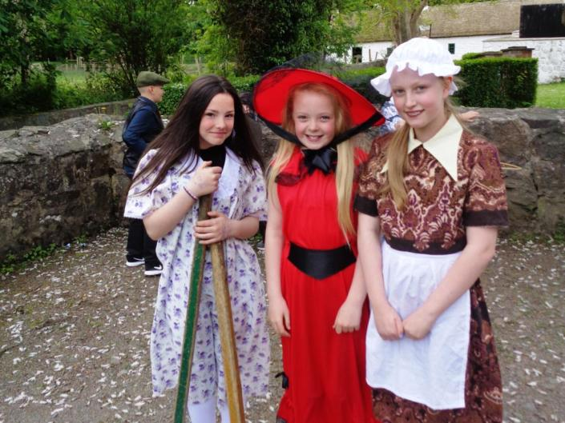
P7 residential at the
Folk Museum May 2016

Slide 2
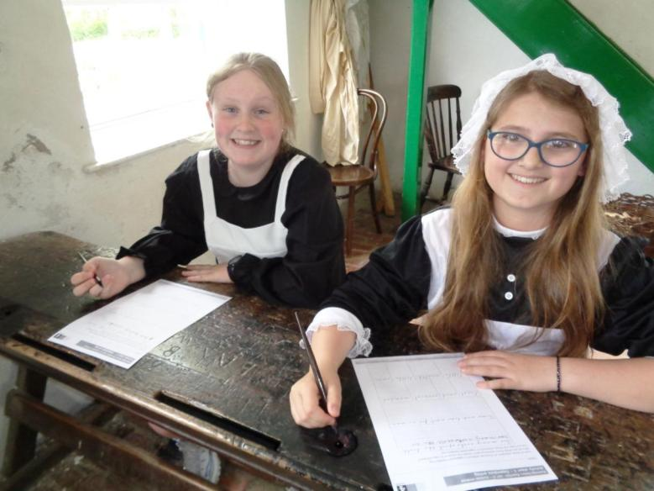
A Victorian school lesson!

Slide 3
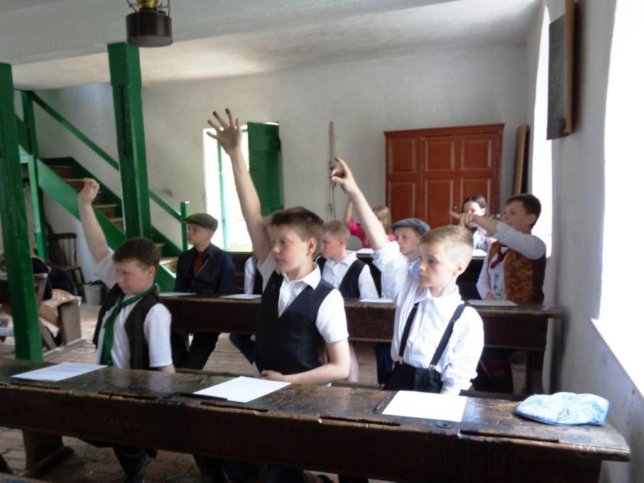

Slide 4
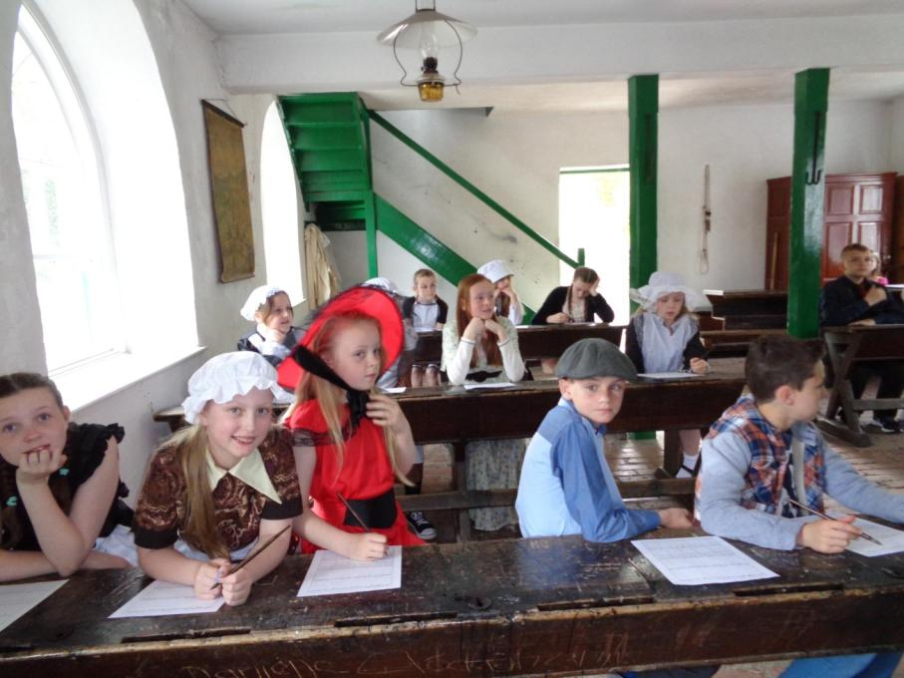

Slide 5
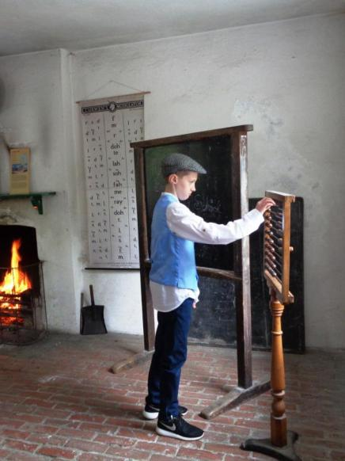
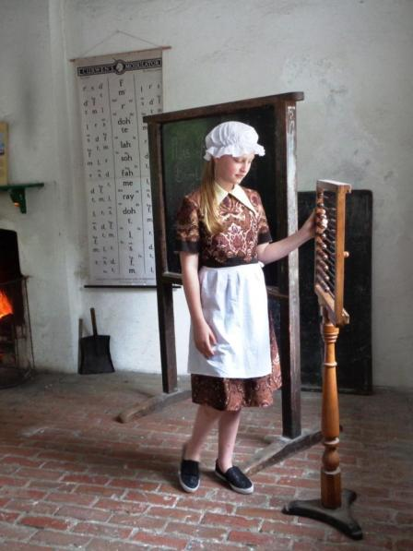

Slide 6
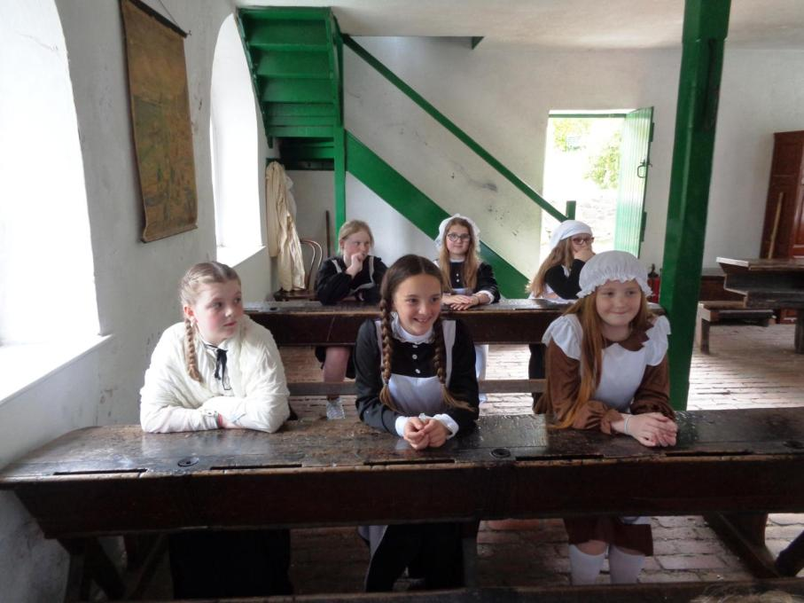

Slide 7
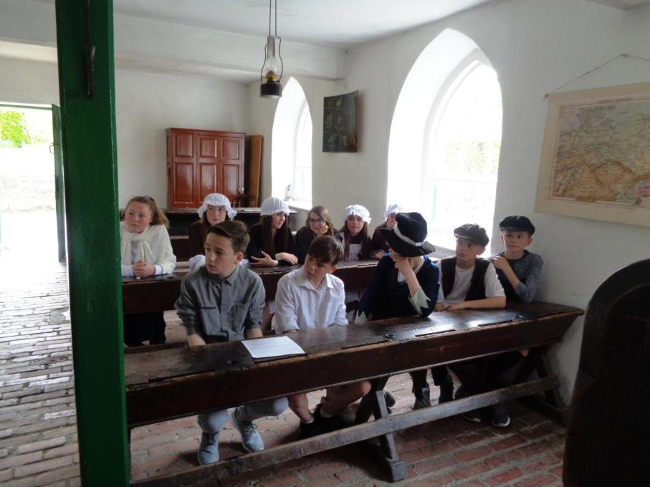

Slide 8
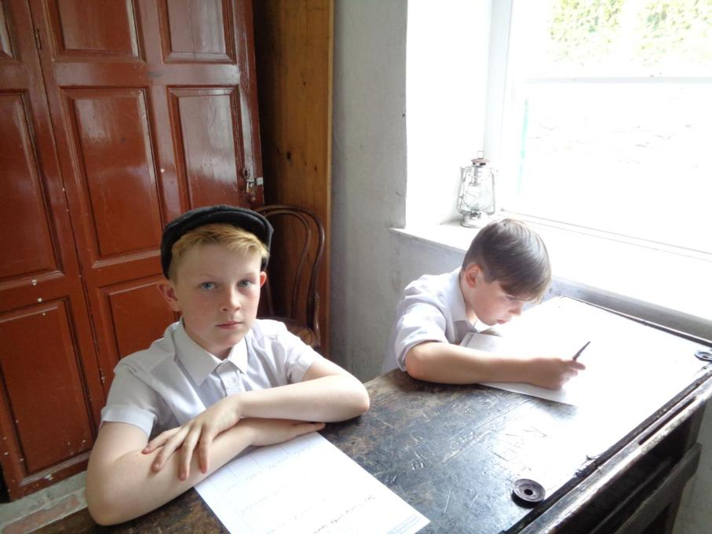

Slide 9
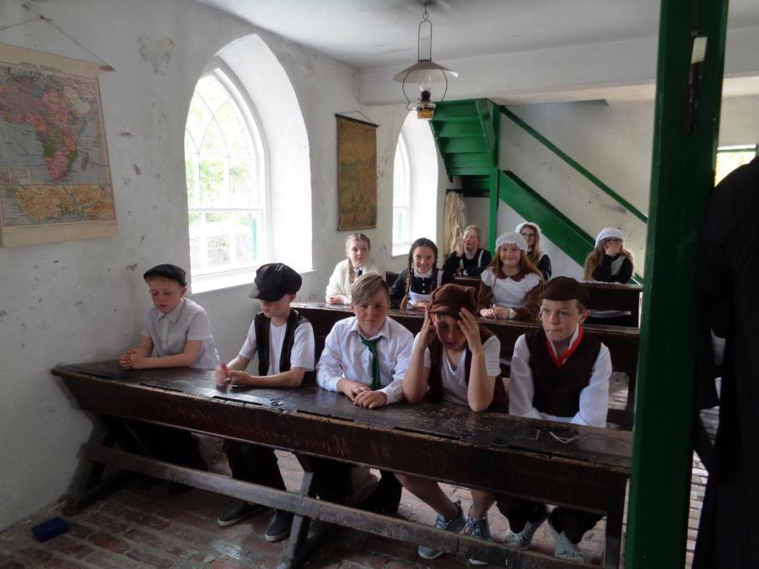

Slide 10
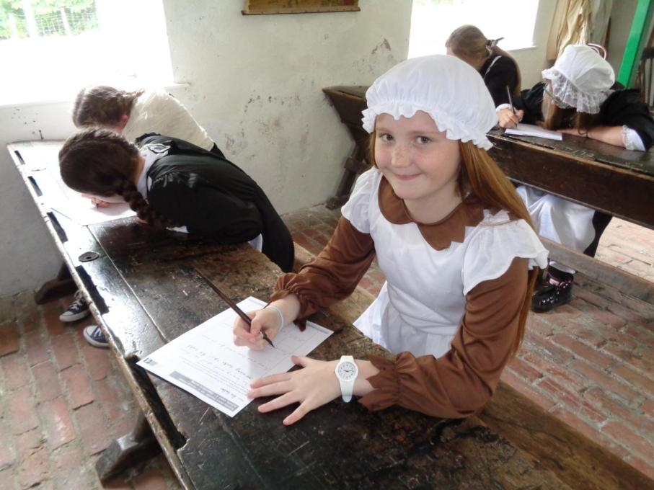

Slide 11
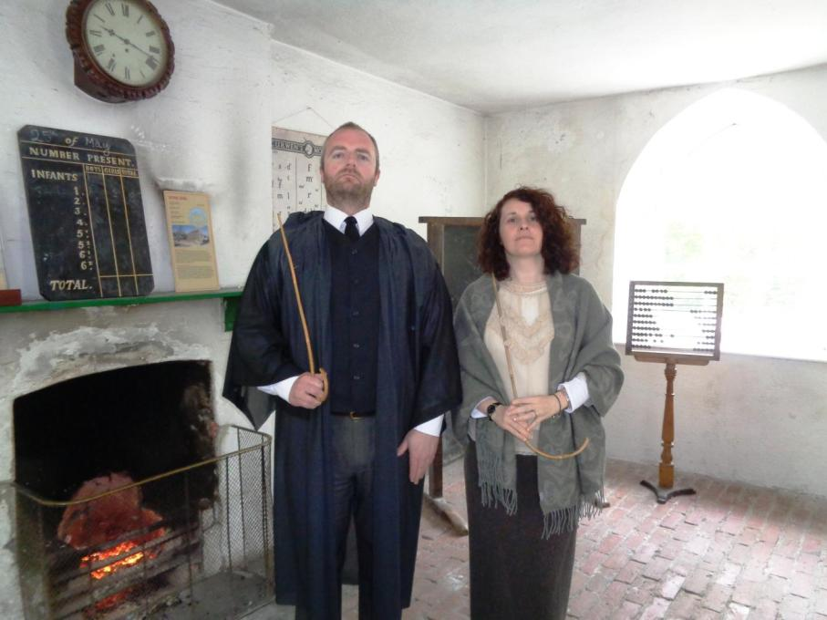

Slide 12
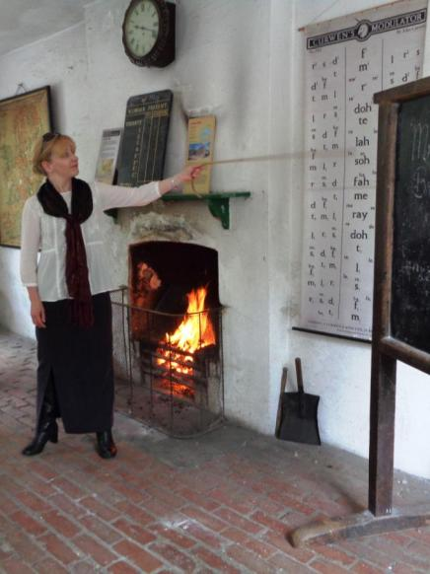
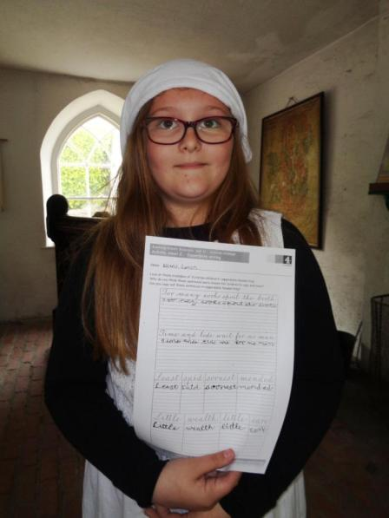

Slide 13
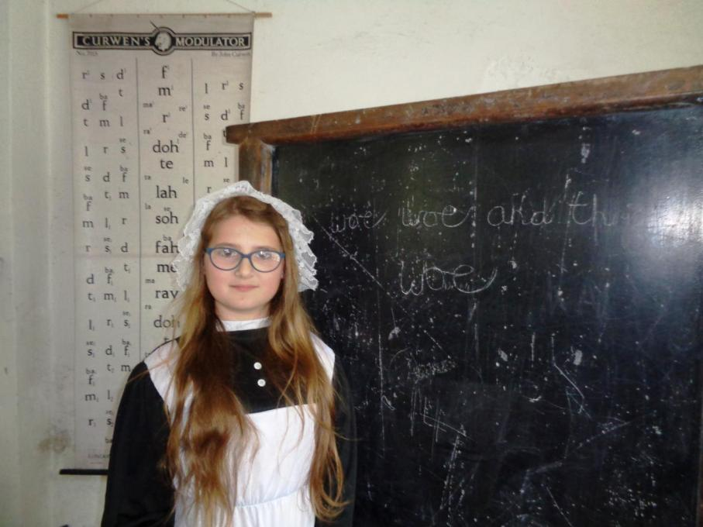

Slide 14
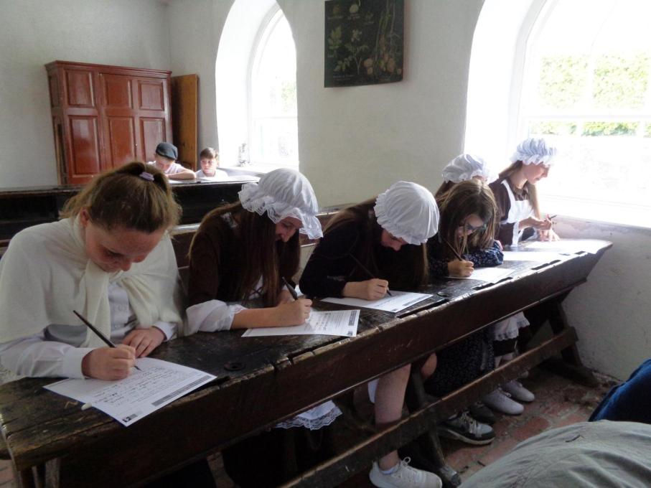

Slide 15
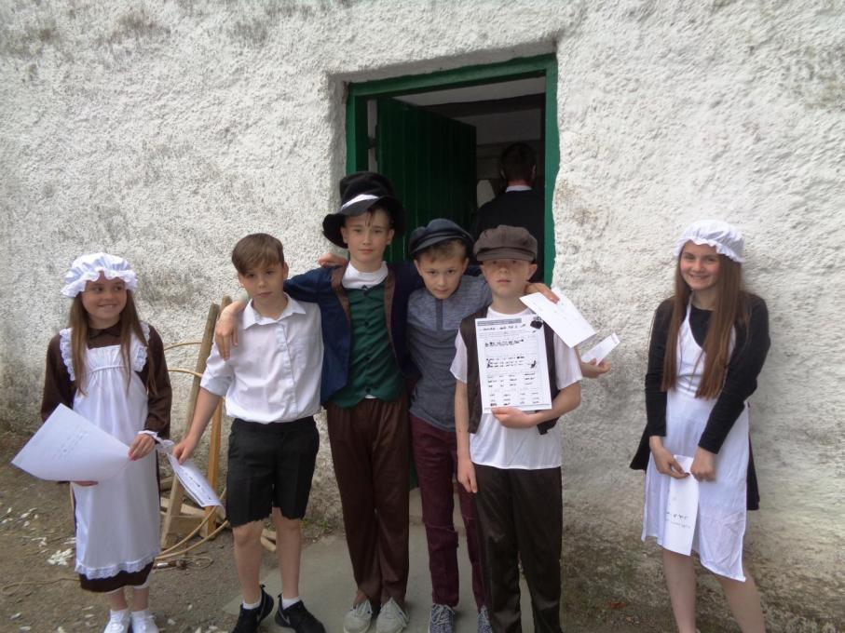

Slide 16
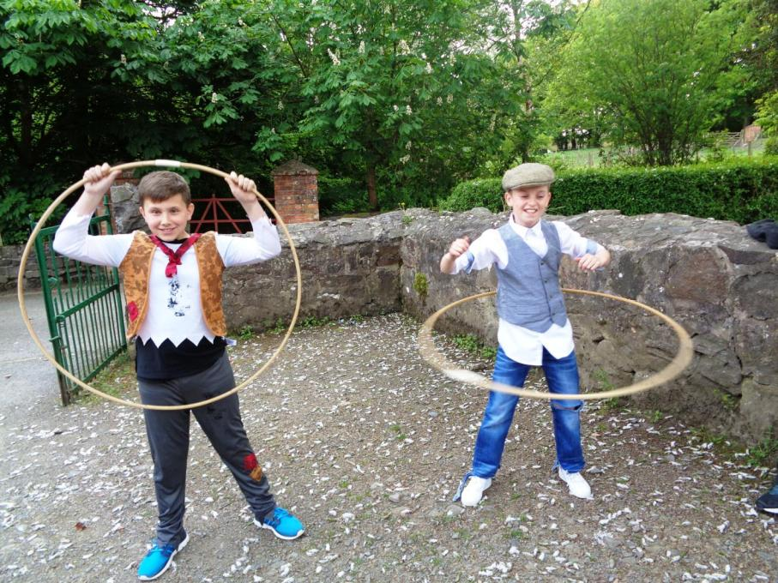

Slide 17
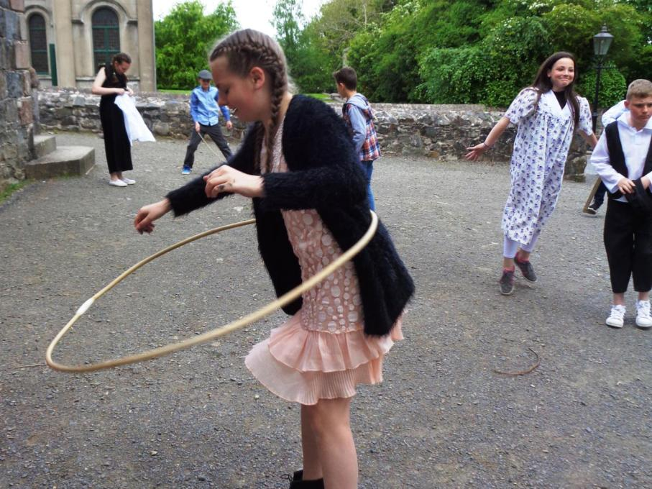

Slide 18
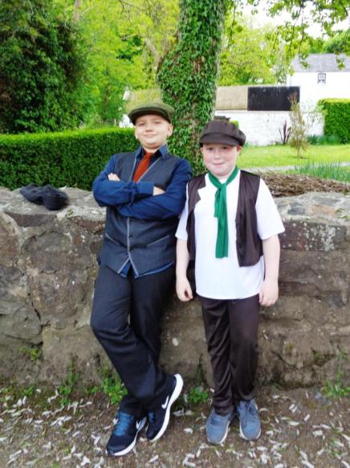
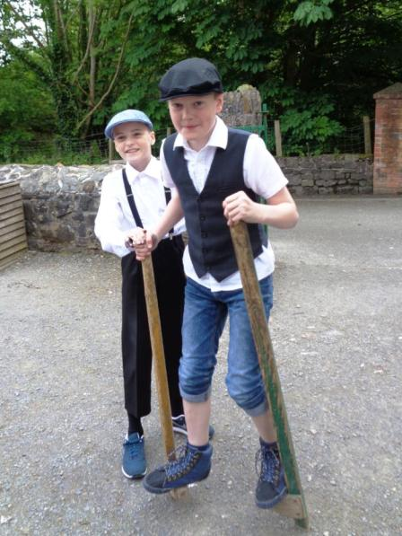

Slide 19
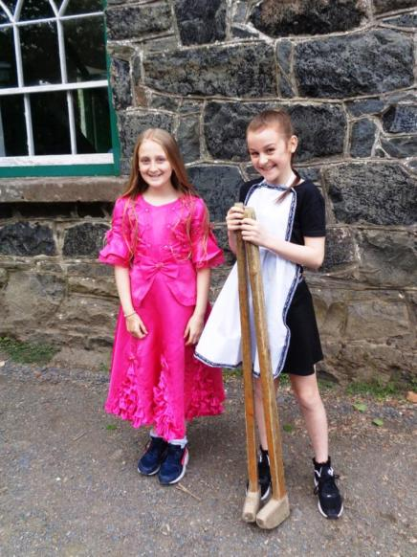
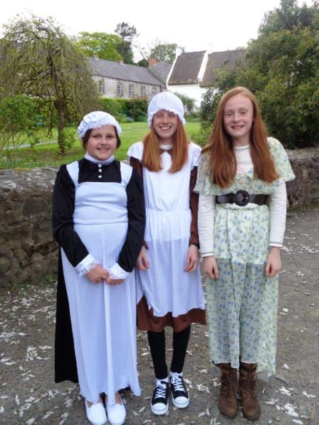

Slide 20
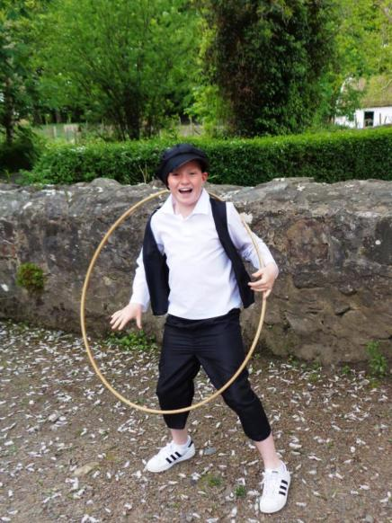
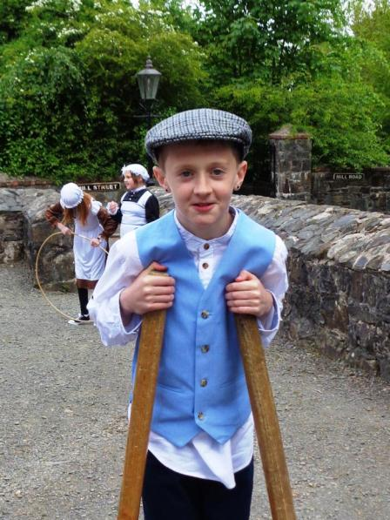

Slide 21
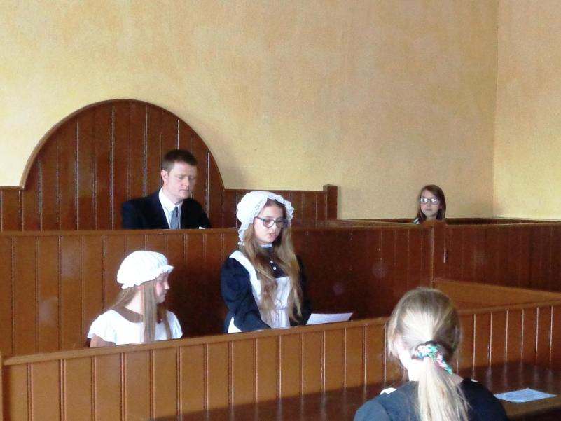
Courtroom drama

Slide 22
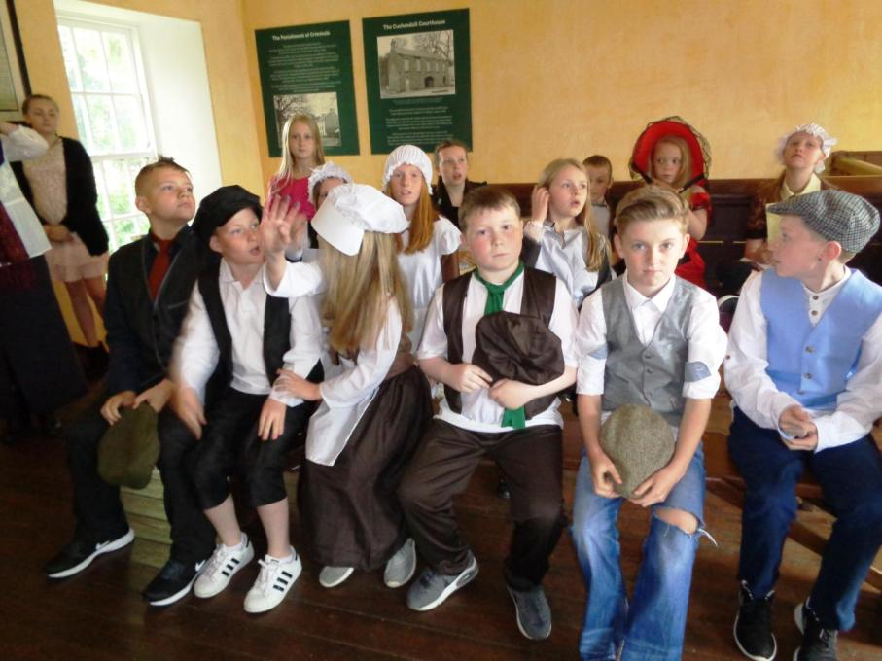

Slide 23
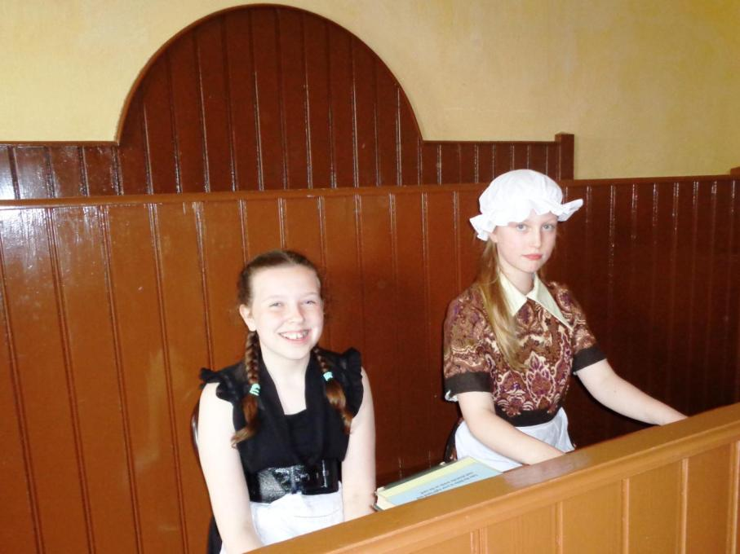

Slide 24
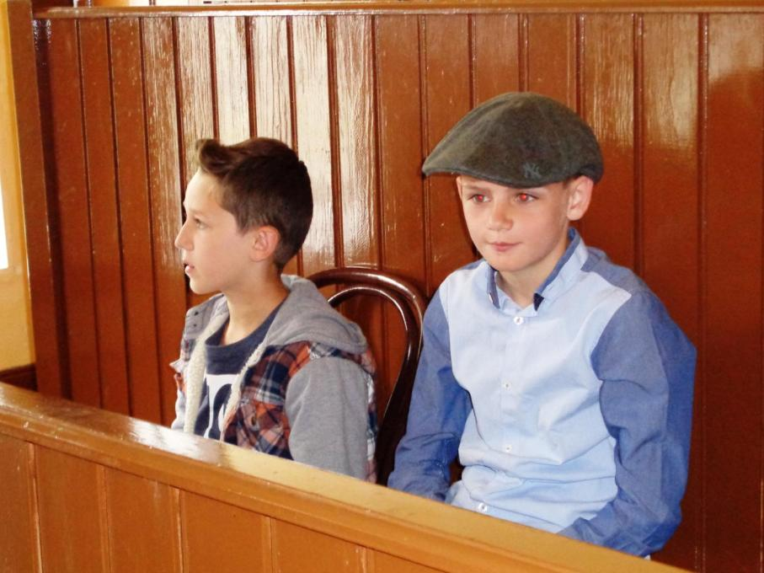

Slide 25
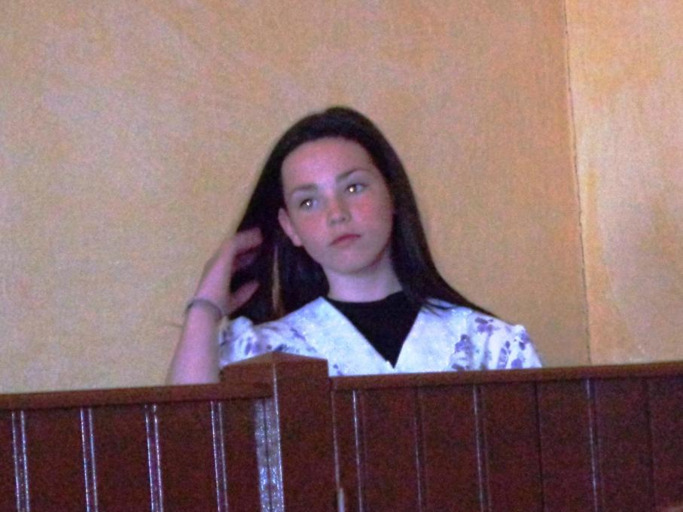

Slide 26
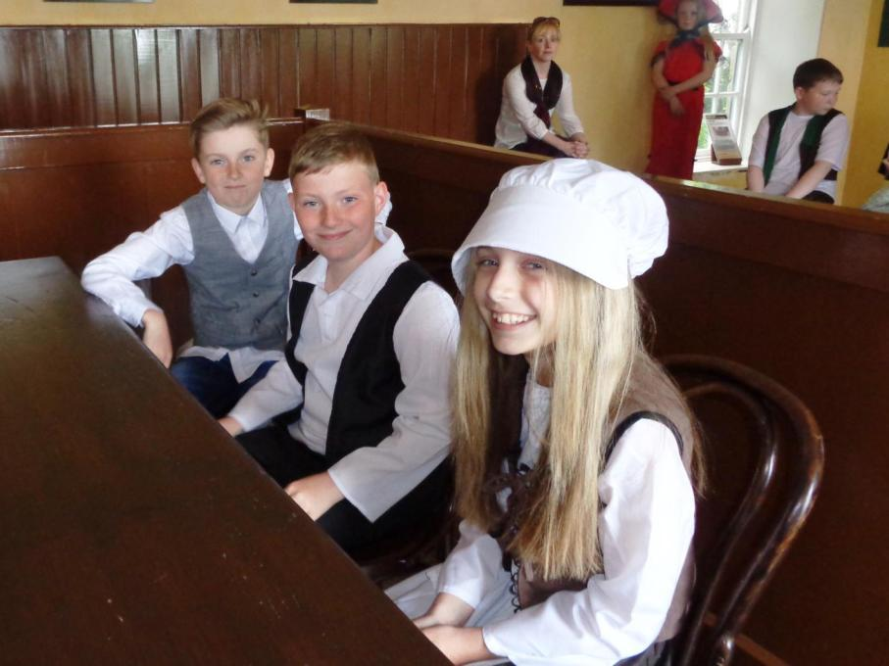

Slide 27
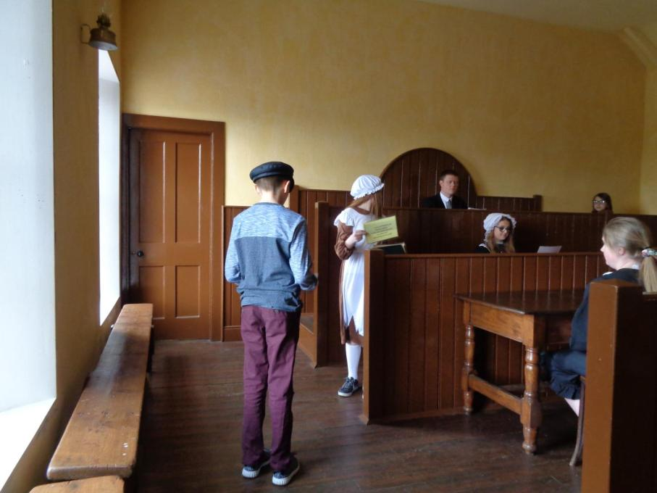

Slide 28
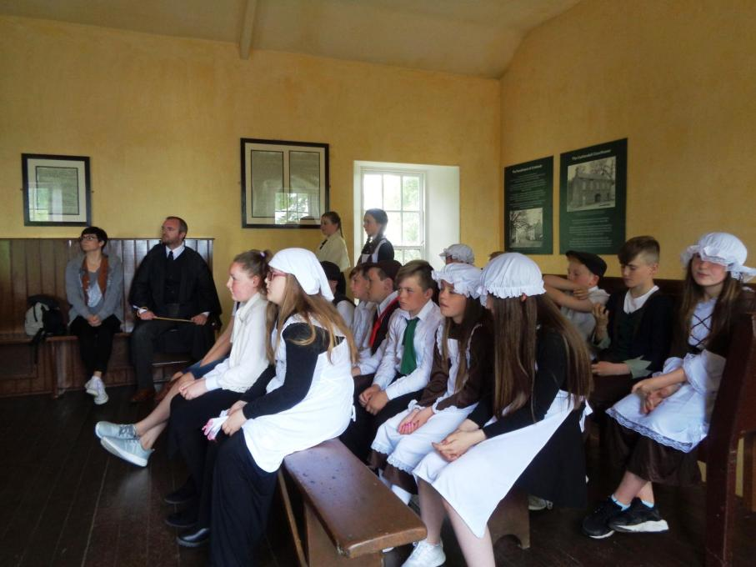

Slide 30
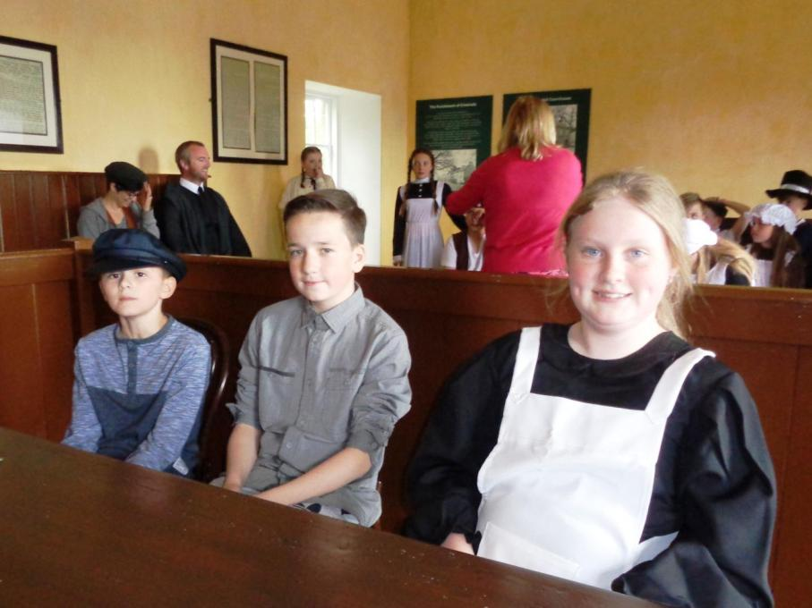

Slide 31
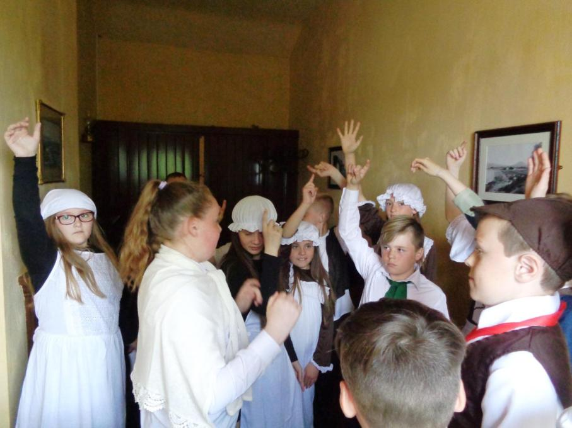

Slide 32
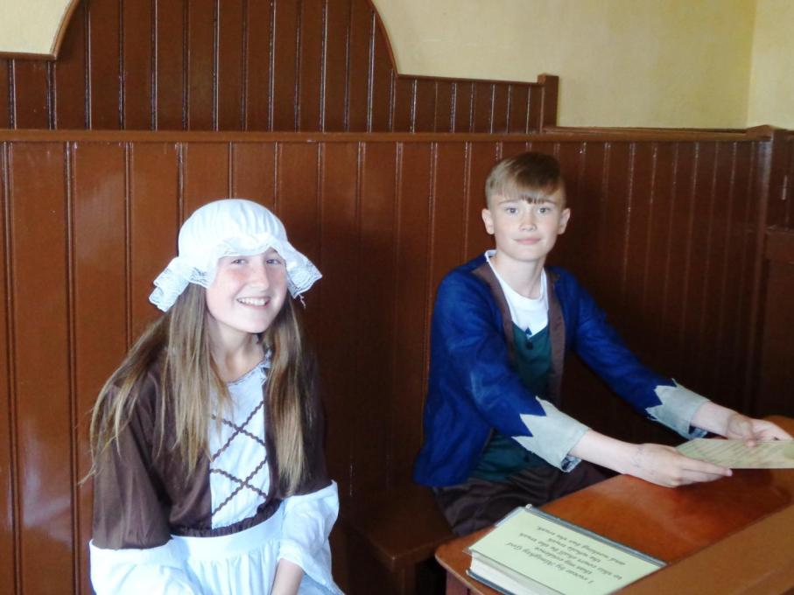

Slide 33
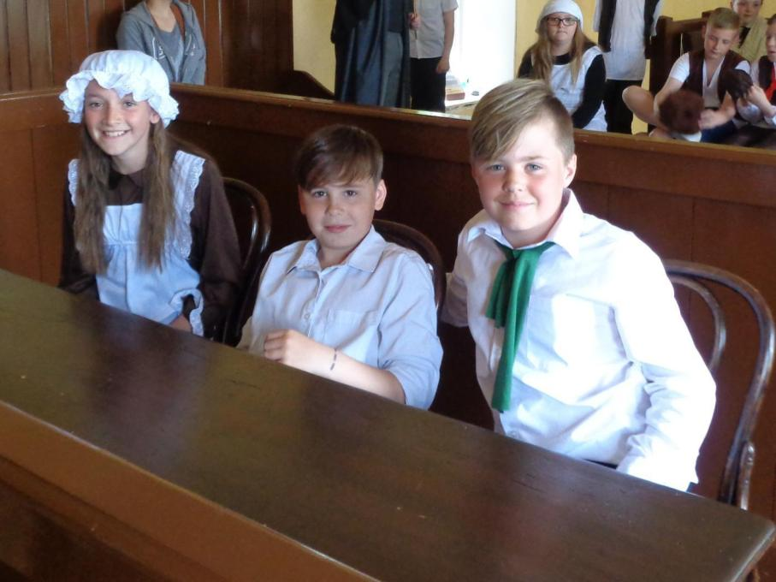

Slide 34
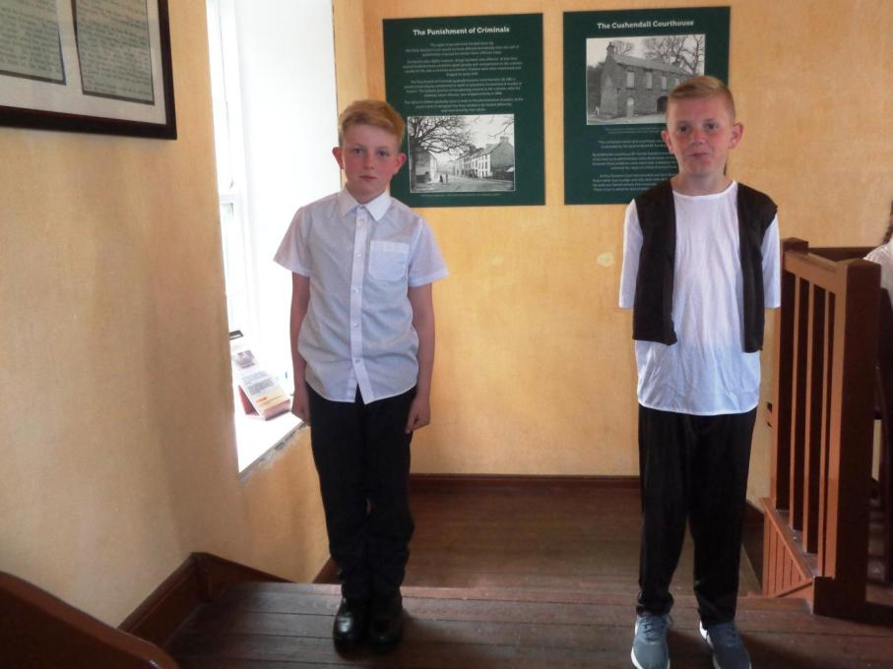

Slide 35
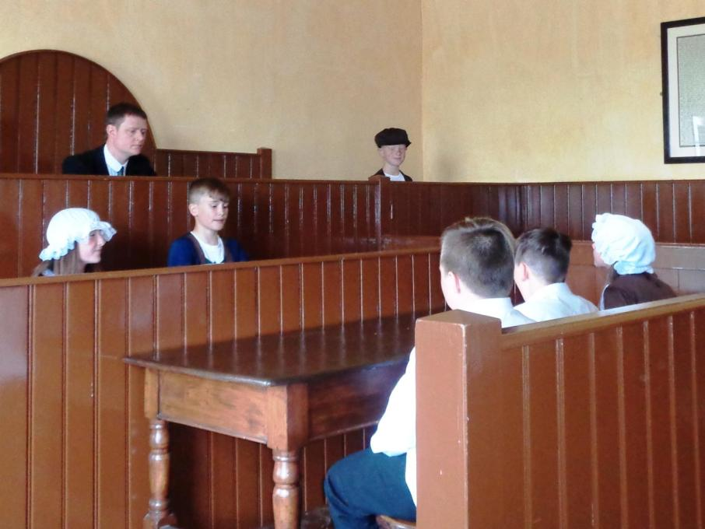

Slide 36
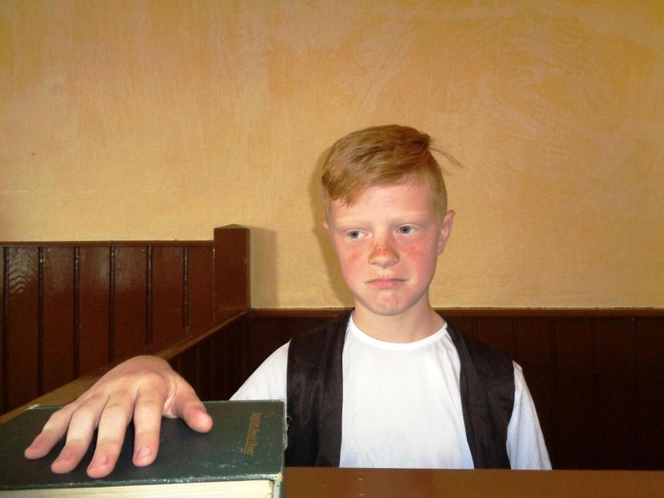

Slide 37
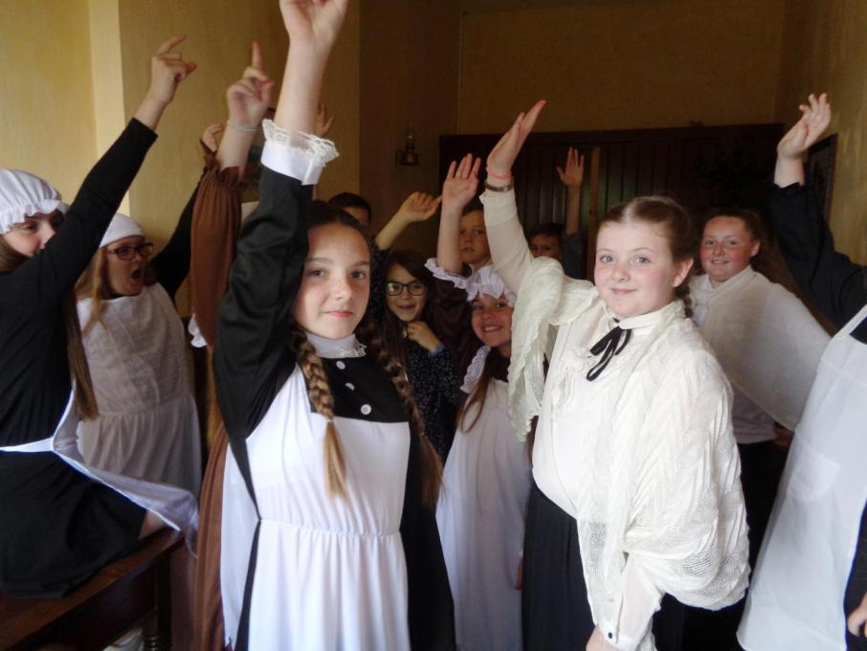

Slide 38
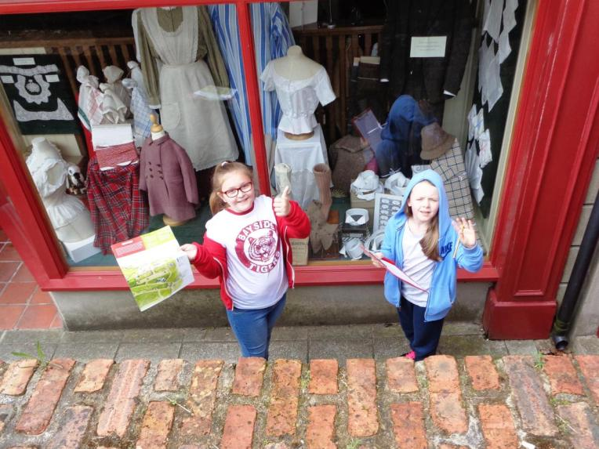
Out and about!

Slide 39
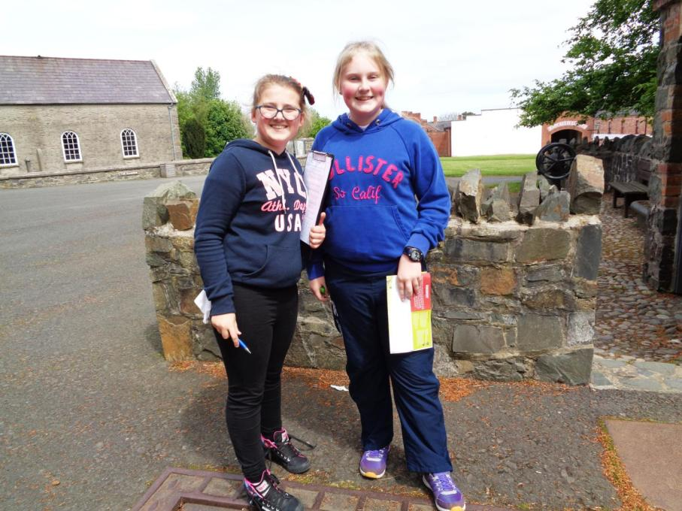

Slide 40
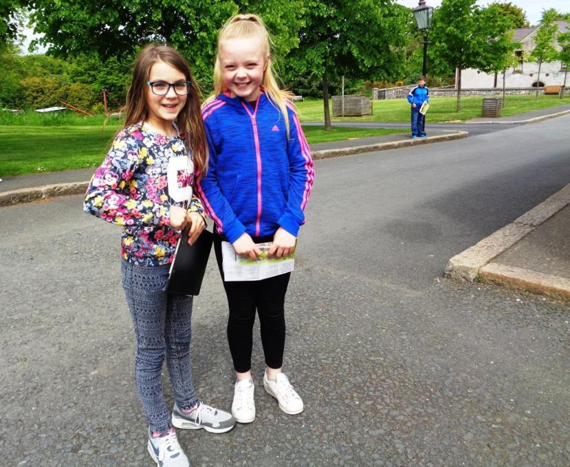

Slide 41
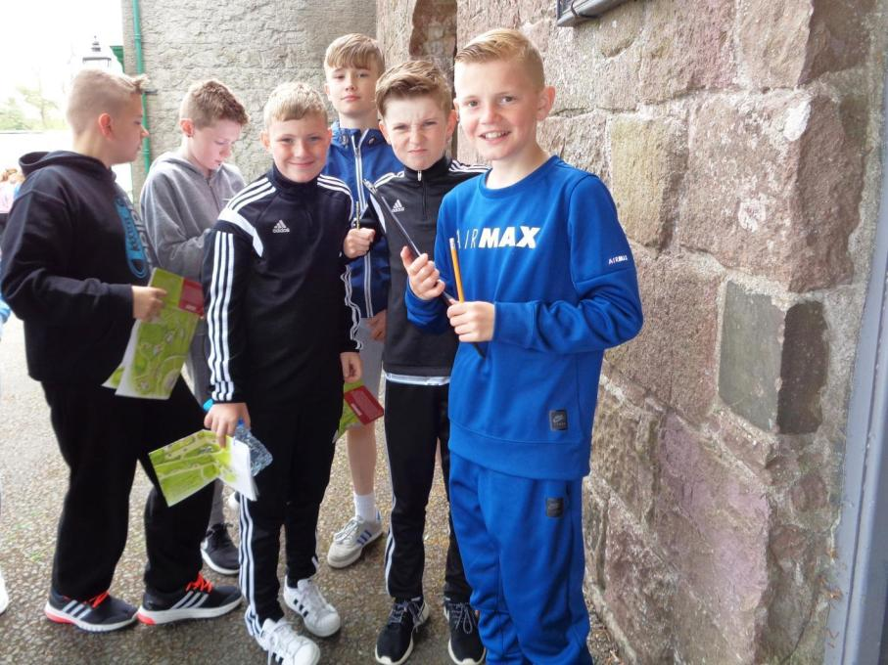

Slide 42
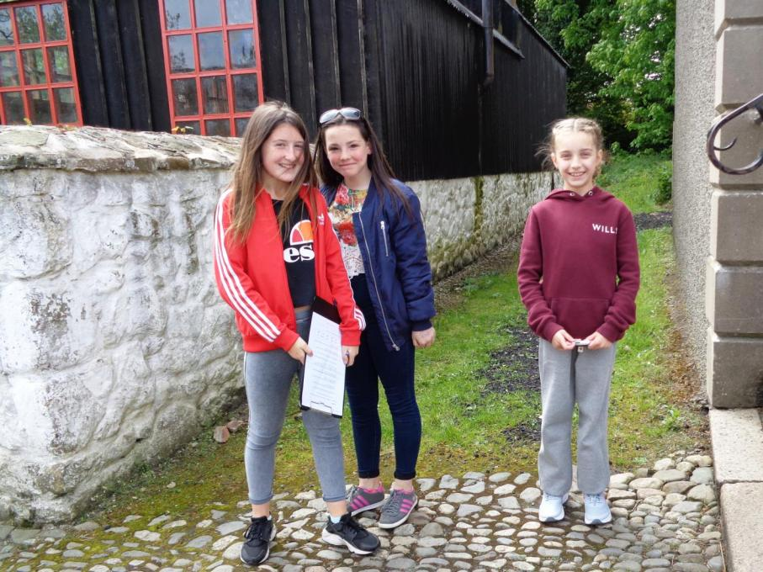

Slide 43
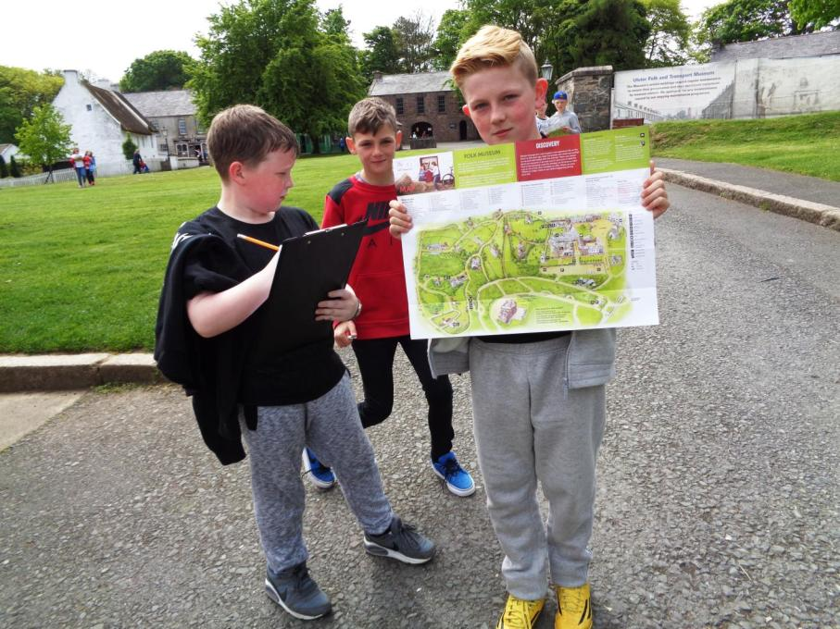

Slide 44
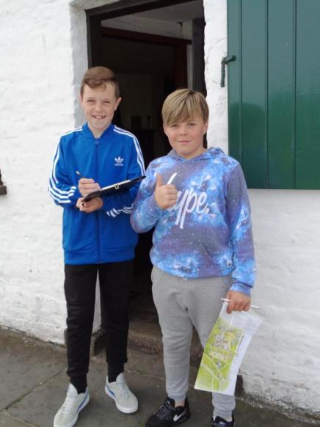
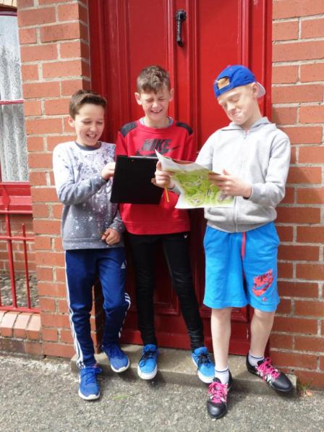

Slide 45
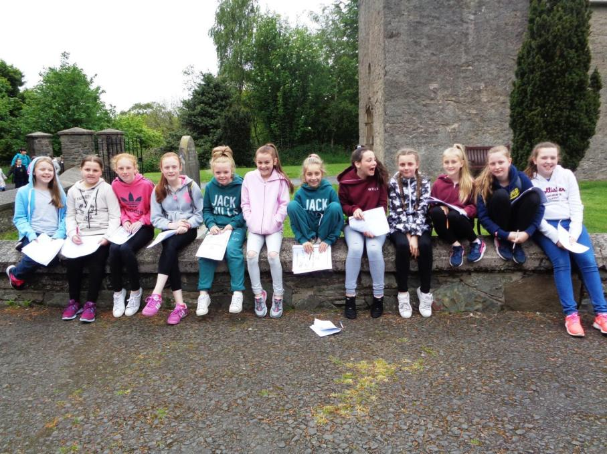

Slide 46


Slide 47


Slide 48


Slide 49


Slide 50


Slide 51


Slide 52


Slide 53


Slide 54


Slide 55


Slide 56


Slide 57


Slide 58


Slide 59


Slide 60


Slide 61

Craft and cooking!

Slide 62


Slide 63


Slide 64


Slide 65


Slide 66


Slide 67


Slide 68


Slide 69



Slide 70


Slide 71



Slide 72

A walk in the countryside

Slide 73


Slide 74


Slide 75

It’s time to meet the...

Slide 76


...psycho goats!!!

Slide 77

Object detectives

Slide 78


Slide 79


Slide 80


Slide 81


Slide 82


Slide 83

Barn dance!

Slide 84


Slide 85


Slide 86


Slide 87


Slide 88


Slide 89


Slide 90


Slide 91


Slide 92


Slide 93


Slide 94


Slide 95


Slide 96


Slide 97


Slide 98


Slide 99



Slide 100



Slide 101


Slide 102

Transport Museum

Slide 103


Slide 104


Slide 105



Slide 106


Slide 107


Slide 108


Slide 109



Slide 110



Slide 111


Slide 112


Slide 113



Slide 114



Slide 115


Slide 116



Slide 117


Slide 118


Slide 119



Slide 120


Slide 121


Slide 122


Slide 123



