Slide 2
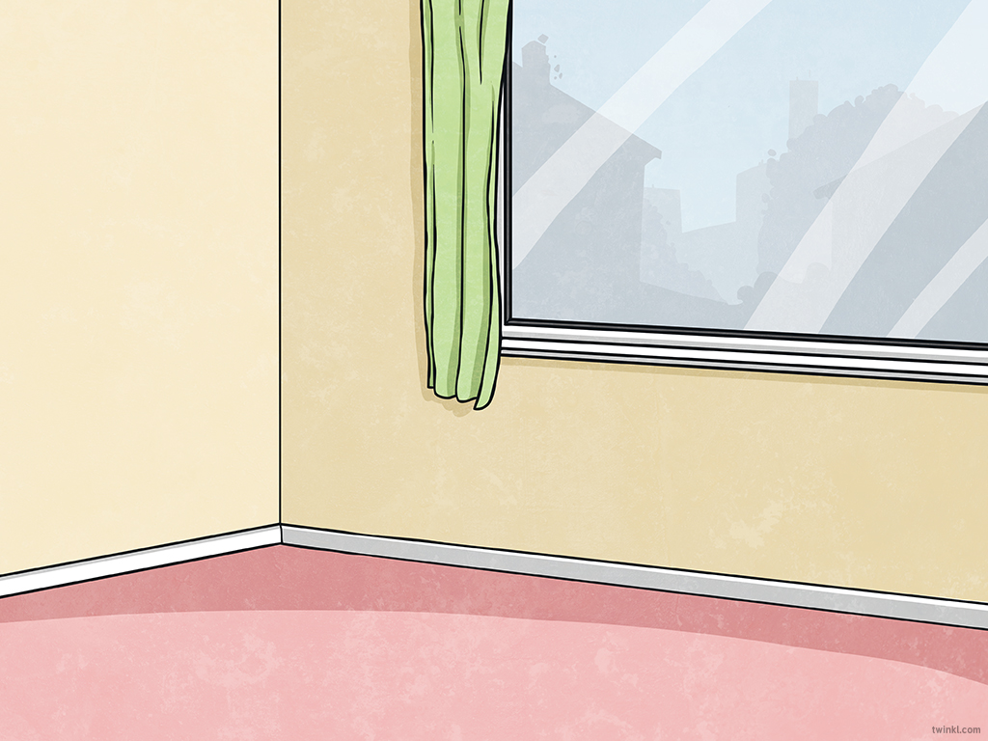
Aim
To learn how to correctly set out a formal thank you letter.

Slide 3
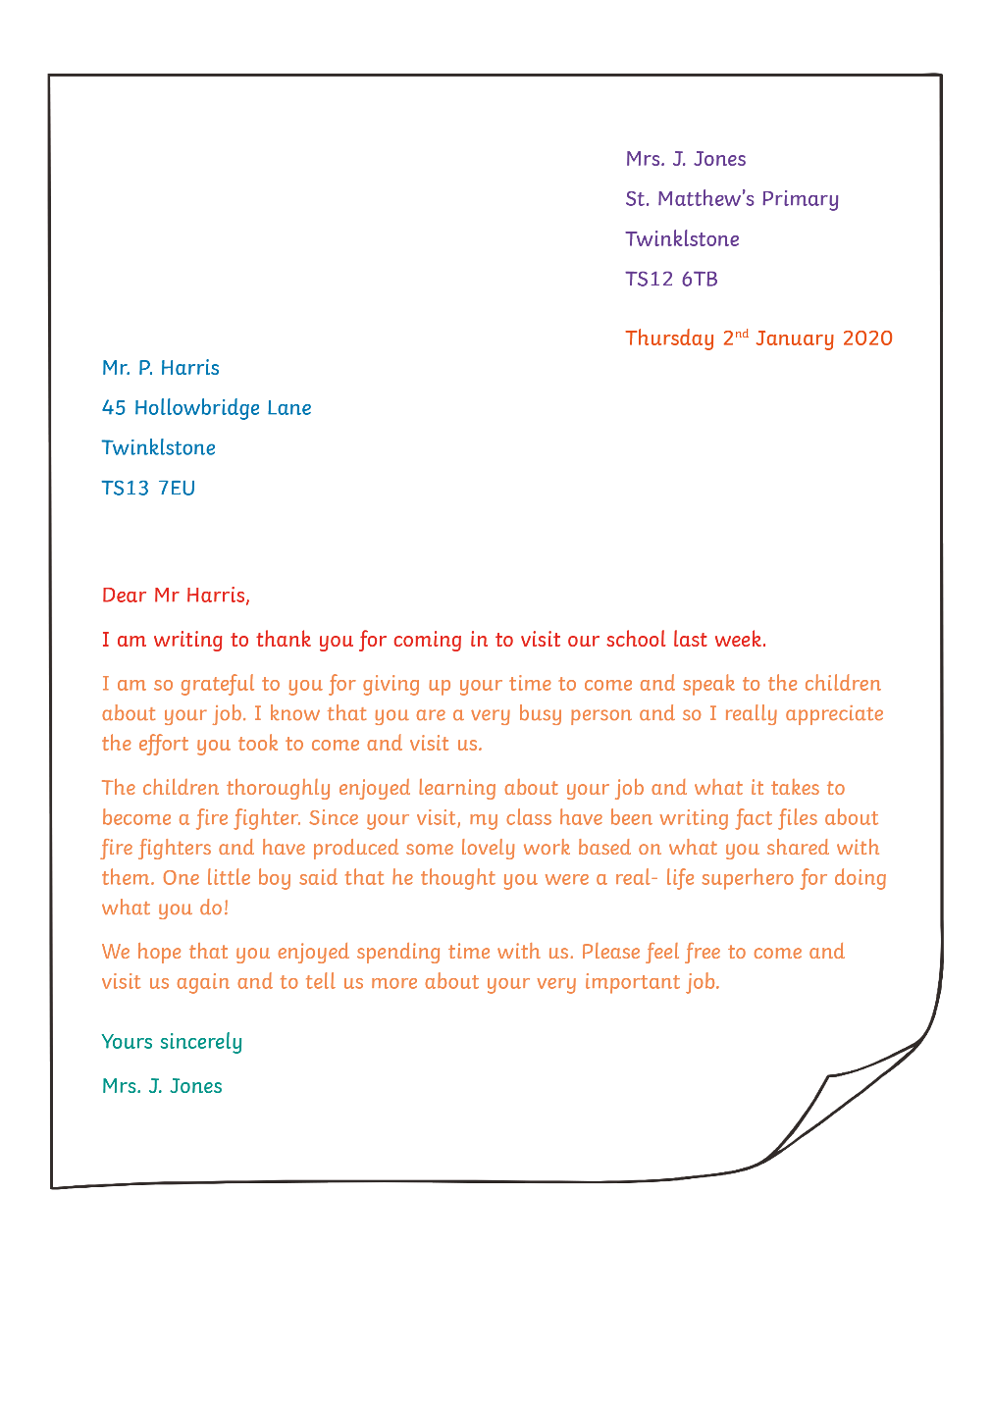
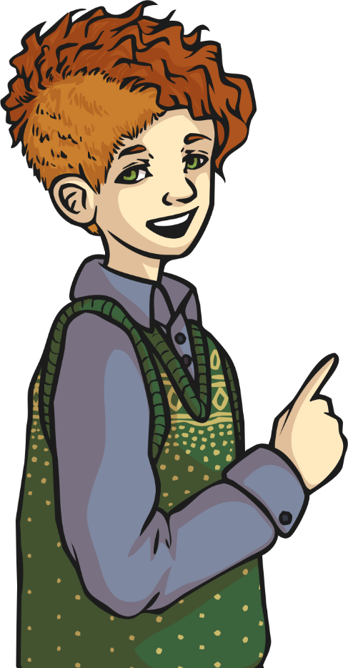
Layout

Slide 4


Beginning Your Letter
If you don’t know who to address your letter to, then you must begin the letter with:
If you know the name of the person you are writing to, then you must begin the letter with Mr, Mrs or Ms along with their surname:
Dear Sir or Madam,
Dear Mr Smith,

Slide 5
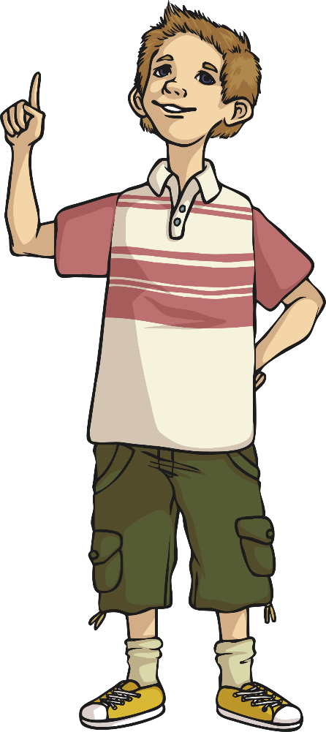
Content
Remember to begin your letter by telling them why you are writing,
e.g. I am writing to thank you for…
Tell the recipient that you appreciate what they did for you or what they gave you, e.g.
I really appreciate…
Thank you so much for…
Tell the recipient what you enjoyed or liked about what you are thanking them for, e.g.
We really enjoyed…
I particularly liked...

Slide 6
Ending Your Letter
If you don’t know who to address your letter to, then you must end the letter with:
If you know the name of the person you are writing to, then you must end the letter with:
Yours faithfully,
(YOUR NAME)
Yours sincerely,
(YOUR NAME)

