Slide 2
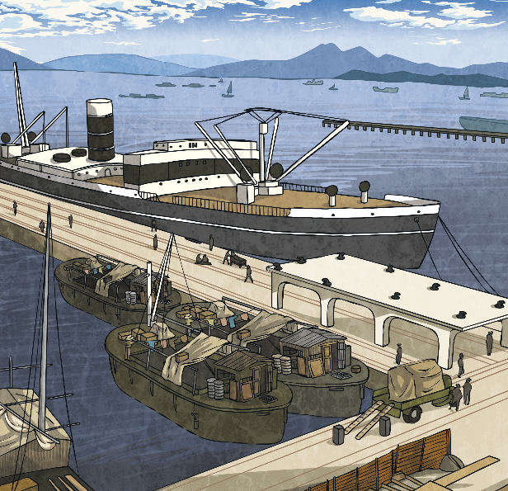

SS Nomadic
The Nomadic is now the only White Star Line ship remaining in the world.
The Nomadic was built at Harland and Wolff's shipyard in Belfast in 1911.
When completed, the Nomadic sailed to Cherbourg, a port in France to be used as a tender ship.
The ship carried passengers from the dockside in Cherbourg to the cruise ships that were too large to enter the harbour of the French port.

Slide 3
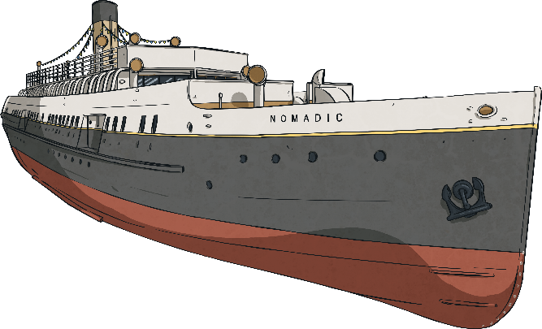
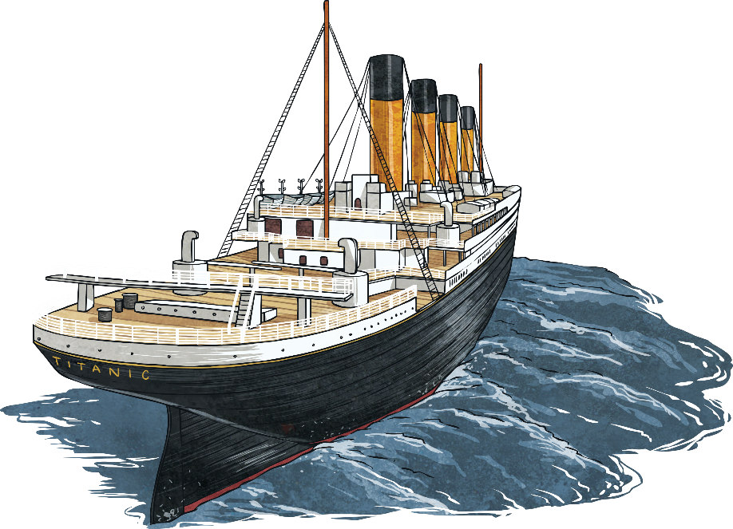
Links to Titanic
As well as being built alongside the Titanic, the SS Nomadic also has other links to the famous ship.
The Nomadic was designed by Thomas Andrews, who also designed the Titanic.
Nomadic
Titanic
The Nomadic was used to ferry
about 140 first and second-class passengers from the quayside at
Cherbourg out to the Titanic.

Slide 4


SS Nomadic Facts and Figures
The Nomadic was one quarter the size of the Titanic.
It took 159 days to build the ship.
It was more than 233 feet long and over 37 feet high.
The ship had one funnel and two engines.
It saw 57 years of service (tragically Titanic’s official service lasted for only thirteen days).
The Nomadic weighed 1273 tonnes.
Its top speed was 12 knots.

Slide 5

History of the Ship
The SS Nomadic clocked up active service in both the First and Second World Wars, after being requisitioned as a troop carrier.
When not being used during the wars, it continued its original role of carrying passengers to ships in Cherbourg, until the late 1960s.
The ship also had another life as a floating restaurant and party venue in Paris. It was moored near the Eiffel Tower for almost thirty years in
this capacity.

Slide 6

The Rescue Mission
Nearly a century after being built in Belfast, the Nomadic was in a sorry state, rusting and missing many original features.
The Belfast Industrial Heritage society convinced the Northern Ireland Office of the importance of preserving the Nomadic.
The ship was acquired at an auction in France in 2006 by the Department for Social Development.
The ship was then towed back to the docks that it had emerged from so many years before.

Slide 7
New Life
The ship was carefully and lovingly restored and is now permanently moored at Hamilton Dock close to the Titanic Belfast exhibition centre.
Visitors can now experience and explore the Nomadic and learn about the history of the ship through audio visual presentations and tours. A key part of Belfast’s rich ship-building heritage has been saved for future generations.

