Slide 1
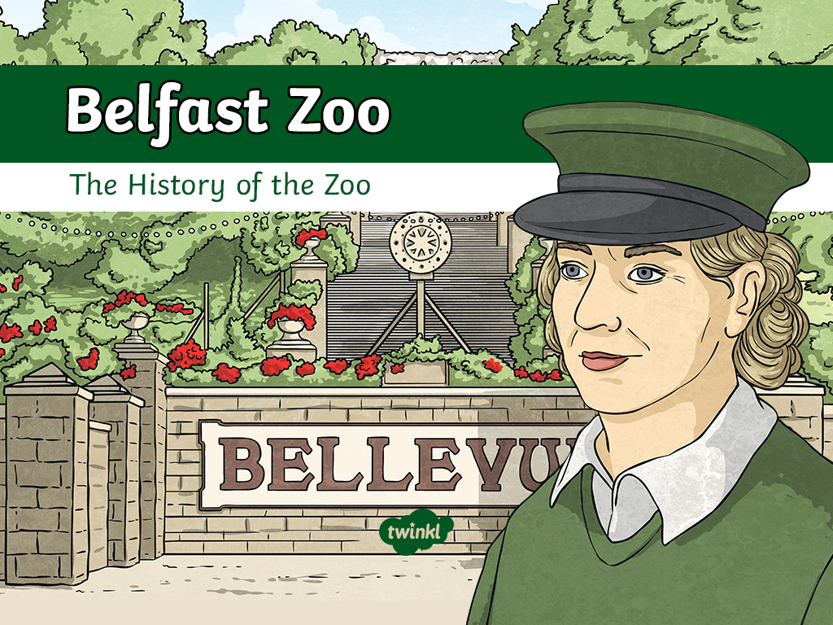

Slide 2
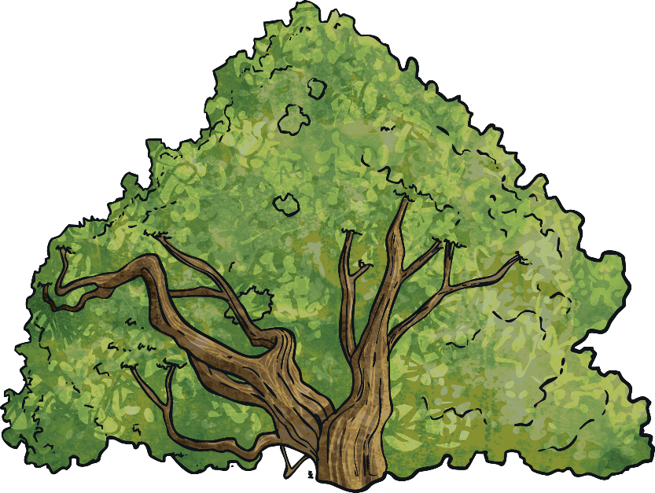
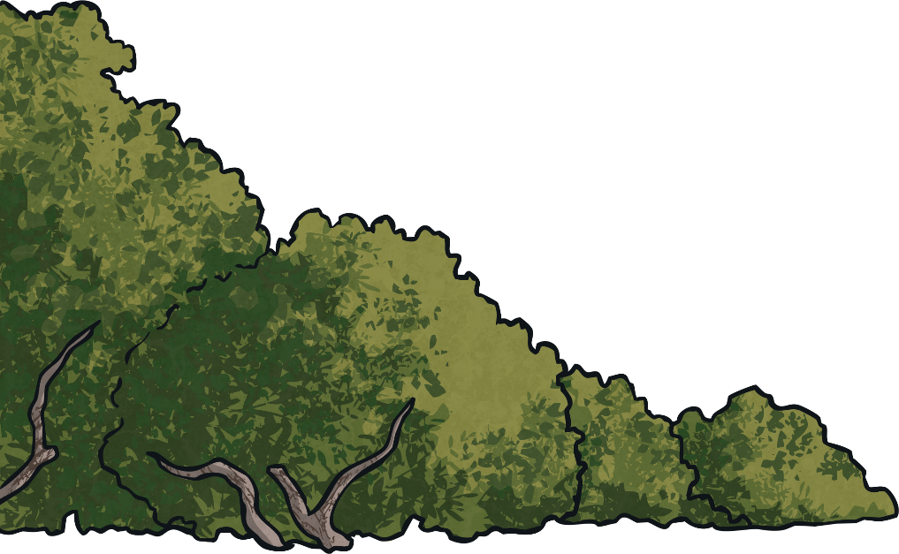
Back to the Beginning
In 1911, Belfast Corporation (which later became Belfast City Council) took over the tram line that transported passengers from Belfast to
outlying villages.
In order to encourage people to use the tram service, the corporation built a playground and pleasure gardens at the end of the line.
The corporation gave the site the name Bellevue Gardens. The name means
‘pretty view’.
The corporation’s plan worked and Bellevue Gardens became popular with day trippers in the 1920s and 1930s.

Slide 3
The New Zoo
In 1933, encouraged by the success of the playground and gardens, the corporation made the decision to begin a zoological collection.
The following year, 12 acres of the Bellevue site were set aside for
the zoo.
The build cost £10,000 and 150 men worked on the site.
The Lord Mayor of Belfast, Sir Crawford McCullough, opened the new zoo on the 28th March, 1934.
The zoo welcomed 284,713 people in its first year.

Slide 4
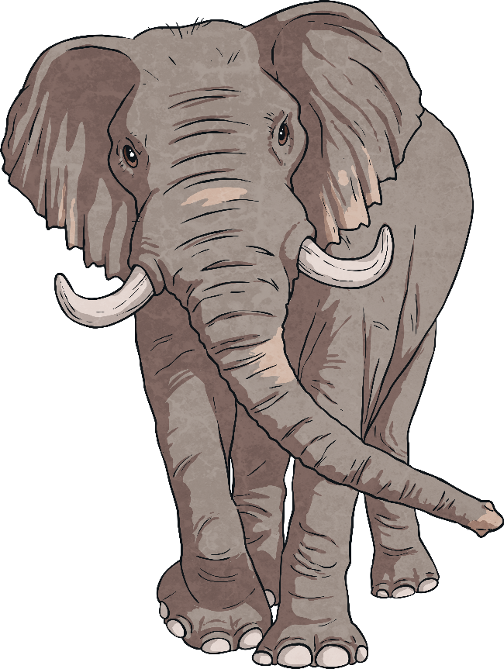
Elephants Never Forget
Elephants play a significant role in the history of Belfast Zoo.
The first elephant was named Daisy and she arrived on site the day before the zoo first opened to the public, in
March 1934.
Daisy had crossed the Irish Sea on board the Heysham Ferry to reach her new home.
She had previously been a circus elephant and had also featured in a film called ‘Red Wagon’, released the year before she came to Belfast.

Slide 5
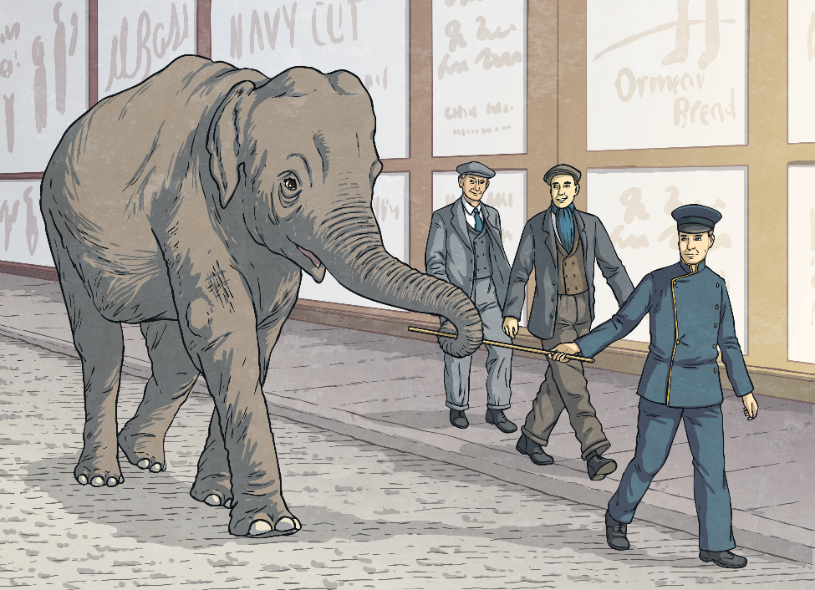
Daisy the Elephant
A zoo worker named Manus Kane had to collect Daisy from the boat.
A stick had been left with Daisy along with a note that explained this was how to lead her.
When Manus held the stick out to Daisy, she wrapped her trunk around it and allowed him to lead her towards her new home.
Daisy and Manus walked from the docks to the Antrim Road.

Slide 6
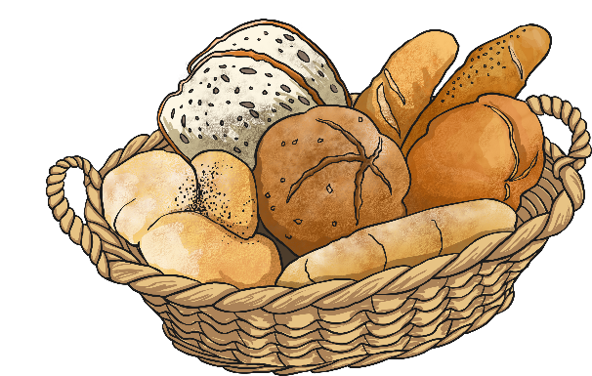

Daisy’s Walk
Daisy’s walk to the zoo was far from dull. She proved to be quite a mischievous character.
On the way, she spooked a baker's carthorse. She made quick work of the bread strewn all over the road after the frightened horse bolted down York Street!
Passing Duncairn Gardens, Daisy spotted a greengrocer's shop. She lumbered into an outside display of fresh produce and reappeared with a large turnip!

Slide 7
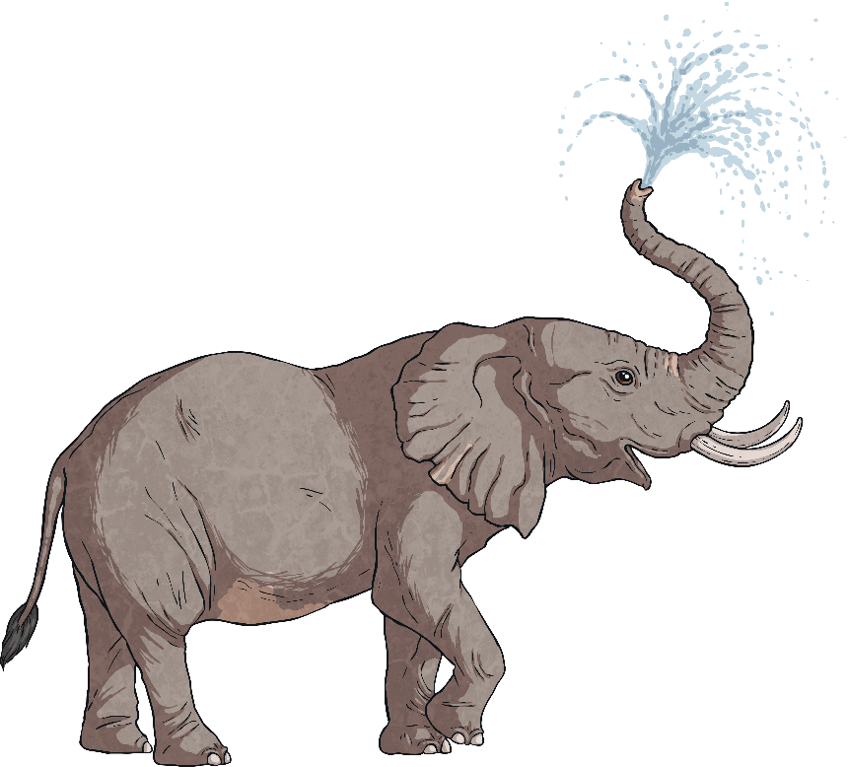
An Elephant’s Thirst
As well as grabbing all the food that took her fancy on her walk to the zoo, Daisy also caused a commotion with water.
The elephant spotted a water trough outside Shaftesbury Inn.
After taking a drink, she climbed into the trough and sat there, squirting herself and anyone who came too close!

Slide 8

Daisy’s Treats
While at the zoo, Daisy used many of her old circus tricks.
Her favourite treat was sugar lumps.
Daisy would reach over the low barrier in the elephant house to shake the pockets and handbags of visitors.
If the amused visitors gave her a coin, she would put it on the tip of her trunk and then drop it into a money box on the wall of her enclosure! This was how she tried to ensure a constant supply of her favourite treats as the money was used to buy more sugar lumps.

Slide 9
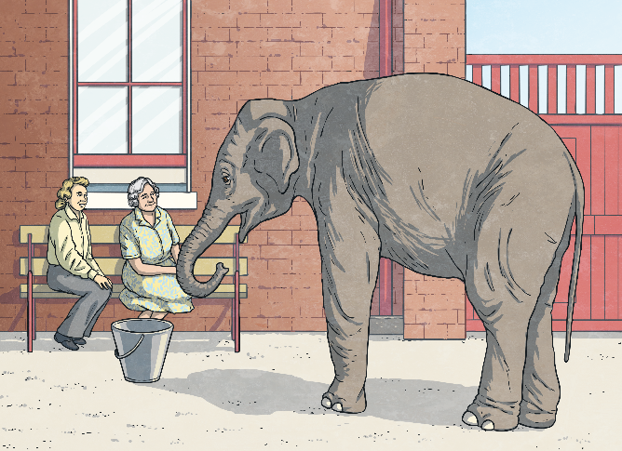
Sheila Arrives
The zoo acquired a new elephant, Sheila, in late 1935.
At this point, the decision was taken to move Daisy to Whipsnade Zoo
in London.
Daisy had other ideas and after being led to the Belfast docks, she turned back and headed for home.
The keepers could do nothing but follow her; it can’t be easy to try and change the mind of a stubborn elephant!
Daisy stayed at Belfast zoo, with Sheila the new arrival, for the rest of her life.
Daisy died around the beginning of 1936.

Slide 10
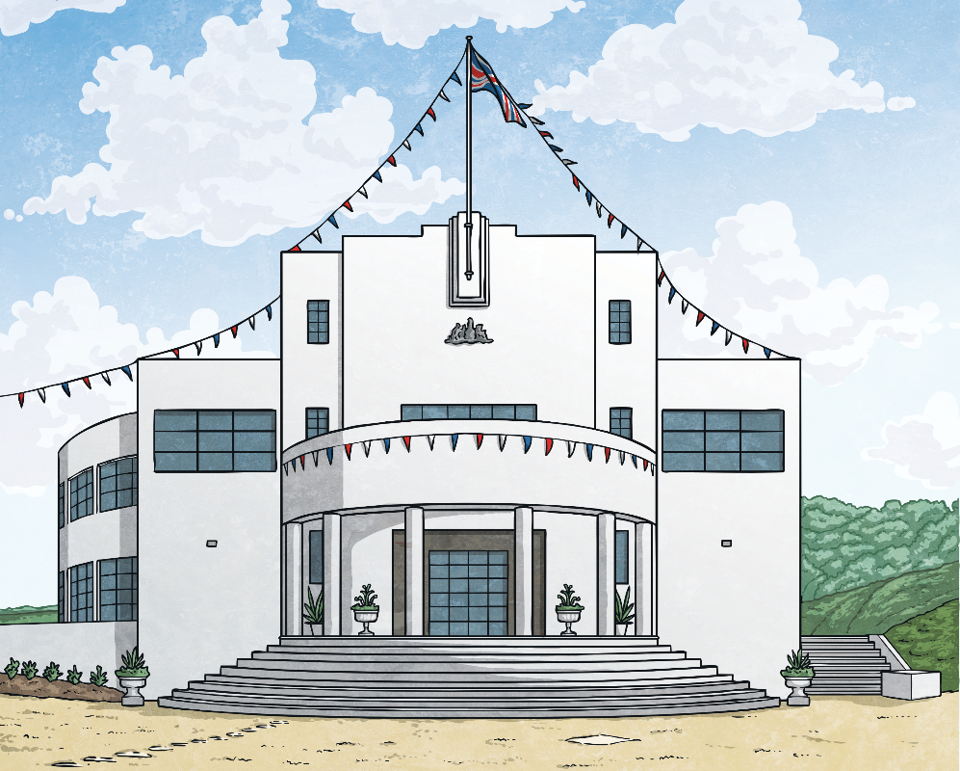
The Floral Hall
The Floral Hall was built in the mid-1930s on the slopes of Cave Hill.
It was a two storey, modernist-style dance hall.
In the past, the dance hall was an extremely popular attraction of Bellevue Gardens and is now within the grounds of Belfast Zoo.

Slide 11
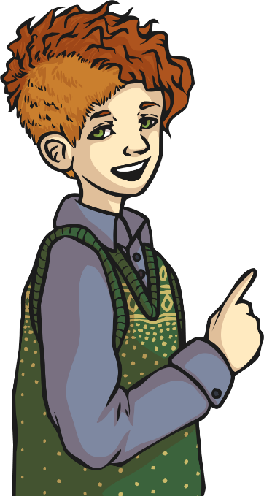
Building Floral Hall
The Floral Hall was designed by DW Boyd and was built and furnished by the firm of J & R Taggart, at a cost of £14,520.
It was opened on the 4th May 1936.
It had capacity for 1000 people and it welcomed hundreds of thousands of dancers and music enthusiasts from all over Northern Ireland over
the years.
In 1947 alone, 130,000 people entered the building.
Show bands played every week for much of the 1960s.

Slide 12

Floral Hall’s Closure
The Floral Hall has a special place in the family history of many residents of Northern Ireland; lots of people met their future husbands or wives while being entertained there!
The last time that the hall held a concert was 1972.
Sadly, by the mid 1970s, when work had begun on the new zoo site, the Floral Hall was no longer looking its best and visitor numbers had fallen, causing its closure.

Slide 13
Hope for the Floral Hall?
The Belfast Buildings Trust is keen to see the Floral Hall building restored to its former glory, as is Belfast City Council.
It is hoped that the building could be used as a wedding, conference and education facility.
News of these plans have been warmly welcomed by the public and many hope that they will come to fruition.

Slide 14

The Second World War and the Zoo
The Belfast Blitz (bombing raids on the city) had tragic consequences for many of the zoo’s animals.
In 1941, after considering the possibility of some of the zoo’s dangerous residents escaping during the bombing raids, the Ministry of Public Security ordered the destruction of 33 animals, including lions, wolves, polar bears, a hyena, a puma, a tiger, a black bear and a lynx.
No new animals arrived at the zoo until two years after the end of the war.

Slide 15
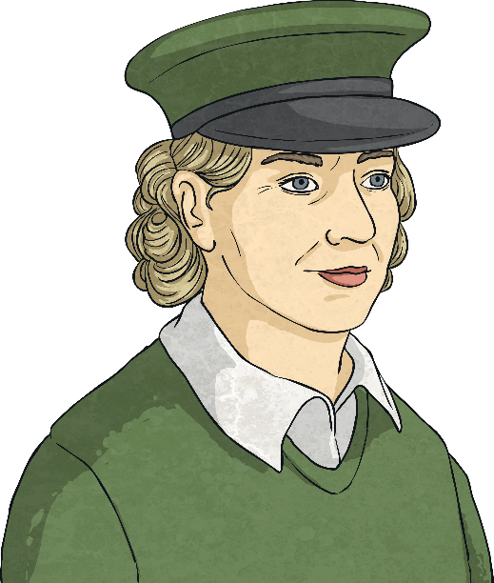
An Elephant in the Backyard
Belfast Zoo celebrated its 75th anniversary in 2009. An appeal was made in an effort to find out more about the elephant angel.
The zoo knew that there was a lady who looked after Sheila the elephant during the war, even taking her home in the evening!
Denise was one of the first female zoo keepers at the zoo.
It was discovered that the special lady was named Denise Weston Austin.

Slide 16
An Elephant’s Angel
Denise lived in North Belfast, her home was called Loughview House.
For a time during the war, each evening Denise would release Sheila from her enclosure and walk her to the keeper’s own home on the Whitewell Road.
Photographs still exist of the lady and the elephant, showing them relaxing in Denise’s backyard.
The Austin’s had a farm and Shelia was given hay to eat while a backyard guest.
Sheila would sleep in Denise’s garage at night.
Denise would take Sheila back to the zoo each morning.
The strange pair would even sometimes stop at a local shop so Sheila could be given stale bread!

Slide 17
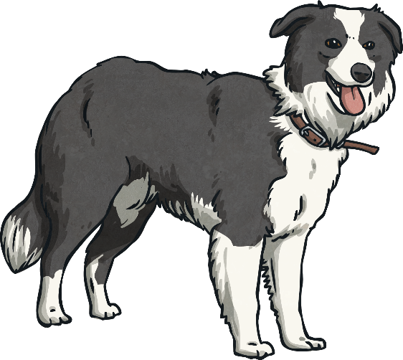
The Secret Discovered
It seems that other staff at the zoo were not initially aware of Denise’s safeguarding mission on behalf of the little elephant.
Strangely, the cat was let out of the bag by a dog! One evening, while in the Austin’s backyard, Sheila chased a dog into a neighbouring garden. During the pursuit, Sheila broke a fence.
Some of the neigbours told the zoo’s headkeeper, Dick Foster, about the demolishing of the fence and that put an end to Sheila’s ramblings down the Whitewell Road!
Denise’s special bond with Sheila wasn’t broken though and she would even visit her friend on nights when the air sirens sounded, rubbing Sheila’s ears to calm her.

Slide 18
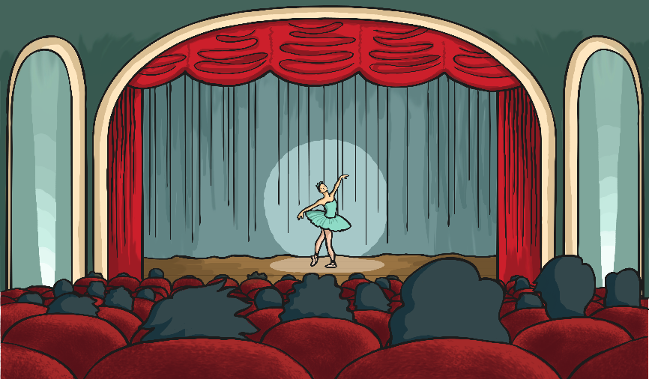
An Inspirational Story
The special story of Sheila and her elephant angel captured
attention globally.
The bond they shared and their story has inspired theatre shows, an opera, Michael Morpurgo’s book ‘An Elephant in the Garden’ and the feature film 'Zoo’, released in
June 2018.
The movie was filmed in Belfast Zoo. It centres on a boy named Tom, who tries to save Buster the elephant.

Slide 19
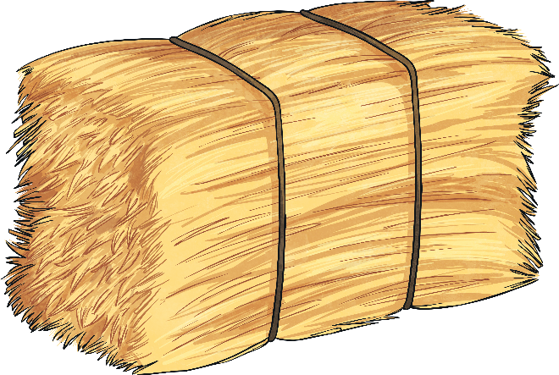

Tina Arrives and Work Begins
By 1962, when the corporation’s park committee took charge of the zoo site, it was obvious that restorations would be required.
Tina the elephant arrived at the zoo from Birmingham on the
14th June 1966.
It cost £20 to ship Tina from England.
Tina had three bales of hay, half a sack of oats, half a sack of bran and eight large loaves of bread for the journey.
Work began on the new zoo site in 1974.

Slide 20

Tina the Elephant
During Tina’s first few months in Belfast, a keeper would keep her company at night, feeding her and sleeping in her enclosure.
Tina shared the mischievous character of Daisy, the zoo’s first elephant.
Many visitors over the years lost coats, gloves, hats, bags and cameras to Tina’s thieving ways. She even ate some of the items that
she stole!
She became a firm favourite at the zoo, displaying kindness as well as mischievousness, often rescuing little birds and frogs that had got into trouble in her enclosure.

Slide 21
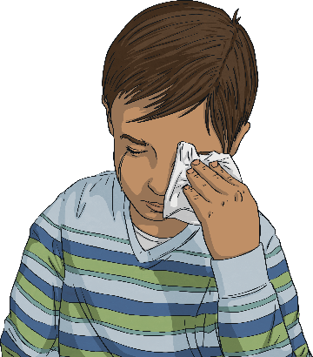
Tina the Elephant
The largest and most costly animal house in the new zoo was the elephant and giraffe house.
It officially opened on the 27th May 1988.
Tina became the longest resident of the zoo, even becoming a cherished resident of the elephant retirement home that was set up.
She sadly passed away on the 5th November 2017, leaving a legacy of fun and happy memories. There was an outpouring of grief throughout Belfast and beyond when she died.

Slide 22
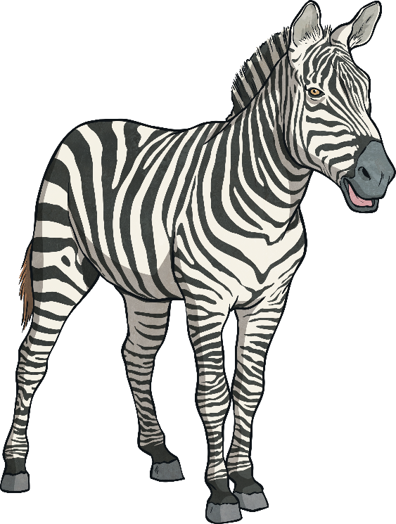
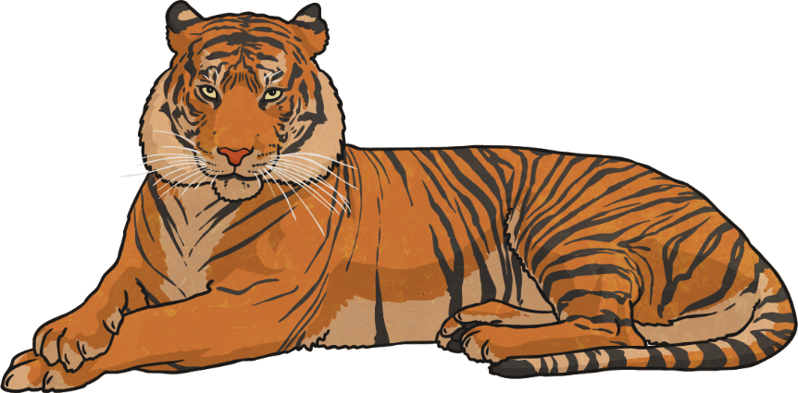
The Modern Zoo
Belfast Zoo has become a leading conservation zoo, working to help many animals under threat.
It is now owned by Belfast City Council.
Belfast Zoo is now a 55 acre site, where visitors can see more than 130 species of animal.

Slide 23
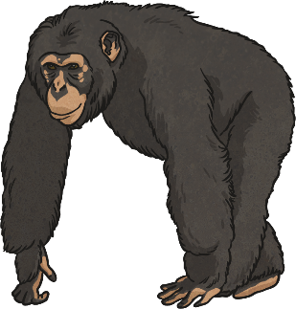
Break Outs
Chimpanzees at Belfast Zoo took advantage of damage caused by Storm Erik in February 2019 to temporarily escape their enclosure.
The clever chimps used a broken fallen tree branch as a makeshift ladder to help them scale the enclosure wall!
Some chimps sat on top of the wall, while one went for a little walk on the path, to the astonishment of visitors.
The chimp returned to its enclosure by itself.
An endangered red panda made the local news when it actually briefly escaped the zoo itself in January 2019; it was found in a nearby garden! Zoo staff fixed a fault that they discovered in the fence of the red
panda habitat.

