Slide 1



Number Chains
This activity helps you learn the sequence of
Prime Numbers
2, 3, 5, 7, 11, 13, 17, 19, 23, 29, 31, 37, …
You not only need to be able to remember what the numbers are and their order…
You need to remember where each one is hidden!

Slide 2

Instructions
When you click ‘Play’ you will see a game board which contains the first sixteen prime numbers arranged in random order – but they are covered up.
You have to uncover the numbers in the correct order.
If you make a mistake, then you [RESET] the board and let the next person have a go.
The winner is the player who manages to uncover the most (or all) numbers in the correct order.
Note that it is very difficult to complete this game, but repeated plays will help you familiarise yourself with what the numbers are.

Slide 3
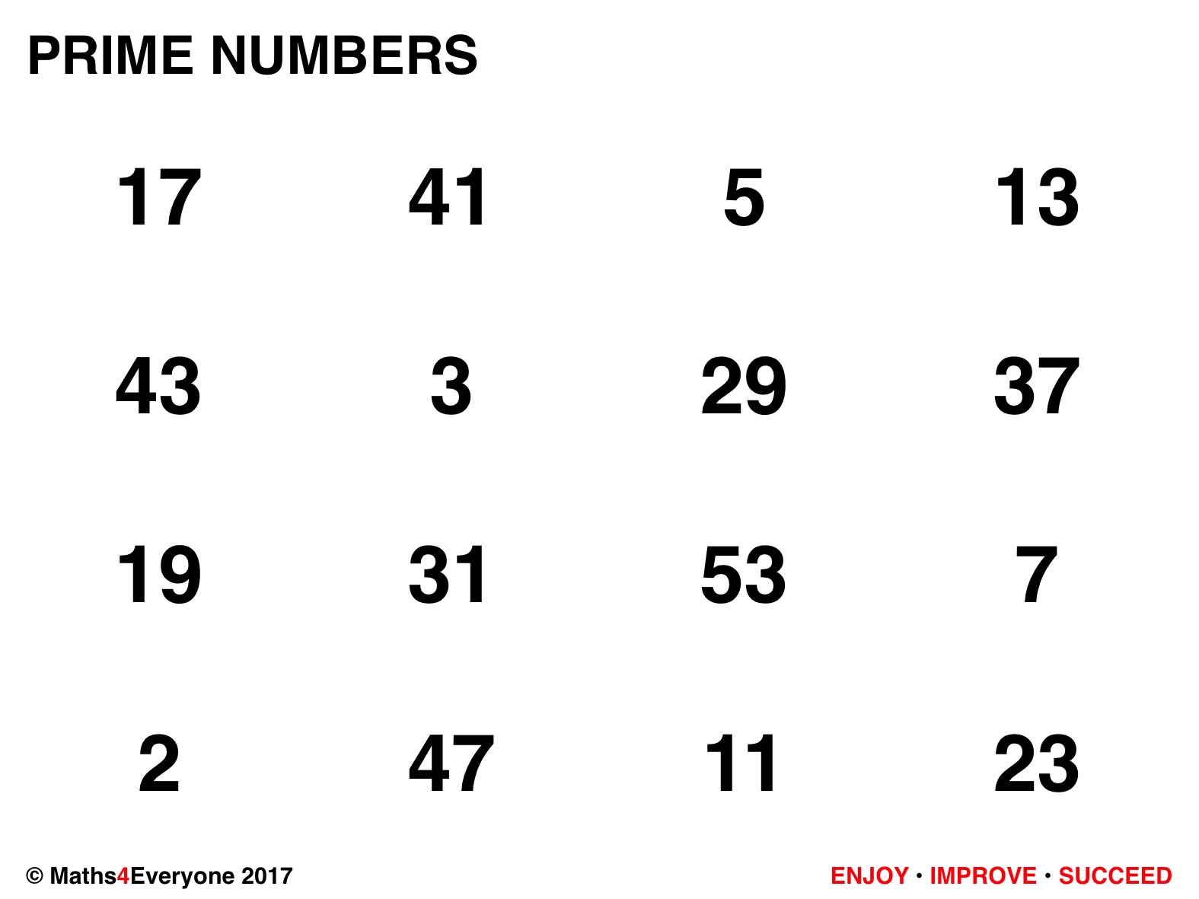





Slide 4
CLOSE

